Slide 1
Obesity and Metabolic Disorders Program
Results of Studies of ALN1003 in Diet-Induced Obese Mouse Model, May 2026

Slide 2
Forward Looking Statements
This presentation contains forward-looking statements that are based on current expectations and assumptions that are subject to risks and uncertainties, which could cause actual results to differ materially. Important factors that could cause actual results to differ materially include, but are not limited to: changes in the Company’s operating plans that may impact its cash expenditures; uncertainties built into research and development such as preclinical mouse data not translating to human trials, or challenges in scaling up formulations, including the risk that early non-GLP study results may not be replicated in confirmatory studies or pose safety concerns in IND-enabling studies; delays or failures in future studies; whether Alaunos’ product candidates will advance further in the clinical trial process, including getting approval by the U.S. Food and Drug Administration (FDA) or other foreign health authority to conduct clinical trials and whether and when, if at all, they will receive final approval from the FDA or equivalent foreign regulatory agencies and for which uses; challenges to the strength and enforceability of Alaunos’ intellectual property rights (such as patent disputes); competition from other pharmaceutical and biotechnology companies (including in the crowded obesity treatment market); funding shortages or market changes affecting our cash needs; tolerability issues from drug administration; the inherent uncertainties in drug development, including potential failures optimizing formulations, mechanistic studies, or large-animal pharmacokinetics that could delay IND-enabling activities; manufacturing and supply chain disruptions related to CMC work; and other factors discussed in our latest Form 10-Q and Form 10-K filed with the Securities and Exchange Commission (SEC). Forward-looking statements may also be protected if they are immaterial.

Slide 3
Looking Beyond Weight Loss in Metabolic Dysfunction
Oral, Non-incretin Approach to treat Metabolic Diseases
Opportunity Across
3 Large Markets
Obesity: Validated by GLP-1/GIP blockbusters, yet significant market share remains for next-gen therapies addressing high discontinuation rates, GI tolerability, and muscle mass loss.
Near Term Path
to IND Enabling Studies
Preclinical and CMC activities to prepare for IND enabling studies - 2026
IND enabling studies – 2027
ALN1003 is a preclinical, non-incretin, oral candidate targeting metabolic dysfunction beyond weight loss that may address:
insulin resistance,
adipose signaling,
liver biology, and
body composition
MASH: A rapidly emerging therapeutic area associated with metabolic dysfunction and liver-related morbidity.
Insulin Resistance / Type 2 Diabetes: Insulin resistance is a shared feature of obesity- and MASH-relevant metabolic dysfunction and may represent an important area for further therapeutic evaluation.
Subject to available capital, technical feasibility, and completion of additional preclinical work
ALN1003 is preclinical. Data are from non-GLP mouse studies. ALN1003 has not been evaluated in humans, and safety and efficacy have not been established. Findings may not translate to human disease.

Slide 4
ALN1003 Shows Preclinical Metabolic Improvement across Multiple Axes in Diet-Induced Obese (DIO) Mouse Model
Non-hormonal Approach to treat Metabolic Diseases
Two non-GLP DIO studies demonstrate activity
Weight/Body composition
Insulin-resistance/Adipose signaling
Next Steps: Path to IND Enabling Studies
Additional preclinical development
IP expansion around ALN1003-related compounds
MASH-relevant histology
ALN1003 is a preclinical, oral, non-hormonal metabolic therapeutic candidate
Being evaluated for:
Liver/lipid biology
obesity-related metabolic dysfunction,
MASH-relevant biology, and
insulin resistance
CMC scale-up and formulation activities
PK optimization
Confirmatory benchmark studies
MASH-relevant histology
IP expansion around ALN1003-related compounds

Slide 5
Two DIO Mouse Studies Show ALN1003 Activity Across Weight, Metabolic, and MASH-Relevant Liver Measures
Two non-GLP studies completed in DIO mice:
DIO Study 1: ALN1003 administered PO, BID at Low dose for 48 days
DIO study 2: ALN1003 administered via drinking water (DW) at Low, Mid and High doses for 18 days
ALN1003 associated with a favorable metabolic profile change:
Reductions in body weight and food intake
Improvement in body composition
Decreased HOMA-IR, a biomarker of insulin resistance
Reductions in cholesterol related measures
Favorable adipose endocrine biomarker changes
Reductions in liver weight, liver injury markers (ALT, AST) and biliary dysfunction (ALP)
Qualitatively improved liver histology consistent with lower hepatic steatosis in selected samples

Slide 6
DIO Study 1: ALN1003 Produced a 10.3 Percentage-Point Lower Body-Weight Change vs Control at Day 48
DIO 1

Slide 7
Significant reduction in Food Intake versus Control
Non-significant reduction in Water Intake versus Control
DIO 1

Slide 8
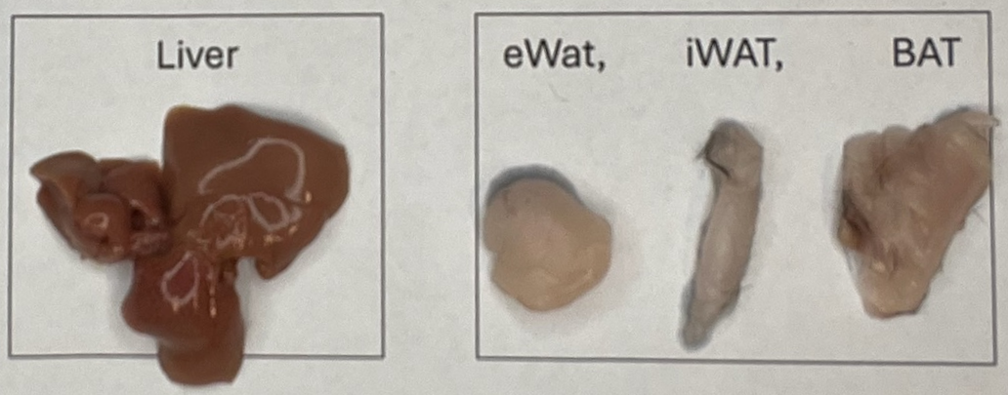
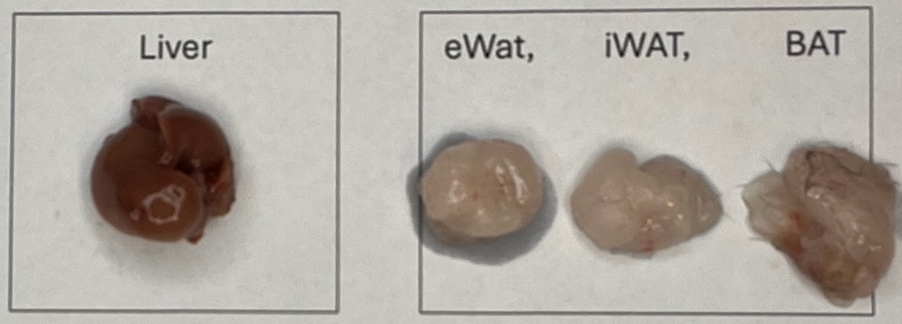
ALN1003 was associated with significantly lower liver weight, supporting further evaluation of hepatic effect
DIO 1
WFI (control)
ALN1003
An unblinded de novo review of 24 macroscopic images (12 control and 12 ALN1003-treated animals) comparing the liver and adipose tissues of the DIO control to the ALN1003 treatment group demonstrated consistent treatment-related changes across liver, white adipose tissue (WAT), and brown adipose tissue (BAT). Relative to DIO controls, ALN1003-treated animals exhibited smaller, deep reddish-brown livers; reduced epididymal white adipose tissue (eWAT) and inguinal white adipose tissue (iWAT) depots consistent with decreased adiposity; and darker interscapular BAT with appearance consistent with reduced “whitening” of BAT. These visual differences were hypothesis-generating and supported further histology analyses.
One-way ANOVA, **** p<0.0001
Representative images selected for illustration; not a blinded quantitative image analysis
Notes:
Median liver weights selected: Control Mouse #10; ALN1003 Mouse # 26

Slide 9
ALN1003 Improved Liver Injury / Cholestatic Markers
DIO 1
Two-way factorial ANOVA, ** p<.01, **** p<0.0001, ns – not significant

Slide 10
Histology; Blinded Pilot
Pathology Readout
DIO 1 & 2
H&E stains of liver tissue from DIO1/DIO2 were evaluated for NAS components and Masson’s trichrome for fibrosis. Three (3) control and 3 treatment samples per study, quantitatively selected.
Controls were reported at NAS 5, while ALN1003 samples averaged NAS 2.7 in DIO1 and 1.3 in DIO2
Selected evaluable samples showed qualitative/semi-quantitative findings consistent with lower hepatic steatosis, concordant with liver weight findings
Encouraging trends in other NAS components
These pilot pathology findings require confirmation in a powered MASH-relevant model
NAS scoring system: Kleiner et al., Hepatology 2005, 41:1313–1321

Slide 11
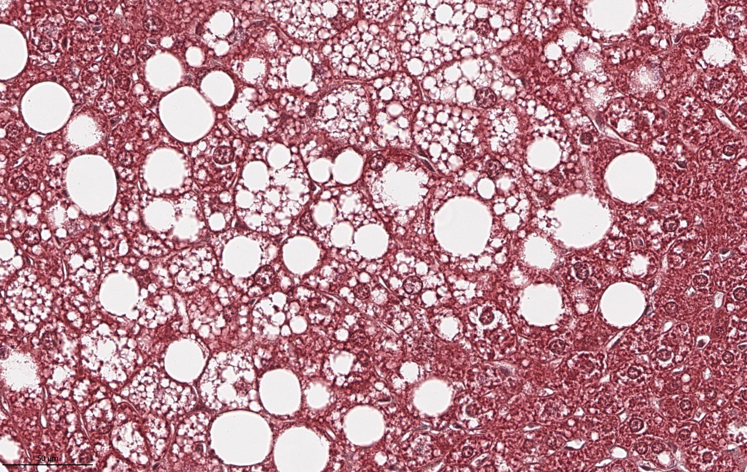
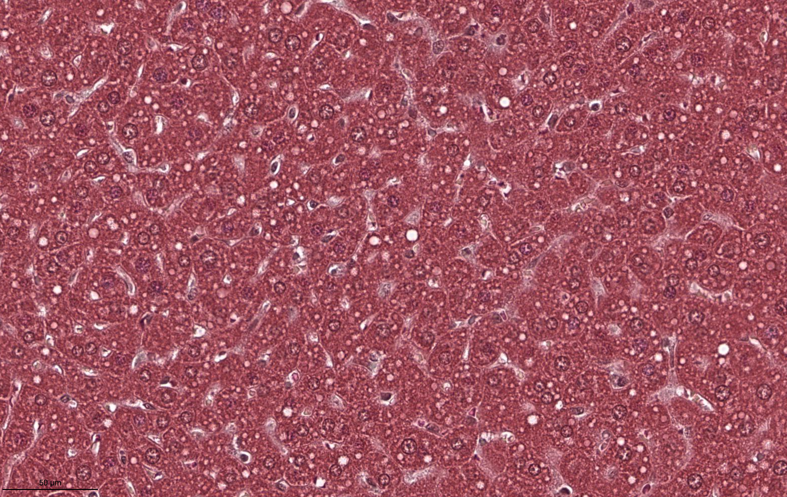
DIO 1: Representative Images of Liver Histology
DIO 1
Representative image from HistoWiz pathology report, selected control sample 2507101-08EL, with pathologist-reported NAS score 5 / steatotic liver disease-like activity. NAS components were assessed on H&E whole-slide images; Masson’s trichrome was used for fibrosis assessment.
Representative image from HistoWiz pathology report, selected ALN1003 low dose-treated sample 2507101-29EL, pathologist report label: normal liver. Representative selected sample only; pilot pathology findings require confirmation in a powered MASH-relevant study.

Slide 12
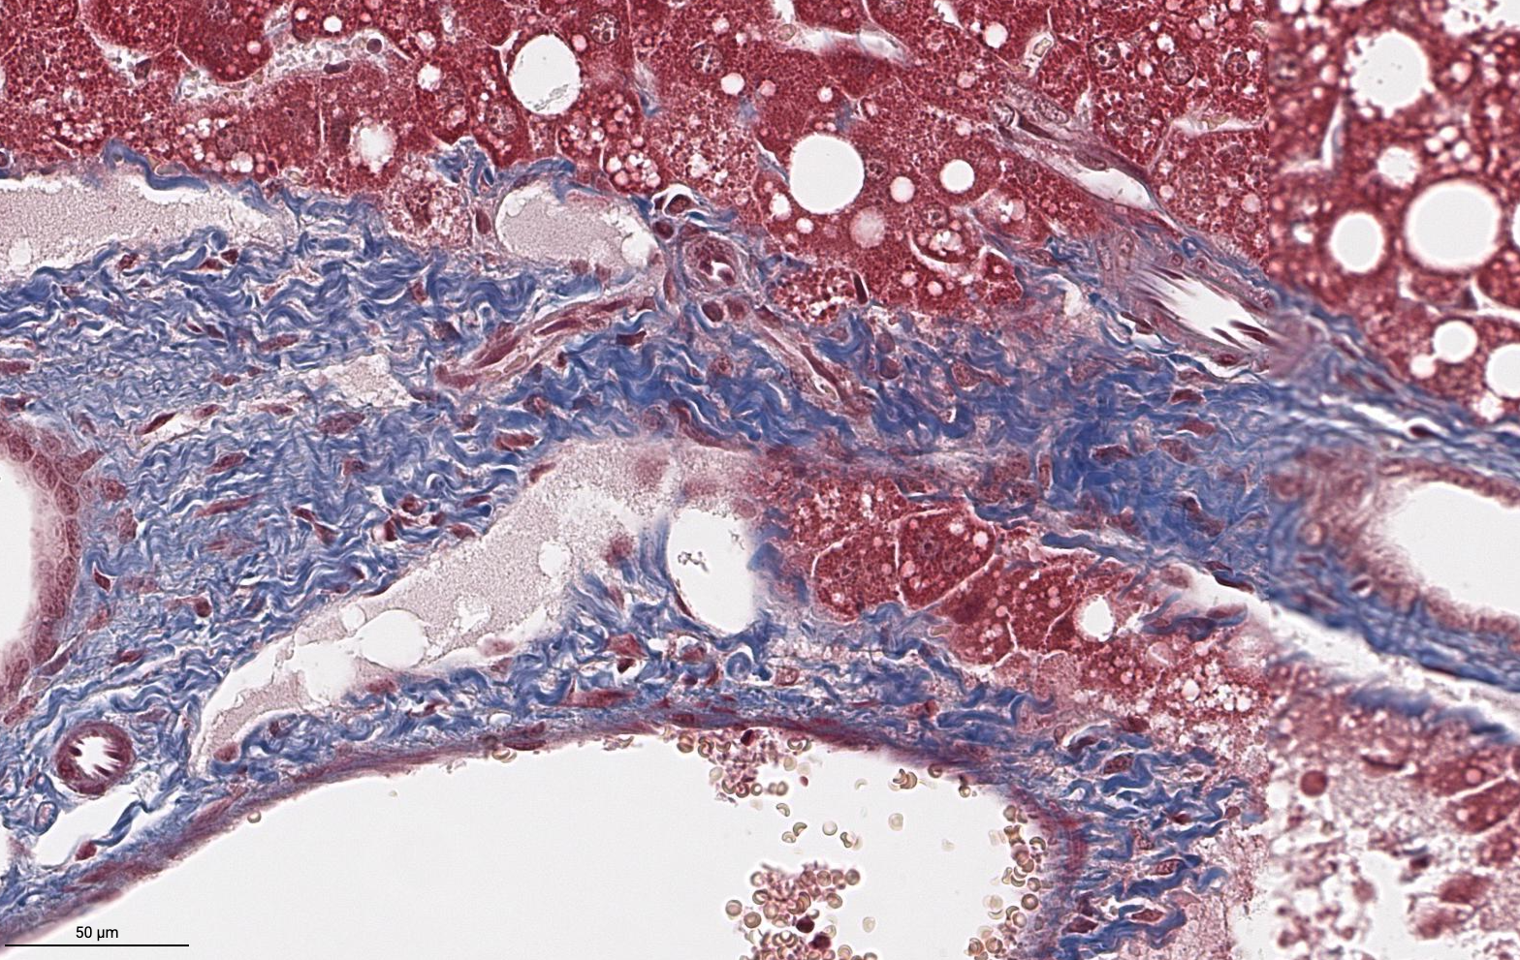
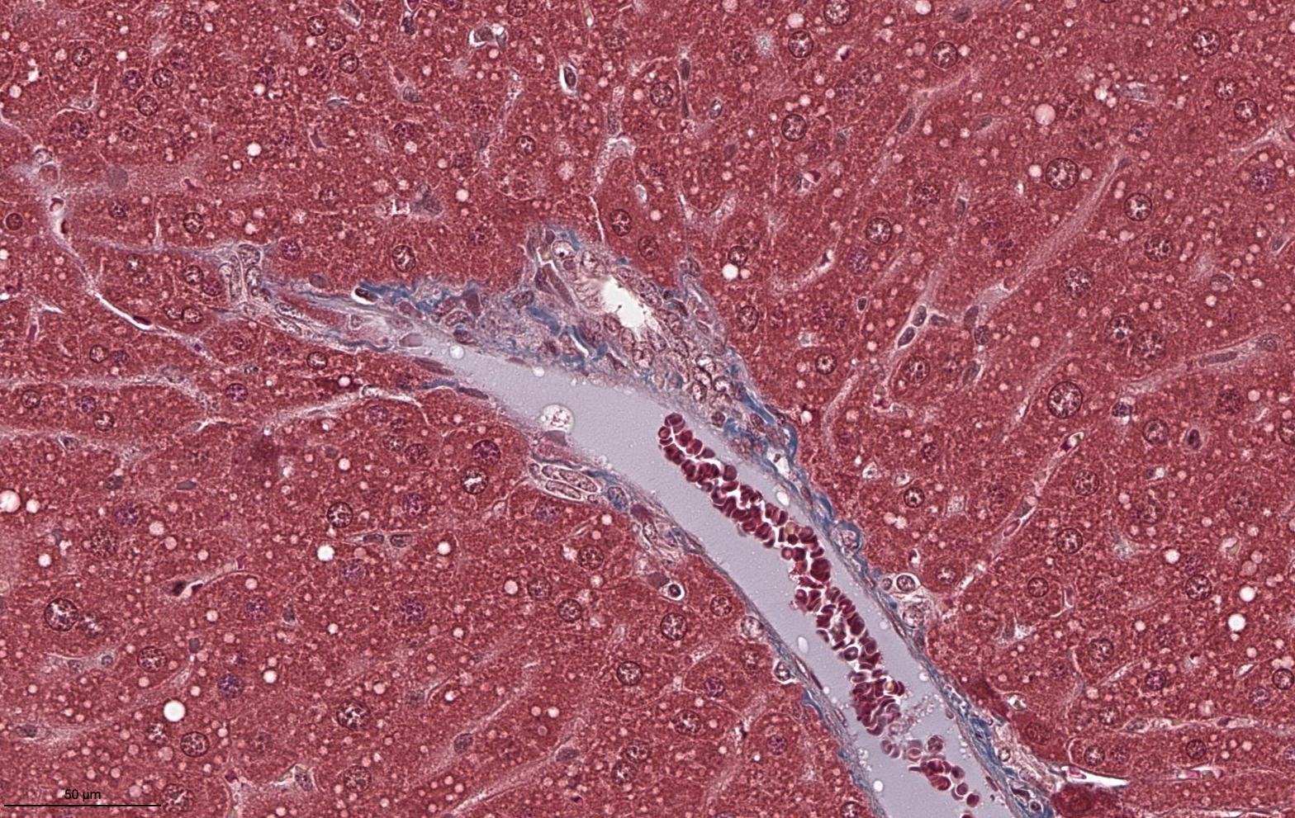
DIO 1: Representative Images of Liver Histology - Fibrosis
DIO 1
Control (WFI) (sample 2507101-06EL) Masson’s
Fibrosis grade 2, 40x magnification, 50um
ALN1003 Low Dose, PO, BID (sample 2507101-29EL) Masson’s Fibrosis grade 0, 40x magnification, 50um
Representative pathologist selected samples; these images are hypothesis generating only and not evidence of fibrosis reversal. Pilot pathology finds require confirmation in a powered MASH study.

Slide 13
ALN1003 was associated with lower HOMA-IR after adjustment for percentage body fat, suggesting effects on insulin-resistance-related biology not fully explained by adiposity alone
DIO 1
WHY IT MATTERS
HOMA-IR is a calculated fasting glucose/insulin index commonly used as an insulin-resistance-related biomarker. Lower HOMA-IR is consistent with improved insulin-resistance-related biology in this model.
Because adiposity can influence HOMA-IR, the analysis adjusted for % body fat — ALN1003 had lower HOMA-IR after this adjustment, supporting a biomarker signal not fully explained by percentage fat differences alone.
Statistical Analysis
ALN1003 Low Dose PO, BID for 48 days had significantly lower HOMA-IR index scores than Control (WFI) after adjustment for percentage fat (standard ANCOVA (p=0.0006), confirmed by the heteroscedasticity-robust HC3 standard errors sensitivity analysis (p = 0.0014)).
The interaction (treatment x percentage fat) was not statistically significant (p=0.2128), supporting the homogeneity-of-slopes assumption.
Regression plot of Homeostasis Model Assessment of Insulin Resistance (HOMA-IR) index and percentage body fat. HOMA-IR is a calculated index derived from fasting glucose and insulin commonly used as an insulin-resistance-related biomarker. HOMA-IR formula: [Fasting Glucose (mg/dL) x Fasting Insulin (µU/mL)]/405. Insulin values (pg/mL) were converted to molar concentrations (pmol/L) based on the molecular weight of mouse insulin and subsequently converted to activity units (µU/mL) using a conversion factor of 35. Percentage fat was measured on Day 46 using Bruker LF90II.

Slide 14
ALN1003 showed significantly higher adiponectin-to-leptin ratio, suggesting improved metabolic profile
DIO 1
Adiponectin and leptin are adipose-derived endocrine markers associated with metabolic health and adipose tissue biology. In DIO Study 1, ALN1003 was associated with numerically lower leptin, significantly higher adiponectin, and a significantly higher adiponectin-to-leptin ratio
WHY IT MATTERS
Leptin rises with excess fat and drives inflammation. Lower leptin means the body is responding better to weight loss.
Adiponectin protects against insulin resistance and fatty liver disease. Higher levels signal healthier metabolism.
The adiponectin-to-leptin ratio is a key marker of metabolic health. A higher ratio means the body is shifting from fat storage toward fat burning.
These biomarkers are associated with adipose endocrine biology and metabolic health. The findings are consistent with favorable adipose endocrine biomarker changes in this preclinical model.

Slide 15
DIO Study 1 Conclusions
DIO 1
ALN1003 was tolerated throughout the study period, although mild, transient, reversible hypolocomotion was observed after dosing in approximately one-half of dose administrations. There were no similar observations in DIO control animals.
ALN1003 resulted in significant liver weight reduction, improvement in liver injury markers (ALT, AST) and qualitatively improved liver histology findings consistent with lower hepatic steatosis in selected samples
ALN1003 was associated with significantly lower HOMA-IR, a biomarker of insulin resistance, compared to controls after adjustment for percentage body fat
ALN1003 may influence multiple components of metabolic syndrome biology in DIO mouse models, including insulin-resistance-related biomarkers, adipose endocrine signaling, and hepatic lipid accumulation

Slide 16
ALN1003 administered via drinking water produced dose-dependent weight loss in DIO mice; interpretation should consider reduced water consumption in treatment groups
DIO 2

Slide 17
Dose-dependent reductions in water consumption indicate administration-related limitations that should be addressed through optimized formulation and PK studies
DIO 2
One-way ANOVA, * p<0.05, *** p<0.001, **** p<0.0001

Slide 18
Significant Improvement in Body Composition
DIO 2
After 17 days of ALN1003, changes in Body Composition using Bruker LF90II:
  Dose-dependent decrease in Fat%
  Dose-dependent increase in Lean%
  Dose-dependent decline in Fluid%
While lean percentage increased as a proportion of body weight, absolute lean and fluid decreases should be interpreted in the context of overall weight loss and reduced water intake
One-way ANOVA, ** p<0.01, **** p<0.0001

Slide 19
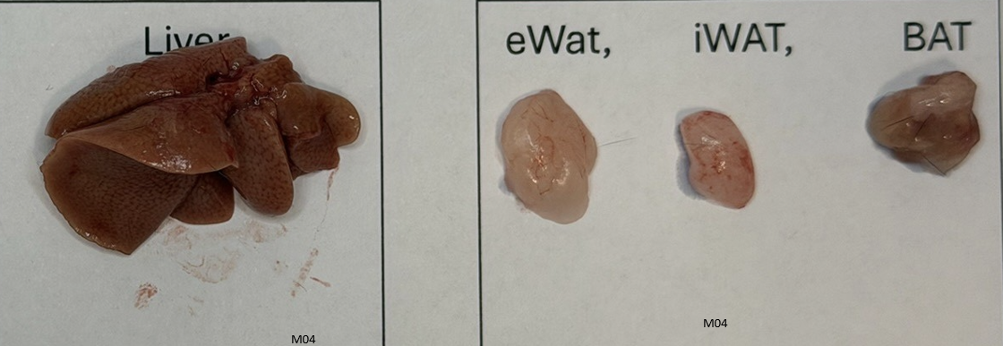
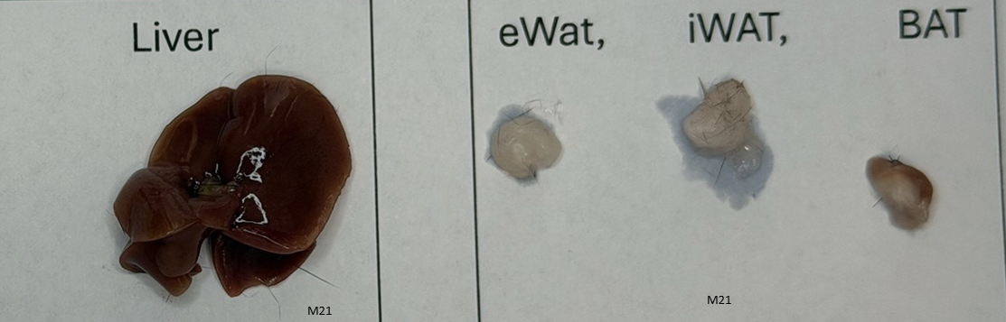
ALN1003 Treatment Reduced Weight of Liver in Dose-Dependent Manner, significantly at High Dose
DIO 2
Representative images selected for illustration; not a blinded quantitative image analysis
WFI/Control: Mouse 4
ALN1003 High Dose: Mouse 21
One-way ANOVA, * p<0.05, ** p<0.01
An unblinded macroscopic visual review of organ morphology was conducted comparing the liver and adipose tissues of the DIO control to the High Dose group. This analysis showed reductions in white fat depots (such as epididymal white adipose tissue, or eWAT, and inguinal white adipose tissue, or iWAT) and an interscapular BAT appearance consistent with reduced “whitening” in the ALN1003 tissues vs DIO control. Review of liver images suggested less visible fat accumulation and smaller, deep red-brown livers compared to DIO control.

Slide 20
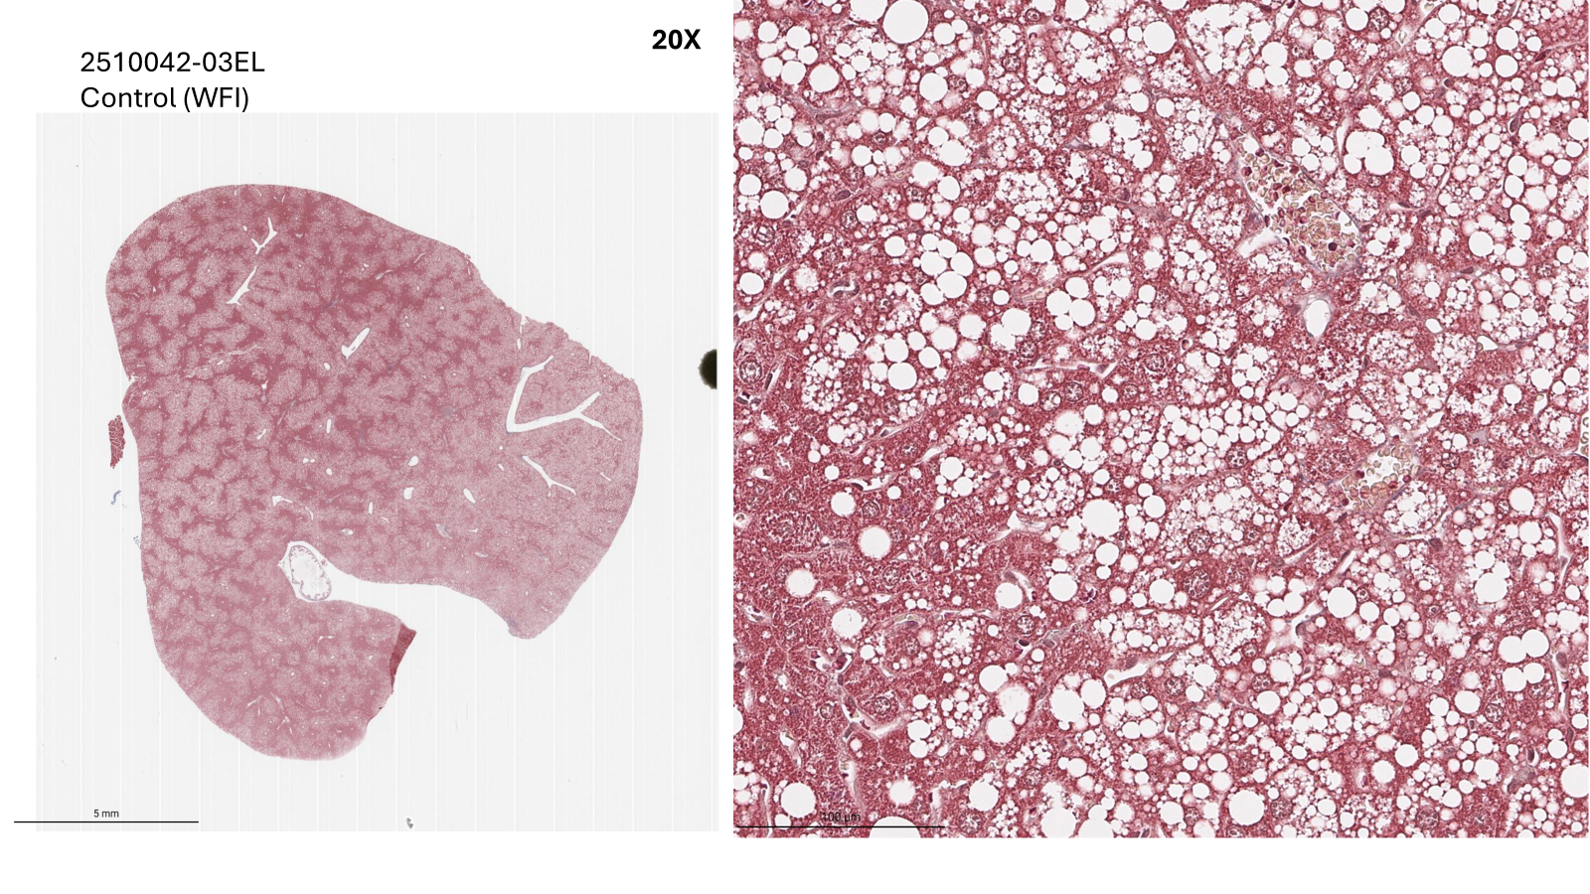
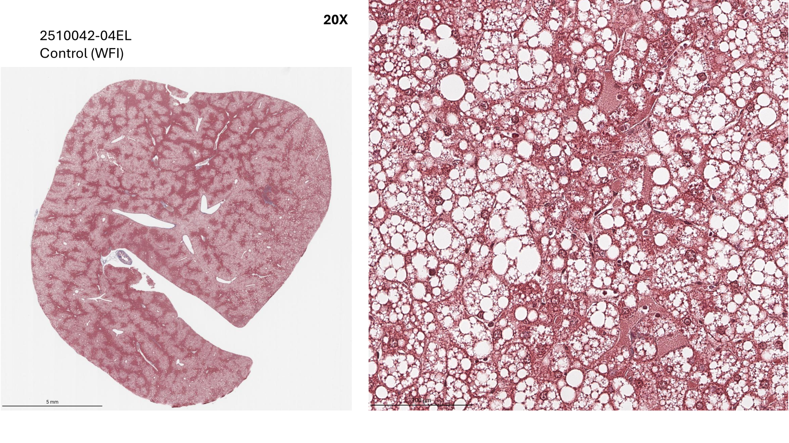
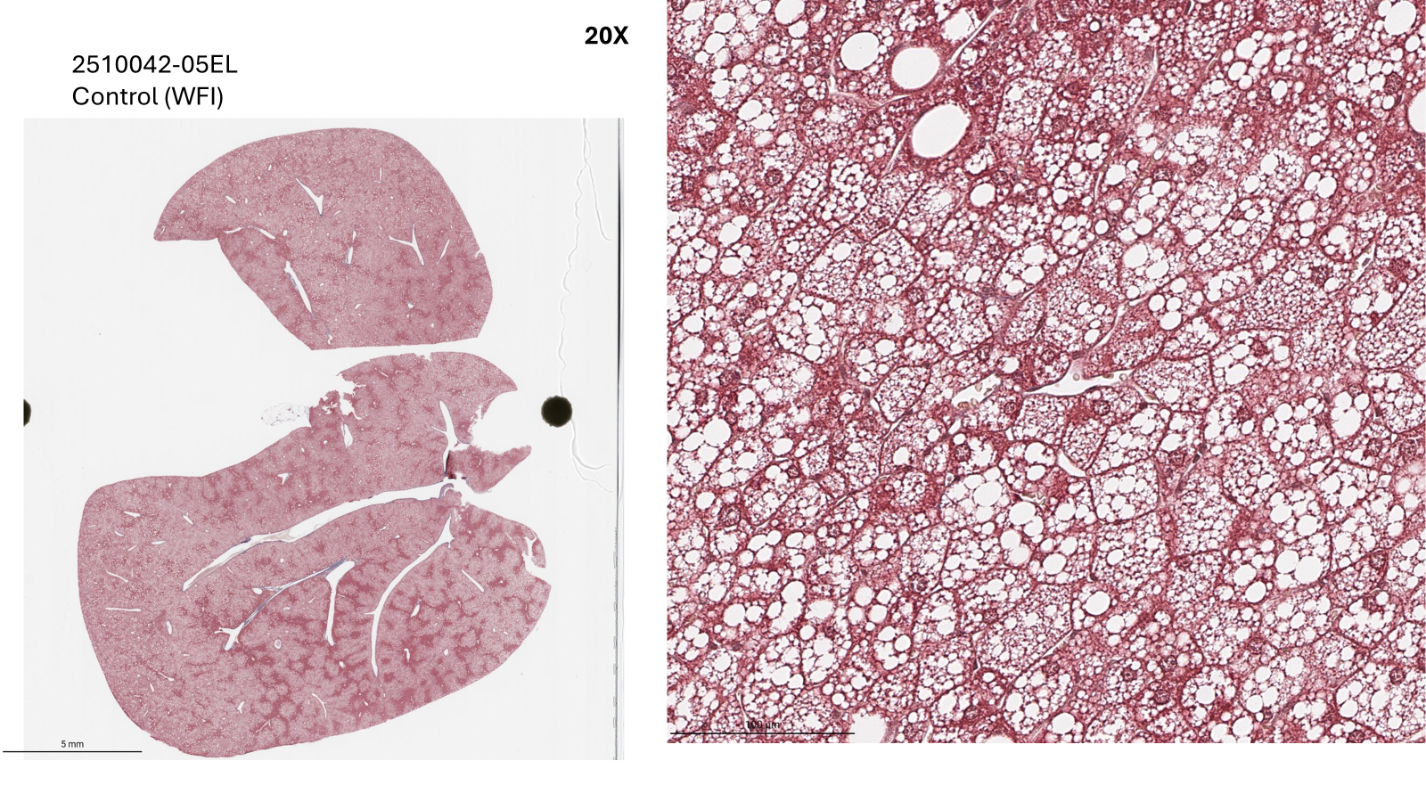
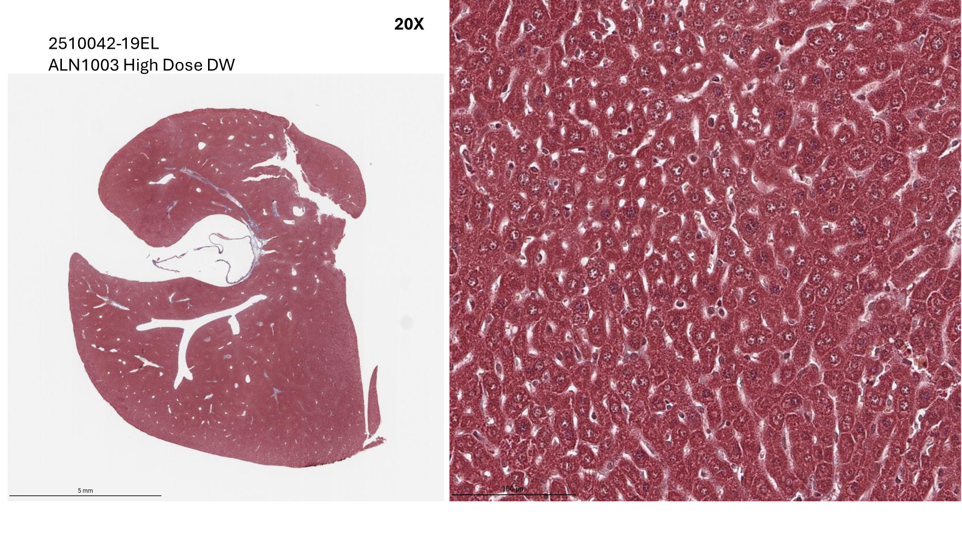
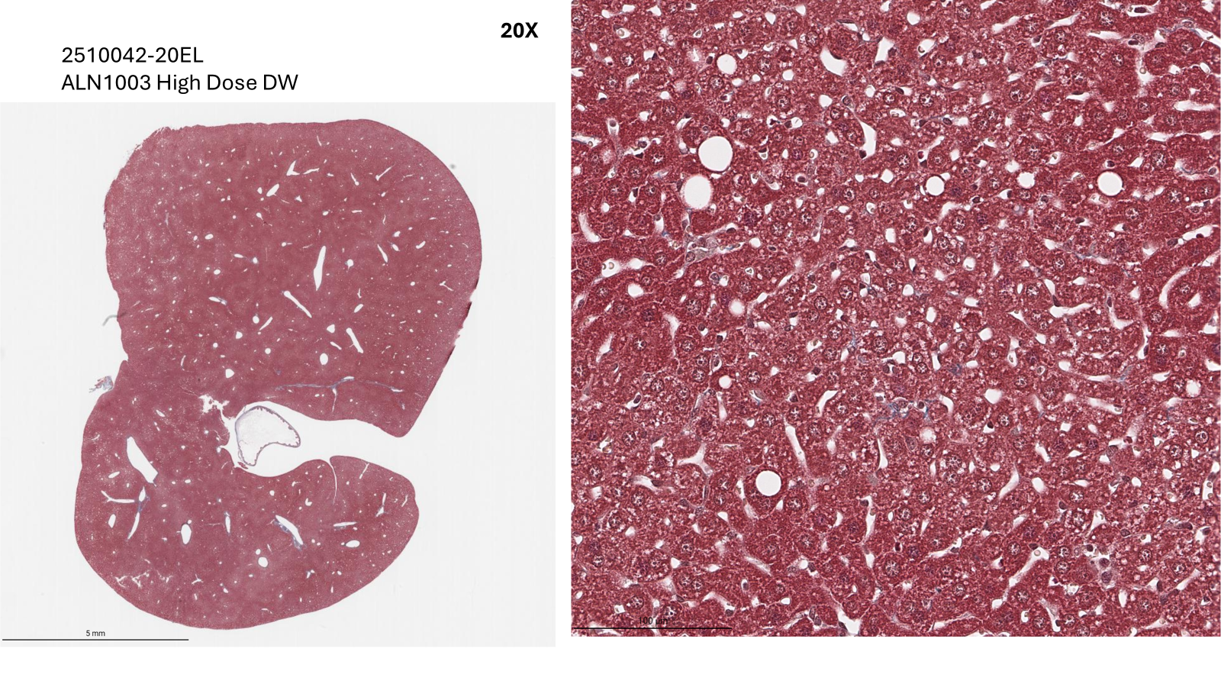
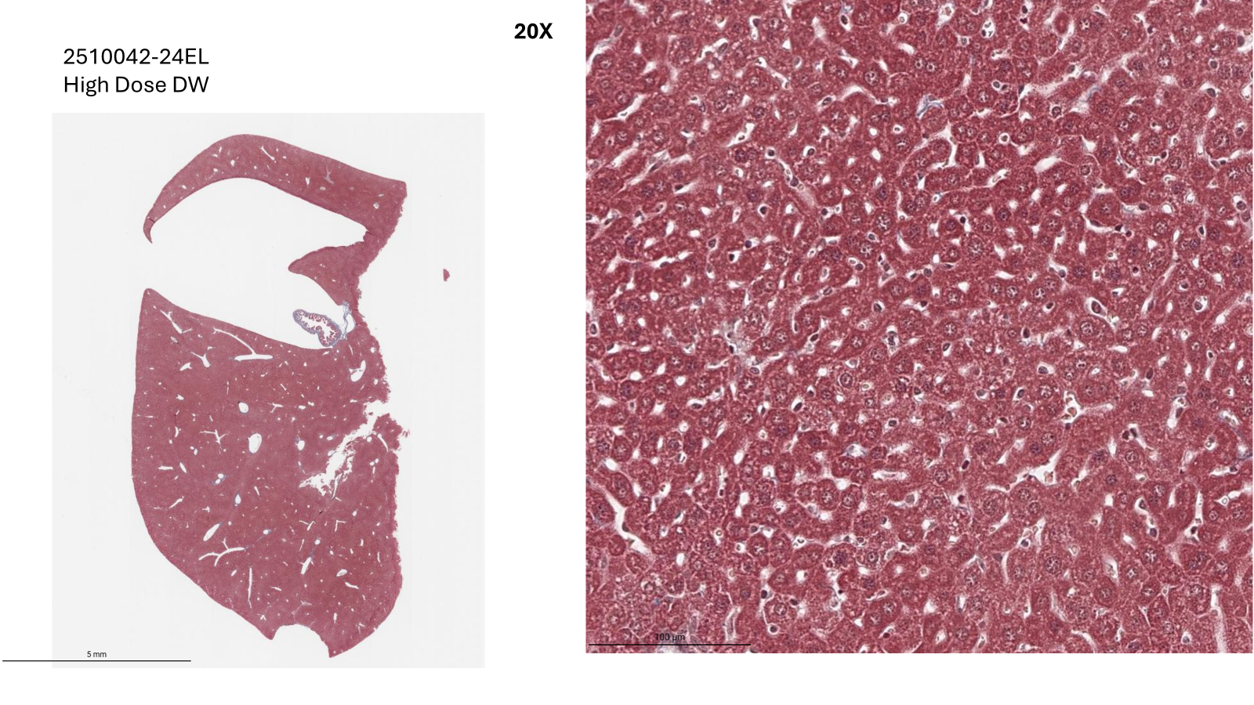
DIO 2: Masson’s Trichrome Stain
DIO 2
Pilot pathology findings require confirmation in a powered MASH study.

Slide 21
High-dose ALN1003 was associated with lower glucose, total cholesterol and HDL-C in DIO Study 2
DIO 2
High-dose ALN1003 was associated with lower glucose, lower total cholesterol, and changes in HDL-C, the dominant lipoprotein in DIO mice
One-way ANOVA, * p<0.05, **** p<0.0001

Slide 22
DIO Study 2 Conclusions
DIO 2
ALN1003 dosed via drinking water was feasible and well tolerated during the treatment period; although interpretation is limited by reduced water consumption and apparent dose aversion. Slight dehydration observed starting on Day 2 of PK period (D16) in 2 animals.
No hypolocomotion observations were reported in DIO Study 2. Drinking-water administration may have reduced peak-associated activity findings, but additional PK/tolerability studies are needed; Maximum daily dose in High Dose group was up to ~18x higher than Low dose
DIO Study 2 showed favorable dose-associated changes in body weight, body composition, liver weight, qualitative liver histology, glucose, and cholesterol-related measures in DIO mice.
Interpretation is limited by reduced water consumption and dose aversion in treatment groups, including slight dehydration observed in two high-dose animals during the PK period.
These findings support further formulation optimization, PK/tolerability assessment, and controlled benchmark studies.

Slide 23
ALN1003 Shows Preclinical Metabolic Improvement across Multiple Axes in Diet-Induced Obese (DIO) Mouse Model
Non-hormonal Approach to treat Metabolic Diseases
Path to IND Enabling Studies
Additional preclinical development
IP expansion around ALN1003-related compounds
Confirmatory benchmark studies
CMC scale-up and formulation activities
MASH-relevant histology
ALN1003 is a preclinical, oral, non-hormonal metabolic therapeutic candidate
Being evaluated for:
obesity-related metabolic dysfunction,
MASH-relevant biology, and
insulin resistance
PK optimization
ALN1003 is being developed to address multi-organ, adiposity-associated disease state characterized by insulin resistance, dysfunctional adipose tissue, chronic low-grade inflammation, and hepatic lipid accumulation.

