Slide 1
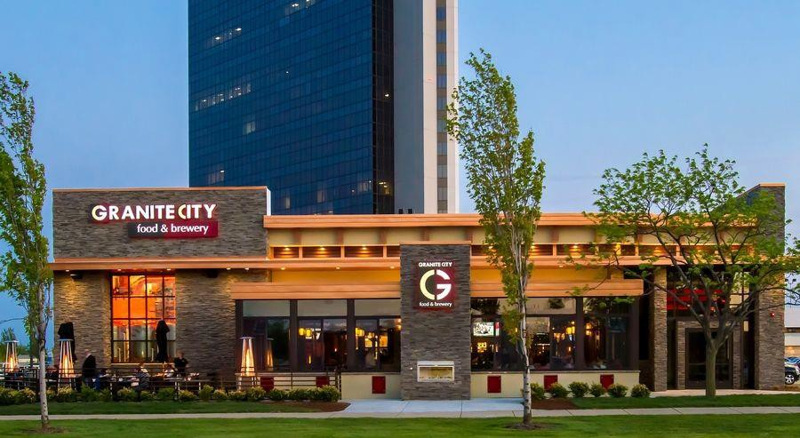

Management Presentation

Slide 2

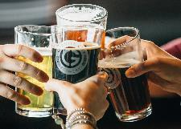
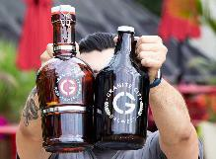
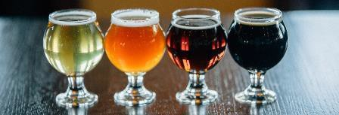
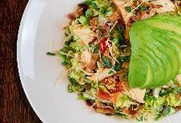
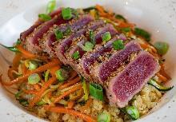
The Granite City Brand
Made-From-Scratch Craft Food
Scratch kitchen, contemporary American cuisine appealing to a broad demographic mix
Chef-driven menu designed to introduce guests to innovative new cuisine choices and flavor profiles
No “veto vote” due to extensive menu including both indulgent and lighter fare
Menu options that meet guests’ preferences for any dining occasion
Award-Winning Craft Beer
Produces and serves beer worthy of the silver medal at the Great American Beer Festival, the most prestigious award in the brewing industry
Restaurants feature between 8-20 taps, including four signature Granite City craft beers, a selection of seasonal Granite City favorites, and guest taps from popular regional and local brewers
Produces over 450,000 gallons of beer annually
Beer represents a meaningful portion of total sales (~10%) and with a 17% cost of sales (vs. 28% for third-party selections)
Unique and patented craft beer brewing system supported by highly efficient, centralized wort production facility and expert brewmaster

Slide 3
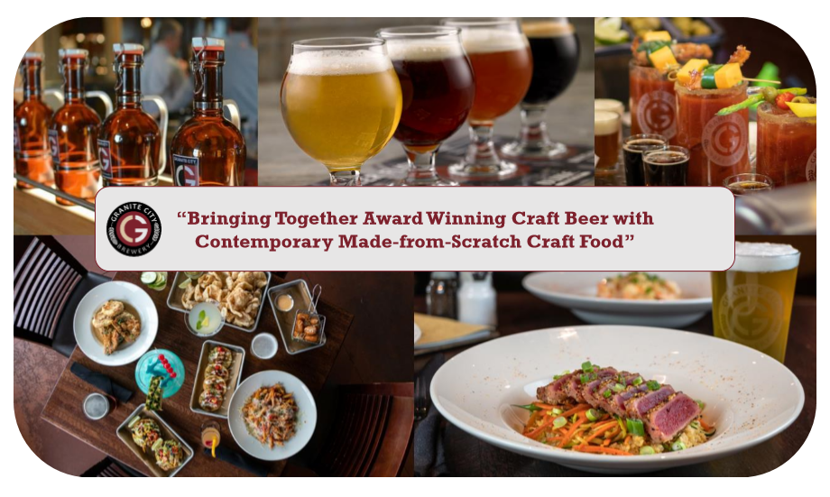
The Granite Food & Brewery

Slide 4
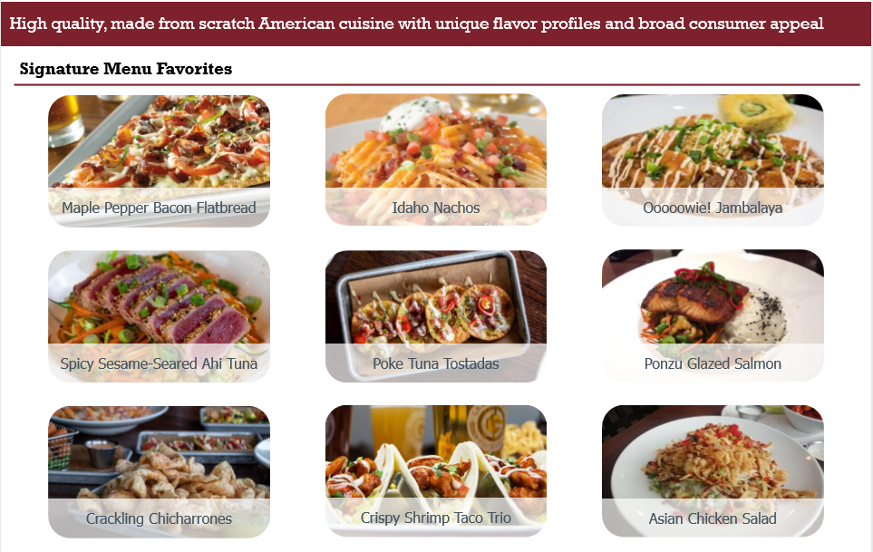
Scratch Kitchen and On-Trend Menu Offering

Slide 5
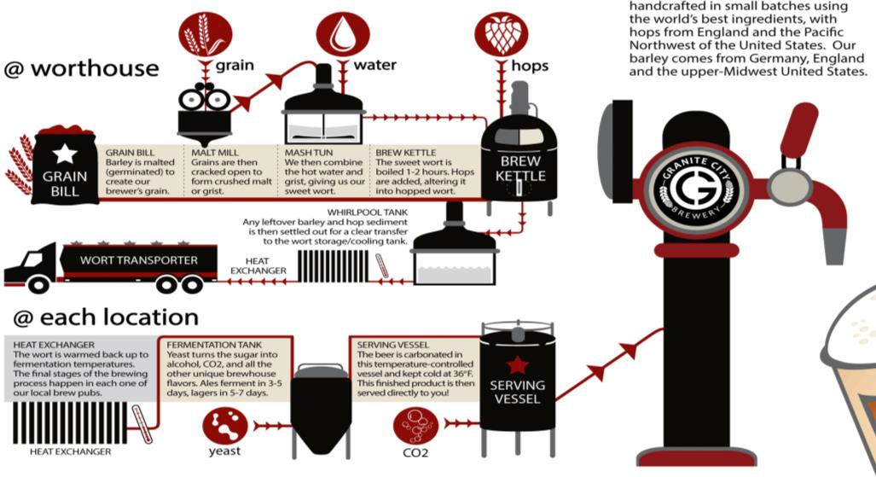

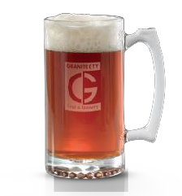
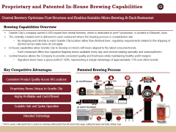
Proprietary and Patented In-House Brewing Capabilities
Central Brewery Optimizes Cost Structure and Enables Scalable Micro-Brewing At Each Restaurant
Brewing Capabilities Overview
Granite City’s company-owned 5,400 square foot central brewery, which is dedicated to wort⁽¹⁾ production, is located in Ellsworth, Iowa
The centrally created wort is delivered to each restaurant where the brewing process is completed on-site
By shipping wort directly to each Granite City location rather than finished beer, regulatory requirements related to the shipping of alcohol across state lines do not apply
In-house capabilities allow Granite City to develop on-trend craft beers aligned to the latest consumer trends
Each restaurant offers four signature flagship brews available every day and several rotating specialty and seasonal beers
Central brewery allows the Company to provide consistent quality and freshness while maintaining healthy profit margins
Signature beers have a gross profit of ~83%, representing a margin advantage of approximately 11% over other brands
Key Competitive Advantages Patented Brewing Process
Consistent Product Quality Across All Locations
Proprietary Brews Unique to Granite City
Highly Profitable and Cost Efficient Scalable Hub and Spoke Operation Patented Technology
⁽¹⁾ Wort is sweet, malty liquid that is created by mashing malted grains that will convert into sugar, boiling the liquid and finally adding hops

Slide 6
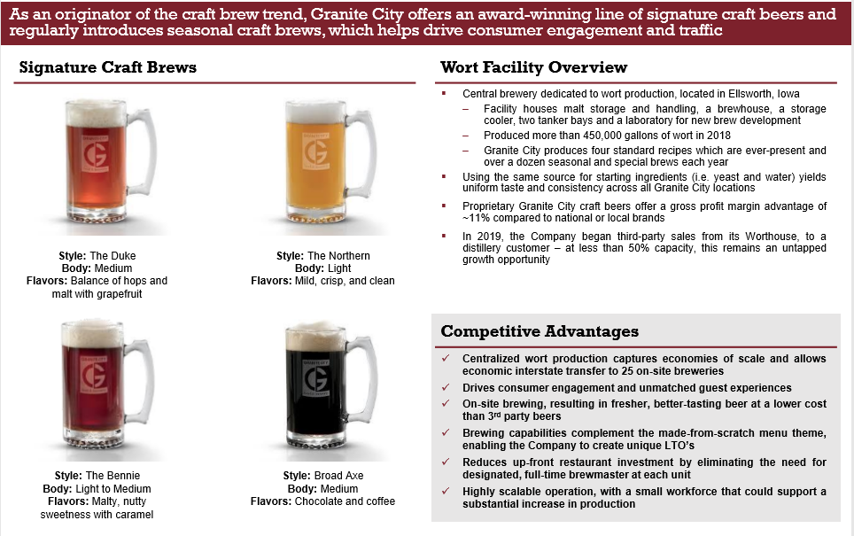
Granite City’s On-Trend Craft Brew Offering

Slide 7




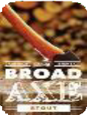



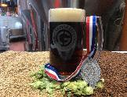
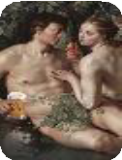








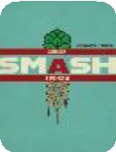





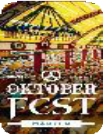



Award Winning Beer Selections
Granite City Maintains a Substantial Library of Award-Winning and Proprietary Craft Beer Selections
Signature Craft Beers Numerous Awards are a Testament to Quality
2018 Silver Medal
Best Food & Beer Pairing 2016
Best Beer of Show (2nd) 2016
Gold, Silver, and Bronze Medals 2016, 2017
Quarterly IPA Rotation
Best Belgian 2010 – 2013
Best Fruit Beer 2009
Best Bock 2008, 2011
Gold Medal 2014
Silver Medal 2015, 2016
Bronze Medal 2016
Seasonal and Specialty Craft Beers – Innovation Keeps Expanding
Barrel Aged Cellar Room |  |  | Spring | Burning |  | Bump In | Blue-Eyed
Series Series SABRO | Gold Fever | Brewnado Smash | Board | Barn | The Hustle | The Night | Brunette Oktoberfest | Zug Zwang
Bourbon | Small Batch | NE IPA | Belgian Strong | Collaboration – | Single Malt and Lemon Lavender | Irish Red Ale | Coffee Cream | Black IPA | Bourbon | German | Vanilla Porter
 |  |  | Ale | Session IPA | Single Hop Shandy |  | Ale |  | Brown Ale | Märzen

Slide 8
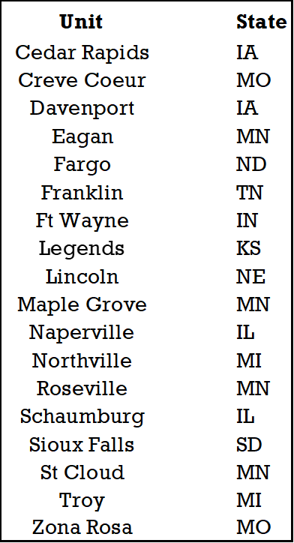
Granite City Acquisition Metrics

