Slide 1
Proof of Pharmacology Demonstrated in Phase 2a Stage 2 CKD Patients in Cohort A of 201 Demonstrate Largest Reductions in sUA
All Patients in Cohort A Data
ALLN-346 Stage 2 CKD Subgroup of Cohort A
Mean sUA change from baseline %
**
*
*
*
Mean sUA change from baseline absolute (mg/dL)
*
**
*
*
*
**
**
*
*P <0.1; **P <0.05 vs placebo
1

Slide 2
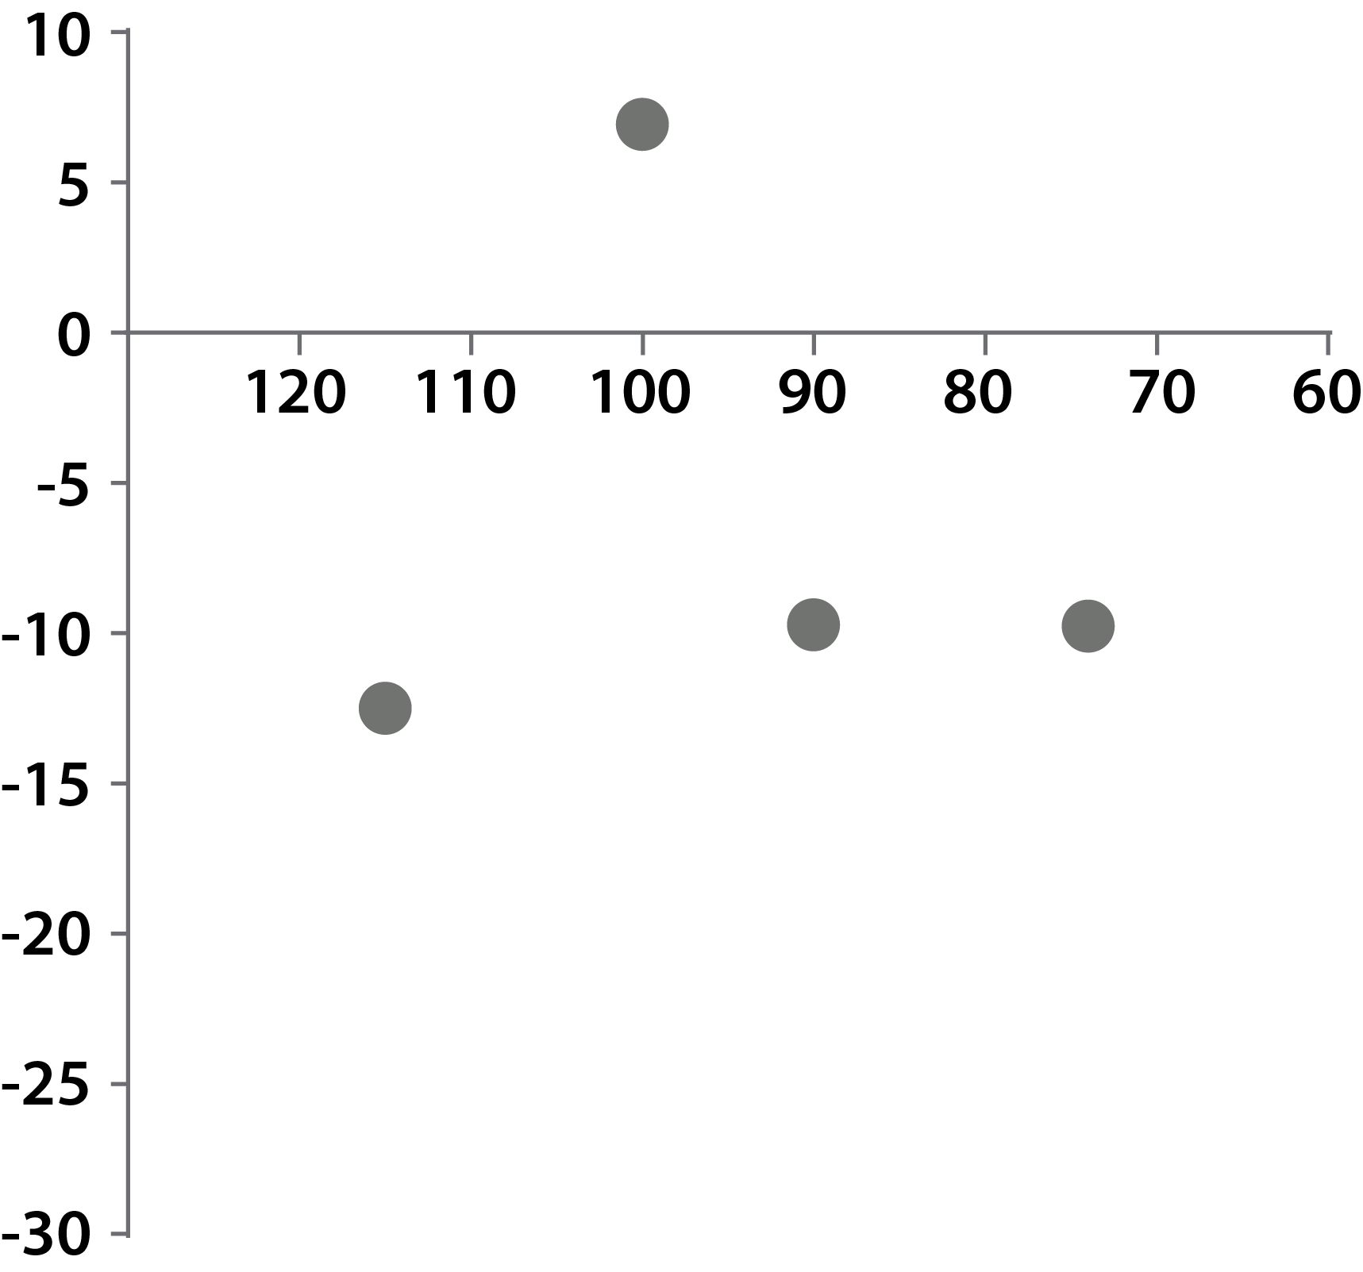
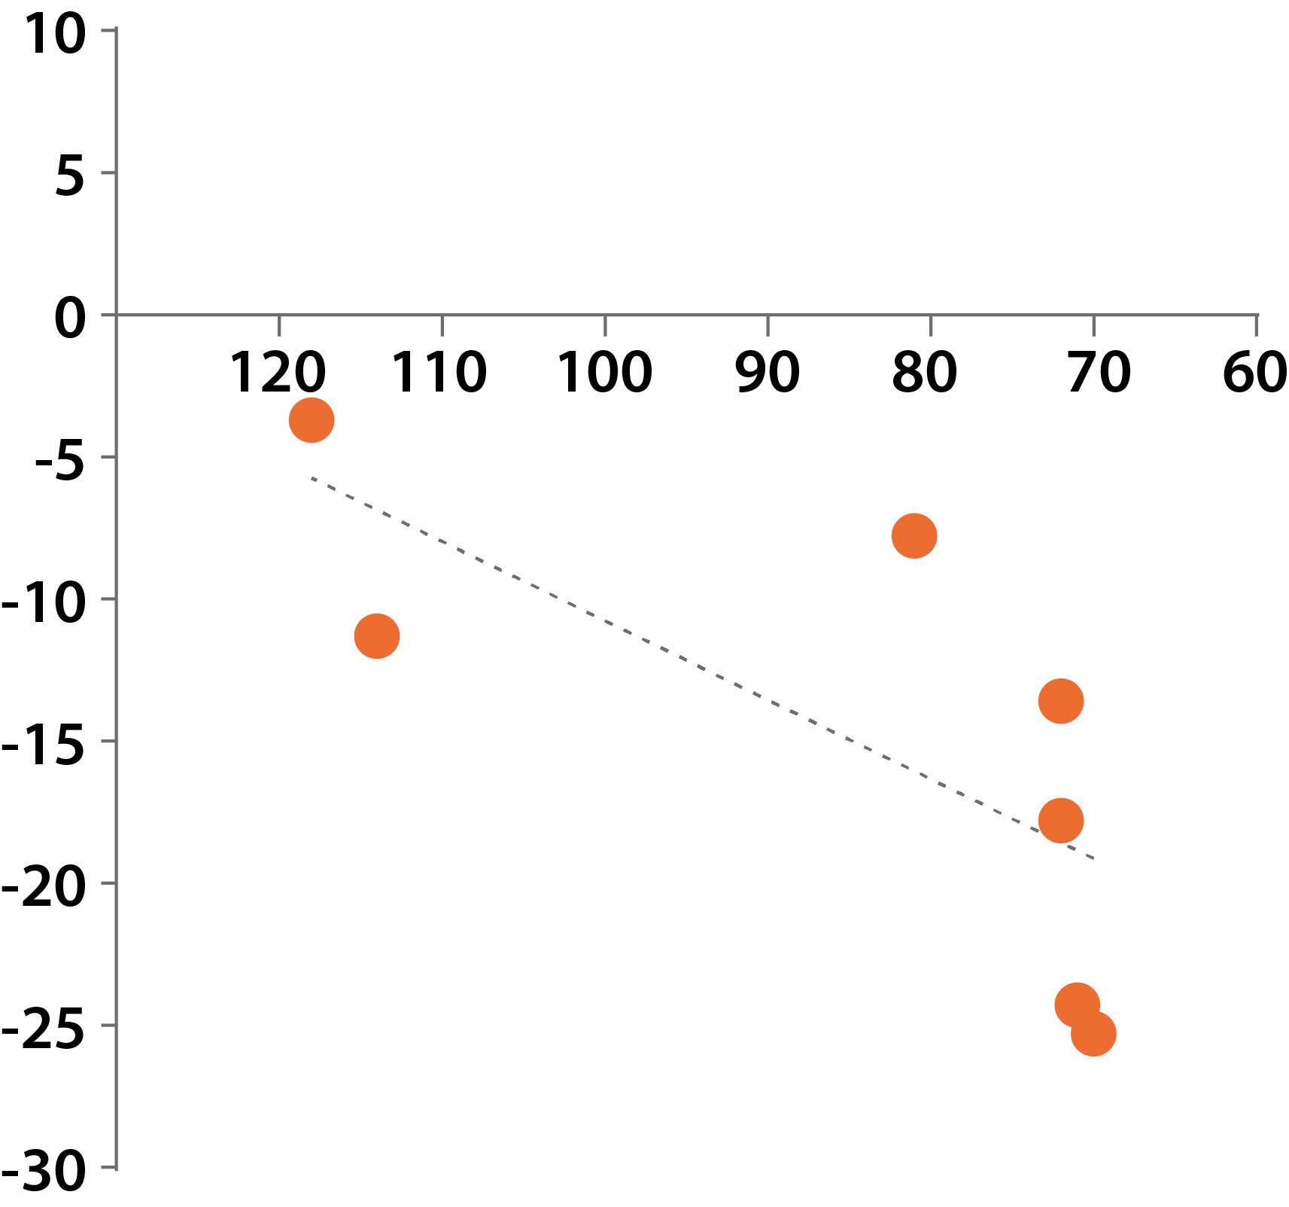
sUA Reductions Correlate with eGFR in ALLN-346 Group
ALLN-346 MOA indicative of potential for greater efficacy in Stage 3 to 5 CKD Patients as renal function loss is non-linear
Placebo
ALLN-346
Baseline eGFR
Baseline eGFR
sUA change from baseline %
r=-0.2
p=0.91
r=0.95
p=0.003
Correlation between % change of serum urate and eGFR in ALLN-346 compared to placebo at day 6, 4-hour time point
Percent change in sUA correlates with decrease in eGFR in ALLN-346 patient group but not in placebo group

