Slide 1

GMEX ROBOTICS
NASDAQ: GMEX
Revolutionizing
Robotics
TRANSPORTATION & LOGISTICS
INDUSTRIAL AUTOMATION
RESOURCES EXPLORATION
AI-DRIVEN SOLUTIONS
with AI Integration
Cutting-edge Robotics Solutions for Industries
www.fitellcorp.wixsite.com/gmexrobotics | 23-25 Mangrove Lane, Taren Point, Sydney NSW 2229

Slide 2
WHO WE ARE
About GMEX Robotics
NASDAQ
Sydney
GMEX ROBOTICS (formerly FITELL CORPORATION) is advancing from precision fitness engineering into advanced robotics — applying decades of motion, biomechanics, and hardware expertise to build intelligent machines with reliable performance and human-centric design.
Stock Listed
HQ, Australia
We are a human performance technology company — not leaving fitness behind - but redefining it: moving from selling equipment to delivering measurable, personalized human performance transformation.
Dual
AI-First
Business Units
Technology Focus
A strategic evolution from precision fitness hardware to intelligent robotic systems.
GMEX ROBOTICS | COMPANY OVERVIEW

Slide 3
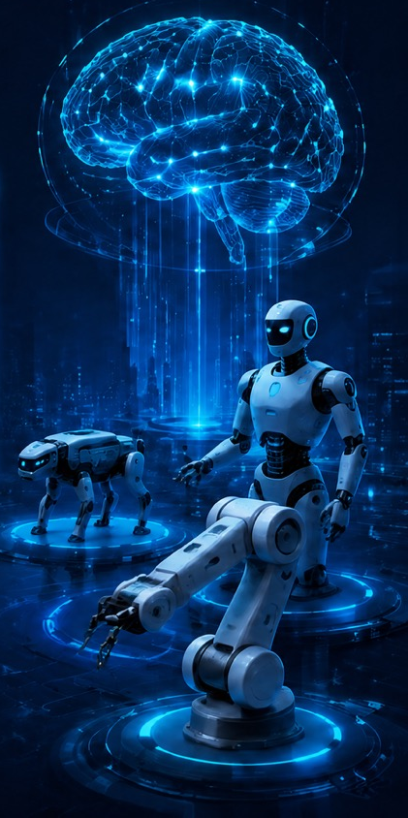
WHY INVEST
Investment Highlights
Integrated “Terminal + Brain” Platform. Robotics hardware + AI routing layer forming a closed-loop embodied intelligence system
Multi-Model Intelligence at Scale. Dynamic model routing across navigation, vision, interaction, and vertical AI use cases
Hardware-Driven Data & Distribution Advantage. Deployed robots act as high-frequency inference nodes generating continuous real-world data
Recurring, High-Margin Revenue Model. Transition from hardware sales to subscriptions, OTA updates, and usage-based AI services
Defensible Moat & Infrastructure Positioning. Dual data flywheel, strong network effects, and positioning as core AI infrastructure layer
GMEX ROBOTICS | COMPANY OVERVIEW

Slide 4
Key Challenges in Robotics & Hardware
Dumb Hardware & Fragmented Intelligence
Low-Margin Hardware Commoditization
Disconnected
Data Silos
Traditional robots lack dynamic, multi-model switching capabilities. Relying solely on edge computing makes them rigit and unadaptable to complex real-world scenarios.
The hardware manufacturing sector is trapped in severe price wars. Companies are limited to one-time hardware sales and struggle to capture recurring, high-margin software value.
There is no unified system to seamlessly capture physical behavioral data (how robots interact) and AI inference data, losing the opportunity to build a powerful data moat.
GMEX ROBOTICS | COMPANY OVERVIEW

Slide 5
OUR BUSINESS
Two Complimentary Business Units
Fitness Operations
GMEX
ROBOTICS
Fitness equipment & precision products
Precision fitness equipment
Connected sensor-integrated machines
Real-time biomechanics data capture
Health & performance monitoring
Foundation of GMEX motion expertise
Robotics solutions & intelligent machines
AI-integrated robotic systems
Transportation & Logistics automation
Industrial & collaborative robots
Resources exploration platforms
2FCulinary AI product line
GMEX ROBOTICS | BUSINESS STRUCTURE

Slide 6
OUR TRANSFORMATION
From Precision Hardware to Intelligent Systems
Precision
Hardware
Data &
Robotics
Intelligent
Systems
Modernizing foundational expertise — integrating sensors and connected systems to capture real-time movement and force data through precision fitness solutions.
Expanding into robotics — developing systems centered on actuation, sensor fusion, and machine learning that can operate in dynamic settings.
Building robotics capabilities with responsive actuators, vision systems, and adaptive control algorithms — a versatile new pillar of our business.
GMEX ROBOTICS | STRATEGIC EVOLUTION

Slide 7

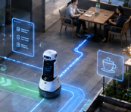

OUR TRANSFORMATION
Engineering the Possible
At GMEX Robotics, we turn visionary questions into intelligent machines that perform reliably in the real world. We bridge visionary AI research with robust mechanical engineering.
Human-Augmentation First
Cross-Disciplinary Fusion
Iterative Prototyping
Every system is designed to work alongside people — enhancing human capability rather than replacing it. Safety, ergonomics, and usability are non-negotiable.
Our teams bring together AI researchers, mechanical engineers, biomechanics specialists, and software developers to create machines that work in the real world.
We believe in rapid cycles of building, testing, and refining. Every GMEX product goes through rigorous real-world validation before deployment.
GMEX ROBOTICS | STRATEGIC EVOLUTION

Slide 8
WHY CHOOSE GMEX
Competitive Advantages
Proven Hardware Heritage
Real-World Reliability
Comprehensive Transformation
High-Impact Industries
Human-Centric Innovation
Cross-Disciplinary Fusion
End-to-End Logistics
Versatile Applications
Evolved from durable precision fitness equipment to intelligent cobots. Robots designed to work alongside people — enhancing safety, productivity, and quality of life
Bridging visionary AI research with robust mechanical engineering, iterative prototyping, and proven principles to deliver deployable, high-performance solutions.
Holistic supply chain automation: warehouse fulfillment, inventory management, material hauling, and last-mile delivery via sidewalk robots and drones.
From collaborative industrial automation to resource exploration, GMEX pioneers multi-domain expertise as a strategic partner for resilient, adaptive workplaces.
GMEX ROBOTICS | COMPETITIVE ADVANTAGES

Slide 9
SOLUTIONS
Four Core Solution Domains
Consumer Solutions
Transportation
& Logistics
Collaborative &
Industrial Automation
Resources Exploration
& Excavation
Launched Cooking Robotics Platform in December 2025
All-in-One Kitchen Robots
Intelligent Culinary Robotics System
Reduces Labor Intensity while Maintaining High-Quality Food Preparation
Warehouse & Fulfillment Automation
Intelligent Inventory Management
Transportation & Material Hauling
Last-Mile & Final Delivery
Advanced Force-Torque Sensors
AI & Machine Learning Integration
Simplified No-Code Programming
Digital Twins & Simulation
AI Path Planning & Navigation
Precision Mining Technology
GPS-Denied Terrain Operations
Selective Precision Extraction
GMEX ROBOTICS | SOLUTIONS PORTFOLIO

Slide 10
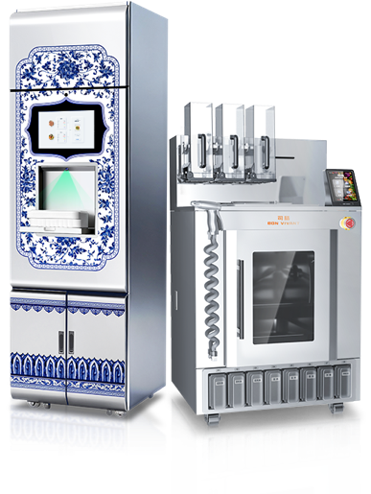
Consumer Solutions
2FCulinary AI
NEW Product Launch
AI-Driven Personal Robot Chef for Personalized Meals
Our First Robotic Product
GMEX Robotics has successfully launched 2FCulinary AI — our first robotic product. The 2F Culinary AI is designed to deliver personalized and nutrition-customizable meals, combining AI-driven recipe intelligence with precise robotic execution.
This marks a landmark milestone as we bridge our human performance expertise with intelligent robotic cooking systems.
Personalized
Meals
Nutrition-Customizable
Robotic
Precision
Smart
Integration
AI customizes recipes based on nutritional needs, preferences, and dietary requirements
Calorie and macro tracking built into the cooking process for health-conscious users.
Leverages GMEX motion expertise for consistent, repeatable high-quality food preparation.
Connects to GMEX's broader ecosystem of health monitoring and performance platforms.
GMEX ROBOTICS | 2FCULINARY AI PRODUCT LAUNCH

Slide 11
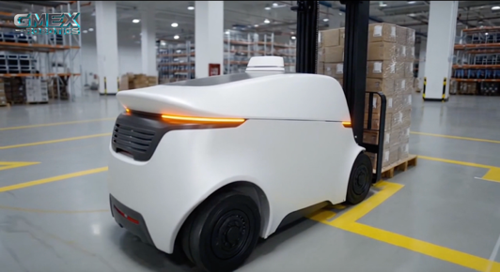
Transportation & Logistics
GMEX robotics creates a seamless, automated flow of applications across the supply chain — transforming fundamental operations from manual processes into high-tech, efficient systems.
Warehouse & Fulfillment
Intelligent
Inventory
Material
Hauling
Last-Mile
Delivery
Our robots turn manual labor into a high-tech symphony — automating picking, packing, and dispatch operations with precision and speed
GMEX robots continuously provide accurate stock-level visibility across facilities, eliminating costly over-ordering and stockouts
Robots orchestrate effortless, safe transport of materials across entire facilities, reducing human exposure to heavy loads and hazards
Sidewalk robots and drone delivery solutions are rapidly evolving into game-changing real-world applications for final delivery
GMEX ROBOTICS | TRANSPORTATION & LOGISTICS

Slide 12
Collaborative & Industrial Automation
Advanced Sensors
AI & Machine Learning
Simplified Programming
Force-torque sensors allow robots to 'feel,' while 2D/3D vision systems enable bin-picking and precise guidance in complex environments.
Enables predictive maintenance, adaptive control (adjusting grip force), and vision-based quality inspection across production lines.
Lead-through teaching, graphical interfaces, and no-code platforms allow shop-floor workers to program robots without specialist training.
Mobile Robot Arms
Digital Twins
Combining AMR mobility with manipulation arms for highly flexible material transport and task execution across a factory floor.
Robots and entire workcells are virtually commissioned and optimized before physical deployment, reducing downtime and risk significantly.
GMEX ROBOTICS | COLLABORATIVE AUTOMATION

Slide 13
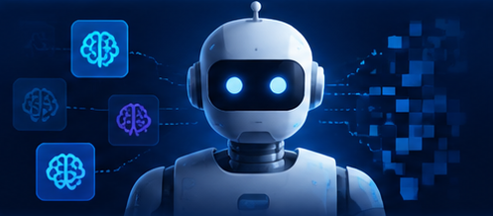
Resources Exploration & Excavation
AI-Powered Exploration
GMEX pioneers AI-driven robotic systems designed to operate in the most challenging and hazardous environments on Earth — from dense forests and mine shafts to deep-sea environments where GPS signals cannot reach.
Our platforms integrate advanced sensor fusion, computer vision, and adaptive AI to navigate, map, and extract resources with precision while maintaining strict environmental standards.
Path Planning
Precision Mining
Precision Extraction
3
Real-time navigation in GPS-denied terrain — mine shafts, dense forests, deep-sea environments.
Selective high-grade ore extraction while leaving low-grade material, dramatically improving efficiency.
AI vision systems selectively harvest mineral deposits while minimizing environmental disturbance.
GMEX ROBOTICS | RESOURCES EXPLORATION

Slide 14
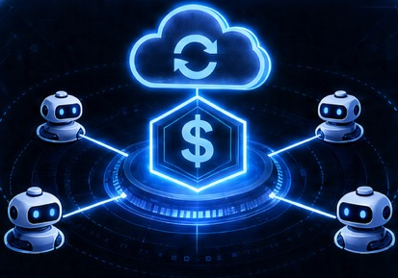
Fitell Fitness: Cash Flow & Strategic Platform
What is Fitell Fitness
Strategic Role Within GMEX Robotics
Established e-commerce fitness and wellness platform
Online retailer of gym and fitness equipment (2,000+ SKUs)
100,000+ customers with strong repeat purchasing trends
Expanding ecosystem across equipment, digital fitness services, and mobile applications
Generates ~$XX in revenue to support infrastructure and fund robotics R&D
Serves as a real-world lab for ergonomics, human movement, and daily routines
Enhances brand visibility and investor engagement during GMEX’s transition
Positioning
Bridges today’s revenue base with tomorrow’s robotics platform, supporting near-term stability while accelerating long-term innovation
GMEX ROBOTICS | RESOURCES EXPLORATION

Slide 15
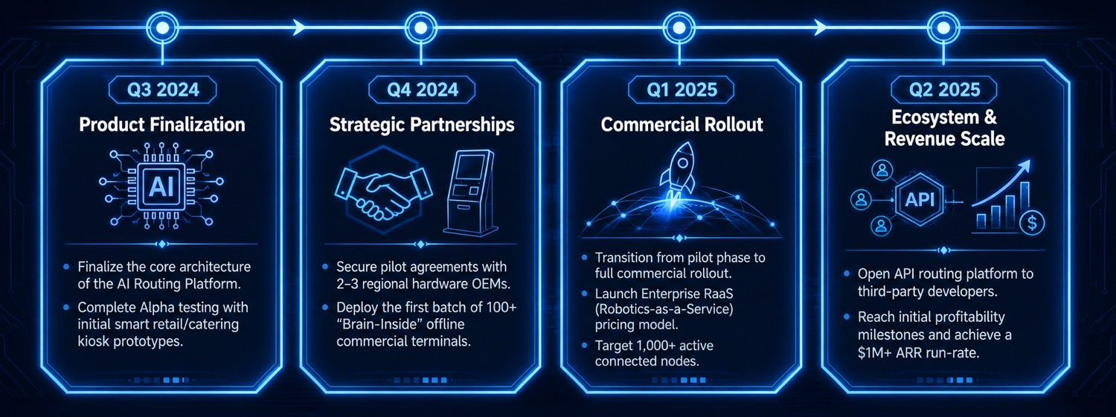
STRATEGIC VISION
Our Growth Roadmap
PHASE 1
PHASE 2
PHASE 3
PHASE 4
Fitell
Foundation
GMEX
Rebrand
2FCulinary
AI Launch
Industrial
Scale
Precision fitness hardware & biomechanics expertise
Strategic pivot to robotics &
AI-integrated systems
First robotic product successfully deployed
Full solutions across logistics, automation & mining
GMEX Robotics is building toward a future where intelligent machines augment human capability across every industry — from the factory floor to the kitchen counter. Our dual business model provides both near-term revenue stability and long-term exponential growth potential through AI and robotics innovation.
Looking Ahead
GMEX ROBOTICS | STRATEGIC ROADMAP

Slide 16
MEET THE TEAM
Management Team
Yinying (Sam) Lu, Chief Executive Officer and Director
Served as CEO since October 2023 and director since April 2022
General manager of General Dynamics (GD) since April 2017, overseeing procurement, operations, marketing and financing
Grew GD’s customer database from 60,000 members in 2019 to over 100,000 in 2023
Introduced Lion Loyalty, GD’s VIP membership program
Chun Wai Edwin Tam, Chief Finance Officer
Over 20 years experience in accounting, auditing, corporate and treasury management
Fellow member of The Hong Kong Institute of Certified Public Accountants
Fellow member of the Association of Chartered Certified Accountants
Member of The Chartered Governance Institute in the United Kingdom
Jack Zeng, Chief Technology Officer
Head of Technology at Fitell, driving commercialization and partnerships under CEO Sam Lu
Founded and scaled tech ventures; delivered AI solutions to Fortune 500 clients
Led global launches of advanced hardware and robotics across North America and Australia
GMEX ROBOTICS | STRATEGIC ROADMAP

Slide 17
WHY INVEST
Investment Summary
Integrated “Terminal + Brain” Platform. Robotics hardware + AI routing layer forming a closed-loop embodied intelligence system
Multi-Model Intelligence at Scale. Dynamic model routing across navigation, vision, interaction, and vertical AI use cases
Hardware-Driven Data & Distribution Advantage. Deployed robots act as high-frequency inference nodes generating continuous real-world data
Recurring, High-Margin Revenue Model. Transition from hardware sales to subscriptions, OTA updates, and usage-based AI services
Defensible Moat & Infrastructure Positioning. Dual data flywheel, strong network effects, and positioning as core AI infrastructure layer
GMEX ROBOTICS | STRATEGIC ROADMAP

Slide 18

Let's Build
the Future
Together
Pioneering the next generation of intelligent machines
Address:
23-25 Mangrove Lane, Taren Point, Sydney, NSW 2229
Website:
fitellcorp.wixsite.com/gmexrobotics
Nasdaq:
GMEX

Slide 19
INVESTOR INFORMATION
Investor Relations
Nasdaq Listing
IR Resources Available
Ticker Symbol:
GMEX
Press Releases · Events & Presentations · Stock Information
Publicly traded on the Nasdaq exchange
SEC Filings · Financial Results · Board of Directors · Governance Documents
IR Alerts & IR Contact available on website
"The future belongs to AI and robotics, and we are the pioneers shaping that future."
— GMEX Robotics Team
GMEX ROBOTICS | INVESTOR RELATIONS

