Slide 1





Second Quarter 2023 Financial Results
August 2, 2023

Slide 2
Forward-Looking Statements
This presentation includes or may include forward-looking statements. Forward-looking statements include the Company’s financial performance outlook and statements regarding goals, beliefs, strategies, objectives, plans or current expectations. These statements involve known and unknown risks, uncertainties and other factors which may cause the actual results to be materially different from any future results, performance or achievements contemplated in the forward-looking statements. Such factors include: economic conditions, especially as they relate to commercial and consumer credit conditions and business spending; commercial real estate property values, vacancy rates and general conditions of financial liquidity for real estate transactions; the effects of changes in foreign exchange rates in relation to the US dollar on Canadian dollar, Australian dollar, UK pound sterling and Euro denominated revenues and expenses; competition in markets served by the Company; labor shortages or increases in commission, wage and benefit costs; the impact of higher than expected inflation could impact profitability of certain contracts; impact of pandemics on client demand, ability to deliver services and ensure the health and productivity of employees; disruptions or security failures in information technology systems; cybersecurity risks; a change in/loss of our relationship with US government agencies could significantly impact our ability to originate mortgage loans; default on loans originated under the Fannie Mae Delegated Underwriting and Servicing program could materially affect our profitability; the effect of increases in interest rates on our cost of borrowing and political conditions or events, including elections, referenda, changes to international trade and immigration policies and any outbreak or escalation of terrorism or hostilities.
Additional factors and explanatory information are identified in the Company’s Annual Information Form for the year ended December 31, 2022 under the heading “Risk Factors” (which factors are adopted herein, and which can be accessed at www.sedar.com) and other periodic filings with Canadian and US securities regulators. Forward looking statements contained in this presentation are made as of the date hereof and are subject to change. All forward-looking statements in this press release are qualified by these cautionary statements. Except as required by applicable law, Colliers undertakes no obligation to publicly update or revise any forward-looking statement, whether as a result of new information, future events or otherwise.
This presentation does not constitute an offer to sell or a solicitation of an offer to purchase an interest in any fund.
Non-GAAP measures
This presentation makes reference to certain non-GAAP measures, including local currency (“LC”) revenue growth rate, internal revenue growth rate, Adjusted EBITDA (“AEBITDA”), Adjusted EPS (“AEPS”) and assets under management (“AUM”). Please refer to Appendix for reconciliations to GAAP measures.

Slide 3
Highlights
High value recurring revenues continue to scale
(US$ millions, except per share amounts)
        Robust growth in Investment Management and Outsourcing & Advisory
        Capital Markets and, to a lesser extent, Leasing declined compared to the prior year’s record transactional revenue levels
        Completed three strategic Engineering and Project Management investments in Australia, New Zealand and the US
        Completed early redemption of 4% convertible notes, substantially all of which were converted to subordinate voting shares
        Maintaining outlook for 2023 previously provided in May 2023

Slide 4

Broad Diversification
Trailing twelve months ended June 30, 2023
TTM Q2 2023 Revenue by Service
TTM Q2 2023 AEBITDA by Service
56%
Recurring
65%
Recurring
Outsourcing & Advisory
Leasing
Leasing and Capital Markets
Investment Management
Capital Markets
Please refer to Slide 18

Slide 5

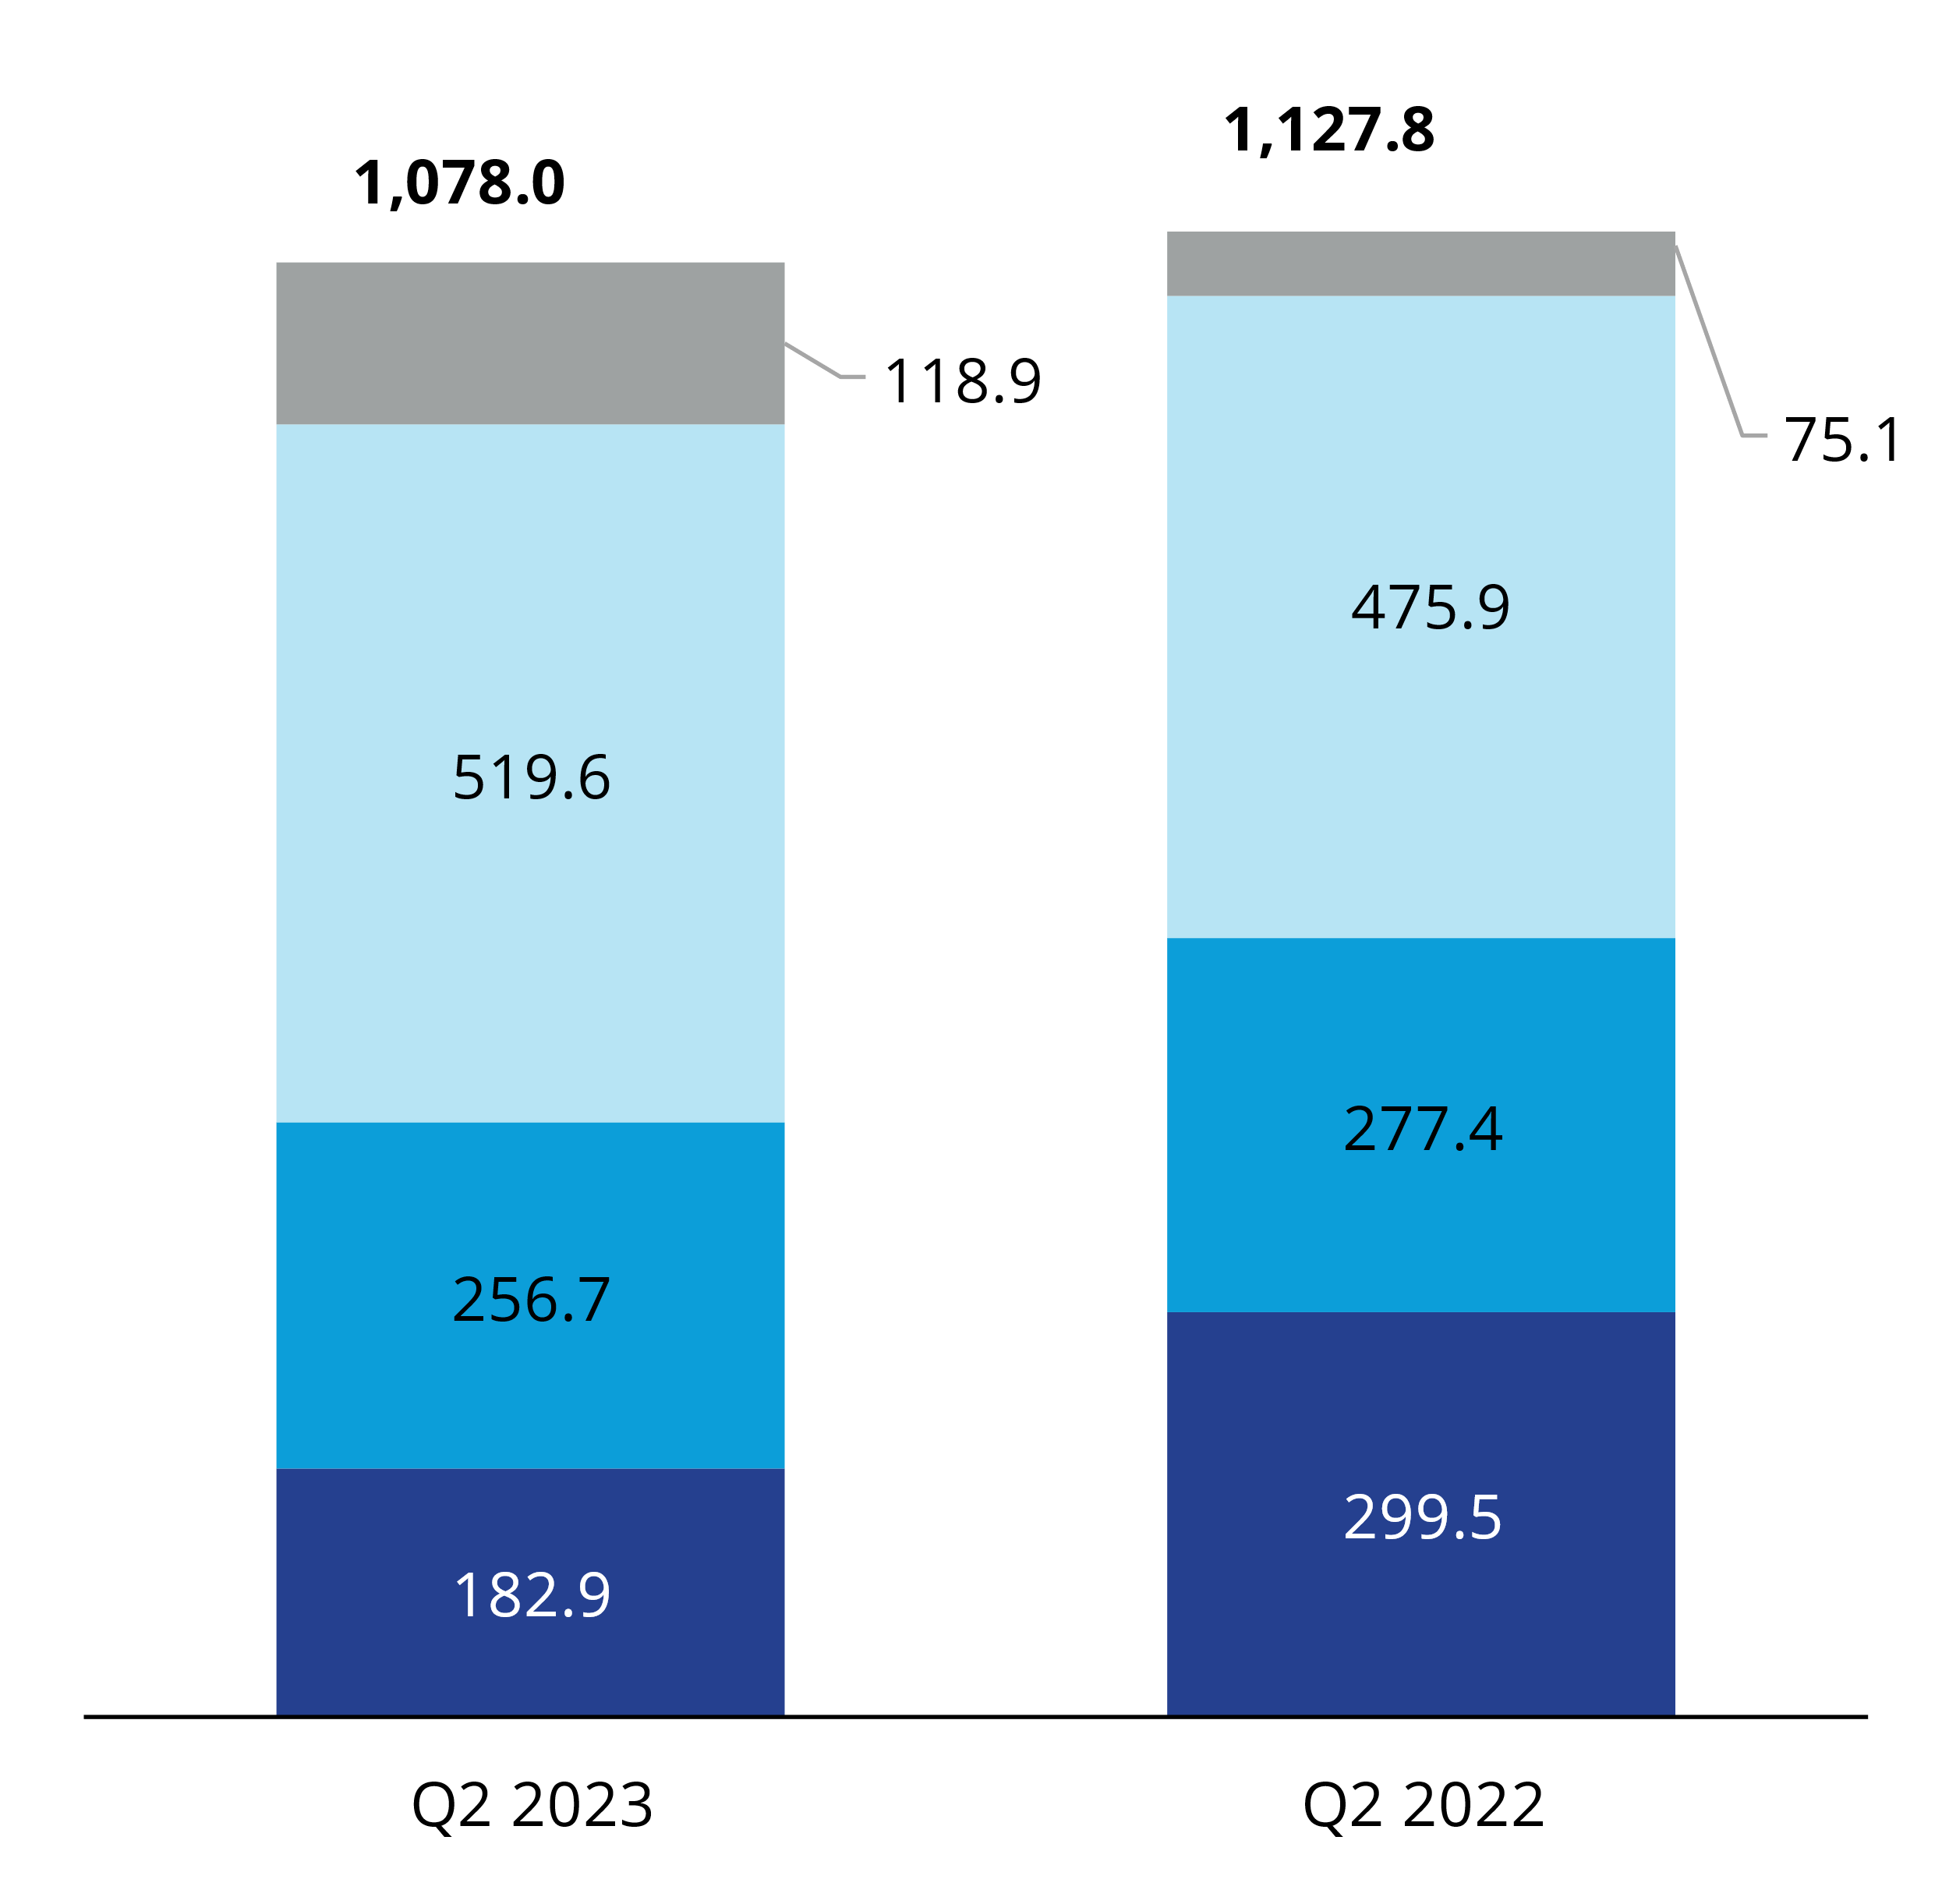
Consolidated Revenues
Second Quarter
(US$ millions)
Investment Management ⁽¹⁾
Outsourcing & Advisory
Leasing
Capital Markets
Local currency internal decline: -10%
⁽¹⁾ Investment Management LC revenue growth, excluding pass-through carried interest, was 62%

Slide 6

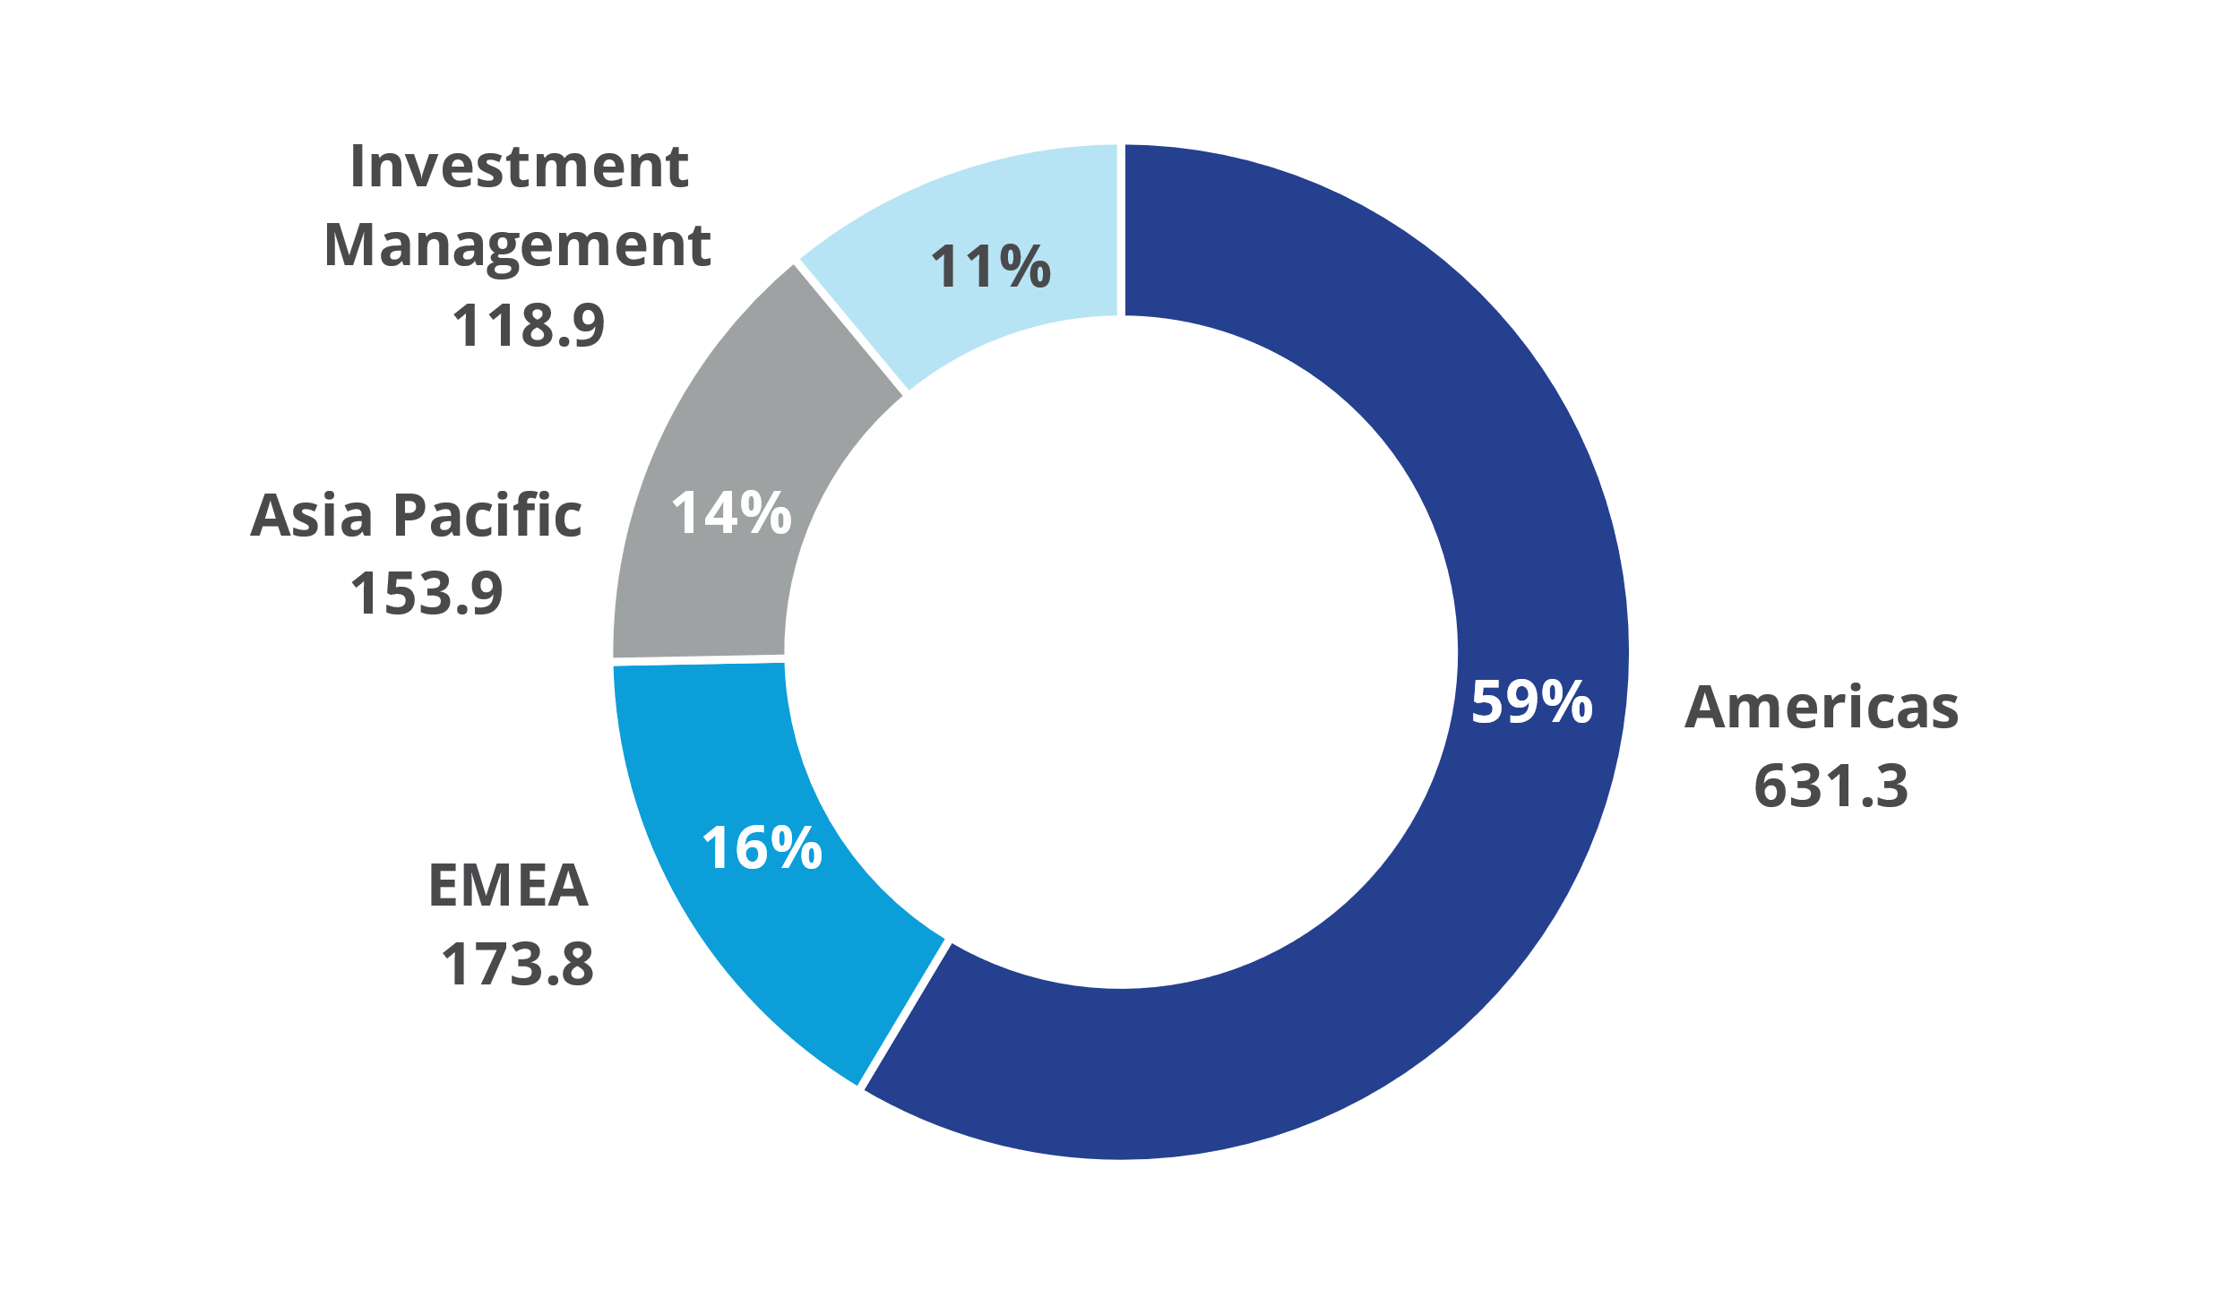
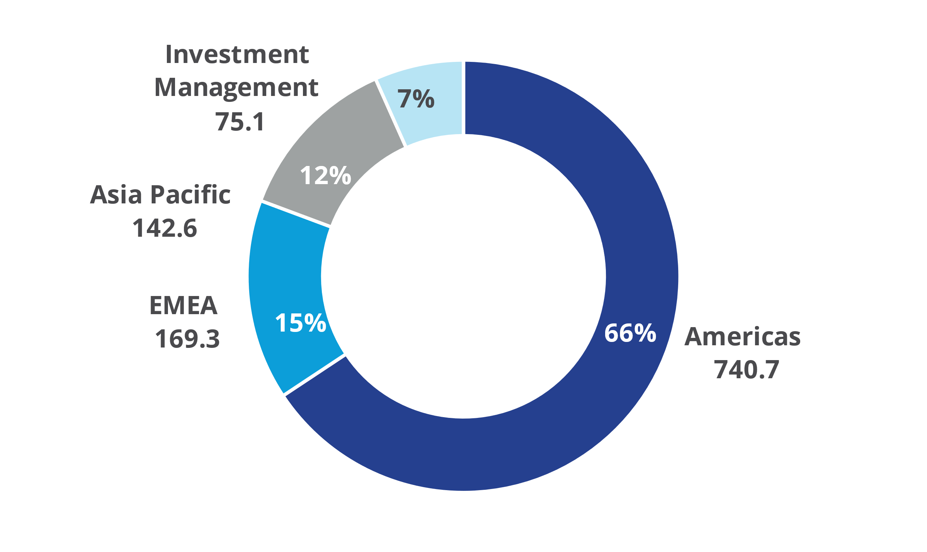
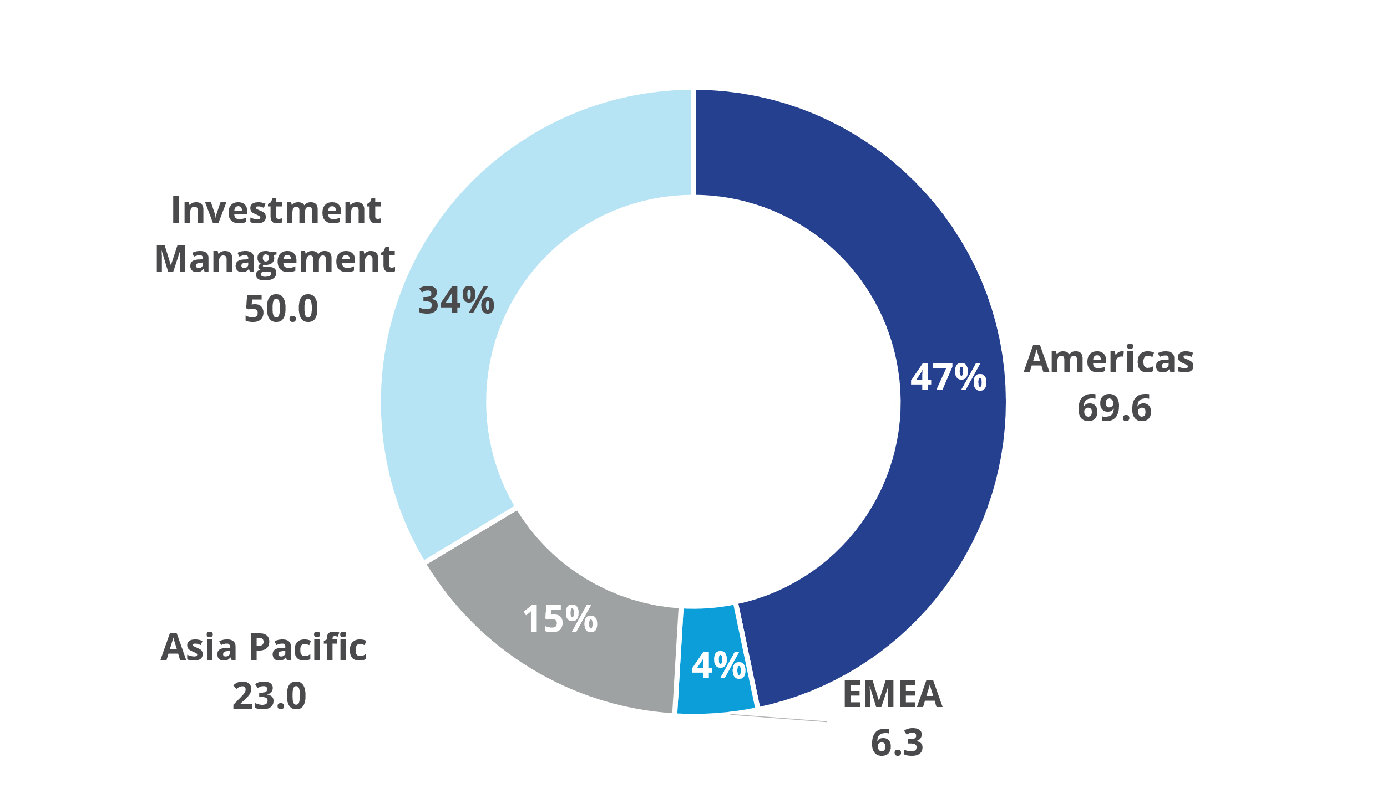
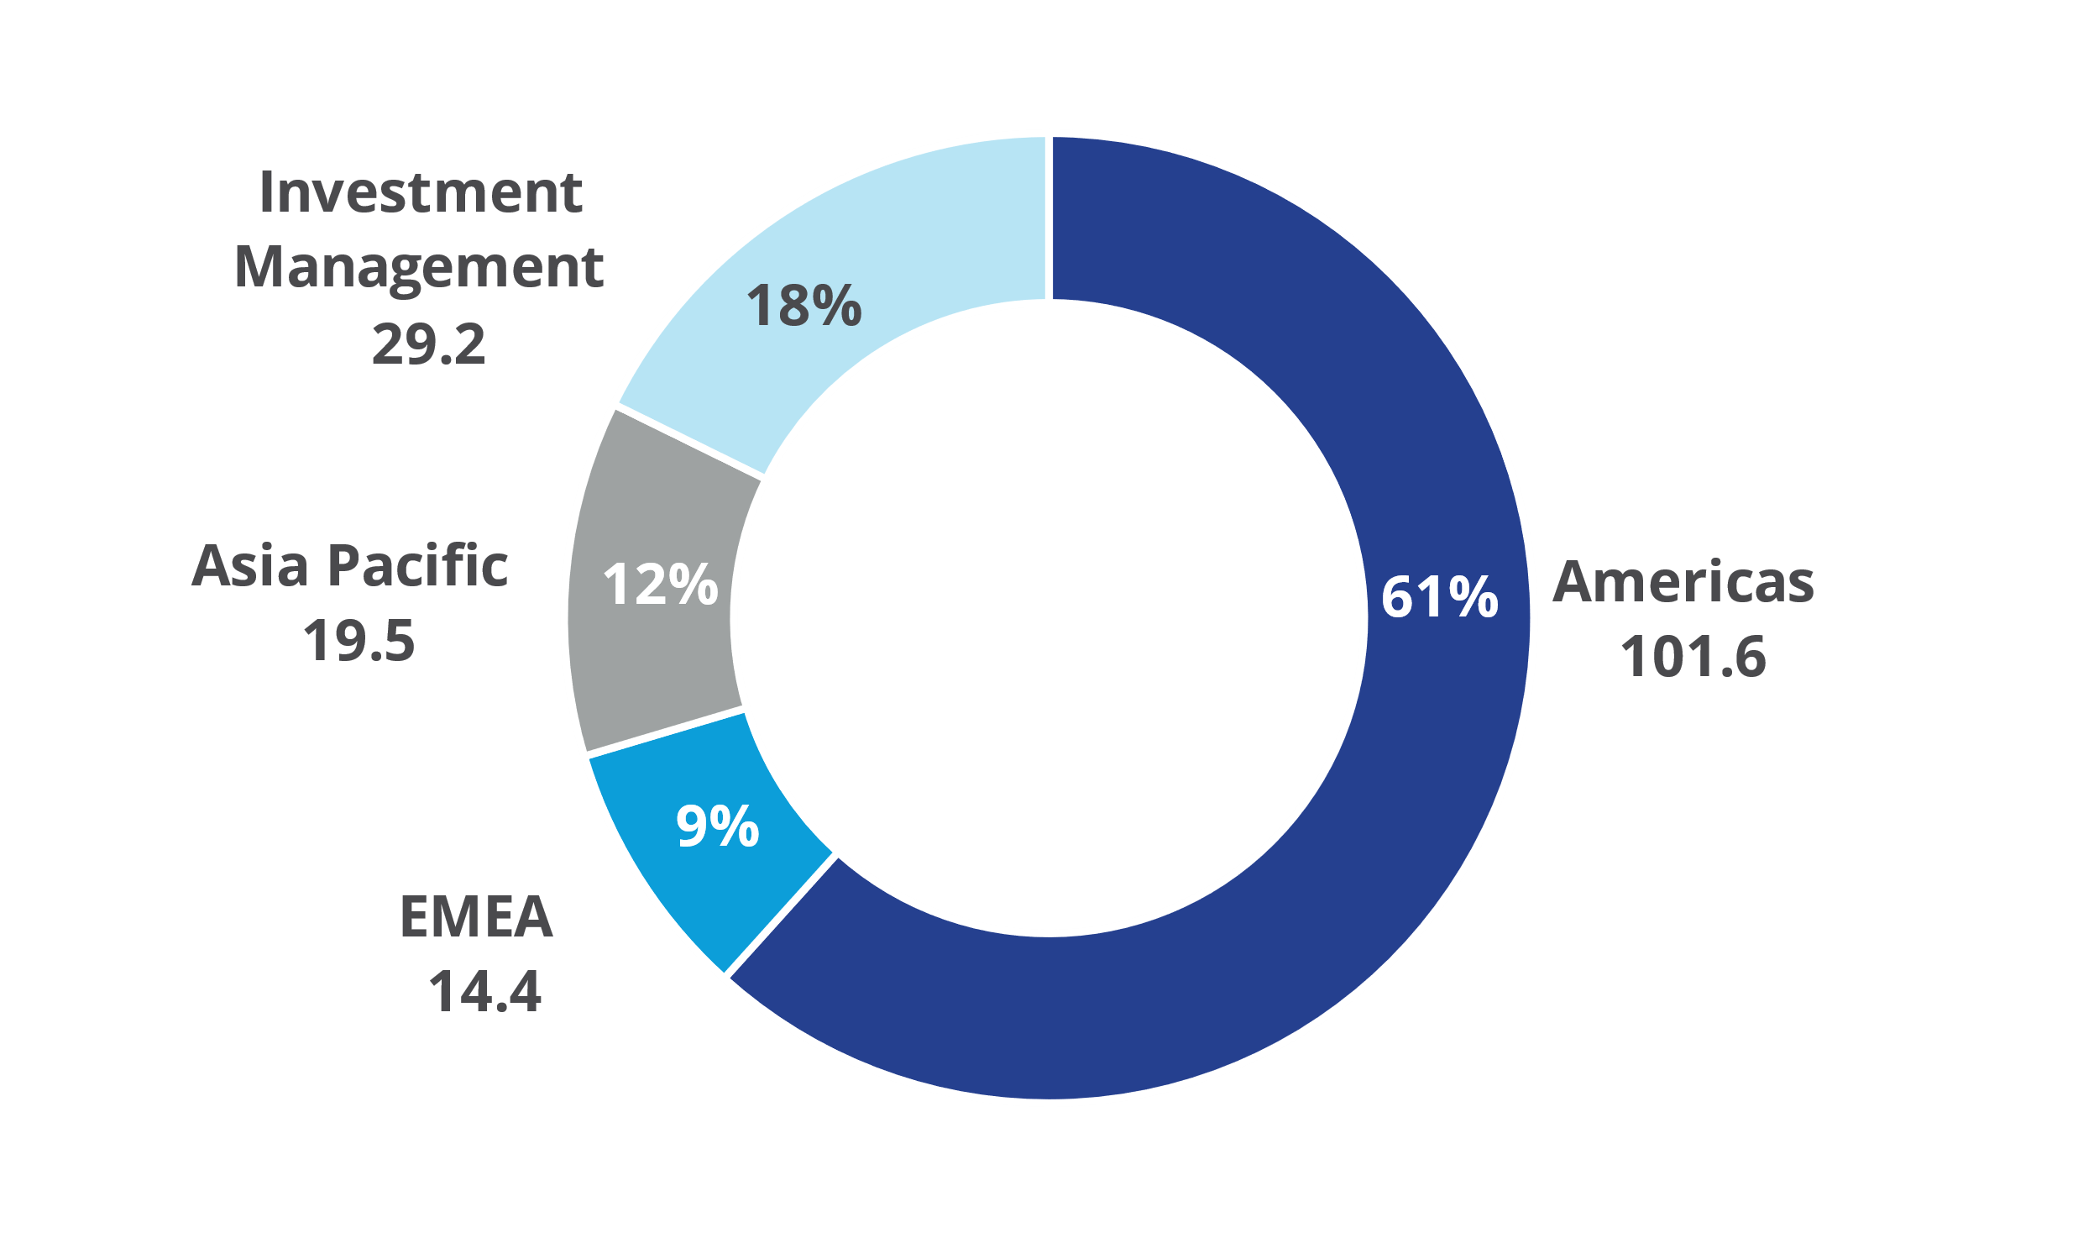
Geographic Mix
Second Quarter
(US$ millions)
Q2 2023 Revenues
Q2 2022 Revenues
Q2 2023 AEBITDA
Q2 2022 AEBITDA
(1) Q2 2023 GAAP Operating Earnings: $46.5M Americas, ($5.1M) EMEA, $19.6M Asia Pacific, $26.4M Investment Management
(2) Q2 2022 GAAP Operating Earnings: $81.1M Americas, $4.2M EMEA, $17.6M Asia Pacific, $19.2M Investment Management

Slide 7

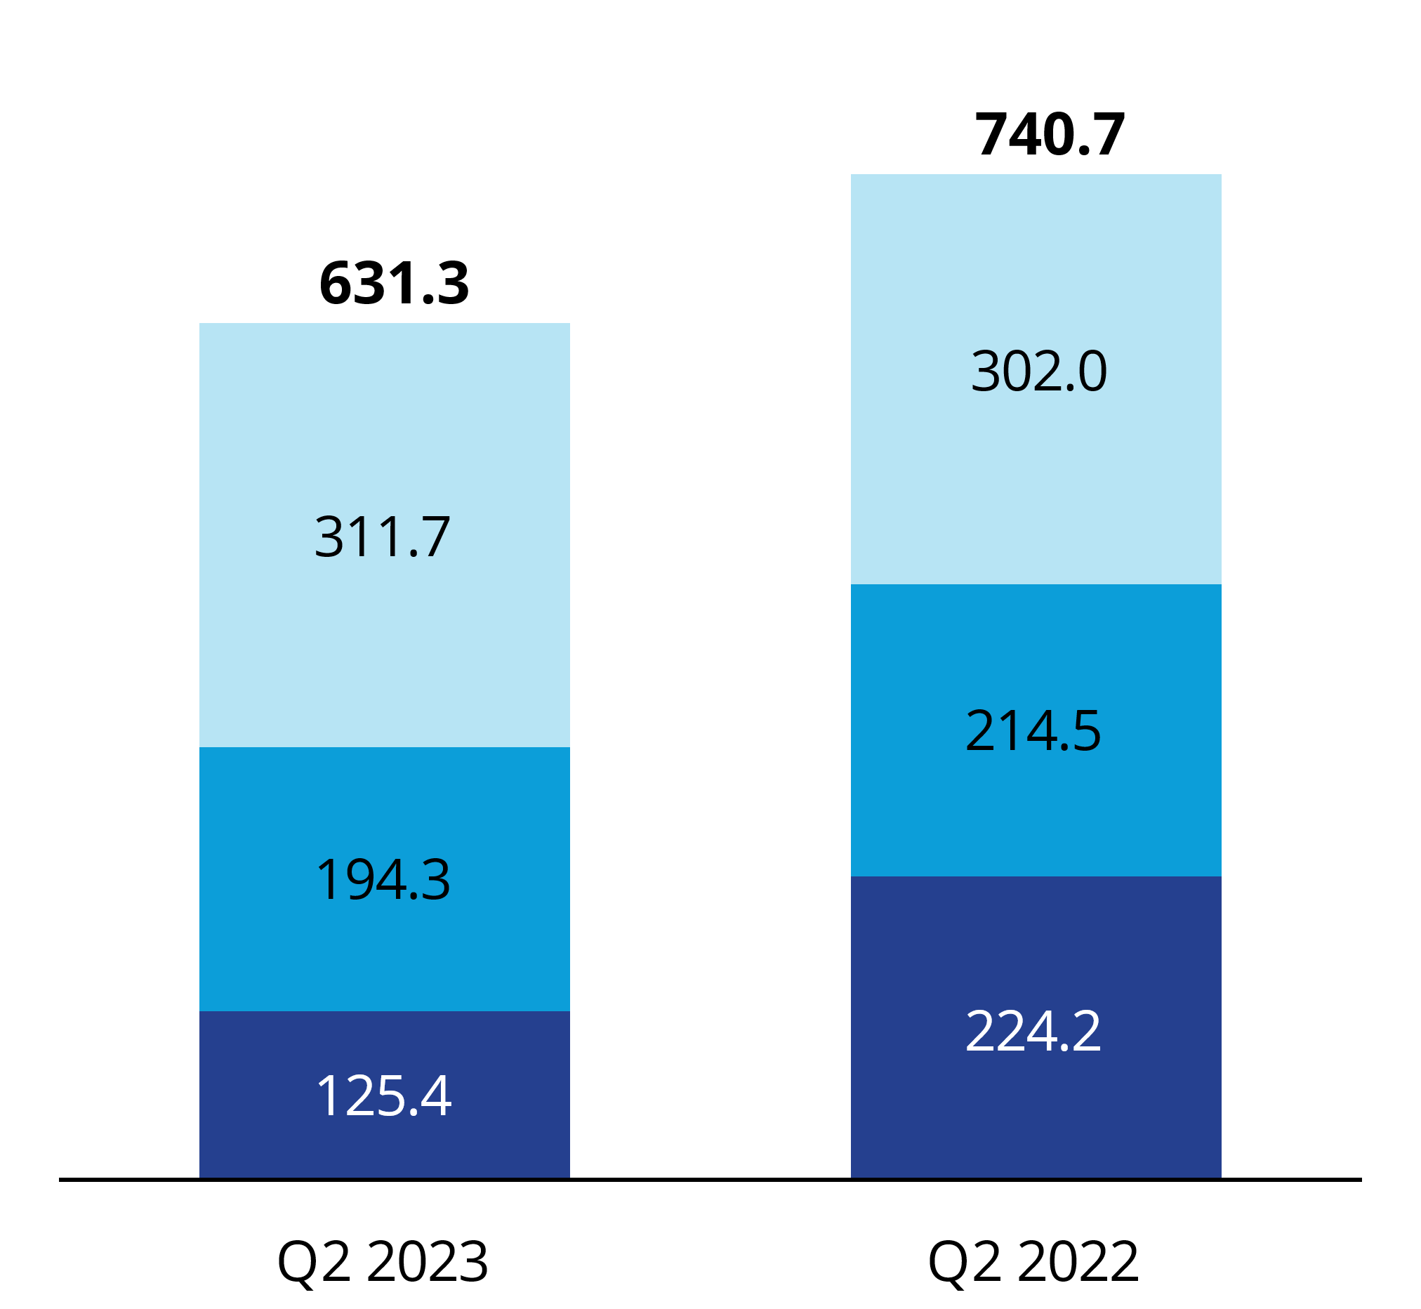
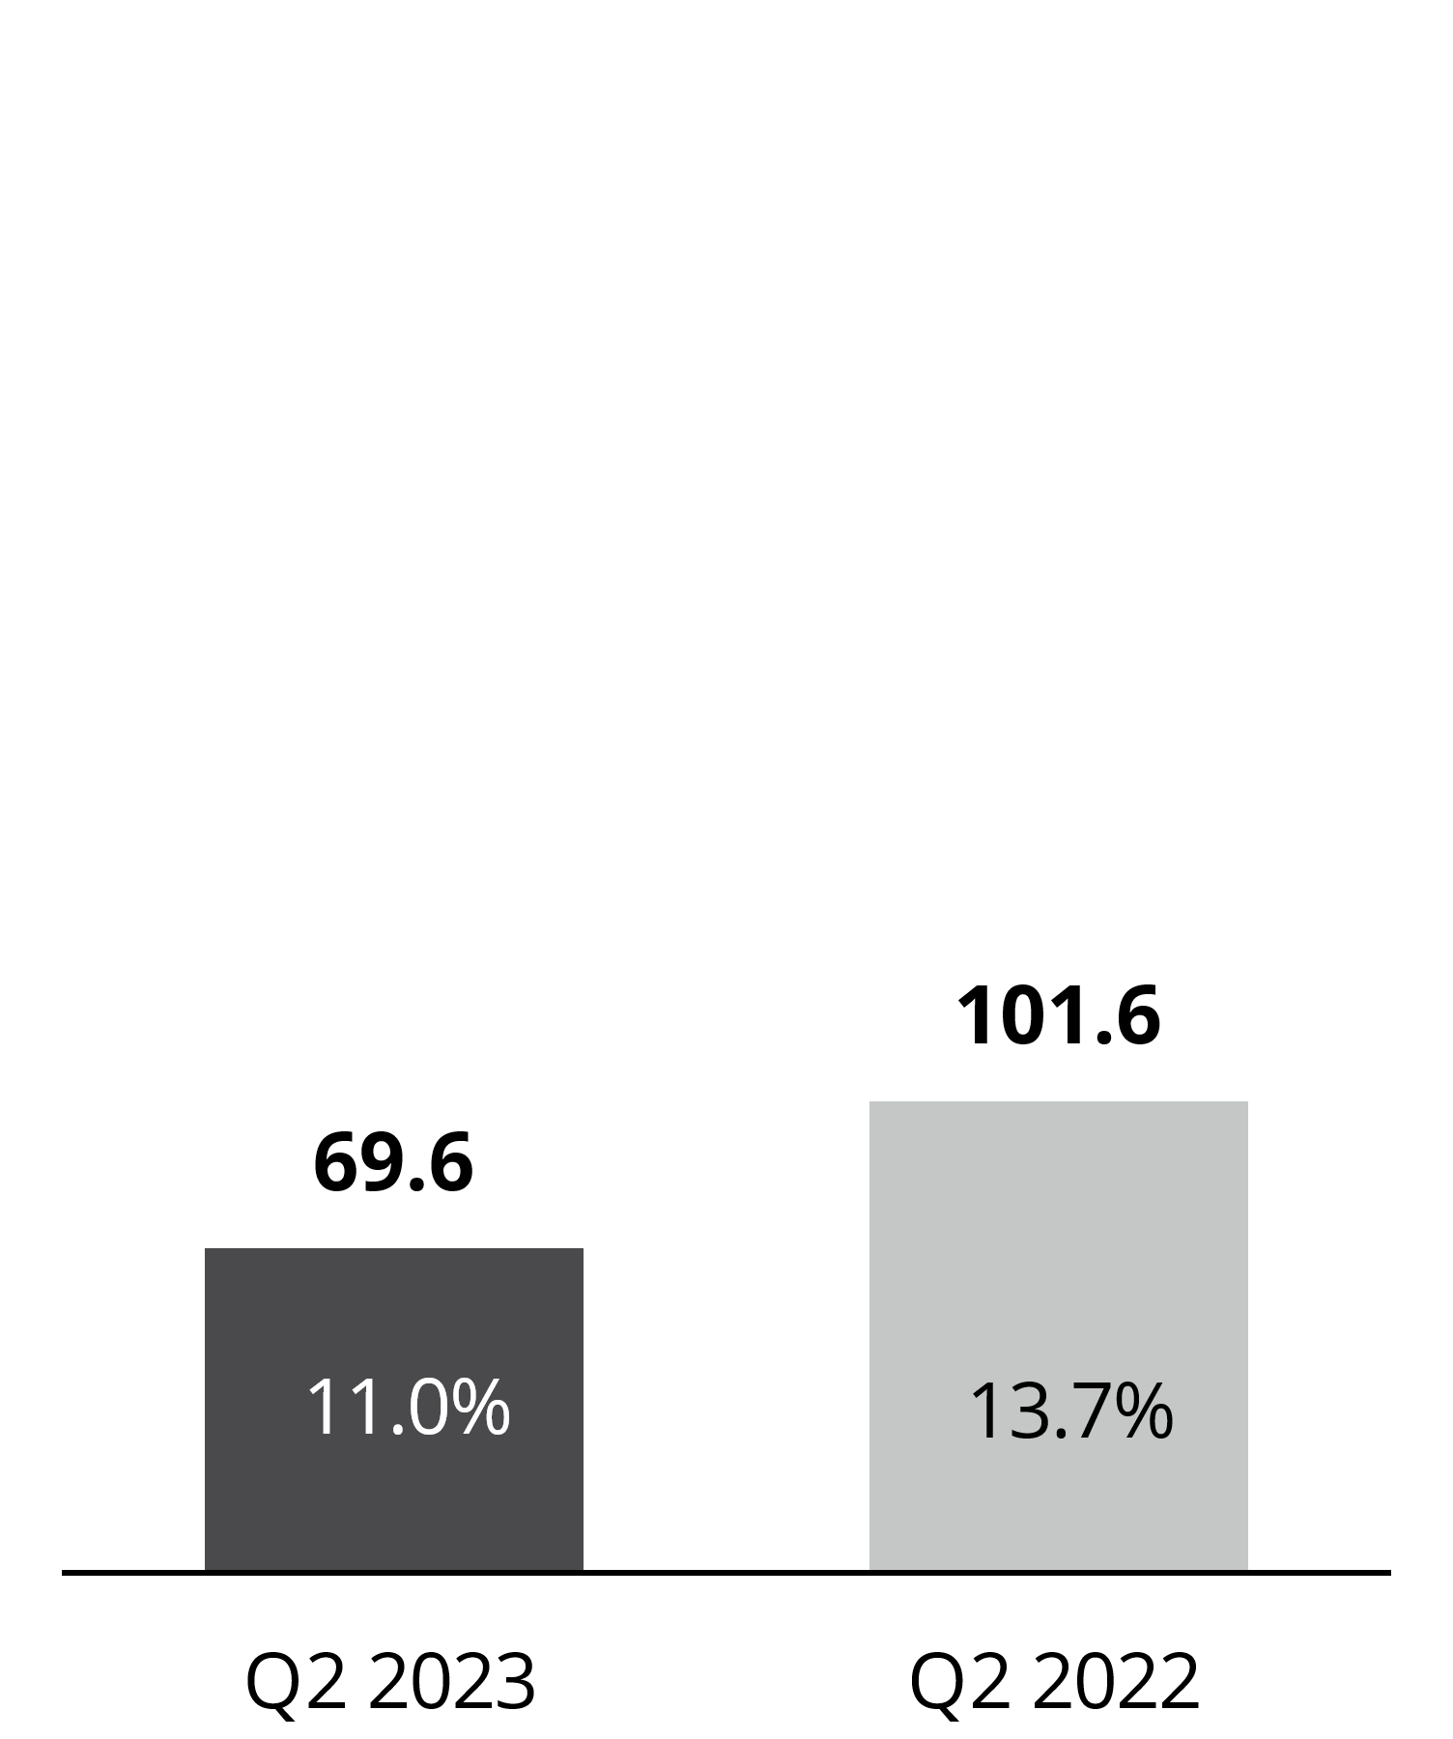
Americas
Second Quarter
(US$ millions)
Revenues
AEBITDA
        Capital Markets and, to a lesser extent, Leasing declined relative to a record prior year quarter
        Outsourcing & Advisory growth led by Engineering & Design and Project Management
        Adjusted EBITDA benefitted from cost control actions; Prior year included an $11.7 million gain on termination of a lease
Outsourcing & Advisory
Leasing
Capital Markets
GAAP Operating Earnings: Q2 2023 $46.5M at 7.4% margin; Q2 2022 $81.1M at 11.0% margin

Slide 8

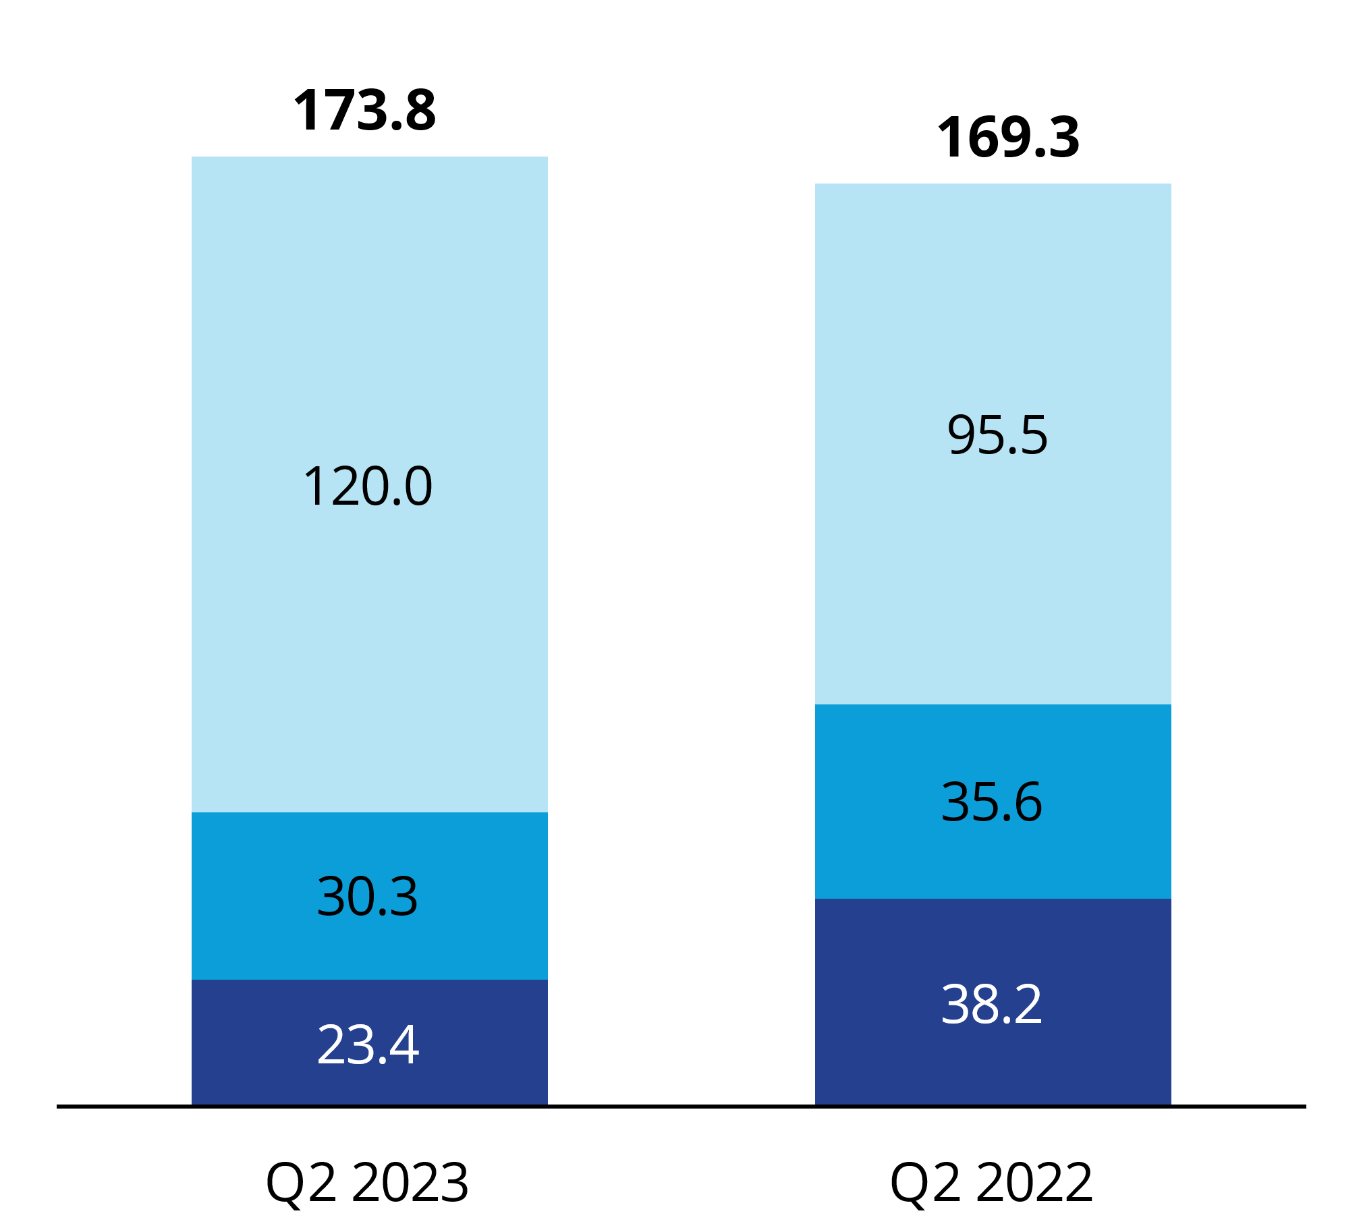

EMEA
Second Quarter
(US$ millions)
Revenues
AEBITDA
        Higher Outsourcing & Advisory (including recent acquisitions), partially offset by declines in Capital Markets and Leasing, in line with market conditions
        Adjusted EBITDA impacted by reduction in higher-margin transactional revenues
Outsourcing & Advisory
Leasing
Capital Markets
GAAP Operating Earnings: Q2 2023 ($5.1M) at (2.9%) margin; Q2 2022 $4.2M at 2.5% margin

Slide 9

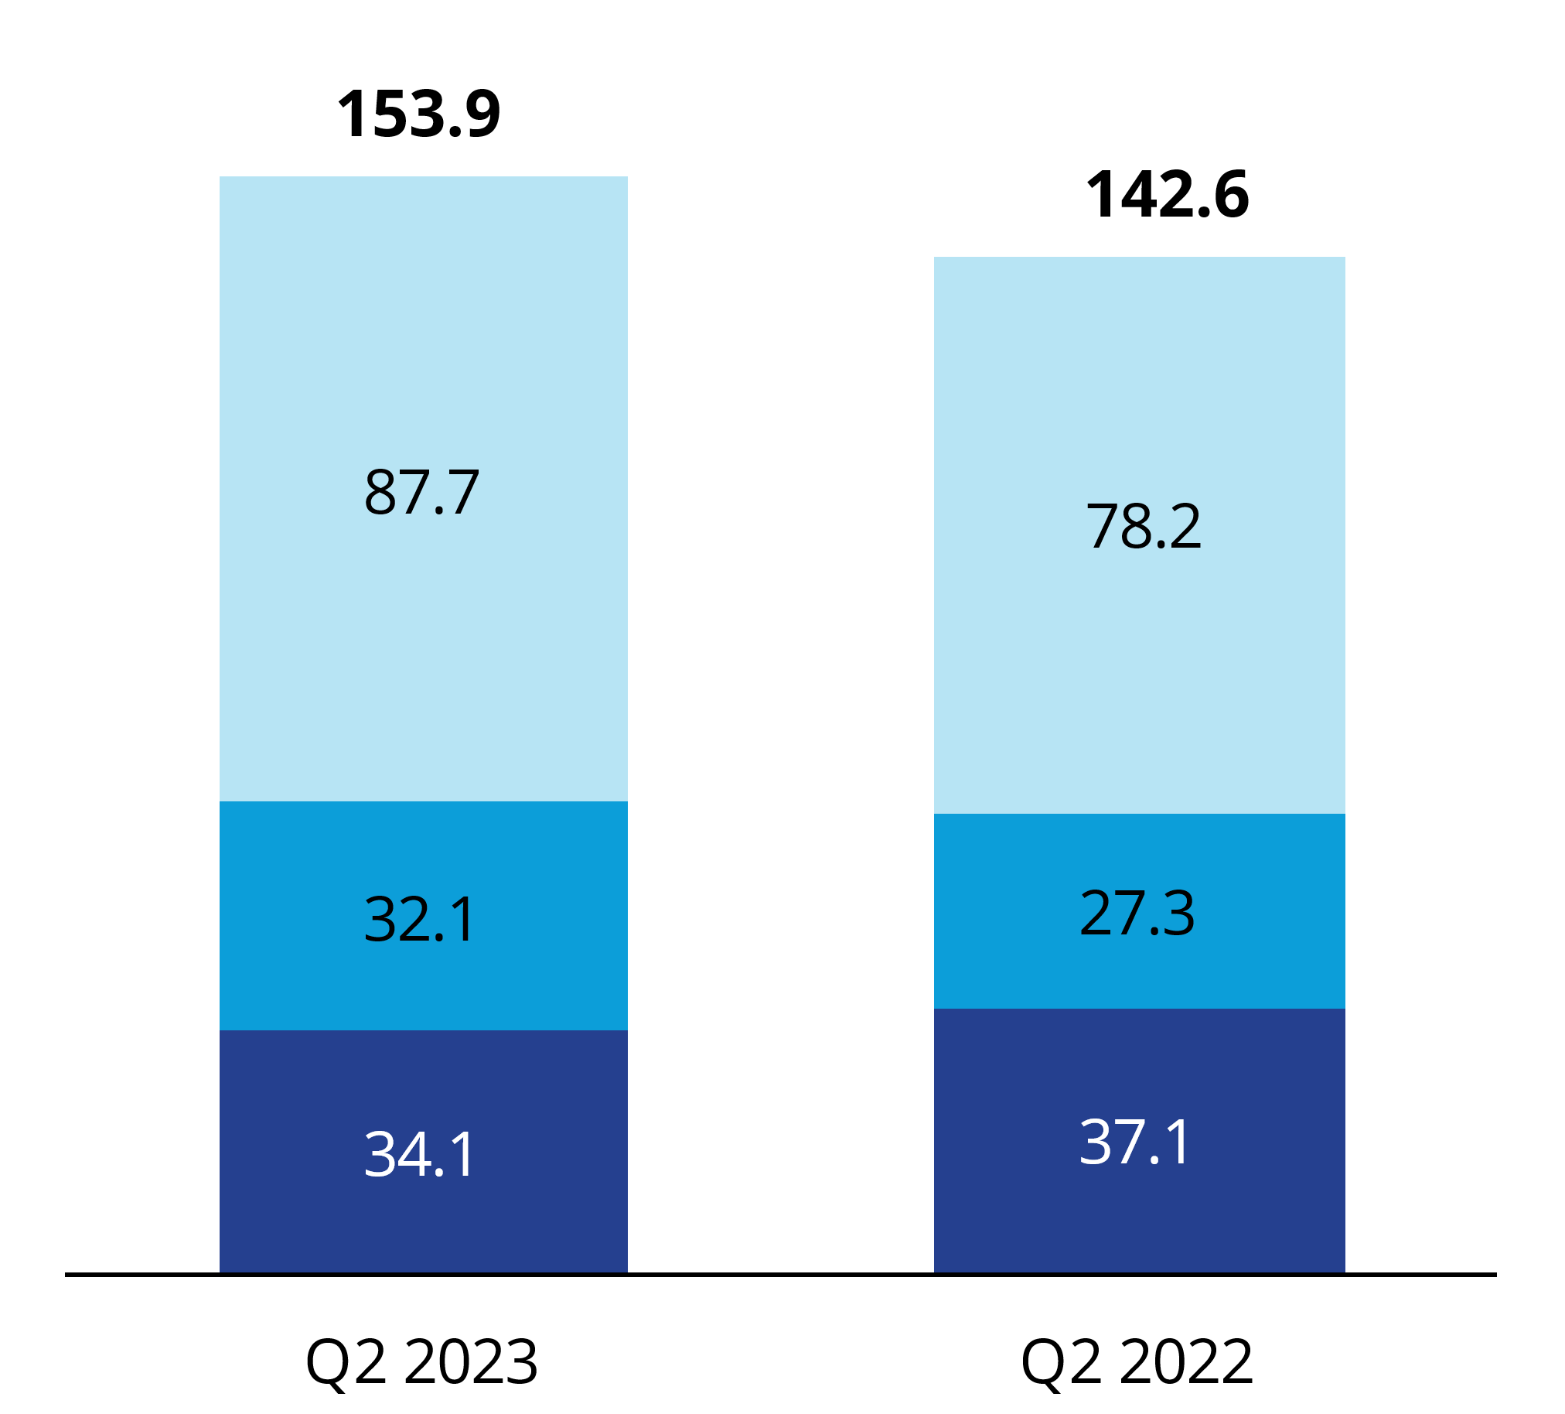
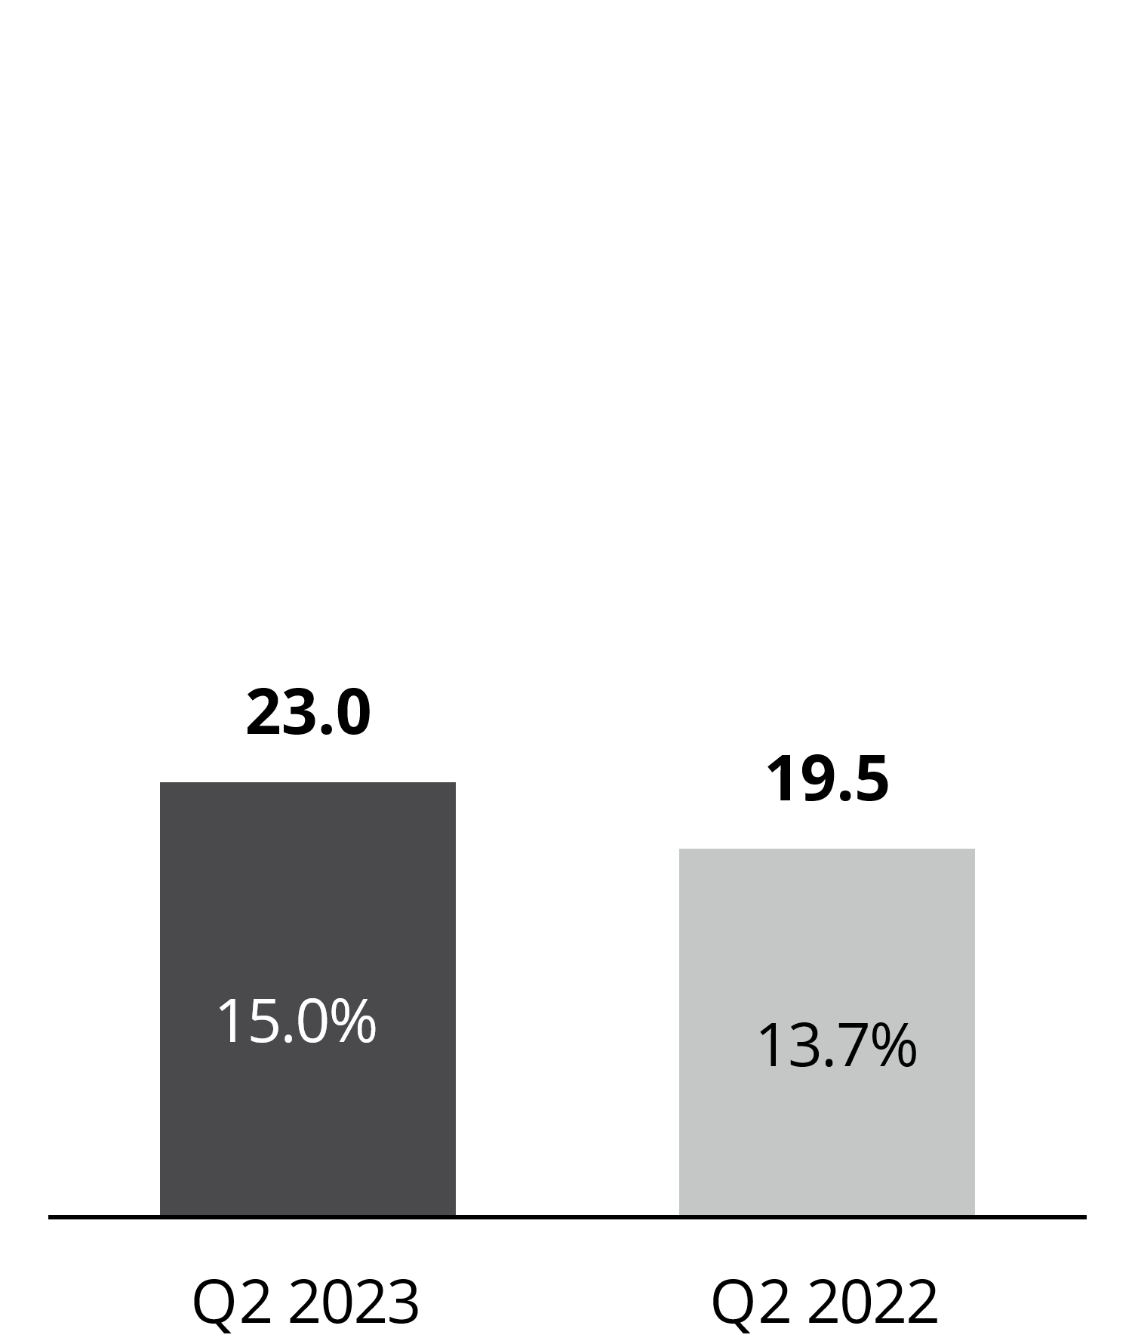
APAC
Second Quarter
(US$ millions)
Revenues
AEBITDA
        Leasing and Outsourcing & Advisory (including recent acquisitions) growth more than offset a modest decline in Capital Markets
        Foreign exchange headwinds impacted revenues by 6%
        Adjusted EBITDA favourably impacted by higher revenues and the impact of recent acquisitions
Outsourcing & Advisory
Leasing
Capital Markets
GAAP Operating Earnings: Q2 2023 $19.6M at 12.7% margin; Q2 2022 $17.6M at 12.3% margin

Slide 10
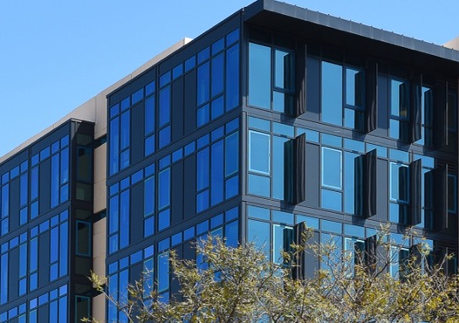
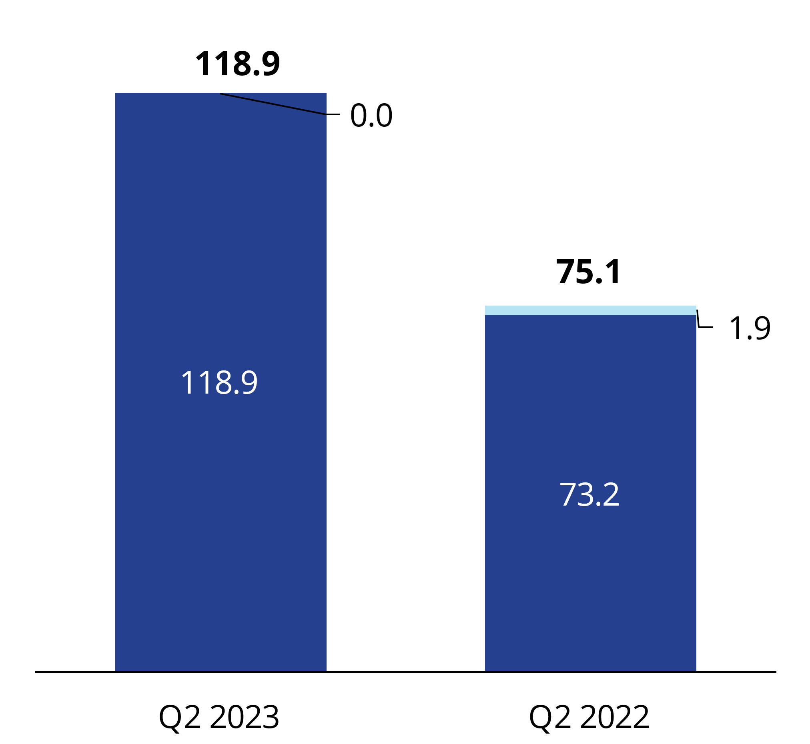
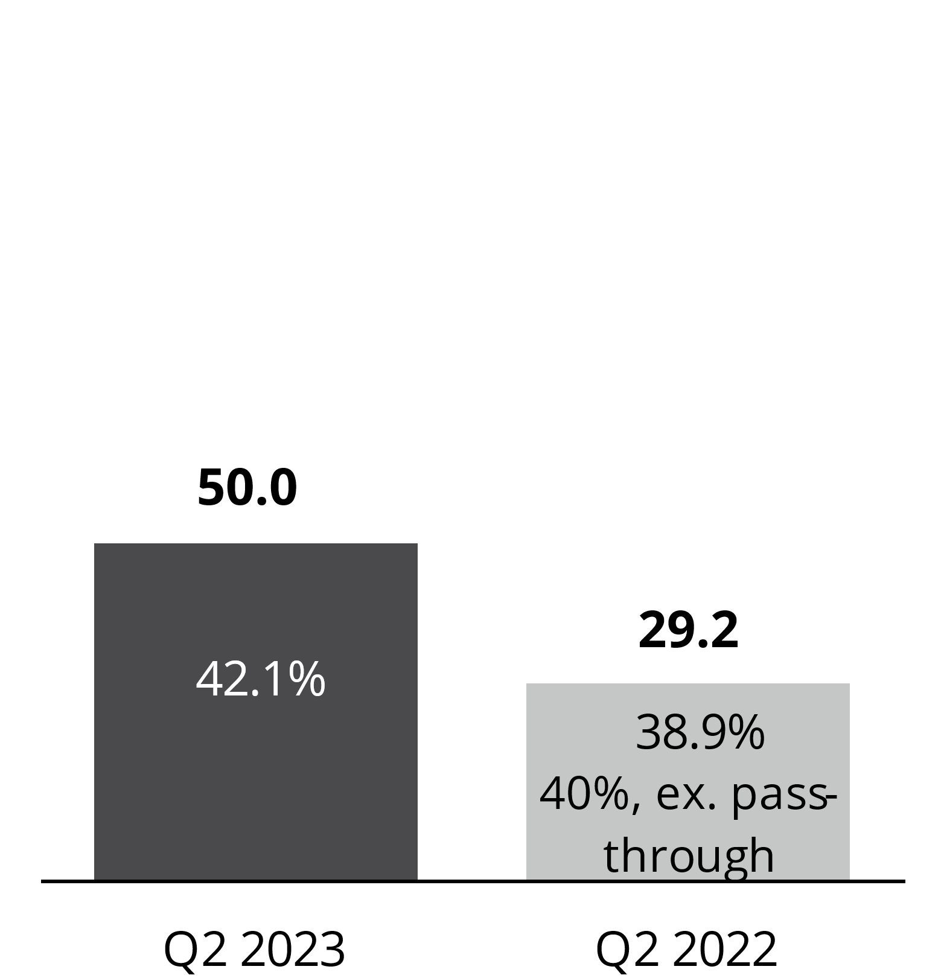
Investment Management
Second Quarter
(US$ millions)
Revenues
AEBITDA
        Growth driven by acquisitions and higher management fees from increased assets under management year over year
        $99.0 billion AUM as of June 30, 2023
        Up 1% versus March 31, 2023
        Up 44% versus June 30, 2022
Investment Management
Pass-through carried interest
GAAP Operating Earnings: Q2 2023 $26.4M at 22.2% margin; Q2 2022 $19.2M at 25.5% margin

Slide 11
Investment Management
Focus on long-duration, highly differentiated AUM
AUM: $99.0B | FPAUM: $52.3B
AUM by Asset Class
AUM by Strategy
AUM by Geography

Slide 12

Capitalization & Capital Allocation
(US$ millions)
Highlights
        Leverage ratio of 2.4x
        Early redemption of 4% convertible notes; Substantially all converted into subordinate voting shares
        55% of debt at fixed rates as of June 30, 2023
        Ample liquidity to fund acquisitions and internal growth
        Anticipating capital expenditures of $90-$100 million in 2023
(1) Net debt for financial leverage ratio excludes restricted cash, warehouse credit facilities and convertible notes, in accordance with debt agreements
(2) Includes business acquisitions, contingent acquisition consideration and purchases of non-controlling interests in subsidiaries

Slide 13


Outlook for 2023
(US$ millions)
Maintaining outlook previously provided in May 2023
Lower Capital Markets and Leasing transaction volumes to persist for the remainder of the year
Robust growth (including the impact of recent acquisitions) in high value recurring service lines
Measure | 2022 | Outlook for 2023
Revenue | $4.5 billion | $4.4 billion - $4.6 billion
Adjusted EBITDA | $630.5 million | $670 million - $720 million
Adjusted EPS | $6.99 | $6.70 - $7.50
The financial outlook is based on the Company’s best available information as of the date of this presentation, and remains subject to change based on, but not limited to, numerous macroeconomic, health, social, geopolitical (including escalation of hostilities, outbreak of war, elections, disruption of supply chains) and related factors.

Slide 14

Appendix
Reconciliation of non-GAAP measures

Slide 15
Reconciliation of GAAP earnings to adjusted EBITDA

Slide 16
Reconciliation of GAAP earnings to adjusted
net earnings and adjusted earnings per share
Adjusted EPS is calculated using the “if-converted” method of calculating earnings per share in relation to the Convertible Notes, which were issued on May 19, 2020 and fully converted or redeemed by June 1, 2023

Slide 17
Reconciliation of net cash flow from operations to free cash flow

Slide 18
Other Non-GAAP Measures
Local currency revenue growth rate
and internal revenue growth rate measures
Percentage revenue and AEBITDA variances presented on a local currency basis are calculated by translating the current period results of our non-US dollar denominated operations to US dollars using the foreign currency exchange rates from the periods against which the current period results are being compared. Percentage revenue variances presented on an internal growth basis are calculated assuming no impact from acquired entities in the current and prior periods. Revenue from acquired entities, including any foreign exchange impacts, are treated as acquisition growth until the respective anniversaries of the acquisitions. We believe that these revenue growth rate methodologies provide a framework for assessing the Company’s performance and operations excluding the effects of foreign currency exchange rate fluctuations and acquisitions. Since these revenue growth rate measures are not calculated under GAAP, they may not be comparable to similar measures used by other issuers.
Assets under management
We use the term assets under management (“AUM”) as a measure of the scale of our Investment Management operations. AUM is defined as the gross market value of operating assets and the projected gross cost of development assets of the funds, partnerships and accounts to which we provide management and advisory services, including capital that such funds, partnerships and accounts have the right to call from investors pursuant to capital commitments. Our definition of AUM may differ from those used by other issuers and as such may not be directly comparable to similar measures used by other issuers.
Fee paying assets under management
We use the term fee paying assets under management (“FPAUM”) to represent only the AUM on which the Company is entitled to receive management fees. We believe this measure is useful in providing additional insight into the capital base upon which the Company earns management fees. Our definition of FPAUM may differ from those used by other issuers and as such may not be directly comparable to similar measures used by other issuers.
Recurring revenue percentage
Recurring revenue percentage is computed on a trailing twelve-month basis and represents the proportion that is derived from Outsourcing & Advisory and Investment Management service lines. Both these service lines represent medium to long-term duration revenue streams that are either contractual or repeatable in nature. Revenue for this purpose incorporates the expected full year impact of acquisitions and dispositions.
Adjusted EBITDA from recurring revenue percentage
Adjusted EBITDA from recurring revenue percentage is computed on a trailing twelve-month basis and represents the proportion of adjusted EBITDA that is derived from Outsourcing & Advisory and Investment Management service lines. Both these service lines represent medium to long-term duration revenue streams that are either contractual or repeatable in nature. Adjusted EBITDA for this purpose is calculated in the same manner as calculated for our debt agreement covenant calculation purposes, incorporating the expected full year impact of business acquisitions and dispositions.

