Slide 1

2Q20 Results Conference Call
Investor Presentation

Slide 2
SAFE-HARBOR STATEMENT
Broadwind obtained the industry and market data used throughout this presentation from our own research, internal surveys and studies conducted by third parties, independent industry associations or general publications and other publicly available information. Independent industry publications and surveys generally state that they have obtained information from sources believed to be reliable, but do not guarantee the accuracy or completeness of such information. Forecasts are particularly likely to be inaccurate, especially over long periods of time. We are not aware of any misstatements in the industry data we have presented herein, but estimates involve risks and uncertainties and are subject to change based on various factors beyond our control.
Our forward-looking statements may include or relate to our beliefs, expectations, plans and/or assumptions with respect to the following, many of which are, and will be, amplified by the COVID-19 pandemic: (i) the impact of global health concerns, including the impact of the current COVID-19 pandemic on the economies and financial markets and the demand for our products; (ii) state, local and federal regulatory frameworks affecting the industries in which we compete, including the wind energy industry, and the related extension, continuation or renewal of federal tax incentives and grants and state renewable portfolio standards as well as new or continuing tariffs on steel or other products imported into the United States; (iii) our customer relationships and our substantial dependency on a few significant customers and our efforts to diversify our customer base and sector focus and leverage relationships across business units; (iv) the economic and operational stability of our significant customers and suppliers, including their respective supply chains, and the ability to source alternative suppliers as necessary, in light of the COVID-19 pandemic; (v) our ability to continue to grow our business organically and through acquisitions, and the impairment thereto by the impact of the COVID-19 pandemic; (vi) the production, sales, collections, customer deposits and revenues generated by new customer orders and our ability to realize the resulting cash flows; (vii) information technology failures, network disruptions, cybersecurity attacks or breaches in data security, including with respect to any remote work arrangements implemented in response to the COVID-19 pandemic; (viii) the sufficiency of our liquidity and alternate sources of funding, if necessary; (ix) our ability to realize revenue from customer orders and backlog; (x) our ability to operate our business efficiently, comply with our debt obligations, manage capital expenditures and costs effectively, and generate cash flow; (xi) the economy, including its stability in light of the COVID-19 pandemic, and the potential impact it may have on our business, including our customers; (xii) the state of the wind energy market and other energy and industrial markets generally and the impact of competition and economic volatility in those markets; (xiii) the effects of market disruptions and regular market volatility, including fluctuations in the price of oil, gas and other commodities; (xiv) competition from new or existing industry participants including, in particular, increased competition from foreign tower manufacturers; (xv) the effects of the change of administrations in the U.S. federal government; (xvi) our ability to successfully integrate and operate acquired companies and to identify, negotiate and execute future acquisitions; (xvii) the potential loss of tax benefits if we experience an “ownership change” under Section 382 of the Internal Revenue Code of 1986, as amended; (xviii) our ability to utilize various relief options enabled by the Coronavirus Aid, Relief and Economic Security Act (CARES Act), including our ability to receive forgiveness of the PPP Loans; (xix) the limited trading market for our securities and the volatility of market price for our securities; and (xx) the impact of future sales of our common stock or securities convertible into our common stock on our stock price. These statements are based on information currently available to us and are subject to various risks, uncertainties and other factors that could cause our actual growth, results of operations, financial condition, cash flows, performance, business prospects and opportunities to differ materially from those expressed in, or implied by, these statements including, but not limited to, those set forth under the caption “Risk Factors” in Part I, Item 1A of our Annual Report on Form 10-K for the year ended December 31, 2019, as supplemented by our Current Report on Form 8-K filed April 17, 2020 . We are under no duty to update any of these statements. You should not consider any list of such factors to be an exhaustive statement of all of the risks, uncertainties or other factors that could cause our current beliefs, expectations, plans and/or assumptions to change. Accordingly, forward-looking statements should not be relied upon as a predictor of actual results.
.
This presentation contains non-GAAP financial information. We believe that certain non-GAAP financial measures may provide users of this financial information with meaningful comparisons between current results and results in prior operating periods. We believe that these non-GAAP financial measures can provide additional meaningful reflection of underlying trends of the business because they provide a comparison of historical information that excludes certain infrequently occurring or non-operational items that impact the overall comparability. Non-GAAP financial measures should be viewed in addition to, and not as an alternative to, our reported results prepared in accordance with GAAP. Please see our earnings release dated August 5, 2020 for a reconciliation of certain non-GAAP measures presented in this presentation.

Slide 3
PERFORMANCE
OVERVIEW

Slide 4
2Q20 EXECUTIVE SUMMARY
1. Net Income increased $1.5 million y/y to $0.5 million
Earnings per share of $0.03 in 2Q20 vs. ($0.06) in 2Q19, second consecutive profitable quarter
2. Total Revenue +33% y/y to $54.9 million: Improved demand from wind, industrial and natural gas turbine markets
Wind market sales increased by more than $11.0 million on a y/y basis; wind tower sections sold up ~60% y/y to highest level since 1Q17
3. Continued Margin Expansion: Gross Margin +40 bps y/y; Operating Margin +240 bps y/y
Benefit from improved plant utilization and operating efficiencies
4. Total Adjusted EBITDA +$1.0 million y/y to $2.9 million
TTM Adjusted EBITDA of $10.1 million vs. $2.1 million in prior-year TTM period
5. Total backlog (12%) sequentially: Timing of customer orders delayed by COVID-19
O&G Customers delaying scheduled deliveries, Wind Tower deliveries on track
6. Total orders +17% sequentially: Strength in Heavy Fabrications offset softness in Gearing
90% of FY20 optimal Tower capacity booked, discussing 2021 production with multiple customers
Cyclical end markets down since COVID-19

Slide 5
2Q20 EXECUTIVE SUMMARY (Continued)
7. Heavy Fabrications revenue +50% y/y: Acceleration in tower sections demand and diversification progress
Tower plants operating near 100% of optimal production capacity
~$6M of Industrial Fabrication revenue in 2Q20; delivering against our long-term diversification strategy
8. Gearing revenue (25%) y/y: COVID-19 impacted customer capex and project timing
Broad-based softness due to pause in customer orders and weakness in OG markets
Cost structure actions being taken; deferring capital investments
9. Industrial Solutions revenue +50% y/y: Growth through diversification
Improved y/y growth due to strong demand from the natural gas turbine market
10. Total cash and availability of $22 million as of 6/30/20; up nearly $14 million y/y
Continued focus on disciplined working capital management
11. Anticipate y/y growth in Revenue, Net Income and Adjusted EBITDA in the Full-Year 2020
Given current market uncertainty, not providing detailed financial guidance at this time, but expect 2H to resemble 1H

Slide 6
KEY FINANCIAL DATA
Y/Y Growth In Revenue, Gross Profit, Adjusted EBITDA and EPS
Sustained Profitability
Total Revenue
($MM)
Gross Profit
($MM)
Second consecutive quarter of profitability; Generated net income of $0.5 MM or $0.03 per share in 2Q20
Positive Margin Trend
Y/Y expansion in gross margin, operating margin and Adj EBITDA margin
Adjusted EBITDA
($MM)
Earnings Per Share
Diversification Continues
Increased demand from the wind tower, industrials, steel and natural gas turbine markets

Slide 7
HEAVY FABRICATIONS SEGMENT
Approximately 90% of Full-Year 2020 Optimal Tower Production Capacity in Backlog
Strong Visibility
Revenue
($MM)
Adjusted EBITDA
($MM)
2020 Tower production is secured, pursuing orders for 2021 production
Revenue Growth
Heavy Fabrications revenue +50% y/y in 2Q20 due to strong Wind Tower and Industrial Fabrication demand
Orders
($MM)
Backlog
($MM)
Improved Margin Capture
Adj. EBITDA margin increased 450 bps y/y to 9.6% in 2Q20
Orders/Backlog
6/30/19
3/31/20
6/30/20
Combination of pre-ordering in 1H19 and COVID-19 impact resulted in y/y decline in orders and backlog

Slide 8
HEAVY FABRICATIONS SEGMENT
Demand For Tower Sections
Total Tower Sections Sold
(Number of Sections)
+66% y/y
+59% y/y
+372% y/y
+84% y/y
Note: In December 2019, the United States production tax credit for renewable wind projects was extended for one-year, pursuant to a year-end 2019 appropriations bill, from January 1, 2020 to January 1, 2021. As a result of the new legislation, the PTC will subsidize wind projects commenced as late as 2020 and completed by 2024, or later, if continuous construction can be demonstrated.

Slide 9
GEARING SEGMENT
COVID-19 Impacted Timing of Customer Project Spend and New Orders
COVID-19 Negative Impacts
Revenue
($MM)
Adjusted EBITDA
($MM)
Shift in focus to industrial and steel markets did not offset Oil/Gas and mining weakness
Customers delayed nearly $2MM of deliveries into 2H ‘20
Orders
($MM)
Backlog
($MM)
Backlog Stable
End-market diversification has translated into minimal y/y decline in backlog, despite softness in Oil/Gas markets
6/30/19
3/31/20
6/30/20

Slide 10
INDUSTRIAL SOLUTIONS SEGMENT
Natural Gas Turbine Market Driving Revenue Growth
Positive KPI Trend
Revenue
($MM)
Adjusted EBITDA
($MM)
Y/Y improvement in 2Q20 and TTM Revenue, Adjusted EBITDA
Strong Order Growth
Natural gas turbine orders up more than 60% y/y in 2Q20
Backlog +38% y/y, supported by demand for natural gas turbine components
Orders
($MM)
Backlog
($MM)
Realization of Efficiencies
Cost reduction efforts over the past year have contributed to improved margin realization
6/30/19
3/31/20
6/30/20

Slide 11
BALANCE SHEET UPDATE
Improved Operational Performance / Working Capital Initiatives Bolstering Liquidity
Operating Working Capital as a % of Sales(1)
6/30/18
9/30/18
12/31/18
3/31/19
6/30/19
9/30/19
12/31/19
3/31/20
6/30/20
Total Cash and Availability on Credit Facility
($MM)
6/30/18
9/30/18
12/31/18
3/31/19
6/30/19
9/30/19
12/31/19
3/31/20
6/30/20
(1) Operating working capital divided by T3M annualized sales

Slide 12
MANAGEMENT OUTLOOK

Slide 13
COVID-19 BUSINESS RESPONSE
We Continue to Monitor the Potential Impact of the Pandemic on our Business
Employee Health & Safety
Liquidity Profile
Business Continuity
We are closely monitoring the potential impact of the novel coronavirus (COVID-19) on our operations, customers and supply chain
We have adopted all necessary and appropriate virus prevention protocols consistent with the recommendations provided by the U.S. Centers for Disease Control and Prevention
The Company remains in full compliance with all debt covenants
The Company received a Paycheck Protection Program loan in April; planning to submit forgiveness application in 3Q20
This loan was necessary to protect our employees and business due to the uncertainty of the impact to our workforce, maintain production at our plants, customer demand and global supply chain response
Our business is considered critical and essential infrastructure by the U.S. Department of Homeland Security
All facilities are considered essential businesses; are currently open and operating
Order rates have declined since the COVID-19 outbreak

Slide 14






DEMAND OUTLOOK BY END-MARKET
Customer Guidance Drives Our Outlook
Wind Sector
Industrial/Other Sector
Power Generation Sector
TTM Revenue
  8%
Sector Outlook
  Positive
Customer Feedback
  Primary customer regaining share in the near term
TTM Revenue
  69%
Sector Outlook
  Positive
Customer Feedback
  Near to medium term strength
  Tax equity financing challenges + project delays due to COVID-19
TTM Revenue
  8%
Sector Outlook
  Positive/Neutral
Customer Feedback
  Manitowoc deep-water port and manufacturing competencies are strategic advantages
  Focused on Material Handling
Mining Sector
Oil & Gas Sector
Construction Sector
TTM Revenue
  9%
Sector Outlook
  Neutral
Customer Feedback
  Strong Q1 orders, weakened in Q2
TTM Revenue
  5%
Sector Outlook
  Negative
Customer Feedback
  Customers deferring purchases
  Frac fleets / North America capex declining rapidly
TTM Revenue
  1%
Sector Outlook
  Negative
Customer Feedback
  Infrastructure bill would be meaningful

Slide 15
U.S. WIND SECTOR FORECAST
Onshore Ramp Occurring; Offshore Ramp Accelerating 2023-2025
Onshore Update
U.S. Wind Power Onshore and Offshore Capacity Installations
(Annual On-Shore GW Installed)(1)
PTC extension expected to drive strong demand in 2021
Federal guidance giving an extra year to bring projects online without jeopardizing tax credits(1)
15.0
14.0
10.3
9.8
8.0
7.8
8.6
8.7
8.8
Offshore Update
6.9
7.6
6.2
COVID-19 is compounding federal permit delays, pushing ~1 GW of offshore wind from 2023 into 2024-25; states continue to plan solicitations, leading to an overall upgrade through 2029
Source: Wood MacKenzie 2Q20 Wind Sector Outlook; wind values include new build and repowering
On May 27, 2020, the Internal Revenue Service issued Notice 2020-41, providing taxpayers with relief for purposes of satisfying the beginning-of-construction requirement for qualifying production tax credit (PTC) and investment tax credit (ITC) projects, including wind and solar projects. Specifically, the IRS notice provides (1) a one-year extension to the Continuity Safe Harbor for projects that began construction in 2016 or 2017, and (2) a new safe harbor for satisfying the 3-1/2 Month Rule for property or services purchased after Sept. 15, 2019, and received by the taxpayer no later than Oct. 15, 2020.

Slide 16
KEY INITIATIVES BY SEGMENT
Positioned For Profitable Growth
Heavy Fabrications Segment
Continued growth in both wind and non-wind
markets
  Sell ’21 tower capacity and expand tower and repowering customer base
  Add production capabilities and complete key systems upgrades to maximize profitability
  Move forward with assessment of offshore wind market opportunities
  Expand Industrial Fabrication product line customer base
  Leverage strengthened engineering and supply chain organization to support evolving tower market
  Take continuous improvement actions to ensure "zero defect" quality ratings
Gearing Segment
Focused on Gearbox market share growth, increase weighting in less cyclical end-markets
  Accelerate end-market diversification beyond oil/gas gearing market
  Strengthen engineering and sales resources
  Grow custom gearbox business; expand repair business geographically
  Leverage recently completed systems initiatives to maximize profitability
  Continue core focus on gas turbine market, while expanding customer base
  Pursue clean tech growth opportunities
  Leverage BWEN engineering and business development resources
Industrial Solutions Segment
Heavily focused on revenue diversification within gas turbines and growth in clean tech

Slide 17
INVESTMENT THESIS
Diversified Precision Manufacturer Serving Clean Tech and Industrial Applications
1. Leading precision manufacturer with a diversified industry focus
Heritage is in the renewable sector (e.g., Wind); future includes mining, oil/gas, power gen, material handling, construction and industrial
2. Multi-year revenue diversification initiative gaining momentum
Annual revenue outside the wind sector is $65 million, customer concentration improving
Plant utilization dramatically improving; non-wind revenue has increased by nearly 3x since 2016
3. Extension of PTC and recent trade case findings provide major catalyst for Heavy Fabrications
Demand for renewable energy driven by government incentives and corporate ESG initiatives
4. Clean tech play positioned for profitable growth
Base wind business remains strong; off-shore wind remains a key growth opportunity
5. Liquidity profile improving; Total cash and availability of $22 million as of 6/30/20
Supportive of customer and end market diversification strategy; opportunistic acquisitions and organic growth investments

Slide 18
APPENDIX

Slide 19
EXHIBIT A
Orders, Revenues and Operating Income (Loss) By Segment

Slide 20
EXHIBIT B
GAAP to Non-GAAP Consolidated Adjusted EBITDA Reconciliation

Slide 21
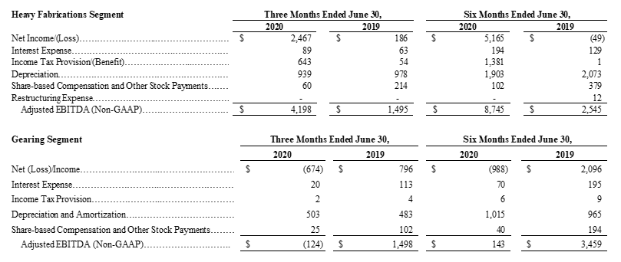
EXHIBIT C
GAAP to Non-GAAP Adjusted EBITDA Reconciliation By Segment

Slide 22
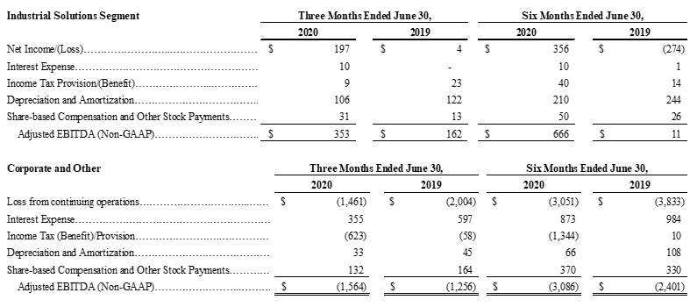
EXHIBIT C (Continued)
GAAP to Non-GAAP Adjusted EBITDA Reconciliation By Segment

Slide 23
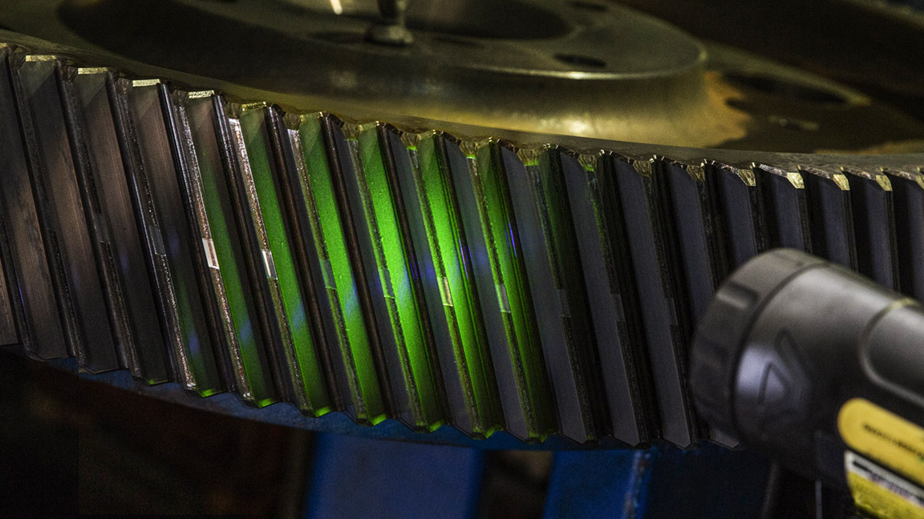
IR CONTACT
Please contact our investor relations team at Investor@BWEN.com

