Slide 1
FORGING COMMERCIAL & CLINICAL PATHWAYS
TARGETING INFECTIOUS DISEASES WITH ORAL IMMUNOTHERAPIES – JUNE 2019
GARY S. JACOB, Ph.D.
CEO
NASDAQ: IMRN ASX: IMC

Slide 2
SAFE HARBOR STATEMENT
Certain statements made in this presentation are forward-looking statements and are based on Immuron’s current expectations, estimates and projections. Words such as “anticipates,” “expects,” “intends,” “plans,” “believes,” “seeks,” “estimates,” “guidance” and similar expressions are intended to identify forward-looking statements.
Although Immuron believes the forward-looking statements are based on reasonable assumptions, they are subject to certain risks and uncertainties, some of which are beyond Immuron’s control, including those risks or uncertainties inherent in the process of both developing and commercializing technology. As a result, actual results could materially differ from those expressed or forecasted in the forward-looking statements.
The forward-looking statements made in this presentation relate only to events as of the date on which the statements are made. Immuron will not undertake any obligation to release publicly any revisions or updates to these forward-looking statements to reflect events, circumstances or unanticipated events occurring after the date of this presentation except as required by law or by any appropriate regulatory authority.

Slide 3
COMPANY HIGHLIGHTS
We are a commercial and clinical-stage biopharmaceutical company focusing on infectious diseases with oral immunoglobulin-based therapies.
IMM-124E & IMM-529, in Clinical Development for Treatment of Liver Disease and C. difficile Infections
Plan for Accelerated Regulatory Path to Approval for IMM-124E (Travelan®) as Drug to Prevent Travelers’ Diarrhea in USA
Validated Technology Platform – with One Registered Asset, Travelan® Generating Revenue

Slide 4
Platform Overview: Oral Immunoglobulins
Development of Highly Specific Vaccines
Isolation of hyperimmune antibody-rich bovine colostrum
Oral Antimicrobial therapeutics without drawbacks of antibiotics
Toxin Neutralization +
Clearance of targeted gut pathogens

Slide 5
DEVELOPMENT PIPELINE: TWO-PRONGED PLAN
 |  | DEVELOPMENT STAGE | DEVELOPMENT STAGE |  |  |  |  |  | HIGHLIGHTS
 |  | PRE-CLINICAL | PRE-CLINICAL | PHASE 1 | PHASE 1 | PHASE 2 | PHASE 3 | MARKET
ANTI-INFLAMMATORY PROGRAMS
Travelan® |  |  |  |  |  |  |  |  | Commercial product - Australia
 |  |  |  |  |  |  |  |  | Commercial product - Canada
 |  |  |  |  |  |  |  |  | Commercial product - USA
IMM-124E (Travelan®) |  |  |  |  |  |  |  |  | PLAN TO DEVELOP AS DRUG TO PREVENT TRAVELERS’ DIARRHEA IN USA
 | IMM-529 |  |  |  |  |  |  |  | TO PREVENT RECURRENCE IN C. DIFFICILE PATIENTS
TGA ARTG Aust L106709 (2004)
Health Canada NPN 80046016 (2015)
Dietary supplement (2015)

Slide 6
US DOD R&D collaboration agreements
Collaboration on Development of a Shigella-Specific Therapeutic
Armed Forces Research Institute of Medical Sciences (AFRIMS) – June 2016
Naval Medical Research Center (NMRC) – August 2016
Walter Reed Army Institute of Research (WRAIR) – June 2016
Travelan® binds 180 pathogenic strains of bacteria from infected personnel deployed in Bhutan, Cambodia, Nepal and Thailand

Slide 7
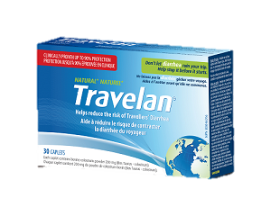
BACKGROUND OF Travelan®: Plan to expand use
COMMERCIAL PRODUCT
DRUG CANDIDATE IMM-124E
Marketed in Australia, USA and Canada
Status with FDA: IND 14,933*
Plan to develop IMM-124E as an approved drug to prevent Travelers’ Diarrhea
*IMM-124E for treatment of NASH

Slide 8
WHAT IS TRAVELERS’ DIARRHEA?
Caused by consuming food or water infected with pathogens. Three or more unformed stools in 24 hours.
Bacterial pathogens are the predominant risk¹.
Enterotoxigenic E. coli (ETEC) are the predominant pathogens^{2,3}:
42% in Latin America
28% in Southeast Asia
Up to 70% of travelers suffer from travelers’ diarrhea⁴.
1 – Steffen, R. 2017 Epidemiology of travelers’ diarrhea. Journal of Travel Medicine 24(1)
2 – Leder, K. 2015 Advising Travellers about Management of Travelers’ Diarrhea. Australian Family
Physician, vol 44 No. 1-2 Jan. Feb 2015
3 – Castelli et. al., Epidemiology of Travelers’ Diarrhea, J. Travel Medicine 2001; 8 (Suppl2) S26-S30
4 – CDC Yellow Book 2018, Chapter 2 Travelers’ Diarrhea.

Slide 9
TRAVELAN® COMMERCIAL PROFILE: Increasing Sales Addressing Large markets
2019 Global market - US $630M Expected to reach US $890M by 2024 at 7% CAGR ¹
https://www.marketwatch.com/press-release/at-71-cagr-travelers-diarrhea-therapeutics-market-size-to-reach-usd-890-million-by-2024-2019-05-08
AUD

Slide 10
antibiotic resistance: Opportunity for Travelan®
International Society of Travel Medicine, 2017 guidelines for treating Travelers’ Diarrhea included¹:
Antibiotics should NOT be used routinely, except patients at high risk of complications
Rifaximin recommended when antibiotic prophylaxis is indicated
Fluoroquinolones not recommended for prophylaxis²
Insufficient evidence to recommend prebiotics or probiotics
The opportunity: Travelan®, the alternative to antibiotic treatment of TD
1 Riddle et al. 2017. Guidelines for the prevention and treatment of travellers’ diarrhea: a graded expert panel report. Journal of Travel
Medicine 24(1).
2 Tribble, D. 2017 Resistant pathogens as causes of traveller’s diarrhea globally and impact(s) on treatment failure and recommendations.
Journal of Travel Medicine 24(1)

Slide 11
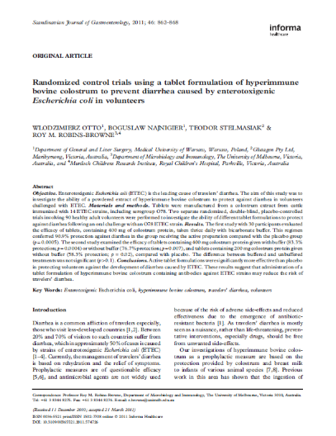
Travelan® as a drug to PREVENT travelers’ diarrhea
Travelan® evaluated in two randomised, double-blind, placebo-Controlled Human Infection Model challenge clinical trials
90 healthy volunteers in Study 1 & 2
Published in Scandinavian Journal of Gastroenterology
STUDY 1: 30 participants
Oral challenge with O78 ETEC strain (H10407)
Diarrhea was defined as passage of two or more unformed stools during 48 hour period within 72 hours of the challenge
PLACEBO
15
IMM-124E
400mg TID
15
RESULTS: Travelan® provided over 90% prophylactic
efficacy against diarrhea due to infection by the major strain of E.coli that causes TD
Otto et al. 2011 Randomized Control Trials using a tablet formulation of hyperimmune bovine colostrum to prevent diarrhea caused by ETEC in volunteers. Scandinavian Journal of Gastroenterology, 2011; 46: 862–868.

Slide 12
SUMMARY OF RESULTS FROM STUDY 1
Treatment Group
Placebo Colostrum p
Number of volunteers | 15 | 15
Number of volunteers with diarrhea | 11 (73%) | 1 (7%) | 0.0005
Number of diarrheal stools/volunteer (mean + SEM) | 4.4 ± 0.9 | 0.4 ± 0.4 | 0.0004
Mean number of diarrheal stools per volunteer with diarrhea (mean and range) | 6 (2 – 8) | 6 (6) | NS
Abdominal pain | 5 (33%) | 0 (0%) | 0.04
ETEC H10407 isolated from feces after challenge | 15 (100%) | 12 (80%) | NS
*Fisher’s exact test or Student’s t-test (two-tailed) as appropriate.
NS, not significant

Slide 13
Summary of results from study 2
Treatment Group
Group 1: Group 2: Group 3: Group 4:
Placebo Colostrum Colostrum Colostrum
tid 400 mg tid + buffer 200 mg tid 400 mg tid
Number of volunteers | 14 | 14 | 14 | 14
Number of volunteers with diarrhea | 12 (86%) | 2 (14%), p = 0.0004* | 5 (36%), p = 0.02 | 3 (20%), p = 0.007
Number of diarrheal stools/volunteer (mean + SEM) | 3.9 ± 0.8 | 0.5 ± 0.3, p = 0.0005 | 1.8 ± 0.8, p = 0.07 | 0.9 ± 0.5, p = 0.003
Mean number of diarrheal stools per volunteer with diarrhea (mean and range) | 5 (3–10) | 3.5 (3–4) | 5 (2–7) | 4.7 (2–7)
Abdominal pain | 5 (36%) | 0 (0%), p = 0.04 | 2 (14%), p = 0.04 | 0 (0%), p = 0.02
ETEC H10407 isolated from feces after challenge | 12 (86%) | 14 (100%) | 14 (100%) | 12 (80%)
*All tests compared results of active treatment with placebo group; calculation by
Fisher’s exact test or Student’s t-test (two-tailed)

Slide 14
Travelan®: oral challenge study prevention of shigellosis (Bacillary dysentery) in PRIMATES*
12 juvenile rhesus monkeys randomly assigned to Travelan® (n=8) or placebo (high protein milk powder) (n=4) treatment groups
Travelan® or placebo (500mg) was administered 2x daily for 6-days, starting on day 0
Each monkey challenged with 2.8 x 10⁹ Shigella flexneri 2a intragastrically on day 3
Travelan® /placebo treatment stopped on day-6. Monkeys monitored through to day 14
Faecal samples taken 2 x daily and cultured to establish presence/absence of Shigella flexneri
Animals continually monitored for clinical signs
*Collaborative animal model study with AFRIMS & WRAIR

Slide 15
RESULTS OF Travelan® SHIGELLA CHALLENGE STUDY*
3 x10⁹
S. flexneri
Travelan® group
“Travelan®” x 6 days
No Treatment x 8 days
DAYS
1
2
3
4
5
6
7
8
9
10
11
12
13
14
“Placebo” x 6 days
Placebo control group
1
*Collaboration with AFRIMS & WRAIR
= last day of S. flexneri consecutive +ve stool culture

Slide 16
Summary of Travelan® Shigella Animal Study
Placebo (high protein milk powder) provided no protection against acute shigellosis
All (4/4) Placebo treated monkeys developed severe acute enteric shigellosis.
Travelan® provided 75% protection against acute shigellosis
2 of 8 (25%) Travelan®-treated monkeys developed severe acute enteric shigellosis
6 of 8 (75%) Travelan®- treated monkeys survived Shigella flexneri challenge
S. flexneri was undetectable in consecutive faecal samples by day-7 in 4 of 6 (67%) survivors and by day 9 in the remaining 2 (33%) survivors

Slide 17
IMM-124E Drug development plan
Revamp Travelan® for FDA approval as drug to prevent Travelers’ Diarrhea in travelers to endemic areas:
Assimilate Data to Support Literature-Based FDA Submission
Hold Pre-IND Meeting to Discuss Merits of 505(b)(2) Application
File IND with Single Double-Blind & Placebo Controlled Trial for Prevention of Travelers’ Diarrhea
Execute Prevention Trial and File Registration Package

Slide 18
US sales forecast for Travelan®: IF approved AS DRUG to Prevent TD
MARKET POTENTIAL FOR TRAVELAN® SALES:
USD >$100 MILLION
Market potential figure derived from:
2014 figures of US citizens traveling to high risk destinations for TD (44.3 million)¹ and obtaining pretravel advice (22.2 million)². Sources of pre-travel advice include primary care provider, travel medicine specialist, company doctors, pharmacist, and travel agencies². Our forecast utilizes a very conservative estimate for % of US citizens purchasing Travelan® after seeking pre-travel advice.
1. U.S. Department of Commerce, International Trade Administration, National Travel and Tourism Office. U.S. Citizen Traffic to Overseas Regions, Canada & Mexico 2014.
Monthly Statistics, U.S.Outbound Travel by World Regions. 2014. Available at: http://travel.trade.gov/view/m-2014-O-001/index.html. Accessed June 26, 2015.
2. Mathyas Wang , MD , Thomas D. Szucs , MD, MBA, MPH, LLM , and Robert Steffen , MD. Economic Aspects of Travelers ’ Diarrhea. Journal of Travel Medicine, Volume
15, Issue 2, 2008, 110–118

Slide 19
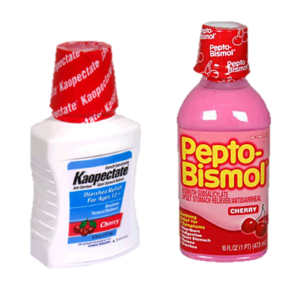
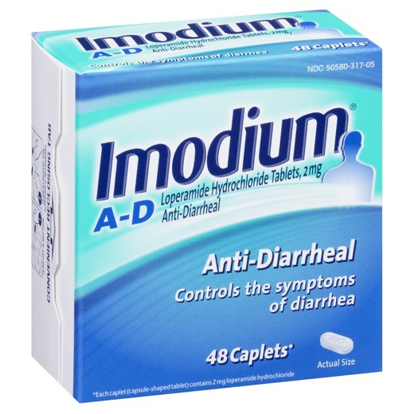
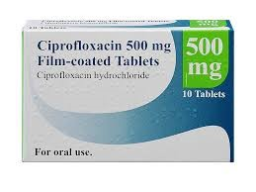
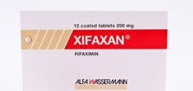
Competitor Market Analysis – ANTi-DIARRHEAL DRUGS
Drug | Indication | Dosing | Ave cost – 2 week trip | Revenue USD Millions (Year)
FDA APPROVED DRUG TREATMENTS FOR DIARRHEA
PEPTO BISMOL (BSS) | Relief for heartburn, nausea, indigestion, upset stomach and diarrhea. | 2 tabs QID | $20.97 ¹ | 82.6 (2013) ²
IMMODIUM | Decrease the frequency of diarrhea in TD, gastroenteritis, inflammatory bowel disease, and short bowel syndrome. | 2 tabs (2 mg) | $17.33 ¹ (48 caplets) | 82.5 (2013) ²
CIPROFLOXACIN (FLUOROQUINOLINE) | Bacterial infections. | 500 mg | $44.52 ³ | 40.8 (2015) ³
RIFAXIMIN | Treatment of Travellers’ Diarrhea. | 3 caps (200 mg) TID | $657 ⁴
PRESENTLY, THERE IS NO FDA APPROVED DRUG TO PREVENT TRAVELERS’ DIARRHEA
TRAVELAN® | Dietary Supplement. | 3 caps (200 mg) TID | $30 – 30 caplets | 0.77 (2018) ⁵
Amazon.com
Top 10 OTC brands for digestives by revenue in the USA in 2013
Almalki et. al., Utilization, spending & price trends for quinolones in the US, Pharmacoecon Open 2017 Jun: 1(2): 123-131
Drugs.com Xifaxan (rifaximin) price guide. Cost of Xifaxan oral tablet 200 mg ~$657 for 30 tablets
US Sales for Travelan – FY2018

Slide 20
Neutralizing Clostridium difficile, while Sparing the Microbiome
Imm-529

Slide 21
Clostridium difficile Market OPPORTUNITY
Clostridium difficile (C. difficile) is a bacterium that causes diarrhea and more serious intestinal conditions such as colitis
Therapeutic market expected to grow from USD $630 million in 2016 to over $1.7 billion by 2026 – CAGR 15%¹
Leading cause of gastroenteritis-associated mortality in U.S.²
Approx. 44,500 patients³ died in 2014 from C. difficile infections (U.S.)
Potential orphan disease (7 years market exclusivity and premium pricing)
https//www.globaldata.com/global-clostridium-difficle-infection-market-approach-2016-2026
Jagai, et.al., BMC Gastroenterology, 2014:14:211 Trends in gastroenteritis-associated mortality in the USA.
K. Desai, BMC Infect. Dis., 2016,16:303

Slide 22
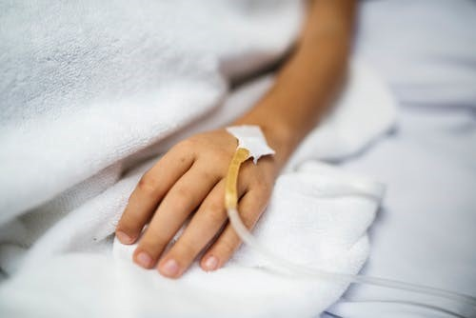
The UNMET NEED
Current standard of care for C. difficile includes vancomycin, metronidazole & fidaxomicin
Therapies plagued by significant CDI recurrences (*1st relapse: 25%; 2nd: 40%; 3rd: 60%) underscoring need for new treatments
Growing resistance to vancomycin treatment
Some treatments are administered intravenously rather than via the gut where C. difficile resides
*Isobel Ramsay, Nicholas Brown and David Enoch. Recent Progress for the Effective Prevention and Treatment of Recurrent
Clostridium difficile Infection. Infectious Diseases: Research and Treatment Volume 11: 1–4 (2018).
DOI: 10.1177/1178633718758023

Slide 23
The C. difficile Prevention of recurrent CDI mouse model*
C57BL/6 mice 6–7 weeks
C. difficile challenge (10³ spores)
Administration of water
or IMM-529
Day -10
-1
0
+8
Monitor:
Weight loss
Physiological appearance
Activity
Diarrhoea
Antibiotics in drinkingwater to
induce susceptibility to C. difficile
Vancomycin treatment
ceases
Administration of vancomycin alone or vancomycin + IMM-529 12 hour post infection
*Collaboration with Prof. Dena Lyras, Monash University, Australia

Slide 24
IMM-529 animal model ‘recurrence’ Study
Relapse Study
All studies statistically significant
Demonstrated ~80% survival rate (7/9) vs. ~10% survival rate in control group (1/9)

Slide 25
The C. difficile prevention mouse model
C57BL/6 mice 6–7 weeks Vancomycin or
IMM-529 administration
Day -10
-3
-2
-1
0
Monitor:
Weight loss
Physiological appearance
Activity
Diarrhoea
Antibiotics in drinkingwater to
induce susceptibility to C. difficile
C. difficile challenge (10³ spores)
*Collaboration with Prof. Dena Lyras, Monash University, Australia

Slide 26
IMM-529 Animal model ‘prevention’ study
All studies statistically significant
Prevention Study
Demonstrated 80% efficacy without use of antibiotics

Slide 27
IMM-529 Drug development plan
Develop clinical protocol for FDA approval as drug to prevent recurrent Clostridium difficle Infection:
Develop clinical registration strategy for FDA submission
Hold pre-IND meeting to discuss clinical protocol and strategy
File IND with plan for placebo controlled trial for prevention of disease recurrence
Execute recurrence prevention trial

Slide 28
COMMERCIAL & PRODUCT DEVELOPMENT PIPELINE
PROGRAM | INDICATIONS | DEVELOPMENT STAGE |  |  |  |  | PROGRAM HIGHLIGHTS
 |  | PRE-CLINICAL | PHASE 1 | PHASE 2 | PHASE 3 | MARKET
ANTI-INFLAMMATORY PROGRAMS
Travelan® | Travelers’ Diarrhea |  |  |  |  |  | Commercial product Australia
Travelan® | Travelers’ Diarrhea |  |  |  |  |  | Commercial product Canada
Travelan® |  |  |  |  |  |  | Commercial product USA
Travelan® (IMM-124E) | Travelers’ Diarrhea |  |  |  |  |  | Plan for FDA submission
Travelan® (IMM-124E) | NASH |  |  |  |  |  | Top Line Results Reported March 2018
IMM-124E | ASH |  |  |  |  |  | NIH Funded U of Virginia Topline results expected 2H 2019
IMM-124E | Pediatric NAFLD |  |  |  |  |  | NIH Funded; Emory University Topline results expected 1Q 2020
IMM-529 | C. Difficile |  |  |  |  |  | Developing to prevent recurrence in C. difficile patients
WRAIR | Shigella |  |  |  |  |  | Walter Reed Army Institute of Research
TGA ARTG Aust L106709 (2004)
Health Canada NPN 80046016 (2015)
Dietary supplement (2015)

Slide 29
IMM-124E: Fatty-Liver Portfolio
Two ongoing NIH funded Phase 2 Programs currently underway: ASH and Pediatric NAFLD
ASH
NIH funded; sponsored by Virginia Commonwealth University
Lead Principal Investigator: Arun Sanyal; Former President of AASLD (American Association for the Study of Liver Diseases) and current Chair of the Liver Study Section at the NIH (National Institute of Health)
Fully recruited: 56 patients
Endpoints: Clinical Safety; Serum endotoxin (LPS) levels
Timing: topline results expected in 2H2019
PEDIATRIC NAFLD
NIH funded; sponsored by Emory University
Lead Principal Investigator: Miriam Vos;
Current enrollment: 23/40 patients
Endpoint: ALT; 3 months treatment
Timing: topline results in 1H 2020

Slide 30
Key Milestones Expected to Drive Value
2H 2019
1H 2020
2H 2020
1H 2021
Pre-IND Meeting to Discuss IMM-124E Literature-Based 505(b)(2)
IMM-124E ASH Clinical Trial Top Line Results
Initiate Phase 3 Clinical Trial on IMM-124E TD prevention study
Pre-IND Meeting on IMM-529 C. difficile program
Pediatric NAFLD Top Line Results
Phase 3 IMM-124E TD Clinical Data Available
Initiate U.S. Phase 2 trial on IMM-529 to treat recurrent CDI
File
505(b)(2) NDA for IMM-124E TD prevention study
Results from US Army trials expected 2019/2020

Slide 31
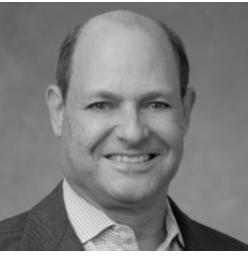
Management
Chief Executive Officer of Immuron Limited since November 16, 2018.
Over 30 years of experience in pharmaceutical and biotechnology - including R&D, operations, business development and capital financing.
Co-founder and founding CEO of Synergy Pharmaceuticals.
Co-inventor of TRULANCE® (plecanatide), an FDA approved drug to treat chronic GI disorders.
Raised over USD $500 million of capital in the public markets to support Synergy from founding to approval of TRULANCE® in 2017.
Ph.D. in Biochemistry; University of Wisconsin-Madison and BS in Chemistry from the University of Missouri.
Former Acting CEO of Immuron Ltd. Over twenty years’ experience in pharmaceutical and biotechnology industries.
Former Chief Operating Officer of TransBio Ltd. Responsible for strategic identification, development and maintenance of global commercial partnerships, along with development, management and IP portfolio, R&D and technology transfer.
Leadership roles in business development, project management, IP portfolio management, R&D, senior management.
Consultant to academic institutes, private and publicly listed companies and government departments specializing in development and commercialization strategies.
PhD in medicine from the University of Melbourne.

Slide 32
Board of Directors – Chairman & Executive Vice Chairman
Dr Roger Aston
CHAIRMAN - B. Sc. (Hons), PhD.
Dr Aston has more than 20 years experience in the pharmaceutical and biotech industries. He was Chief Executive Officer of Mayne Pharma Group Limited, after leading HalcyGen’s acquisition of Mayne Limited in 2009. He has extensive experience with FDA and EU product registration, clinical trials, global licensing, private placement fundraising and prospectus preparation. Dr Aston has held numerous other board positions in the sector including with Clinuvel Limited, HalyGen Limited and Ascent Pharma Health Limited, recently acquired by Watson.
Peter Anastasiou
EXECUTIVE VICE CHAIRMAN - BBSc
Mr. Anastasiou has extensive business experience in a wide range of organisations. He has been a successful entrepreneur from and early age with his first biotech venture, Neuro Developments Australia, seeded at age 24. Mr. Anastasiou was the founder of Investment Group Grandlodge, and ACS International both of which have generated significant wealth through Investment and Management
NON-EXECUTIVE DIRECTORS
Dr Gary Jacob
Stephen Anastasiou
Daniel Pollock
Professor Ravi Savarirayan
Richard Jay Berman

Slide 33
Company Capitalization
Immuron Limited |  | Ordinary Shares | ADS Equivalent¹
Shares |  | 163,215,706 | 4,080,393
Options² |  | 44,823,800 | 1,120,595
Warrants³ |  | 27,760,000 | 694,000
Total |  | 235,799,506 | 5,894,988
Information prepared as at 18 June 2019
Share Price (18 June 2019): AUD $0.135
Market Capitalization: AUD $22 Million
1 ADS represents 40 ordinary shares
Options - Exercise price range: AUD $0.468 to $1.944 (Expiring from 27 Nov 2019 to 15 March 2023)
Exercise price of USD $10.00 per ADS (Expiring 13 June 2022)

