Slide 1
Chart Industries
First Quarter 2019
April 18, 2019

Slide 2
Forward Looking Statements
Certain statements made in this news release are forward-looking statements within the meaning of the Private Securities Litigation Reform Act of 1995. Forward-looking statements include statements concerning the Company’s business plans, including statements regarding the recent VRV acquisition, cost synergies and efficiency savings, objectives, future orders, revenues, margins, earnings or performance, liquidity and cash flow, capital expenditures, business trends, governmental initiatives, including executive orders and other information that is not historical in nature. Forward-looking statements may be identified by terminology such as "may," "will," "should," "could," "expects," "anticipates," "believes," "projects," "forecasts," “outlook,” “guidance,” "continue," or the negative of such terms or comparable terminology.
Forward-looking statements contained in this presentation or in other statements made by the Company are made based on management's expectations and beliefs concerning future events impacting the Company and are subject to uncertainties and factors relating to the Company's operations and business environment, all of which are difficult to predict and many of which are beyond the Company's control, that could cause the Company's actual results to differ materially from those matters expressed or implied by forward-looking statements. Factors that could cause the Company’s actual results to differ materially from those described in the forward-looking statements include: those found in Item 1A (Risk Factors) in the Company’s most recent Annual Report on Form 10-K filed with the SEC, which should be reviewed carefully; and Chart’s ability to successfully integrate VRV, and achieve anticipated revenue, earnings and accretion. The Company undertakes no obligation to update or revise any forward-looking statement.
Chart is a leading diversified global manufacturer of highly engineered equipment servicing multiple market applications in Energy and Industrial Gas. The majority of Chart's products are used throughout the liquid gas supply chain for purification, liquefaction, distribution, storage and end-use applications, a large portion of which are energy-related. Chart has domestic operations located across the United States and an international presence in Asia, Australia, Europe and the Americas. For more information, visit: http://www.chartindustries.com.

Slide 3
Q1 2019 Order Activity All results reflect continuing operations
E&C
D&S East
D&S West
+182%
+30%
(13%)
Highest in history
Big LNG
Air Cooled Heat Exchangers
Petrochemical
Natural Gas Processing
VRV
Industrial gas
LNG fueling systems
Trailers
China
VRV
Industrial gas
Long term agreements
Over the road trucking
Specialty Markets
Parts, repair, service

Slide 4
Big LNG Order Opportunities: 2019
Number | Project | Chart Customer | Operator | Size | Chart Content | Expected Timing of Chart orders
1 - BOOKED | Calcasieu Pass | BHGE | Venture Global | 10 MTPA | 18 cold boxes, BAHX | Throughout 2019
2 – BOOKED | Gimi (Tortue) | Black & Veatch | Golar | 3.75 MTPA | 4x Cold boxes, BAHX | 1H 2019
3 | Driftwood | Bechtel | Tellurian | 27 MTPA (Phase 1 16 MTPA) | IPSMR®, cold boxes, BAHX, ACHX | Q3 2019 for 1st phase
4 – 50% in BACKLOG | Magnolia | LNG Ltd | LNG Ltd | 8.8 MTPA | Cold boxes, BAHX, core-in kettles | 2H 2019
5 | Corpus Christi Stage Three | KBR | Cheniere | 9.5 MTPA | IPSMR®, cold boxes, BAHX, ACHX | 2H 2019 -1H 2020
6 | Pointe LNG | EPC TBD | Pointe LNG | 6 MTPA | IPSMR®, cold boxes, BAHX, ACHX | 2020
7 | FL small scale LNG Expansion | EPC TBD | Confidential | 250,000 gpd | C250N, Cold boxes, BAHX, ACHX | 2H 2019
8 | FL ssLNG | EPC TBD | Confidential | 500,000 gpd | C500 IPSMR®, cold boxes, BAHX, ACHX, tanks | 2H2019-1H 2020
9 | SE Asia LNG (+expansion) | EPC TBD | Confidential | 3 MTPA (+8MTPA expansion) | IPSMR®, cold boxes, BAHX, ACHX | 2H 2019-1H 2020
10 | Liquefaction and distribution project | Black & Veatch | Confidential | Confidential | BAHX, loadout systems, coolers and trailers | 2H 2019
Includes Hudson Products content where applicable
Does not include full list of project opportunities
Opportunities represent possible large projects based on current status of discussions with customers. Ultimate realization of these projects depends upon status of project and on the execution / delivery of definite documentation with customers.

Slide 5
Q1 2019 Margin Expansion Actions
($M) | Facility Reduction / Consolidation | Headcount Reduction / Other | Price Increases and Supply Chain (1) | Product Line Rationalization (1) | Projected Incremental Annual Savings | Projected OpInc Impact to 2019 Versus Prior Guide
E&C | Announced consolidation from 4 facilities to 1 in Tulsa, OK ACHX production | Absorbed LifeCycle backoffice into business units Simplified mgmt. structure |  |  | $4.5 | $2.0
D&S East |  | Eliminated VRV duplicate positions China headcount reduction | Global D&S price increase (Jan 8) | Closed production of BAHX in China | $0.5 | $0.5
D&S West |  | Restructure of parts, repair, service group | Global D&S price increase (Jan 8) |  | $0.5 | $0.5
Corporate |  | Streamlined corporate support functions (Legal, Marketing) and outside professional costs | Sourcing savings across three segments and corporate |  | $1.0 | $0.6
$6.5M
$3.6M
(1) Price increases, supply chain savings, and Product line rationalization were included in prior 2019 guidance

Slide 6
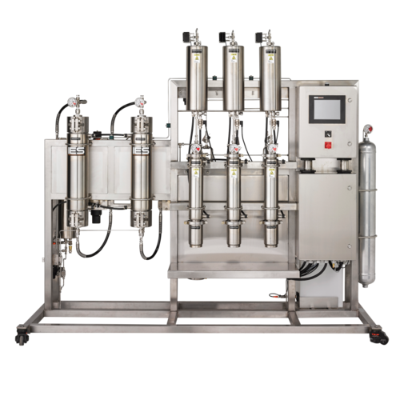
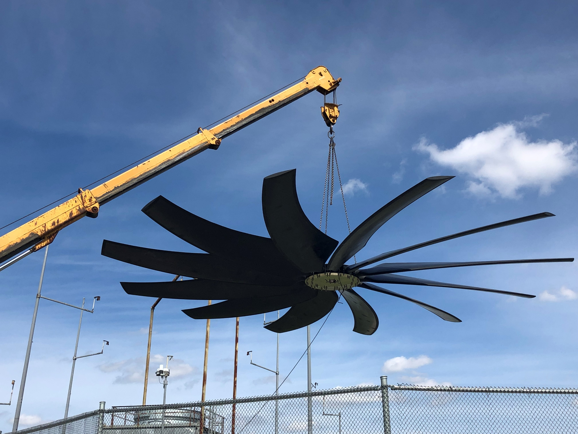
Innovation is Yielding Opportunities
Energy & Chemicals
Tuf-Lite IV Axial Flow Fan
D&S West
CO2 Trifecta for Extraction
Up to 24 Extractors are able to be supplied by a CO2 Trifecta tied to our current CO2 Bulk Tanks
Blade count reduction between 2 and 6 for fans operating between 8,000 ft./min and 12,000 ft./min tip speed
Reduction in overall sound power levels
Between 2% and 5% total efficiency improvement
Between 700 and 2,500 lbs. weight reduction in certain applications
High pressure liquid CO2 feeds extractor pumps
Bulk solutions replace high pressure bottles
Solution does not require pumps
Low maintenance
Capable of 20 lb/min flowrates

Slide 7
2019 Revenue Guidance
2018 actual ($M)
$1,084
2019 Prior Guidance ($M)
$1,260 - $1,310
2019 Guidance ($M)
$1,290 - $1,340
Ref # | Description | Revenue ($M)
1 | 2018 Actual | $1,084
2 | Organic growth | 70 – 100
3 | +10.5 months incremental VRV + synergies | 100 – 120
4 | Pricing | 3 – 4
5 | 2019 Prior Guidance | $1,260 - $1,310
6 | Calcasieu Pass and Gimi | 28 – 30
7 | 2019 Current Guidance | $1,290 - $1,340

Slide 8
2019 Adjusted EPS Guidance
2018 actual
$2.02
2019 Prior Guidance
$2.50 - $2.85
2019 Guidance
$2.70 - $3.05
Ref # | Description | Revenue ($M) | Adjusted EPS (1)
1 | 2019 Prior Guidance | $1,260 - $1,310 | $2.50 - $2.85
2 | Calcasieu Pass and Gimi | 28 – 30 | 0.17 – 0.21
3 | Q1 incremental restructuring benefits |  | 0.08
 | Acquisition integration timing |  | (0.05 – 0.10)
4 | 2019 Current Guidance (2) | $1,290 - $1,340 | $2.70 - $3.05
The Company is not able to provide a reconciliation of projected adjusted EPS because certain items have not yet occurred or are out of the Company’s control and/or cannot be reasonably predicted.
Excludes any potential future dilution impact associated with our convertible notes and related derivative securities.

Slide 9
2019 Guidance
FY 2018 Results
Prior FY 2019 Guidance
Full Year 2019
Sales
$1.08B
28.6% growth
13.4% organic growth
Sales
$1.26B - $1.31B
17% - 22% growth
7%-9% organic growth
Sales
$1.29B - $1.34B
Inclusive of 2019 portion of Calcasieu Pass and Golar Gimi
Adjusted EPS
$2.02
Adjusted EPS
$2.50 - $2.85
Assumes 22-23% full year tax rate
Excludes large LNG related revenue
Includes full year of VRV, s.p.a.
Adjusted EPS (1)
$2.70 - $3.05
Assumes 22-23% full year tax rate
Capital Expenditures
$36M
Capital Expenditures
$35M - $40M
Capital Expenditures
$35M - $40M
(1) Excludes any potential future dilution impact associated with our convertible notes and related derivative securities

Slide 10
Q1 Adjusted EPS
$ millions, except per share amounts Continuing Operations |  | Q1 2019 | Q1 2018 | Change V. PY
Income from continuing operations |  | $0.9 | $4.2 | ($3.3)
Reported EPS |  | $0.03 | $0.13 | ($0.10)
1 | Restructuring and transaction-related costs | 0.23 | 0.05 | 0.18
2 | Integration and Step Up Costs | 0.09 | - | 0.09
3 | Other One-Time Items (2) | 0.03 | - | 0.03
4 | Dilution impact of convertible notes | 0.01 | - | 0.01
Adjusted EPS (1) |  | $0.39 | $0.18 | $0.21
Adjusted EPS (a non-GAAP measure) is as reported on a historical basis. Tax affected adjustments are at normalized statutory periodic rates.
Includes $0.01 related to aluminum cryobiological tank recall reserve expense, and $0.02 related to Tax Reform / transition tax related adjustments.

Slide 11
2019 Guidance
FY 2018 Results
Prior FY 2019 Guidance
Full Year 2019
Sales
$1.08B
28.6% growth
13.4% organic growth
Sales
$1.26B - $1.31B
17% - 22% growth
7%-9% organic growth
Sales
$1.29B - $1.34B
Inclusive of 2019 portion of Calcasieu Pass and Golar Gimi
Adjusted EPS
$2.02
Adjusted EPS
$2.50 - $2.85
Assumes 22-23% full year tax rate
Excludes large LNG related revenue
Includes full year of VRV, s.p.a.
Adjusted EPS (1)
$2.70 - $3.05
Assumes 22-23% full year tax rate
Capital Expenditures
$36M
Capital Expenditures
$35M - $40M
Capital Expenditures
$35M - $40M
(1) Excludes any potential future dilution impact associated with our convertible notes and related derivative securities

