Slide 1
Chart Industries
Second Quarter 2019
July 18, 2019

Slide 2
Forward Looking Statements
Certain statements made in this presentation are forward-looking statements within the meaning of the Private Securities Litigation Reform Act of 1995. Forward-looking statements include statements concerning the Company’s business plans, including statements regarding completed acquisitions, including the recent acquisition of Harsco’s Industrial Air-X-Changers Business (“AXC”), cost synergies and efficiency savings, objectives, future orders, revenues, margins, earnings or performance, liquidity and cash flow, capital expenditures, business trends, governmental initiatives, including executive orders and other information that is not historical in nature. Forward-looking statements may be identified by terminology such as "may," "will," "should," "could," "expects," "anticipates," "believes," "projects," "forecasts," “outlook,” “guidance,” "continue," or the negative of such terms or comparable terminology.
Forward-looking statements contained in this presentation or in other statements made by the Company are made based on management's expectations and beliefs concerning future events impacting the Company and are subject to uncertainties and factors relating to the Company's operations and business environment, all of which are difficult to predict and many of which are beyond the Company's control, that could cause the Company's actual results to differ materially from those matters expressed or implied by forward-looking statements. Factors that could cause the Company’s actual results to differ materially from those described in the forward-looking statements include: the Company’s ability to successful integrate recent acquisitions, including the AXC acquisition, and achieve the anticipated revenue, earnings, accretion and other benefits from these acquisitions; and the other factors discussed in Item 1A (Risk Factors) in the Company’s most recent Annual Report on Form 10-K filed with the SEC, which should be reviewed carefully. The Company undertakes no obligation to update or revise any forward-looking statement.
This presentation contains non-GAAP financial information, including EBITDA. For additional information regarding the Company's use of non-GAAP financial information, as well as reconciliations of non-GAAP financial measures to the most directly comparable financial measures calculated and presented in accordance with accounting principles generally accepted in the United States ("GAAP"), please see slides titled "Non-GAAP Financial Measures" included in the appendix at the end of this presentation.
Chart is a leading diversified global manufacturer of highly engineered equipment servicing multiple market applications in Energy and Industrial Gas. The majority of Chart's products are used throughout the liquid gas supply chain for purification, liquefaction, distribution, storage and end-use applications, a large portion of which are energy-related. Chart has domestic operations located across the United States and an international presence in Asia, Australia, Europe and the Americas. For more information, visit: http://www.chartindustries.com.

Slide 3
Navy blue = 32.64.110
Light blue = 51.163.221
Green = 157.195.53
Orange = 253.164.30
Chart is Benefitting From Industry Tailwinds
Drivers of Results
Correlation to Chart Q2 / FY
Market
✓
Demand for LNG
Big LNG activity is ramping
Small-scale and utility scale LNG targets different customers
Repair, service and aftermarket capabilities
Market
✓
Growth Markets
Developing economies such as India
Revenue synergy capture
ACHX demand outside North America
Specialty markets
Market
Not in guidance
Regulatory Requirements
IMO 2020
LNG By Rail
Internal
✓
Self-Help Margin Expansion
Utilization of global footprint for cost and lead-time
Sourcing
Restructuring / PLS
Cost synergy capture
Source: US Energy Information Administration, ADI Analytics, McKinsey, management

Slide 4
Q2 2019 Sales & Orders
All results reflect continuing operations
E&C
D&S East
D&S West
Sales
+19%
+25%
(-2%)
Orders
+4%
+18%
(9%)
Big LNG
Air Cooled Heat Exchangers
Petrochemical
Natural Gas Processing
VRV
Industrial gas
LNG fueling systems
Trailers
China
VRV
Industrial gas
Long term agreements
Over the road trucking
Specialty Markets
Parts, repair, service

Slide 5
Navy blue = 157.195.53
Light blue = 51.163.221
Green = 157.195.53
Orange = 253.164.30
Small and Utility-Scale LNG
ssLNG opportunities exist globally, and Chart’s global footprint, enhanced by VRV, is well positioned to capitalize.
United States
    EAST COAST
    Utility / peak gas capacity
    WEST COAST
    Utility
    OTHER MARKETS
    Industrial / asphalt / energy
    Inland water transportation
Europe / Russia
    Marine fuel or bunkering
    Road transport
    Refueling infrastructure
China
    Road transportation
    Refueling infrastructure
    Industrial fuel supply
Caribbean
    Power generation
    Refueling infrastructure service/repair
South East Asia and Australia
    Vietnam: road transport
    Indonesia: Regas, power generation
    Myannmar
    Phillippines
    South Korea
Mexico
India
    Mining
    Gas/fuel for off-pipeline grid locations
    Road transportation
    Refueling infrastructure, including LNG, CNG and LCNG

Slide 6
Big LNG Order Opportunities
Number | Project | Chart Customer | Operator | Size | Chart Content | Expected Timing of Chart orders
1 - BOOKED | Calcasieu Pass | BHGE | Venture Global | 10 MTPA | 18 cold boxes, BAHX | Q1 2019
2 – BOOKED | Gimi (Tortue) | Black & Veatch | Golar | 3.75 MTPA | 4x Cold boxes, BAHX | 1H 2019
3 | Driftwood | Bechtel | Tellurian | 27 MTPA (Phase 1 16 MTPA) | IPSMR®, cold boxes, BAHX, ACHX | Q3 2019 for 1st phase
4 – 50% in BACKLOG | Magnolia | LNG Ltd | LNG Ltd | 8.8 MTPA | Cold boxes, BAHX, core-in kettles | 2H 2019
5 | Corpus Christi Stage Three | KBR | Cheniere | 9.5 MTPA | IPSMR®, cold boxes, BAHX, ACHX | 2H 2019 -1H 2020
6 | Pointe LNG | EPC TBD | Pointe LNG | 6 MTPA | IPSMR®, cold boxes, BAHX, ACHX | 2020
7 | Plaquemines | BHGE | Venture Global | 20 MTPA | 36 cold boxes, BAHX | 1H 2020
8 | Corpus Christi Stage Four | TBD | Cheniere | 2 trains at 4.5 MTPA each | Opportunity for: BAHX, ACHX, cold boxes | 2H 2020 – 1H 2021
9 | Ghandria | Black & Veatch | Golar | 3.75 MTPA | 4x Cold boxes, BAHX | 1H 2020
10 | Freeport LNG Train 4 | KBR | Freeport LNG | 15 MTPA | BAHX on the Feed Gas pretreatment | 2020
Includes Hudson Products content where applicable
Does not include full list of project opportunities
Opportunities represent possible large projects based on current status of discussions with customers. Ultimate realization of these projects depends upon status of project and on the execution / delivery of definite documentation with customers.

Slide 7
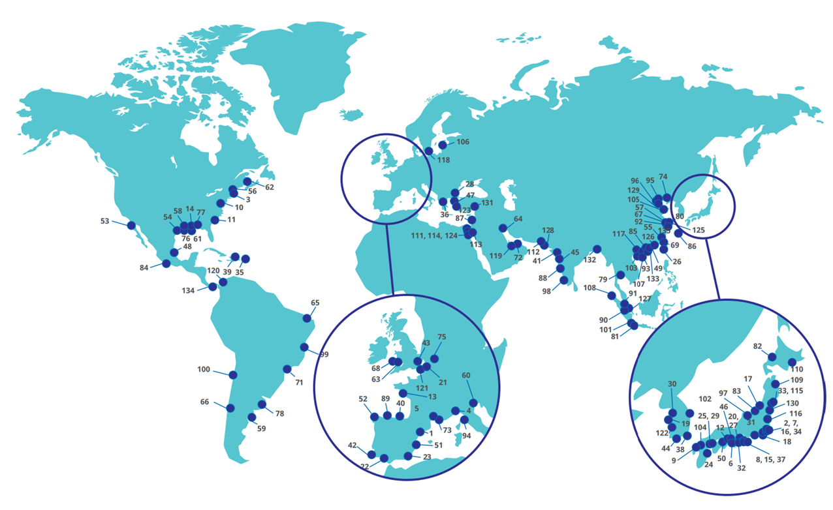
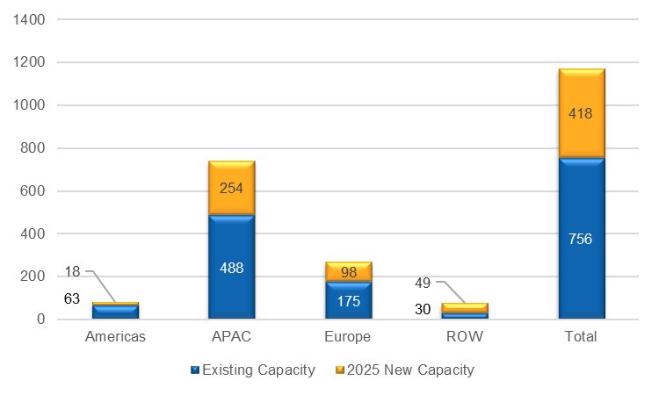
Global LNG Opportunities
International liquefaction projects*
Global receiving terminals locations**
Regasification capacity and 2025 forecast*
*Source: Bloomberg
**Source: IGU World LNG Report – 2019 Edition, IHS Markit, Company Announcements
Note: Terminal numbers correspond to Appendix
Regasification capacity is projected to increase 55% by 2025

Slide 8
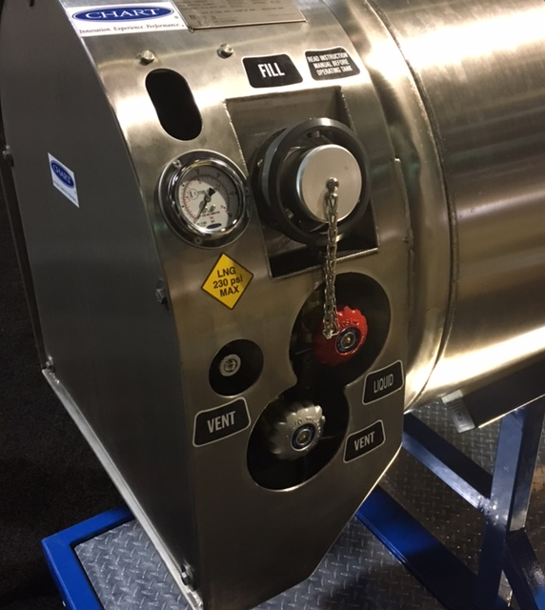
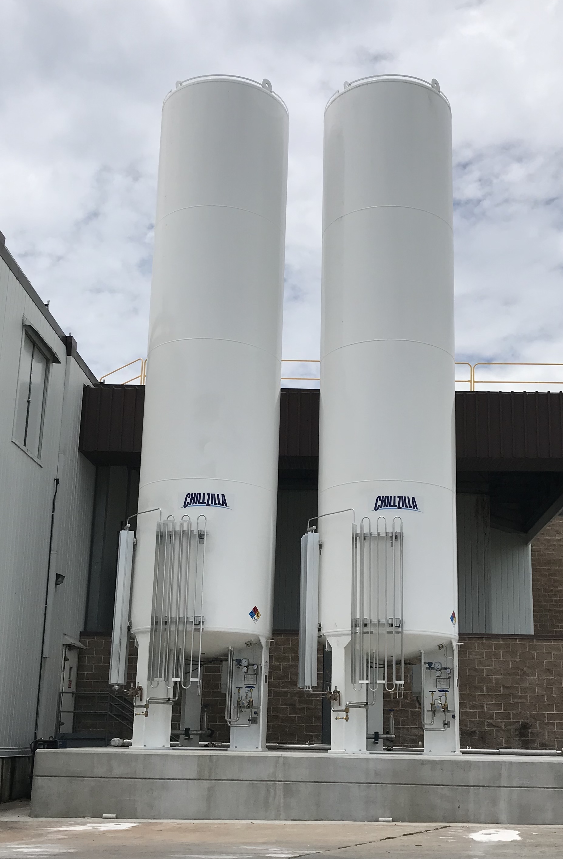
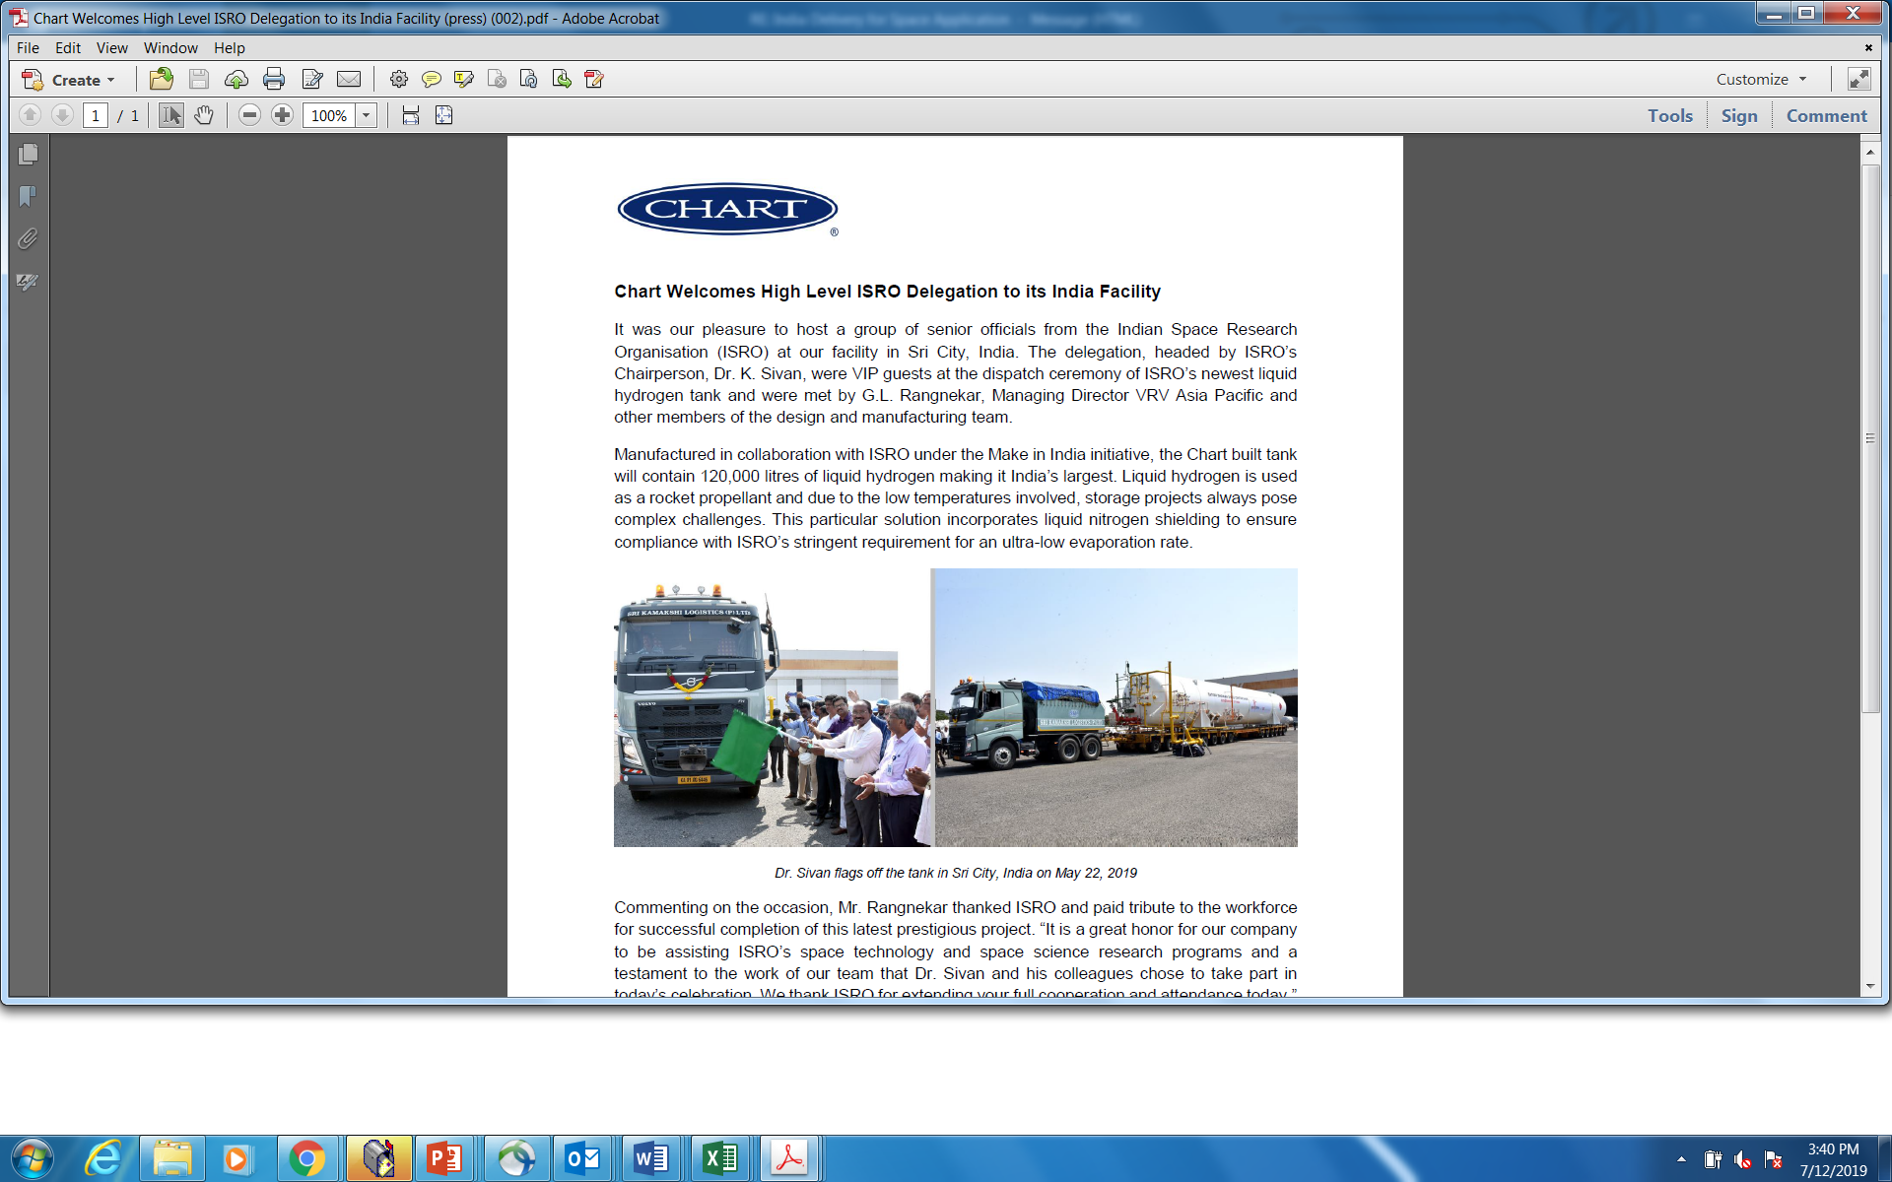
Specialty Market Updates
NextGen Fueling System
Food & Beverage
Space Exploration
Integrated fueling system patents (2017 U.S.; 2019 EU)
Side access will be the next development
Pressure Aide & Tank Control System are specified more often
Five 15,000 gallon nitrogen Chillzilla’s, a 6 ton LCO2, VJ Pipe
End user previously used LCO2, and did not have a consistent supply source; new solution is nitrogen
The nitrogen is used to cool beef & sausage as it goes through a mixer, which is then made into patties for a major food restaurant
In conjunction with India Space Research Organization, delivered the region’s largest hydrogen tank
Booked a United States space exploration order for $3.9 million

Slide 9
Q2 2019 Adjusted Gross Margin¹
All results reflect continuing operations
Sequential
E&C
D&S East
D&S West
As Reported:
18.3% 25.4%
13.0% 14.3%
33.9% 36.8%
vs. Prior Year
E&C
D&S East
D&S West
As Reported:
21.1% 25.4%
22.6% 14.3%
32.5% 36.8%
(1) Adjusted to exclude one-time restructuring and integration related costs

Slide 10
Q1 2019 Margin Expansion Actions
($M) | Facility Reduction / Consolidation | Headcount Reduction / Other | Price Increases and Supply Chain (1) | Product Line Rationalization (1) | Projected Incremental Annual Savings | Projected OpInc Impact to 2019 Versus Prior Guide
E&C | Announced consolidation from 4 facilities to 1 in Tulsa, OK ACHX production | Absorbed LifeCycle backoffice into business units Simplified mgmt. structure |  |  | $4.5 | $2.0
D&S East |  | Eliminated VRV duplicate positions China headcount reduction | Global D&S price increase (Jan 8) | Closed production of BAHX in China | $0.5 | $0.5
D&S West |  | Restructure of parts, repair, service group | Global D&S price increase (Jan 8) |  | $0.5 | $0.5
Corporate |  | Streamlined corporate support functions (Legal, Marketing) and outside professional costs | Sourcing savings across three segments and corporate |  | $1.0 | $0.6
$6.5M
$3.6M
(1) Price increases, supply chain savings, and Product line rationalization were included in prior 2019 guidance

Slide 11
Q2 2019 Margin Expansion Actions
($M) | Facility Reduction / Consolidation | Headcount Reduction / Other | Price Increases and Supply Chain | Product Line Rationalization | Projected Incremental Annual Savings | Projected OpInc Impact to 2019 Versus Prior Guide
E&C | Consolidated backoffice in La Crosse into manufacturing plant | Reduced duplicate positions with streamlined facilities |  |  | $2.2 | $1.9
D&S East |  | Reduced headcount associated with product line closures |  | Closed production of vehicle tank line in China | 1.9 | 1.2
D&S West |  | Reduced overlapping role |  |  | 0.1 | 0.0
Corporate |  | Continued backoffice CBS streamlining | Additional savings achieved above the original $5.5 million included in prior guide (incremental $0.7M) |  | 0.7 | 0.0
$4.2M
$3.1M
(1) Price increases, supply chain savings, and Product line rationalization were included in prior 2019 guidance

Slide 12
Navy blue = 157.195.53
Light blue = 51.163.221
Green = 157.195.53
Orange = 253.164.30
Leveraging Our Global Operations
Benefits:
27 out of 44 D&S product lines have reduced lead times since beginning of 2019
Now carrying parts for high demand products
Europe
Asia-Pacific
    Ferox – Decin, CR
    GOFA –Germany
    Flow – Germany
    VCT Vogel – Germany
    Germany (CryoBio)
    VRV – Italy
    VRV/Cryo Diffusion – France
    VRV – Italy
    IMB – Italy
    Hudson/Cofimco – Italy
    Changzhou, China
    Chengdu, China (CryoBio)
    VRV – India
    Australia (CryoBio)
E&C
D&S East
D&S East
Americas
    Ball Ground, GA
    New Prague, MN
    Fremont, CA
    McCarran, NV (Repairs)
    Houston, TX (Repairs)
    Skaff – Brentwood, NH (Repairs)
    Thermax – Dartmouth, MA
D&S West
Corporate Headquarters
Ball Ground, GA
    New Iberia, LA
    Tulsa, OK
    La Crosse, WI
    The Woodlands, TX
    Hudson/Cofimco – Beasley, TX
    Franklin, IN (Repairs)
E&C

Slide 13
2019 Guidance
Ref # | Description | Revenue ($M) | Adjusted EPS
1 | 2018 Actual | $1,084 | $2.02
2 | Organic growth +10.5 months incremental VRV + synergies | 170 – 220 | 0.27 - 0.47
3 | Pricing, sourcing, net of material cost; and 2018 restructuring actions | 3 – 4 | 0.16 - 0.26
4 | Q1 2019 incremental restructuring benefits |  | 0.08
5 | Calcasieu Pass and Gimi | 28 – 30 | 0.17 – 0.21
6 | 2H 2019 AXC | 120 | 0.15
7 | 2019 Prior Guidance | $1,410 - $1,460 | $2.85 - $3.20
8 | Strategic financing |  | (0.11)
9 | Q2 2019 incremental self-help benefits |  | 0.03
 | Q2 2019 beat |  | 0.07
11 | 2019 Current Guidance | $1,410 - $1,460 | $2.85 - $3.20

Slide 14
Q2 Adjusted EPS
$ millions, except per share amounts Continuing Operations |  | Q2 2019 | Q2 2018 | Change v. PY | 1H 2019 | 1H 2018 | Change v. PY
Income from continuing operations |  | $14.4 | $9.9 | $4.5 | $15.3 | $14.1 | $1.2
Reported EPS |  | $0.41 | $0.31 | $0.10 | $0.45 | $0.44 | $0.01
1 | Restructuring and transaction-related costs | 0.23 | 0.07 | 0.16 | 0.44 | 0.10 | 0.34
2 | Integration and Step Up Costs | 0.02 | - | 0.02 | 0.11 | - | 0.11
3 | Other One-Time Items (2) | - | 0.09 | -0.09 | 0.03 | 0.09 | -0.06
4 | Dilution impact of convertible notes | 0.02 | 0.01 | 0.01 | 0.03 | - | 0.03
Adjusted EPS (1) |  | $0.68 | $0.48 | $0.20 | $1.06 | $0.63 | $0.43
Adjusted EPS (a non-GAAP measure) is as reported on a historical basis. Tax affected adjustments are at normalized statutory periodic rates.
Includes $0.01 and $0.09 related to aluminum cryobiological tank recall reserve expense in Q1 2019 and Q2 2018 respectively, and $0.02 related to Tax Reform / transition tax related adjustments in Q1 2019.

Slide 15
2019 Guidance
FY 2018 Results
Prior FY 2019 Guidance
Full Year 2019
Sales
$1.08B
28.6% growth
13.4% organic growth
Sales
$1.41B - $1.46B
Inclusive of 2019 portion of Calcasieu Pass and Golar Gimi
And 2H 19 AXC
Sales
$1.41B - $1.46B
Inclusive of 2019 portion of Calcasieu Pass and Golar Gimi
And 2H 19 AXC
Adjusted EPS
$2.02
Adjusted EPS
$2.85 - $3.20
Assumes 22-23% full year tax rate
Includes 2H 19 AXC
Adjusted EPS (1)
$2.85 - $3.20
Assumes 21% full year tax rate
Incldues 2H 19 AXC
Capital Expenditures
$36M
Capital Expenditures
$35M - $40M
Capital Expenditures
$35M - $40M
(1) Excludes any potential future dilution impact associated with our convertible notes and related derivative securities

Slide 16
Appendix

Slide 17
Adjusted Gross Margin Detail
(1) Adjusted to exclude one-time restructuring and integration related costs

