Slide 1
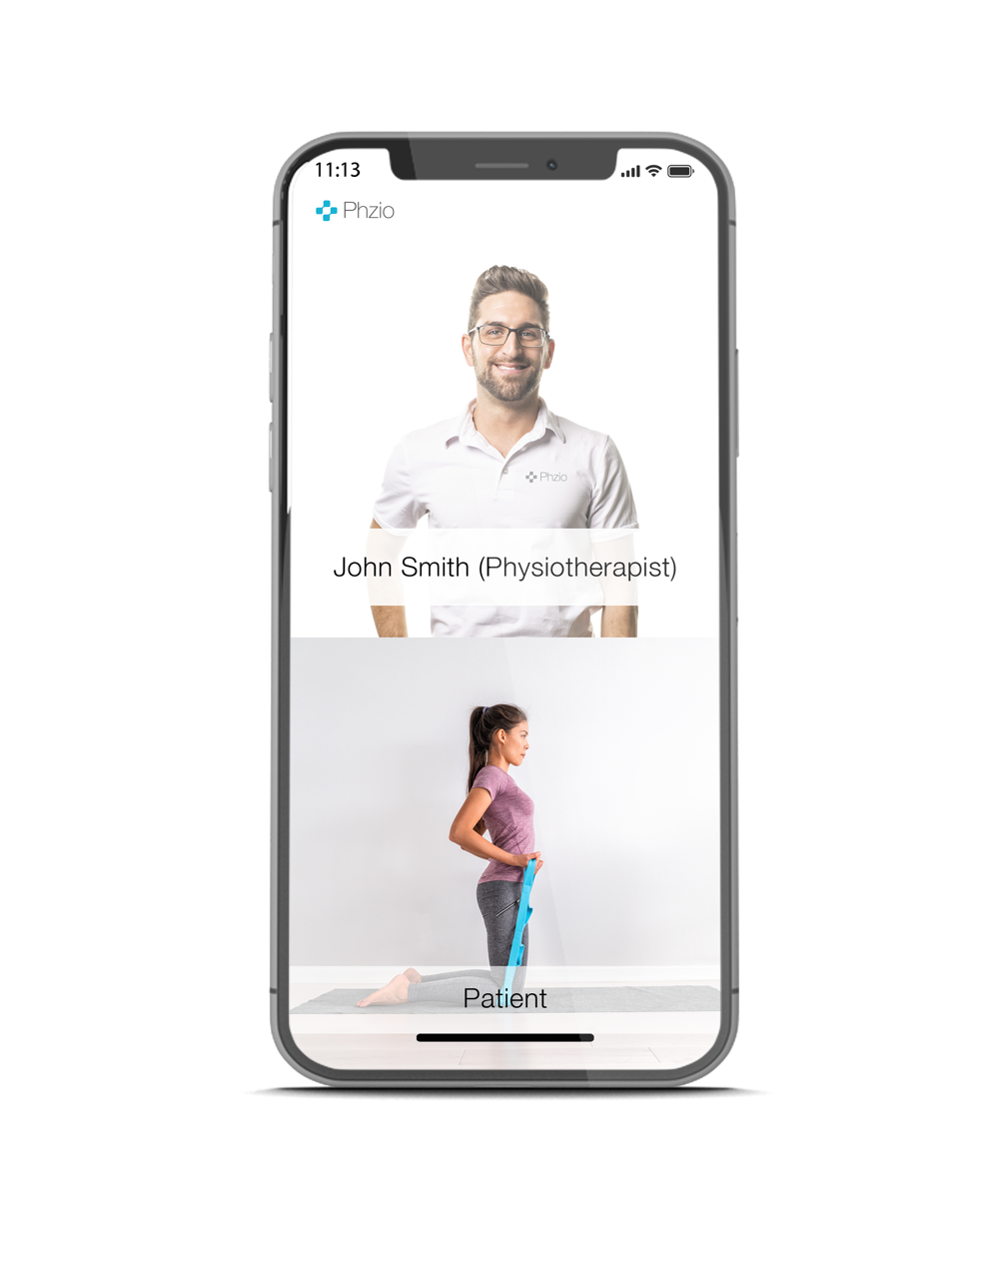
Darwin Fogt, PT, CEO Phzio TeleRehab
Phzio fogt@phzio.com
Oct 25, 2019

Slide 2
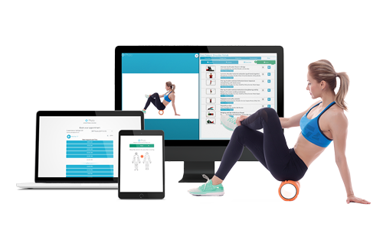
A solution for companies with:
MSK patterns in their operations
High paramedical & disability costs
An interest in a modernized approach
to proactively address MSK disorders

Slide 3
1 in 5 employees are experiencing an
musculoskeletal (MSK) issue.

Slide 4
Proactive MSK Prevention &
Early Intervention
Secondary Engagement with
PhzioFIT Functional Screening
For clients with MSK patterns we can present Prevention & Early Intervention Programs

Slide 5
Traditional Physiotherapy
Moderate to Severe Injuries
Knee Injury
In-clinic
evaluation
In-clinic treatment and exercise monitoring
8-12 visits

Slide 6
Virtual Physiotherapy
Mild to Moderate Injuries
Virtual Exercise Monitoring with a PT or PTA
+
Virtual Triage
with a PT
Virtual Evaluation
with a PT
Back Injury
Self-Service Exercise Sessions

Slide 7
Common Conditions - Virtual Physiotherapy Care
Neck strain
Rotator cuff injuries
Tennis / golf elbow
Carpal tunnel syndrome
Low back pain
Hip dysfunction
Patellofemoral syndrome
Ankle sprain
Plantar fasciitis

Slide 8
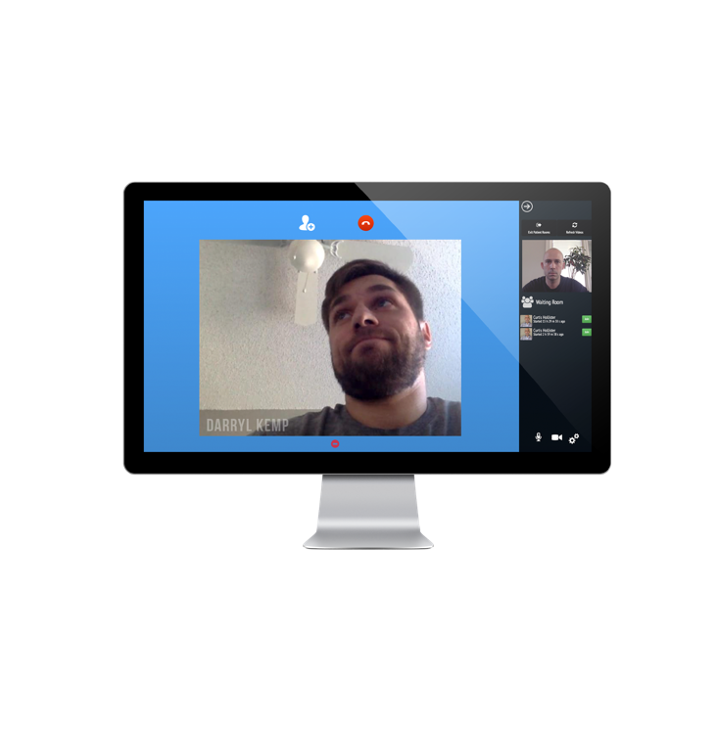
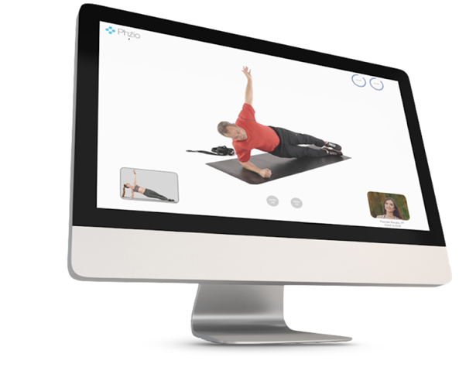
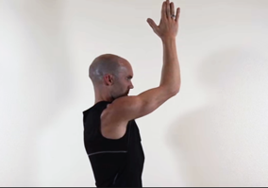
Virtual Care Elements
114
o
Therapeutic Content Library 1200+ VIDEOS
(English, French & Spanish)
Evaluation
Supervised Patients Treatments
T

Slide 9
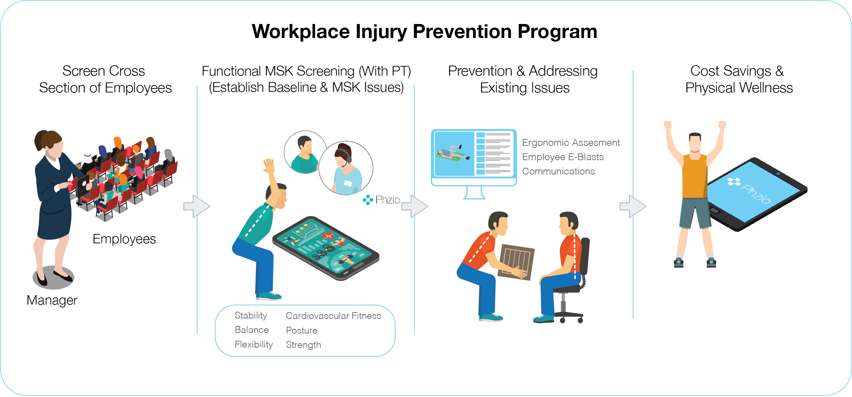

Slide 11
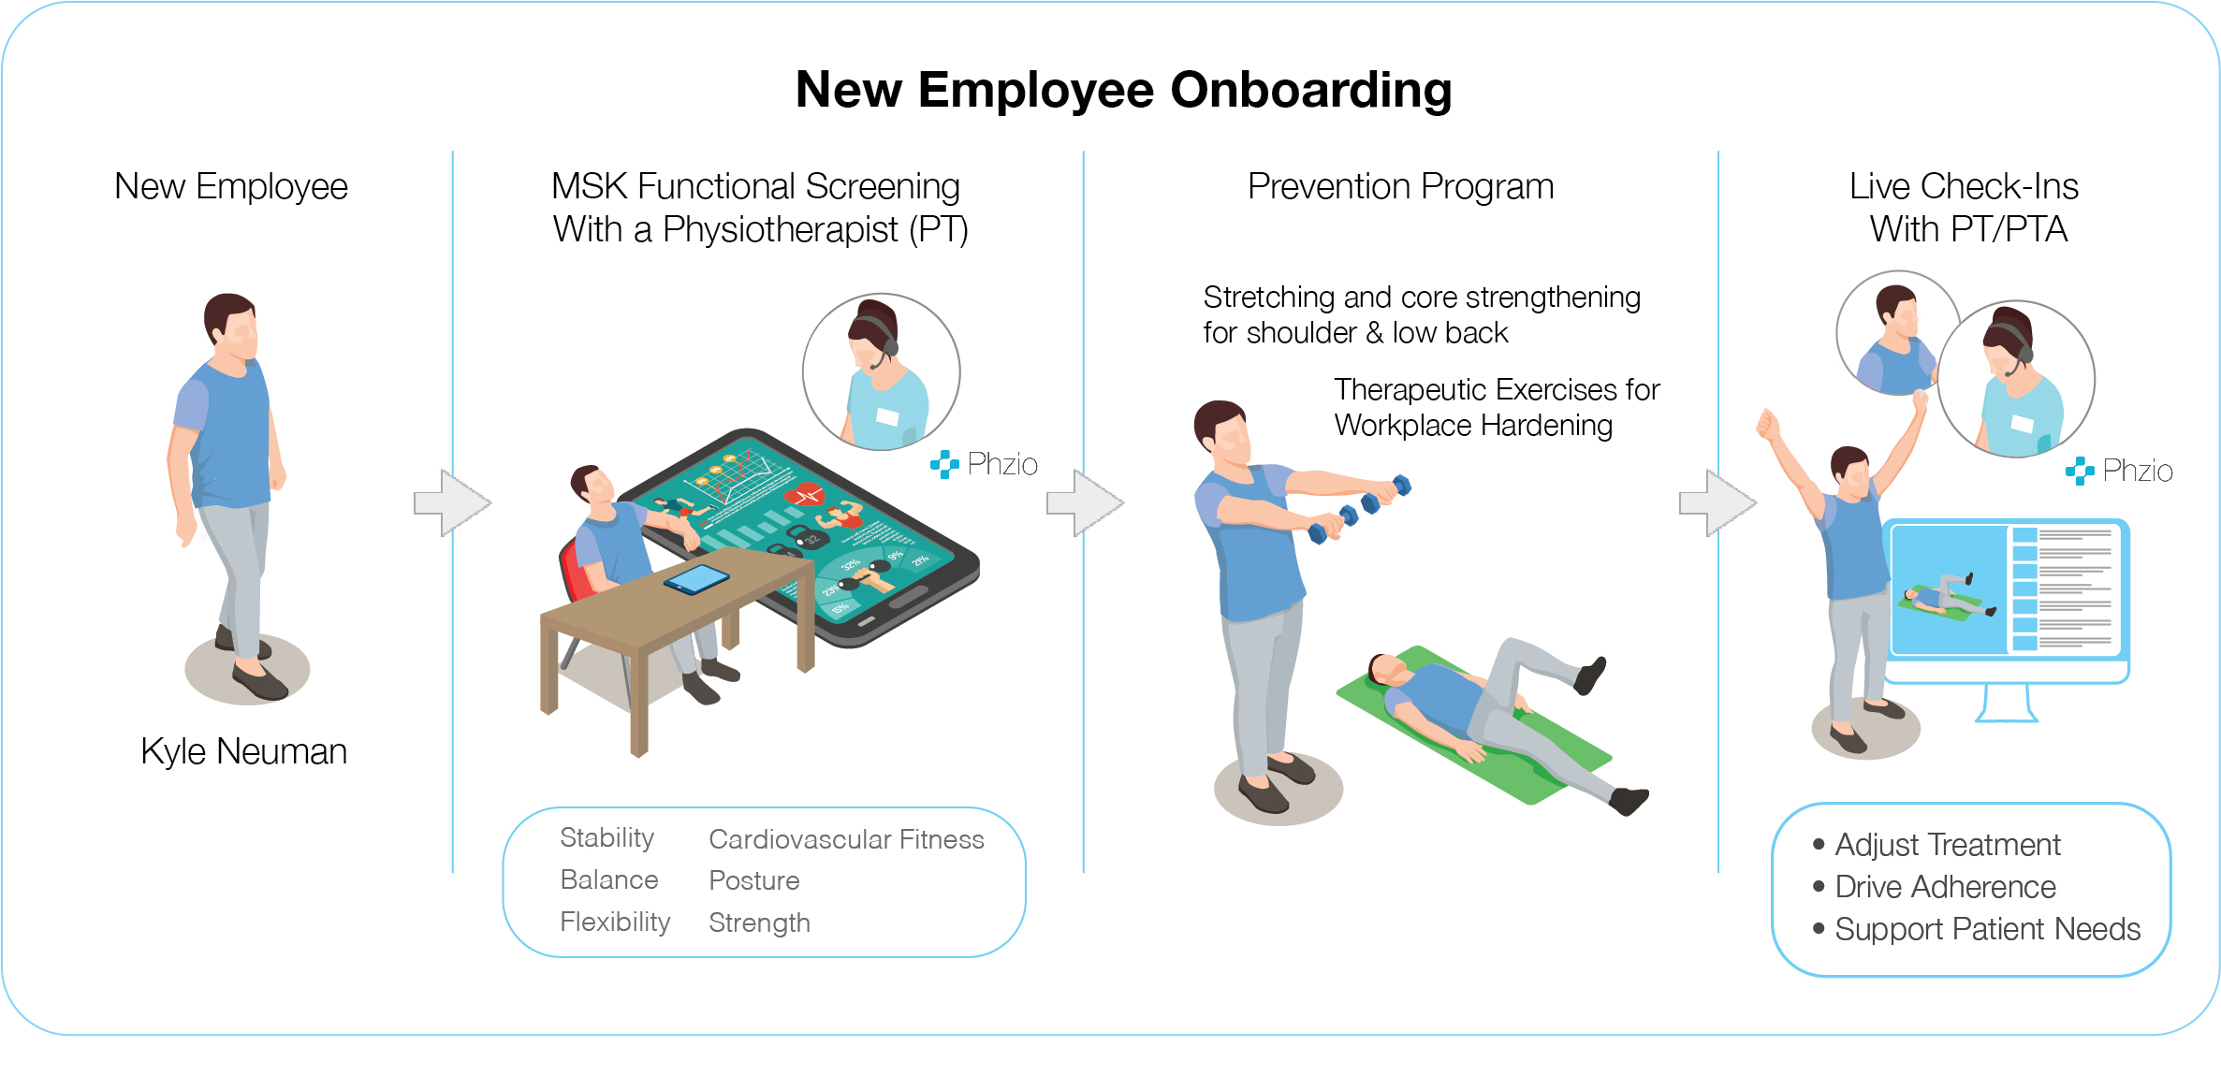

Slide 12
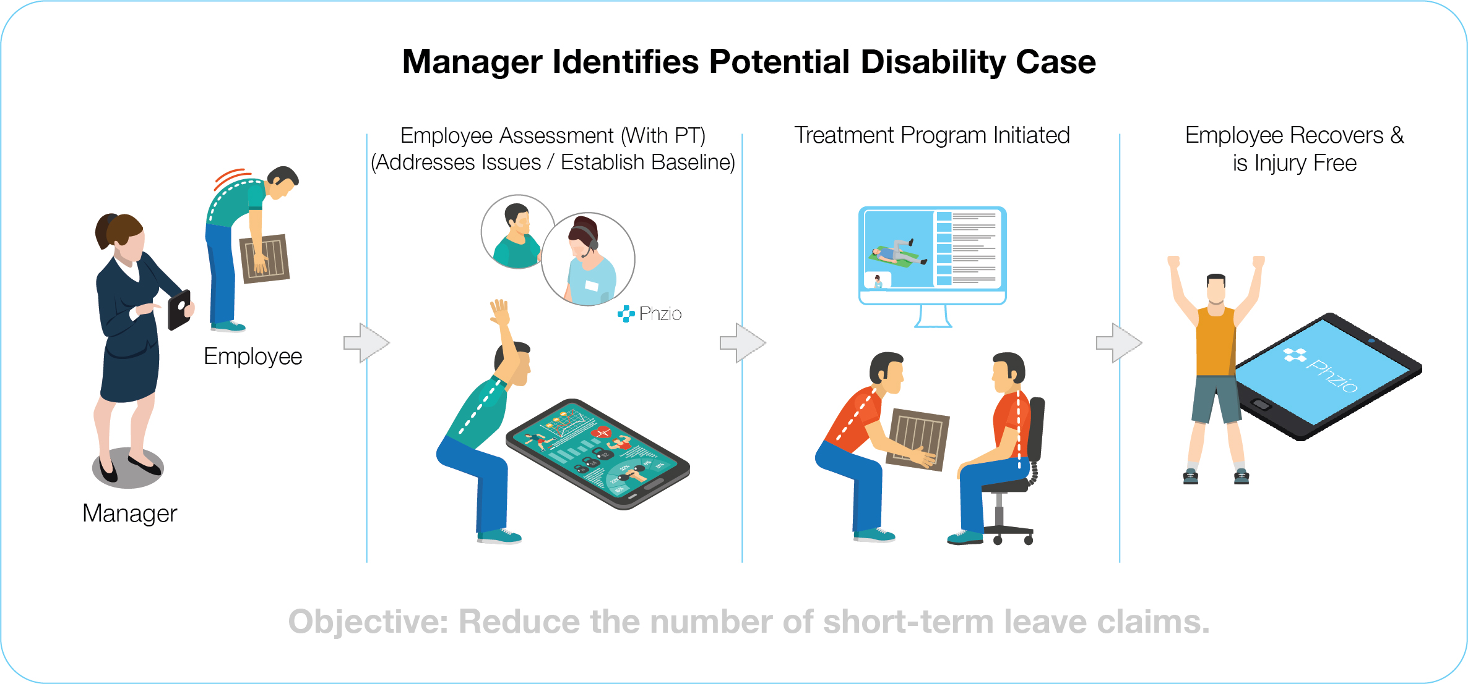

Slide 13
Employee Engagement
Drive Prevention, Adherence, & Outcomes
Education = Prevention
Awareness = Early Intervention
Supervision = Adherence
Adherence = Outcomes

Slide 14
Traditional PT
$100
ASSESSMENT
Cost
Compare
$2 PER EMPLOYEE PER MONTH (PEPM) –
UNLIMITED ASSESSMENTS AND FOLLOW-UPS
$80
FOLLOW UP

Slide 15
Traditional PT
^{[EHC]}
$100
ASSESSMENT
Cost
Compare
$59
ASSESSMENT
$80
FOLLOW UP
$39
FOLLOW UP

Slide 16
Thank you!
Questions?
dfogt@phzio.com

