Slide 1
Q2 2019 Earnings Call

Slide 2
Legal Disclaimer
This presentation contains forward-looking statements within the meaning of the federal securities law. All statements other than statements of historical facts contained in this presentation, including statements regarding our future results of operations and financial position, business strategy and plans and objectives of management for future operations, are forward-looking statements. In many cases, you can identify forward-looking statements by terms such as “may,” “should,” “expects,” “plans,” “anticipates,” “could,” “intends,” “target,” “projects,” “contemplates,” “believes,” “estimates,” “predicts,” “potential” or “continue” or the negative of these terms or other similar words. Forward-looking statements contained in this presentation include, but are not limited to, statements about: (i) growth of the wind energy market and our addressable market; (ii) the potential impact of the increasing prevalence of auction-based tenders in the wind energy market and increased competition from solar energy on our gross margins and overall financial performance; (iii) our future financial performance, including our net sales, cost of goods sold, gross profit or gross margin, operating expenses, ability to generate positive cash flow, and ability to achieve or maintain profitability; (iv) changes in domestic or international government or regulatory policy, including without limitation, changes in trade policy; (v) the sufficiency of our cash and cash equivalents to meet our liquidity needs; (vi) our ability to attract and retain customers for our products, and to optimize product pricing; (vii) our ability to effectively manage our growth strategy and future expenses, including our startup and transition costs; (viii) competition from other wind blade and wind blade turbine manufacturers; (ix) the discovery of defects in our products; (x) our ability to successfully expand in our existing wind energy markets and into new international wind energy markets; (xi) our ability to successfully open new manufacturing facilities and expand existing facilities on time and on budget; (xii) the impact of the accelerated pace of new product and wind blade model introductions on our business and our results of operations; (xiii) our ability to successfully expand our transportation business and execute upon our strategy of entering new markets outside of wind energy; (xiv) worldwide economic conditions and their impact on customer demand; (xv) our ability to maintain, protect and enhance our intellectual property; (xvi) our ability to comply with existing, modified or new laws and regulations applying to our business, including the imposition of new taxes, duties or similar assessments on our products; (xvii) the attraction and retention of qualified employees and key personnel; (xviii) our ability to maintain good working relationships with our employees, and avoid labor disruptions, strikes and other disputes with labor unions that represent certain of our employees; (xix) our ability to procure adequate supplies of raw materials and components to fulfill our wind blade volume commitments to our customers and (xx) the potential impact of one or more of our customers becoming bankrupt or insolvent, or experiencing other financial problems.
These forward-looking statements are only predictions. These statements relate to future events or our future financial performance and involve known and unknown risks, uncertainties and other important factors that may cause our actual results, levels of activity, performance or achievements to materially differ from any future results, levels of activity, performance or achievements expressed or implied by these forward-looking statements. Because forward-looking statements are inherently subject to risks and uncertainties, some of which cannot be predicted or quantified, you should not rely on these forward-looking statements as guarantees of future events. Further information on the factors, risks and uncertainties that could affect our financial results and the forward-looking statements in this presentation are included in our filings with the Securities and Exchange Commission and will be included in subsequent periodic and current reports we make with the Securities and Exchange Commission from time to time, including in our Annual Report on Form 10-K for the year ended December 31, 2018.
The forward-looking statements in this presentation represent our views as of the date of this presentation. We anticipate that subsequent events and developments will cause our views to change. However, while we may elect to update these forward-looking statements at some point in the future, we undertake no obligation to update any forward-looking statement to reflect events or developments after the date on which the statement is made or to reflect the occurrence of unanticipated events except to the extent required by applicable law. You should, therefore, not rely on these forward-looking statements as representing our views as of any date after the date of this presentation. Our forward-looking statements do not reflect the potential impact of any future acquisitions, mergers, dispositions, joint ventures, or investments we may make.
This presentation includes unaudited non-GAAP financial measures including total billings, EBITDA, adjusted EBITDA, net cash (debt) and free cash flow. We define total billings as the total amounts we have invoiced our customers for products and services for which we are entitled to payment under the terms of our long-term supply agreements or other contractual agreements. We define EBITDA as net income (loss) plus interest expense (including losses on the extinguishment of debt and net of interest income), income taxes and depreciation and amortization. We define Adjusted EBITDA as EBITDA plus any share-based compensation expense, plus or minus any gains or losses from foreign currency remeasurement and any gains or losses on the sale of assets. We define net cash (debt) as the total principal amount of debt outstanding less unrestricted cash and cash equivalents. We define free cash flow as net cash flow generated from operating activities less capital expenditures. We present non-GAAP measures when we believe that the additional information is useful and meaningful to investors. Non-GAAP financial measures do not have any standardized meaning and are therefore unlikely to be comparable to similar measures presented by other companies. The presentation of non-GAAP financial measures is not intended to be a substitute for, and should not be considered in isolation from, the financial measures reported in accordance with GAAP. See the appendix for the reconciliations of certain non-GAAP financial measures to the comparable GAAP measures.
This presentation also contains estimates and other information concerning our industry that are based on industry publications, surveys and forecasts. This information involves a number of assumptions and limitations, and we have not independently verified the accuracy or completeness of the information.

Slide 3
Agenda
Q2 2019 Highlights
Q2 2019 Financial Highlights
Guidance for 2019 and 2020 Targets
Q&A
Appendix
  – Non-GAAP Information

Slide 4
Q2 2019 Highlights

Slide 5
Q2 2019 Highlights
Q2 2019 Highlights
Net Sales and Adjusted EBITDA ($ in millions)
  Operating results and year-over-year compared to 2018:
  Net sales were up 43.4% to $330.8 million for the quarter
  Total billings were up 28.3% to $304.5 million for the quarter
  Net income for the quarter was $1.8 million compared to a net loss of $4.1 million in 2018
  Adjusted EBITDA for the quarter was $19.5 million or 5.9% of net sales
  Reached agreement with Nordex to transition multiple existing lines in Turkey to longer blades and extended the end of the contract from 2020 to 2022.
  Acquired a team of engineering resources from the EUROS group, based in Berlin, Germany. The team of approximately 20 technical experts focuses on blade design, tooling, materials and process technology development. It will strengthen our technical capabilities in support of our global operations and growth and the experience and skills of this engineering team will enable us to offer complete blade solutions where valuable.
  Completed negotiations and signed an agreement to sell the remaining Senvion blades in our inventory to Senvion’s customer to enable them to complete a project in Australia.
Net Sales
Adjusted EBITDA
Sets invoiced | 576 | 716
Est. MW | 1,544 | 2,029
Dedicated lines⁽¹⁾ | 52 | 54
Lines installed⁽²⁾ | 40 | 50
Number of wind blade manufacturing lines dedicated to our customers under long-term supply agreements at the end of the period.
Number of wind blade manufacturing lines installed that are either in operation, startup or transition at the end of the period.

Slide 6
Existing Contracts Provide for ~$6.2 Billion in Potential Revenue through 2023⁽¹⁾
Long-term Supply Agreements ⁽¹⁾
 |  | 2019 | 2020 | 2021 | 2022 | 2023
China
India
Iowa
Mexico
Turkey
Long-term supply agreements provide for estimated minimum aggregate volume commitments from our customers of approximately $3.5 billion and encourage our customers to purchase additional volume up to, in the aggregate, an estimated total potential revenue of approximately $6.2 billion through the end of 2023⁽¹⁾
Note: Our contracts with certain of our customers are subject to termination or reduction on short notice, generally with substantial penalties, and contain liquidated damages provisions, which may require us to make unanticipated payments to our customers or our customers to make payments to us.
(1) As of August 7, 2019. The chart depicts the term of the longest contract in each location.

Slide 7
Q2 2019 Financial Highlights

Slide 8
Q2 2019 Financial Highlights ⁽¹⁾
(unaudited)
See Appendix for reconciliations of non-GAAP financial data

Slide 9
Income Statement Summary⁽¹⁾
(unaudited)
See Appendix for reconciliations of non-GAAP financial data

Slide 10
Key Balance Sheet and Cash Flow Data⁽¹⁾
(unaudited)
See Appendix for the reconciliations of net debt and free cash flow

Slide 11
Guidance for 2019 and Targets for 2020

Slide 12
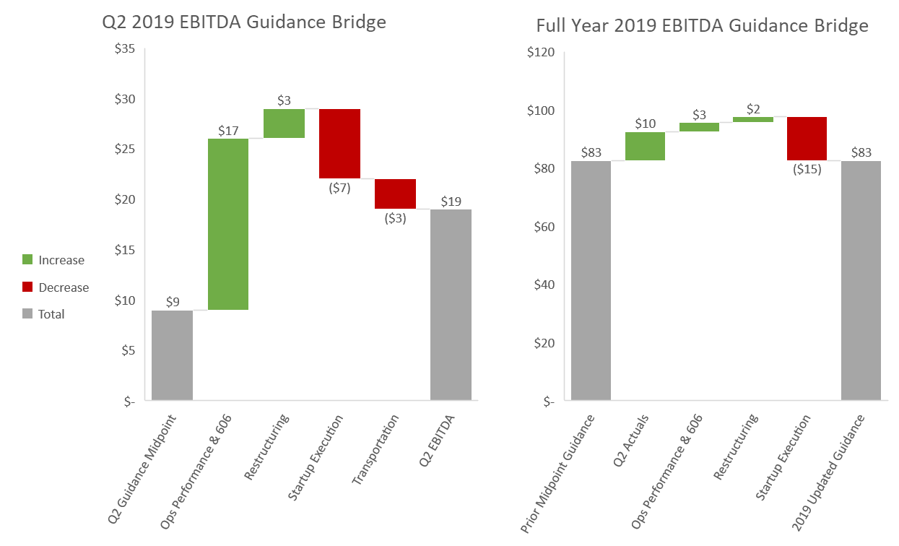
EBITDA Guidance Bridges
($ in millions)

Slide 13
2019 Guidance Metrics and 2020 Targets
 | 2019 Guidance Updated | 2019 Guidance Previous | 2020 Target Updated | 2020 Target Previous
Total Billings | $1.45B – $1.5B | $1.45B – $1.5B | $1.6B – $1.8B | $1.7B – $1.9B
Net Sales | $1.45B – $1.5B | $1.45B – $1.5B | $1.6B – $1.8B | $1.7B – $1.9B
Adjusted EBITDA | $80M – $85M | $80M – $85M | $140M – $160M | $170M – $190M
Earnings (Loss) per Share | ($0.18) – ($0.23) | ($0.03) – ($0.09)
Sets | 3,180 – 3,220 | 3,200 – 3,300
Average Selling Price per Blade | $135K – $140K | $135K – $140K
Non-Blade Billings | $100M – $105M | $100M – $105M
G&A Costs as a % of Billings (incl. SBC and loss on sale of receivables) | 4.0% – 4.25% | 4.0% – 4.25%
Estimated MW | 9,300 – 9,400 | 9,400 – 9,700
Dedicated Lines - EOY | 52 – 55 | 60 – 63
Share-Based Compensation | $7M – $8M | $7M – $8M
Depreciation & Amortization | $37M – $38M | $41M – $42M
Net Interest Expense | $8.0M – $8.5M | $8.5M – $9.5M
Capital Expenditures | $95M – $100M | $95M – $100M
Effective Tax Rate | NM | NM
Note: All references to lines refers to wind blade manufacturing lines

Slide 14
2019 Startup and Transition Guidance Metrics
 | Q1A | Q2A | Q3F | Q4F | 2019 Guidance Updated | 2019 Guidance Previous
Lines Installed – end of period ⁽¹⁾ | 49 | 50 | 48 | 48 | 48 | 48 - 50
Lines in Startup – during period | 13 | 13 | 10 | 3 | 14 | 14
Lines in Transition – during period | 5 | 7 | 8 | 2 | 10 | 10
Startup Costs | $16.1M | $14.7M | $10.5M – $11.5M | $5.7M – $6.7M | $47.0M – $49.0M | $43.0M – $45.0M
Transition Costs | $2.1M | $8.2M | $7.7M – $8.7M | $1.0M – $2.0M | $19.0M – $21.0M | $22.1M – $24.0M
Line Utilization % (based on 50 lines in Q1/Q2 and 48 lines in Q3/Q4) | 64% | 70% | 88% - 90% | 96% - 98% | 79% - 80% | 80% - 82%
Sets | 662 | 716 | 865 – 885 | 937 - 957 | 3,180 – 3,220 | 3,200 – 3,300
Note: All references to lines refers to wind blade manufacturing lines
(1) Senvion lines get deinstalled at the end of Q2

Slide 15
Q&A

Slide 16
Appendix – Non-GAAP Information
This presentation includes unaudited non-GAAP financial measures including total billings, EBITDA, adjusted EBITDA, net cash (debt) and free cash flow. We define total billings as the total amounts we have invoiced our customers for products and services for which we are entitled to payment under the terms of our long-term supply agreements or other contractual agreements. We define EBITDA as net income (loss) plus interest expense (including losses on the extinguishment of debt and net of interest income), income taxes and depreciation and amortization. We define Adjusted EBITDA as EBITDA plus any share-based compensation expense, plus or minus any gains or losses from foreign currency remeasurement and any gains or losses on the sale of assets. We define net cash (debt) as the total principal amount of debt outstanding less unrestricted cash and cash equivalents. We define free cash flow as net cash flow generated from operating activities less capital expenditures. We present non-GAAP measures when we believe that the additional information is useful and meaningful to investors. Non-GAAP financial measures do not have any standardized meaning and are therefore unlikely to be comparable to similar measures presented by other companies. The presentation of non-GAAP financial measures is not intended to be a substitute for, and should not be considered in isolation from, the financial measures reported in accordance with GAAP. See below for a reconciliation of certain non-GAAP financial measures to the comparable GAAP measures.

Slide 17
Non-GAAP Reconciliations
(unaudited)
Net sales is reconciled to total billings as follows:
Net income (loss) is reconciled to EBITDA and adjusted EBITDA as follows:

Slide 18
Non-GAAP Reconciliations (continued)
(unaudited)
Net debt is reconciled as follows:
Free cash flow is reconciled as follows:

Slide 19
Non-GAAP Reconciliations (continued)
(unaudited)
A reconciliation of the low end and high end ranges of projected net loss to projected EBITDA and projected adjusted EBITDA is as follows:

