Slide 1
Q3 2020 Earnings Oct. 29, 2020

Slide 2
Safe Harbor
The Securities and Exchange Commission (“SEC”) encourages companies to disclose forward-looking information so that investors can better understand a company’s future prospects and make informed investment decisions. Certain statements in this communication are forward-looking statements and are made pursuant to the safe harbor provisions of the Securities Litigation Reform Act of 1995. These forward-looking statements reflect, among other things, our current expectations, plans, strategies, and anticipated financial results. There are a number of risks, uncertainties, and conditions that may cause our actual results to differ materially from those expressed or implied by these forward-looking statements. These risks and uncertainties include a number of factors related to our business, including the uncertainties relating to the impact of the novel coronavirus (COVID-19) pandemic on the company’s business, results of operations, cash flows, stock price and employees; economic and financial market conditions generally and economic conditions in our service areas; various risks to the price and volatility of our common stock; changes in the valuation of pension plan assets; the substantial amount of debt and our ability to repay or refinance it or incur additional debt in the future; our need for a significant amount of cash to service and repay the debt restrictions contained in our debt agreements that limit the discretion of management in operating the business; regulatory changes, including changes to subsidies, rapid development and introduction of new technologies and intense competition in the telecommunications industry; risks associated with our possible pursuit of acquisitions; system failures; cyber-attacks, information or security breaches or technology failure of ours or of a third party; losses of large customers or government contracts; risks associated with the rights-of-way for the network; disruptions in the relationship with third party vendors; losses of key management personnel and the inability to attract and retain highly qualified management and personnel in the future; changes in the extensive governmental legislation and regulations governing telecommunications providers and the provision of telecommunications services; new or changing tax laws or regulations; telecommunications carriers disputing and/or avoiding their obligations to pay network access charges for use of our network; high costs of regulatory compliance; the competitive impact of legislation and regulatory changes in the telecommunications industry; and liability and compliance costs regarding environmental regulations; and risks associated with discontinuing paying dividends on our common stock. A detailed discussion of these and other risks and uncertainties that could cause actual results and events to differ materially from such forward-looking statements are discussed in more detail in our filings with the SEC, including our reports on Form 10-K and Form 10-Q. Many of these circumstances are beyond our ability to control or predict. Moreover, forward-looking statements necessarily involve assumptions on our part. These forward-looking statements generally are identified by the words “believe,” “expect,” “anticipate,” “estimate,” “project,” “intend,” “plan,” “should,” “may,” “will,” “would,” “will be,” “will continue” or similar expressions. Such forward-looking statements involve known and unknown risks, uncertainties and other factors that may cause actual results, performance or achievements of Consolidated Communications Holdings, Inc. and its subsidiaries to be different from those expressed or implied in the forward-looking statements. All forward-looking statements attributable to us or persons acting on our behalf are expressly qualified in their entirety by the cautionary statements that appear throughout this communication. Furthermore, forward-looking statements speak only as of the date they are made. Except as required under the federal securities laws or the rules and regulations of the SEC, we disclaim any intention or obligation to update or revise publicly any forward-looking statements. You should not place undue reliance on forward-looking statements.

Slide 3
Non-GAAP Measures
This presentation includes certain non-GAAP historical and forward-looking financial measures, including but not limited to “EBITDA,” “adjusted EBITDA,” “total net debt to last twelve month adjusted EBITDA ratio,” and “free cash flow.” In addition to providing key metrics for management to evaluate the Company’s performance, we believes these measurements assist investors in their understanding of operating performance and in identifying historical and prospective trends.
A reconciliation of the differences between these non-GAAP financial measures and the most directly comparable financial measures presented in accordance with GAAP are available on the Company’s website at https://ir.consolidated.com. Non-GAAP measures are not presented to be replacements or alternatives to the GAAP measures, and investors are urged to consider these non-GAAP measures in addition to, and not in substitution for, measures prepared in accordance with GAAP. Consolidated may present or calculate its non-GAAP measures differently from other companies.
Consolidated has filed a Form 8-K reporting the quarterly results for the third quarter of 2020. The 8-K must be read in conjunction with this presentation and contains additional important details on the quarterly results.
.

Slide 4
Third Quarter 2020 Highlights
Q3-2020 as compared to Q3-2019
New Capitalization Plan Positions Company for Return to Growth
Announced strategic partnership with Searchlight Capital Partners, closed on $350M capital infusion and completed global refinancing on 10/2/20
Lowered net debt ratio from 4.39x to 4.01x, as of Sept. 30, 2020
Total liquidity: $191.6M, as of Sept. 30, 2020
Delivered Stable Revenue and Adjusted EBITDA Growth
Revenue: $327.1M, down 1.9%
Adjusted EBITDA: $132.2M, up 1.0%
Free Cash Flow: increased $39.6M in Q3-20 and $128.9M YTD
Capital expenditures: $56M in Q3-20 and $152.2M YTD
Leveraging Fiber Assets Across Three Customer Groups
Data & Transport revenue: up 1.6%
Broadband revenue: up 2.6% (6th consecutive quarter)
Fiber lit buildings +12.5%; 1,100 fiber-route miles added
Stable and improved Adjusted EBITDA and revenue trends reflecting resiliency of business
Global refinancing strengthened balance sheet; lowered leverage and increased liquidity
Strategic investment accelerates fiber expansion plans enabling return to growth

Slide 5
The New Consolidated Communications
Strategic transformation underway for return to growth
Dividend Cut + New Capital Allocation Plan
Lowered Leverage, Extended Maturities, Enhanced Liquidity Profile
Aggressive Debt Paydown from Free Cash Flow
Deliver Best-in-Class Services and Customer Experience Across Three Customer Groups
Conservative Financial Policy
Future-proof the Fiber Network
Accelerate Investment in Business: $425M Committed Capital Infusion
Return to Revenue Growth
$350M Searchlight investment

Slide 6
Third Quarter 2020 Results
$ in millions
 | Q3-20 | Y/Y | YTD 2020 | Y/Y
Total Revenue | $327.1 | (1.9%) | $977.9 | (2.7%)
Adjusted EBITDA | $132.2 | 1.0% | $396.9 | 1.1%
Adjusted EBITDA margin | 40.4% | 1.1% | 40.6% | 1.5%
Third Quarter Highlights
Improved revenue trends driven by broadband and data/transport growth; higher voice retention
Adjusted EBITDA margins improved as a result of improved cost structure, technology and process improvements
Cost management resulted in a 3.3% or $7.2M reduction in operating expenses
Wireless cash distributions totaled $12.3M in Q3

Slide 7
Commercial and Carrier Revenue
$ in millions, Q3-2020 as compared to Q3-2019
Q3-20 Results
Commercial and Carrier Revenue
Data and Transport Revenue: +1.6%
On-net buildings: 13,202, +12.5%
Tower wireless connections: 3,890, +1.9%
Ethernet revenue +2.8%
VoIP revenue +12%
Q3-20 | Y/Y | YTD 2020 | Y/Y
$146.4 | (0.5%) | $439.2 | (1.9%)
Commercial and Carrier Highlights
Data and Transport Revenue
Introduced Exterprise@Home
Enhanced Cloud Services with Pax8 Partnership
Expanded launch of Microsoft Productivity Suite
Q3-20 | Y/Y | YTD 2020 | Y/Y
$90.2 | 1.6% | $269.3 | 1.5%

Slide 8
Consumer Revenue
$ in millions, Q3-2020 as compared to Q3-2019
Q3-20 Results
Broadband Revenue
Consumer revenue: $128.4 M
Consumer broadband revenue: +2.6%; (sixth consecutive quarter of growth)
Consumer ARPU: +4.6%
Voice revenue decline improved from 10.4% in Q3-19 to 6.0% in Q3-20
Q3-20 | Y/Y | YTD 2020 | Y/Y
$67.2 | 2.6% | $196.8 | 2.2%
Consumer ARPU
Consumer Strategy and Highlights
Lead with broadband; upgrade to faster speeds
Increase consumer ARPU; reduce churn
Leverage public-private partnerships to expand broadband services economically
CCiTV expansion to new markets in 2020; launched service in Texas in Q2, CA and IL in Q3

Slide 9
Capital Allocation and Liquidity Update
Debt Maturity ($ in M)
Successful Recapitalization
New Capitalization following refinance and Searchlight Investment completed on October 2, 2020
Revolving Credit Facility: $250M (unused)
Secured Term Loan: $1,250M, priced at LIBOR+ coupon rate of 4.75% per annum, with 1.0% floor
Senior Secured Notes: $750M, 6.5%
No Short-Term Maturities
Net Debt Leverage
(1)
(1) Pro forma net debt leverage at 9/30/20 includes the net cash proceeds from the refinancing and Searchlight’s Stage 1 investment of $350M completed on 10/2/20

Slide 10
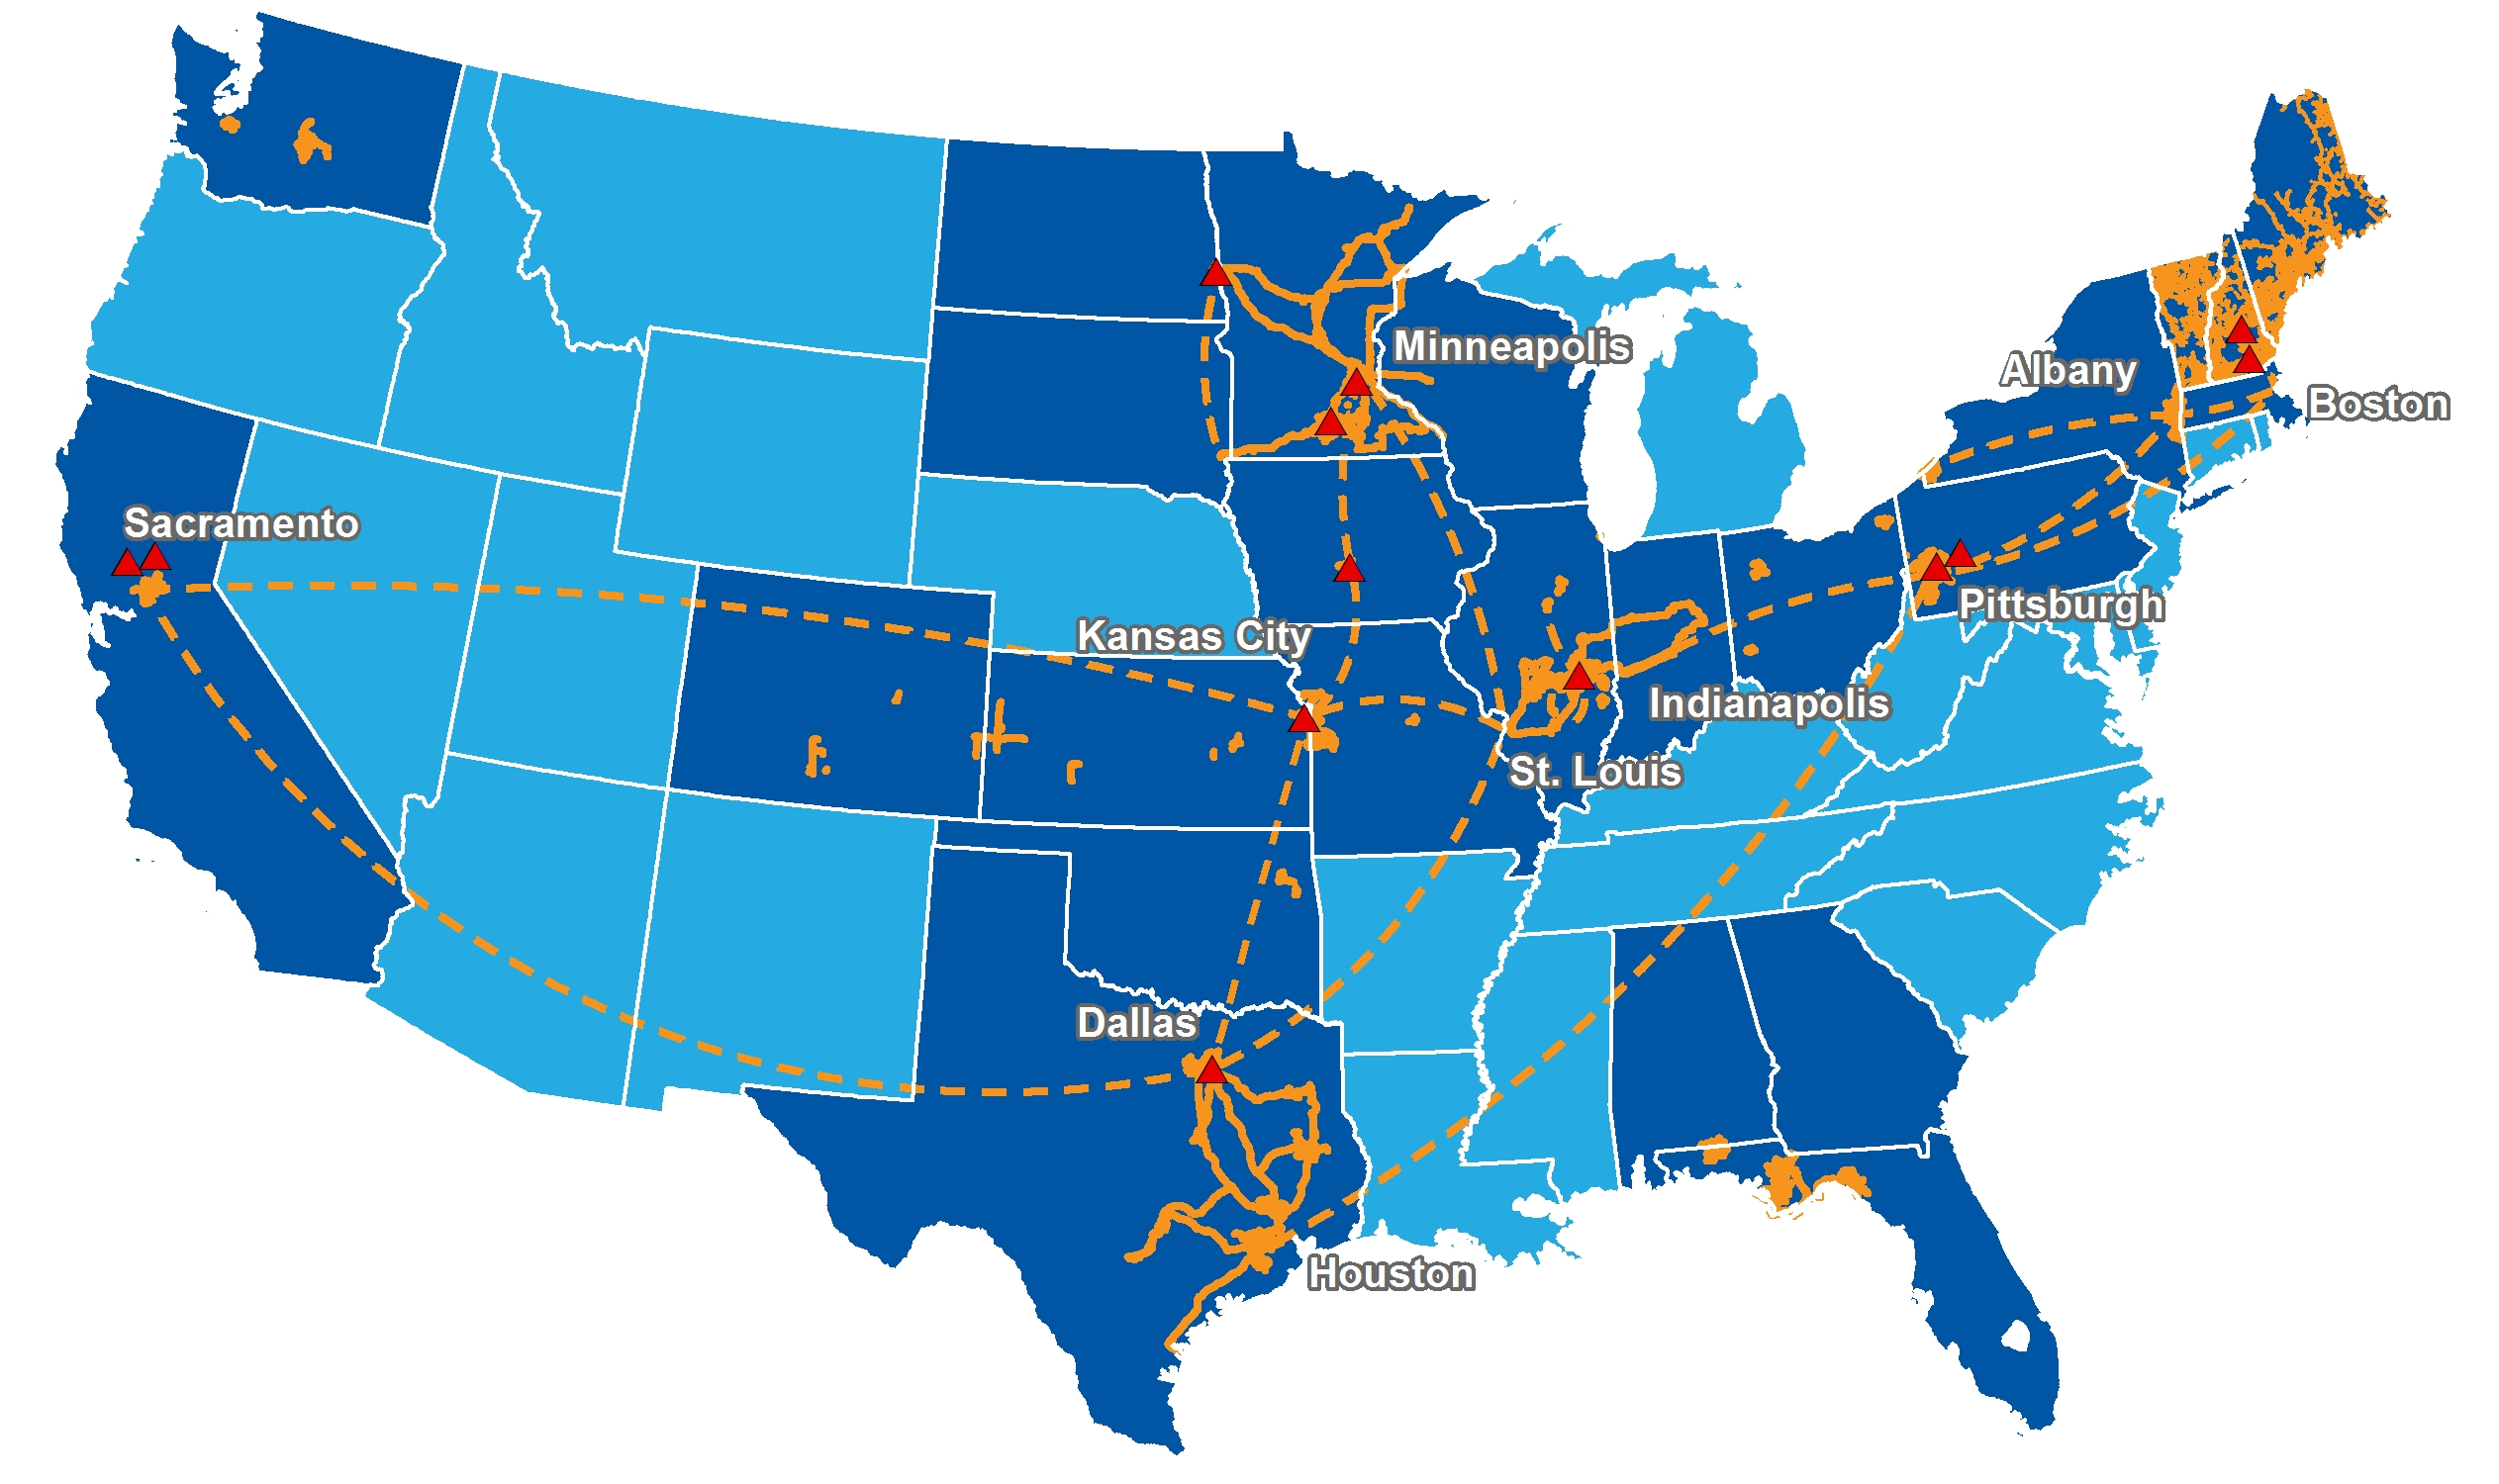
Consolidated’s Fiber-Rich Network
46,300
Fiber-route miles
2M+ Fiber-strand miles
13,200 On-net locations
550 Fiber hubs/COs 3,900
Fiber connections to wireless providers
13
Data centers
23 Operating states
Data Centers
Fiber Networks
Leased Fiber
Operating States

Slide 11
Consolidated Strategic Imperatives
Achieve Top Line Growth by Accelerating FTTH, Expanding Commercial and Carrier Opportunities
Improve EBITDA margins through simplified best-in-class fiber broadband services
Leverage low costs to upgrade 1M+ near net fiber passings
Three Diverse Customer Groups Benefiting From Significant Fiber Expansion
Top 10 fiber provider in the U.S.; 23 states; 46,300 fiber route miles and growing
Compelling Consumer, Commercial and Carrier growth opportunities
Deliver a superior product offering with best-in-class customer experience
New Capital Structure with Extended Maturities and Increased Liquidity, Positions Company for Accelerated Growth
Improved leverage profile of 3.5x¹
Target substantially all free cash flow to focus on highest return fiber expansion projects and increase market share
Strategic Asset Portfolio Review
Continue to evaluate assets for fiber investment or monetization
Ensure all assets have a long-term, strategic fit
¹ Pro forma net debt leverage at 9/30/20 includes the net cash proceeds from the refinancing and Searchlight’s Stage 1 investment of $350M completed on 10/2/20

Slide 12
Free Cash Flow
Improved Cash Flow; Stronger Balance Sheet
$ in millions | Q3-20 |  | Q3-19 |  | YTD 2020 |  | YTD 2019
Adjusted EBITDA | $ 132.2 |  | $ 131.0 |  | $ 396.9 |  | $ 392.7
Interest Payments | (23.0) |  | (26.5) |  | (84.6) |  | (92.5)
Pension and OPEB Payments | (11.8) |  | (12.2) |  | (26.6) |  | (28.0)
Restructuring, Severance and Other ⁽¹⁾ | - |  | (1.1) |  | - |  | (14.0)
Income Tax Payments, net of refunds | (0.8) |  | (0.1) |  | (1.0) |  | (0.6)
Working Capital and Other | 19.0 |  | (5.7) |  | 12.7 |  | (9.0)
Cash provided by Operating Activities | $ 115.6 |  | $ 85.4 |  | $ 297.4 |  | $ 248.6
Capital expenditures | (56.0) |  | (64.6) |  | (152.2) |  | (184.3)
Proceeds from sale of assets | 0.9 |  | 0.1 |  | 7.0 |  | 14.3
Free Cash Flow ⁽²⁾ | $ 60.5 |  | $ 20.9 |  | $ 152.2 |  | $ 78.6
Includes acquisition and non-recurring related costs, and certain miscellaneous items.
(2) 2019 Free Cash Flow excludes $55.4 million in dividends made prior to the change in capital allocation policy announced in April 2019.

Slide 13
Q&A Q3 2020 Earnings

