Slide 1

4Q19 / Full-Year 2019 Results Conference Call
Investor Presentation

Slide 2
SAFE-HARBOR STATEMENT
Broadwind obtained the industry and market data used throughout this presentation from our own research, internal surveys and studies conducted by third parties, independent industry associations or general publications and other publicly available information. Independent industry publications and surveys generally state that they have obtained information from sources believed to be reliable, but do not guarantee the accuracy or completeness of such information. Forecasts are particularly likely to be inaccurate, especially over long periods of time. We are not aware of any misstatements in the industry data we have presented herein, but estimates involve risks and uncertainties and are subject to change based on various factors beyond our control.
Our forward-looking statements may include or relate to our beliefs, expectations, plans and/or assumptions with respect to the following: (i) state, local and federal regulatory frameworks affecting the industries in which we compete, including the wind energy industry, and the related extension, continuation or renewal of federal tax incentives and grants and state renewable portfolio standards as well as new or continuing tariffs on steel or other products imported into the United States; (ii) our customer relationships and our substantial dependency on a few significant customers and our efforts to diversify our customer base and sector focus and leverage relationships across business units; (iii) our ability to continue to grow our business organically and through acquisitions; (iv) the production, sales, collections, customer deposits and revenues generated by new customer orders and our ability to realize the resulting cash flows; (v) the sufficiency of our liquidity and alternate sources of funding, if necessary; (vi) our ability to realize revenue from customer orders and backlog; (vii) our ability to operate our business efficiently, comply with our debt obligations, manage capital expenditures and costs effectively, and generate cash flow; (viii) the economy and the potential impact it may have on our business, including our customers; (ix) the state of the wind energy market and other energy and industrial markets generally and the impact of competition and economic volatility in those markets; (x) the effects of market disruptions and regular market volatility, including fluctuations in the price of oil, gas and other commodities; [(xi) competition from new or existing industry participants including, in particular, increased competition from foreign tower manufacturers with access to lower cost steel]; (xii) the effects of the change of administrations in the U.S. federal government; (xiii) our ability to successfully integrate and operate companies and to identify, negotiate and execute future acquisitions; (xiv) the potential loss of tax benefits if we experience an “ownership change” under Section 382 of the IRC; (xv) the limited trading market for our securities and the volatility of market price for our securities; and (xvi) the impact of future sales of our common stock or securities convertible into our common stock on our stock price. These statements are based on information currently available to us and are subject to various risks, uncertainties and other factors. We are under no duty to update any of these statements. You should not consider any list of such factors to be an exhaustive statement of all of the risks, uncertainties or other factors that could cause our current beliefs, expectations, plans and/or assumptions to change.
This presentation contains non-GAAP financial information. We believe that certain non-GAAP financial measures may provide users of this financial information with meaningful comparisons between current results and results in prior operating periods. We believe that these non-GAAP financial measures can provide additional meaningful reflection of underlying trends of the business because they provide a comparison of historical information that excludes certain infrequently occurring or non-operational items that impact the overall comparability. Non-GAAP financial measures should be viewed in addition to, and not as an alternative to, our reported results prepared in accordance with GAAP. Please see our earnings release dated February 27, 2020 for a reconciliation of certain non-GAAP measures presented in this presentation.

Slide 3
PERFORMANCE
OVERVIEW

Slide 4
4Q19 EXECUTIVE SUMMARY
1. Total backlog +48% y/y to $142.3 million: Driven by growth in Heavy Fabrications and Diversification
Total Heavy Fabrications backlog +$53.6 million y/y, significant growth in towers sold, expansion of industrial fabrications
2. Total Revenue + 81% y/y to $49.3 million: Highest quarterly revenue since 1Q17
Growth driven by recovery in tower demand
3. Heavy Fabrications revenue +210% y/y; Seeing accelerated demand for wind towers
Tower plants operating at 75% capacity
4. Gearing revenue -30% y/y: Impacted by lower oil/gas activity
Richer product mix provides earnings resilience; record full year operating profit of $3.2M
5. Industrial Solutions revenue flat y/y: First solar kitting order received during 4Q19; y/y growth in EBITDA
Lower NGT-related deliveries offset by first solar kitting order; generated third consecutive quarter of positive EBITDA

Slide 5
4Q19 EXECUTIVE SUMMARY (Continued)
6. Total Adjusted EBITDA $1.8 million in 4Q19 vs. ($1.7) million in 4Q18
Y/Y growth in Heavy Fabrications and Industrial Solutions Adj. EBITDA more than offset y/y decline in Gearing
7. Total cash and availability of $19.0 million as of 12/31/19
Working capital management initiatives successful; working capital declines to 3% of sales
8. Production Tax Credit (PTC) extension provides uplift in wind tower demand into 2024 and beyond
December legislation provides 60% PTC for projects commenced during 2020
9. Favorable preliminary outcome on trade litigation
Limits wind tower producers in Indonesia, Canada, Vietnam and Korea from participating in unfair trade practices in the U.S.
10. BWEN leadership transition underway, effective March 1, 2020
Current CEO Kushner will retire as CEO and become Chairman of the Board; current COO Blashford named CEO

Slide 6
FIVE-YEAR HISTORICAL TREND DATA
Significant Y/Y Increase In Orders and Backlog Exiting 2019
Total Annual Orders
($MM)
Backlog
($MM)
1
Surge of Tower orders to support scheduled PTC installations
2
Significant Tower customer adds in ’19; Positive ’20 outlook
3
$21 MM of Industrial fabrication orders booked in 2019

Slide 7
KEY FINANCIAL DATA
Fourth Quarter and Full-Year 2019
Total Revenue
($MM)
Gross Profit
($MM)
1
CY revs +42% y/y due to consistency of tower production, industrial fabrications growth
2
Improved operating leverage due to higher volume and production efficiencies
Adjusted EBITDA
($MM)
Diluted EPS
($ Per Share)
3
$8.2 MM improvement in EBITDA y/y

Slide 8
HEAVY FABRICATIONS SEGMENT
Positive Commercial Momentum Leading to Improved Operating Performance
Tower sections sold up to ~300 in Q4; 75% plant utilization
Revenue
($MM)
Adjusted EBITDA
($MM)
1
2
Margin pressure during ’19 due to tower imports and supply chain challenges
Orders
($MM)
Backlog
($MM)
3
37% y/y increase in full-year Industrial Fabrications orders
4
~65% of 2020 tower production in 12/31 backlog
12/31/18
9/30/19
12/31/19

Slide 9
HEAVY FABRICATIONS SEGMENT
PTC-Driven Demand For Tower Sections
Total Tower Sections Sold
(Number of Sections)
+372% y/y
+84% y/y
+31% y/y
Flat y/y
Note: In December 2019, the United States production tax credit for renewable wind projects was extended for one-year, pursuant to a year-end 2019 appropriations bill, from January 1, 2020 to January 1, 2021. As a result of the new legislation, the PTC will subsidize wind projects commenced as late as 2020 and completed by 2024, or later, if continuous construction can be demonstrated. The extension of the PTC is expected to result in a material, near-term increase in wind tower orders during calendar 2020, as producers seek to capture the ratable economic benefit associated with the PTC extension.

Slide 10
GEARING SEGMENT
Higher-Value Sales Mix Contributes To Improved EBITDA Generation
Generated record operating income of $3.2 MM, EBITDA margin of 16.1%
Revenue
($MM)
Adjusted EBITDA
($MM)
1
2
Improved margins in Mining, Steel and Wind
Orders
($MM)
Backlog
($MM)
3
Frac gear demand off 2018 highs
4
Custom gearbox revenue doubled y/y in 2019
12/31/18
9/30/19
12/31/19

Slide 11
INDUSTRIAL SOLUTIONS SEGMENT
Benefited From First Solar Kitting Order In The Fourth Quarter 2019
1
3rd consecutive quarter of positive EBITDA – orders increased 25% y/y
Revenue
($MM)
Adjusted EBITDA
($MM)
2
Increased market share gains, seeing positive momentum – orders for NGT content +90% y/y
Orders
($MM)
Backlog
($MM)
3
Recorded $0.8 MM of accelerated amortization in 4Q19 due to rebranding initiative
12/31/18
9/30/19
12/31/19

Slide 12
BALANCE SHEET UPDATE
Improved Operational Performance / Working Capital Initiatives Bolstering Liquidity
Operating Working Capital as a % of Sales
($MM)(1)
3/31/18
6/30/18
9/30/18
12/31/18
3/31/19
6/30/19
9/30/19
12/31/19
Total Cash and Availability on Credit Facility
($MM)
3/31/18
6/30/18
9/30/18
12/31/18
3/31/19
6/30/19
9/30/19
12/31/19
(1) Operating working capital divided by TTM sales

Slide 13
MANAGEMENT OUTLOOK

Slide 14
FINANCIAL GUIDANCE
Current as of February 27, 2020
Revenue Guidance ($MM)
Adjusted EBITDA Guidance ($MM)
1Q20
Forecast
Full-Year 2020
Forecast
1Q20
Forecast
Full-Year 2020
Forecast
Total Company
$48.0 to $52.0
$200 to $220
$2.8 to $3.5
$12 to $14
Heavy Fabrications
$37.0 to $40.0
$4.0 to $4.5
Gearing
$7.0 to $7.5
$0.5 to $0.7
Industrial Solutions
$4.0 to $4.5
$0.0 to $0.2
Corporate/Other
($1.6) to ($1.9)

Slide 15
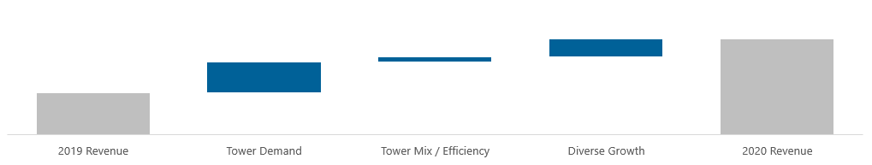
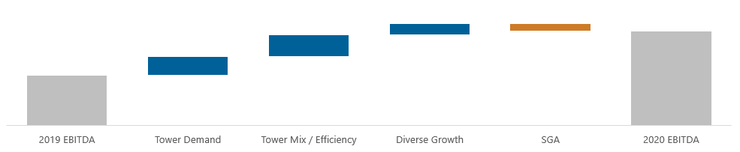
FINANCIAL GUIDANCE PERFORMANCE BRIDGE
Full-Year 2019 vs. Full-Year 2020
2020 Revenue Bridge
($MM)
$200 to $220
$178.2
2020 EBITDA Bridge
($MM)
$12 to $14
$7.2

Slide 16
BROADWIND OVERVIEW
Positioned For Profitable Growth
About Us
Unique Value Proposition
We are a precision manufacturer of structures, equipment and components for clean tech and other specialized industrial applications
Proven technical capabilities
Complete turnkey solutions
Large scale complex fabrications & precision products
Stringent quality standards
Multi-industry focus
Key Strategic Priorities
Diversify customer and product line concentrations beyond the wind energy sector
Maintain elevated capacity utilization levels, while broadening our manufacturing capabilities
Continuously enhance production technology and operational efficiency
Acquire assets that complement our geographic presence and/or product/service offering
Maintain balance sheet optionality to pursue growth investments

Slide 17
KEY INITIATIVES BY SEGMENT
Positioned For Profitable Growth
Heavy Fabrications Segment
Continued growth in both wind and non-wind
markets
  Sell remaining ’20 tower capacity and expand tower and repowering customer base
  Add production capabilities and complete key systems upgrades to maximize profitability
  Develop offshore tower market strategy
  Grow Industrial Fabrication product line customer base
  Expand engineering and supply chain organization to support evolving tower market
  Take continuous improvement actions to ensure "zero defect" quality ratings
Gearing Segment
Focused on Gearbox market share growth, increase weighting in less cyclical end-markets
  Accelerate end-market diversification beyond oil/gas gearing market
  Expand engineering and sales presence
  Grow custom gearbox business; expand repair business geographically
  Leverage recently completed systems initiatives to maximize profitability
  Continue core focus on NGT and aftermarket, while expanding customer base
  Pursue solar energy installation market; a large, untapped opportunity
  Leverage BWEN engineering and business development resources
Industrial Solutions Segment
Heavily focused on revenue diversification within gas turbines and growth in solar market

Slide 18
CUSTOMER DIVERSIFICATION INITIATIVE
Applying Precision Manufacturing Expertise Beyond Wind Energy
Customer Concentration
2016 vs. 2019 (as % of total revenue)
Non-Wind Revenue By Sector
2016 vs. 2019 (as % of total revenue)
1
Continued to execute on customer diversification initiative
2
Non-wind revenue ~1/3 of total revenue exiting 2019
Wind vs. Non-Wind Revenue Concentration
2016-2019 ($MM)(1)
3
Continue to experienced significant growth in most non-wind markets
(1) Wind energy figures shown above exclude repair/replacement demand

Slide 19
U.S. WIND SECTOR OUTLOOK
On-Shore Ramp Occurring; Off-Shore Ramp Beginning In 2023
Who We Serve
U.S. Wind Power On-Shore and Off-Shore Capacity Installations
(Annual On-Shore GW Installed)(1)
Wind turbine OEMs
Wind farm operators
Wind farm developers
15.2
12.5
Our Products
Tower sections
Repowering adapters
Aftermarket gearing
8.3
9.1
7.3
7.8
7.5
6.8
6.9
6.4
6.1
Sector Outlook
Positive Outlook
PTC extension
Positive preliminary outcome on trade case
Source: Wood MacKenzie; wind values include new build and repowering

Slide 20
KEY NON-WIND SECTOR OPPORTUNITIES
Growth Forecasts By Sectors
Mining activity levels continue to be strong
U.S Industrial Machinery Sector
Y/Y Sector Production Growth(1)
U.S. Mining, Oil & Gas, Field Equipment Sector
Y/Y Sector Production Growth(1)
1
2
Focus on Industrial/Material handling markets
Turbines and Power Transmission Sector
Y/Y Sector Production Growth(1)
Construction Sector
Y/Y Sector Production Growth(1)
3
O&G Fracking headwinds, uncertainty remains
4
NGT customer base expanding; key customer regaining share
Source: IHS Markit, AGMA 2020 Forecast (Jan-20)

Slide 21
INVESTMENT THESIS
Diversified Precision Manufacturer Serving Clean Tech and Industrial Applications
1. Leading precision manufacturer with a multi-industry focus
Heritage is in the renewable sector (e.g. Wind); future includes mining, oil/gas, power gen, material handling construction, industrial
2. Multi-year revenue diversification initiative gaining momentum
Annual revenue outside the wind sector is approaching $70 MM, customer concentration improving
3. Total backlog +48% y/y to $142.3 MM, order rates highest since 2016
Plant utilization dramatically improving; margins expected to expand; diverse revenue has increased by nearly 3x since 2016
4. Extension of PTC and preliminary trade case findings provide major catalyst for Heavy Fabrications
Demand for renewable energy driven by government incentives and corporate ESG initiatives
5. Working capital initiatives driving increased liquidity and balance sheet flexibility
$19 MM of liquidity under the company’s $35 MM line of credit
6. Positioned for accelerating growth
Base wind business remains strong; resources added to penetrate new markets

Slide 22
APPENDIX

Slide 23
EXHIBIT A
Orders, Revenues and Operating Income (Loss) By Segment

Slide 24
EXHIBIT B
GAAP to Non-GAAP Consolidated Adjusted EBITDA Reconciliation

Slide 25
EXHIBIT C
GAAP to Non-GAAP Adjusted EBITDA Reconciliation By Segment

Slide 26
EXHIBIT C (Continued)
GAAP to Non-GAAP Adjusted EBITDA Reconciliation By Segment

Slide 27
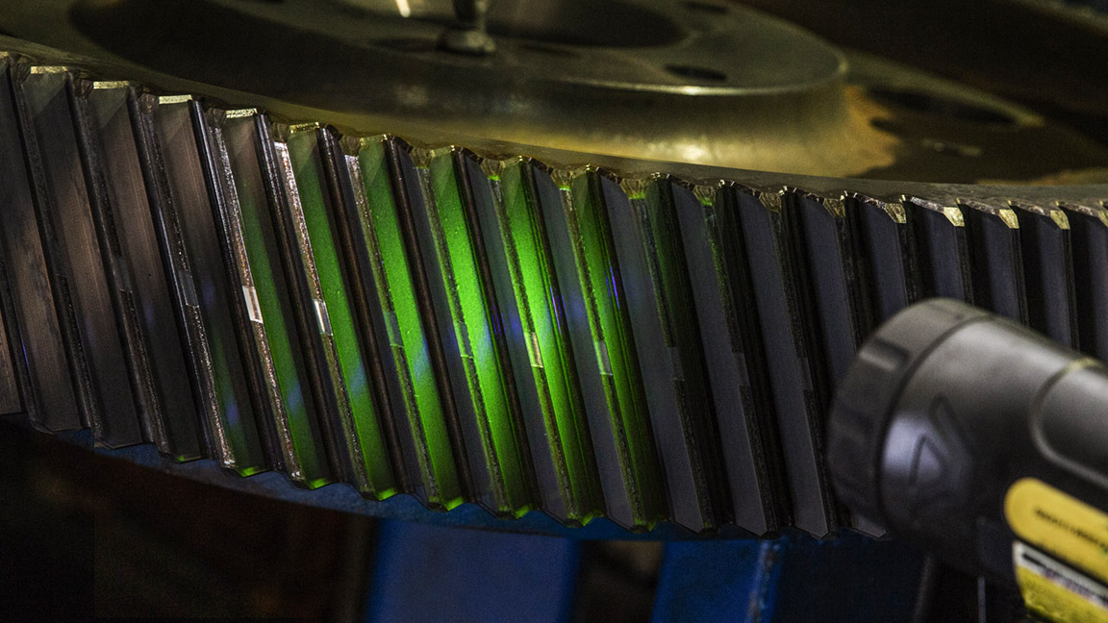
IR CONTACT
Please contact our investor relations team at 720.334.0195

