Slide 1
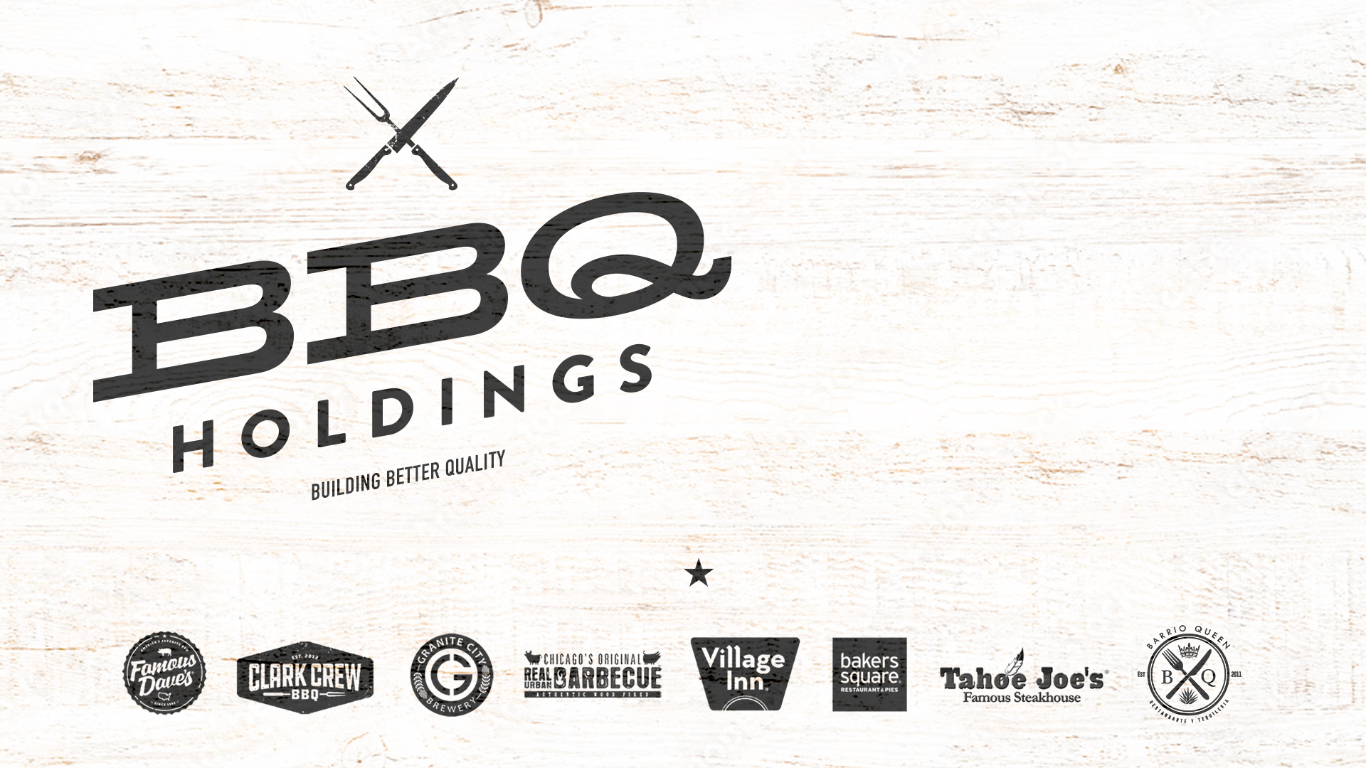
March 2022

Slide 2
SAFE HARBOR STATEMENT
Non-GAAP Financial Measures
To supplement its condensed consolidated financial statements, which are prepared and presented in accordance with accounting principles generally accepted in the United States (“GAAP”), the Company uses non-GAAP measures including those indicated below. These non-GAAP measures exclude significant expenses and income that are required by GAAP to be recorded in the Company’s consolidated financial statements and are subject to inherent limitations. By providing non-GAAP measures, together with a reconciliation to the most comparable GAAP measure, the Company believes that it is enhancing investors’ understanding of the Company’s business and results of operations. These measures are not intended to be considered in isolation of, as substitutes for, or superior to, financial measures prepared and presented in accordance with GAAP. The non-GAAP measures presented may be different from the measures used by other companies. The Company urges investors to review the reconciliation of its non-GAAP measures to the most directly comparable GAAP measure, included in the accompanying financial tables.
Cash EBITDA is net income plus asset impairment, estimated lease termination charges and other closing costs, depreciation and amortization, net interest expense, net (gain) loss on disposal of equipment, stock-based compensation, acquisition costs, pre-opening costs, severance, gain on debt forgiveness, gain on bargain purchase, and provision (benefit) for income taxes. Free cash flow is Cash EBITDA less cash paid for property, equipment and leasehold improvements.
Adjusted net income (loss) is net income plus asset impairment, estimated lease termination charges and other closing costs, less gain on debt forgiveness and gain on bargain purchase. Adjusted earnings per diluted share equals adjusted net income (loss) divided by the weighted average shares outstanding, assuming dilution.
Restaurant-level operating margins are equal to net restaurant sales, less restaurant-level food and beverage cost, labor and benefit costs, and operating expenses.
Forward-Looking Statements
Statements in this press release that are not strictly historical, including but not limited to statements regarding the timing of the Company’s restaurant openings, the timing of refreshes and the timing or success of refranchising plans, are forward-looking statements within the meaning of the Private Securities Litigation Reform Act of 1995. These forward-looking statements involve known and unknown risks, which may cause the Company’s actual results to differ materially from expected results. Although the Company believes the expectations reflected in any forward-looking statements are based on reasonable assumptions, it can give no assurance that its expectation will be attained. Factors that could cause actual results to differ materially from the Company’s expectation include the impact of the COVID-19 virus pandemic, financial performance, restaurant industry conditions, execution of restaurant development and construction programs, franchisee performance, changes in local or national economic conditions, availability of financing, governmental approvals and other risks detailed from time to time in the Company’s SEC reports.

Slide 3
BBQ HOLDINGS WILL BECOME FAMOUS HOSPITALITY
Why are we changing our name?
We’re famous and we’ve grown!
We continue to expand our tastebuds with strong brands serving BBQ, American fare, Mexican, breakfast, steaks and pies.
We are a diversified restaurant operator.
Why we chose Famous Hospitality?
We strive to provide Famous Hospitality to our guests and franchise communities.
It reflects our acquisition and growth of a diversified portfolio of legacy brands.
These brands share a common theme, with each being built on the entrepreneurial spirit of America with original award-winning recipes and hard-working, proud restaurant teams.
We are innovators!
  Dual concepts
  Ghost kitchens
  Prototype development
  Retail products
We maximize synergies as we grow.

Slide 4
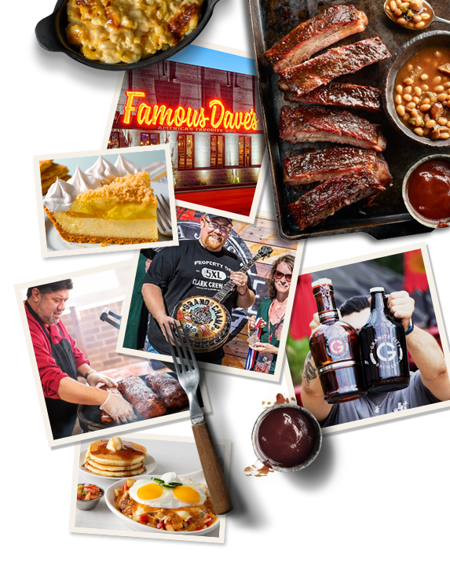
WHO WE ARE
Famous Dave understands what it’s like when the odds are against you. A Native American kid at the bottom half of his high school class, he didn’t have a whole lot of opportunities, but he had dreams and perseverance. His goal: create the best food America ever tasted. BBQ was a passion he caught from his dad, a Southerner working in construction. They always knew where to find the best ribs: the street-corner vendors with their 55 gallon smokers, cooking it up in the tradition of the deep South. After years of learning all he could about BBQ, he opened the first Famous Dave’s in Hayward, WI in 1994, quickly gaining great popularity.
In 2020 the company began acquiring other brands in the pursuit of a diversified portfolio to display its passion for hospitality. Our focus is on evolving and elevating the guest experience, maximizing the capacity of each restaurant, and growing both organically and acquisitively.
This 50 year obsession is with one purpose: To delight Guests with the most enjoyable and authentic experience possible. With an entrepreneurial management team and vision in place, yes in the answer, what’s the question?

Slide 5
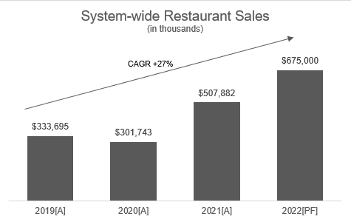
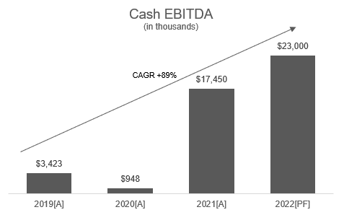
DRIVING TOP AND BOTTOM-LINE GROWTH
Our strategies have been successful at growing sales and EBITDA.
*
*
*
*
*
*
*
*
*A: Actual, PF: Proforma

Slide 6
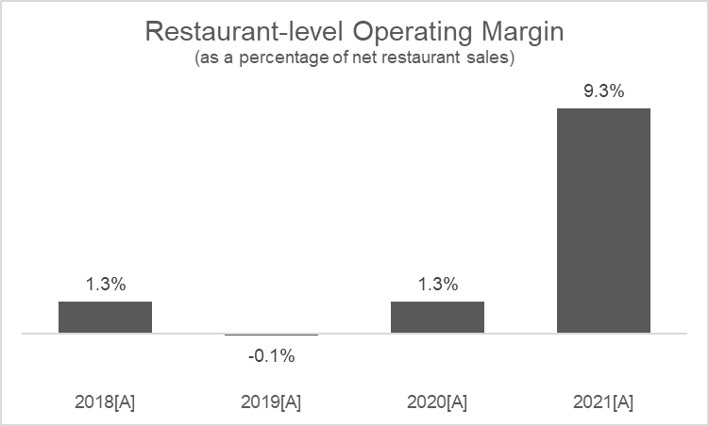
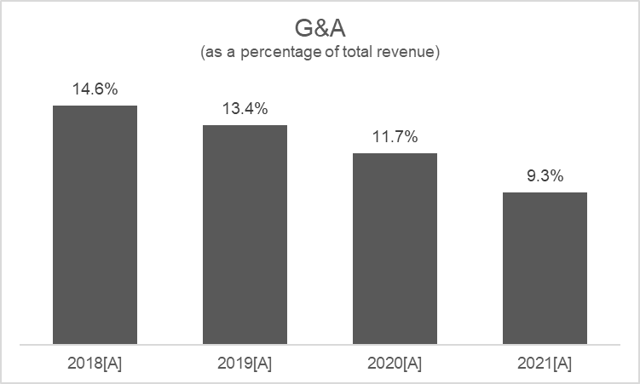
DRIVING PROFITABILITY
We continue to utilize our competencies in operations and marketing, increasing our profitability. General and administrative expense is being leveraged as we grow.
*
*
*
*
*
*
*
*
*A: Actual

Slide 7

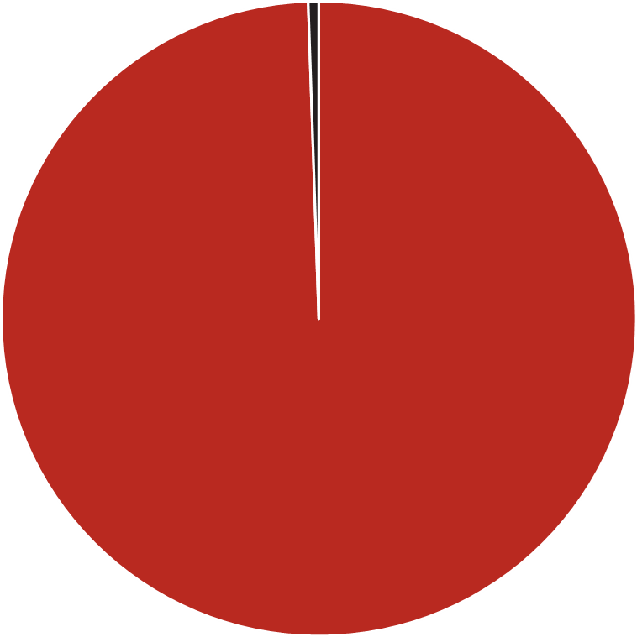
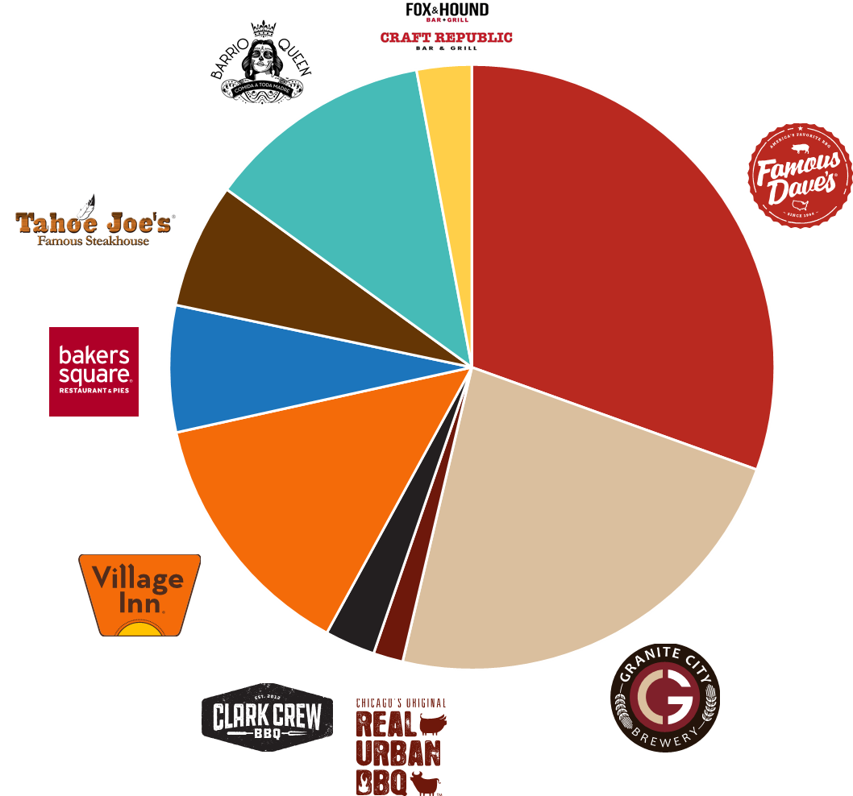
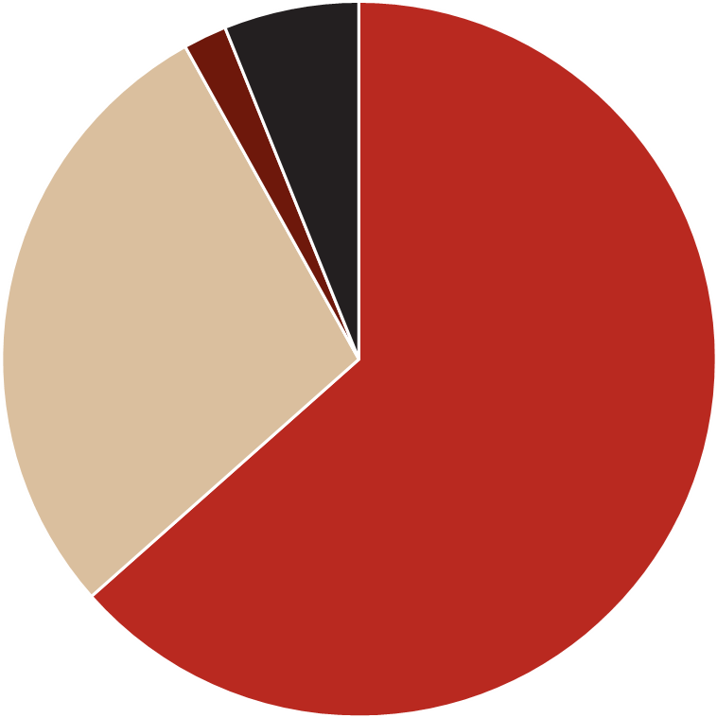
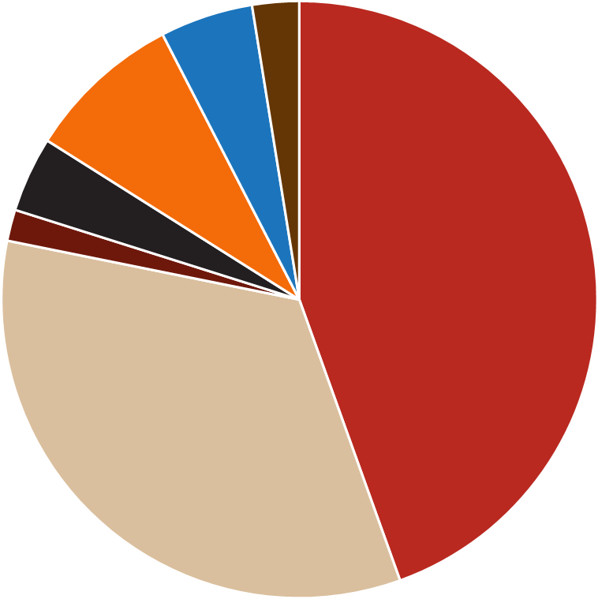
PORTFOLIO DIVERSIFICATION
We have a variety of brands that continue to diversify our revenue and risk.
12-MONTH CORPORATE RESTAURANT REVENUE
2018
2019
2020
2021

Slide 8
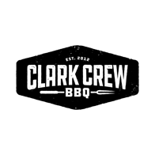
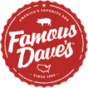

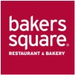





Our Portfolio and Growth

Slide 9

2021 RESULTS
NASDAQ: BBQ
100
Company-owned locations (including Ghost Kitchens)
216
Franchised restaurants in
34 states
>68%
Franchised
Net Restaurant Rev
$187.9 MM
Royalty, License and Other Revenue
$16.9 MM
System-wide Sales
$507.9 MM
Net Income
$24.0 MM
Adj. Net Income
$7.0 MM
Cash EBITDA
$17.5 MM
Corporate: Famous Dave’s 39, Village Inn 21, Granite City’s 18, Bakers Square 14, Tahoe Joe’s 5, Real Urban BBQ 2, Clark Crew 1
Free cash flow
$13.6 MM
Cash¹
$41.5 MM
Bank Debt
$14.8 MM
NASDAQ: BBQ
~10.4 M Shares Outstanding
~10.5 M Shares Fully Diluted
EPS [Diluted]
$2.42
Adjusted EPS [Diluted]
$0.71
¹ Includes $1.1MM restricted cash

Slide 10
2022 GUIDANCE
NASDAQ: BBQ
113
Company-owned locations (including Ghost Kitchens)
223
Franchised restaurants in
34 states
>66%
Franchised
Net Restaurant Rev
$265-280 MM
Royalty, License and Other Revenue
$16.5-18.5 MM
System-wide Sales
$675-715 MM
Net Income and Adj. Net Income
$12.5–15.5 MM
2022 Cash EBITDA
$23 – 25 MM
Corporate: Famous Dave’s 41, Village Inn 22, Granite City’s 18, Bakers Square 14, Barrio Queen 8, Tahoe Joe’s 4, Bar Concepts 3, Real Urban BBQ 2, Clark Crew 1
Free cash flow
$13.5 – 15.5 MM
Cash
$20 MM
Bank Debt
$25 MM
NASDAQ: BBQ
~10.5 M Shares Outstanding
~10.6 M Shares Fully Diluted
EPS [Diluted]
$1.15-1.45
Adjusted EPS [Diluted]
$1.15-1.45

Slide 11
12-MONTH RUN RATE GUIDANCE
NASDAQ: BBQ
113
Company-owned locations (including Ghost Kitchens)
223
Franchised restaurants in
34 states
>66%
Franchised
Net Restaurant Rev
$280-295 MM
Royalty, License and Other Revenue
$16.5-18.5 MM
System-wide Sales
$685-725 MM
Net Income and Adj. Net Income
$14.0–17.0 MM
2022 Cash EBITDA
$25.5 – 27.5 MM
Corporate: Famous Dave’s 41, Village Inn 22, Granite City’s 18, Bakers Square 14, Barrio Queen 8, Tahoe Joe’s 4, Bar Concepts 3, Real Urban BBQ 2, Clark Crew 1
Free cash flow
$15.5 – 17.5 MM
Cash
$20 MM
Bank Debt
$25 MM
NASDAQ: BBQ
~10.5 M Shares Outstanding
~10.6 M Shares Fully Diluted
EPS [Diluted]
$1.30-1.60
Adjusted EPS [Diluted]
$1.30-1.60

Slide 12



THREE PILLARS OF GROWTH
Fill Latent Capacity of Current Boxes
Organic Unit Growth
M&A
Dual concepts within the Famous Dave’s and Granite City boxes
Ghost kitchens
Virtual brands
Famous Dave’s Line Serve Prototype
Famous Dave’s Line Serve w/ Drive Thru
Village Inn a.m. eatery prototype
Pipeline of new franchisees
Lease or purchase prime second gen restaurant real estate
Continue to acquire immediately accretive brands which have withstood the test of time
Buy-in franchise units at accretive valuations

Slide 13
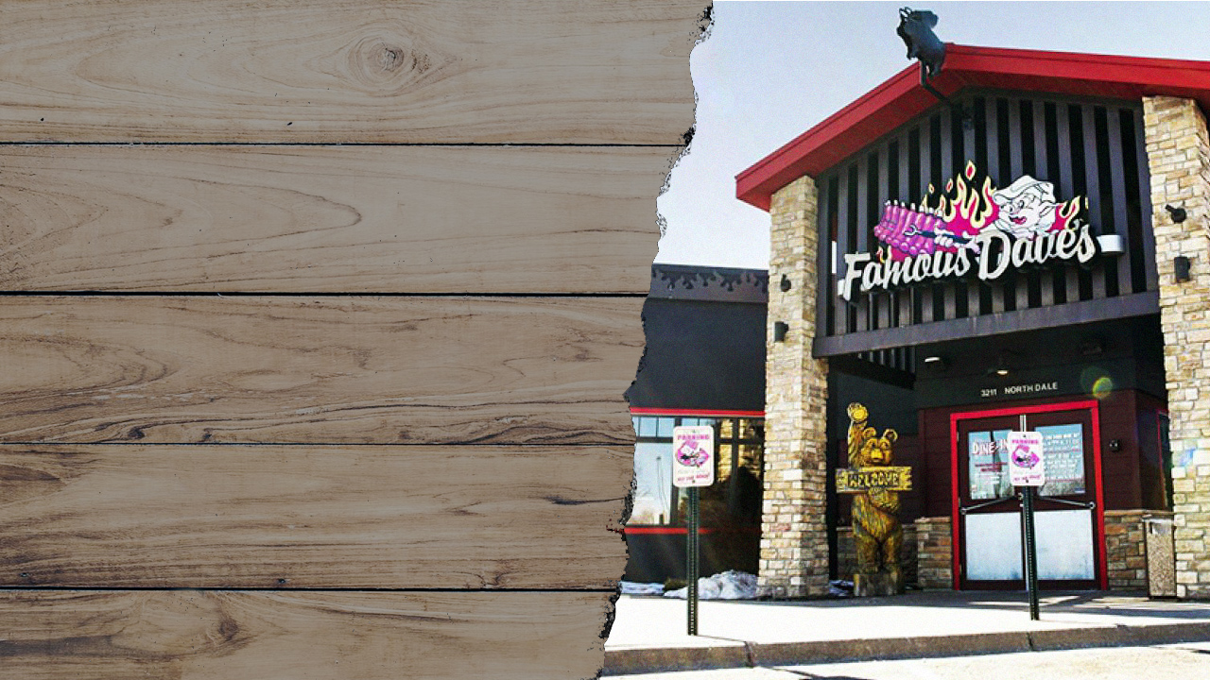
FAMOUS DAVE’S

Slide 14
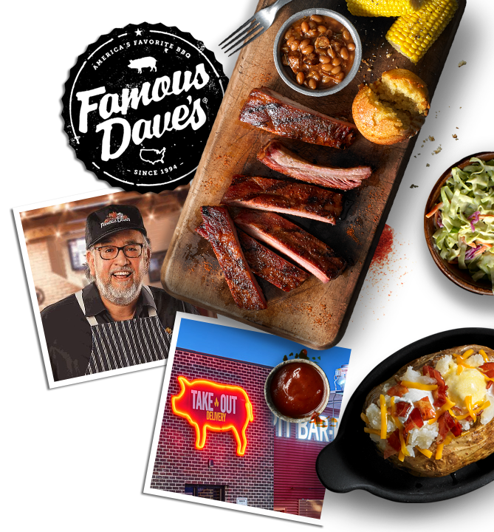
FAMOUS DAVE’S OVERVIEW
  31 corporate stores in U.S. generating $83.0 MM in revenue in 2021
  104 franchise stores in U.S., Canada and UAE generating ~$235 MM in revenue
  Average Corporate Unit Volume (AUV): $2.9 MM
  Strong & Consistent Metrics
    - Food & Beverage Costs 30%
    - Labor Costs: 29%
    - Occupancy: 7%
  Dual Concepts
  Ghost Kitchens
  Virtual Brand

Slide 15
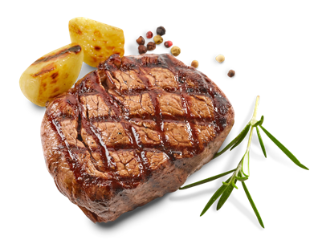
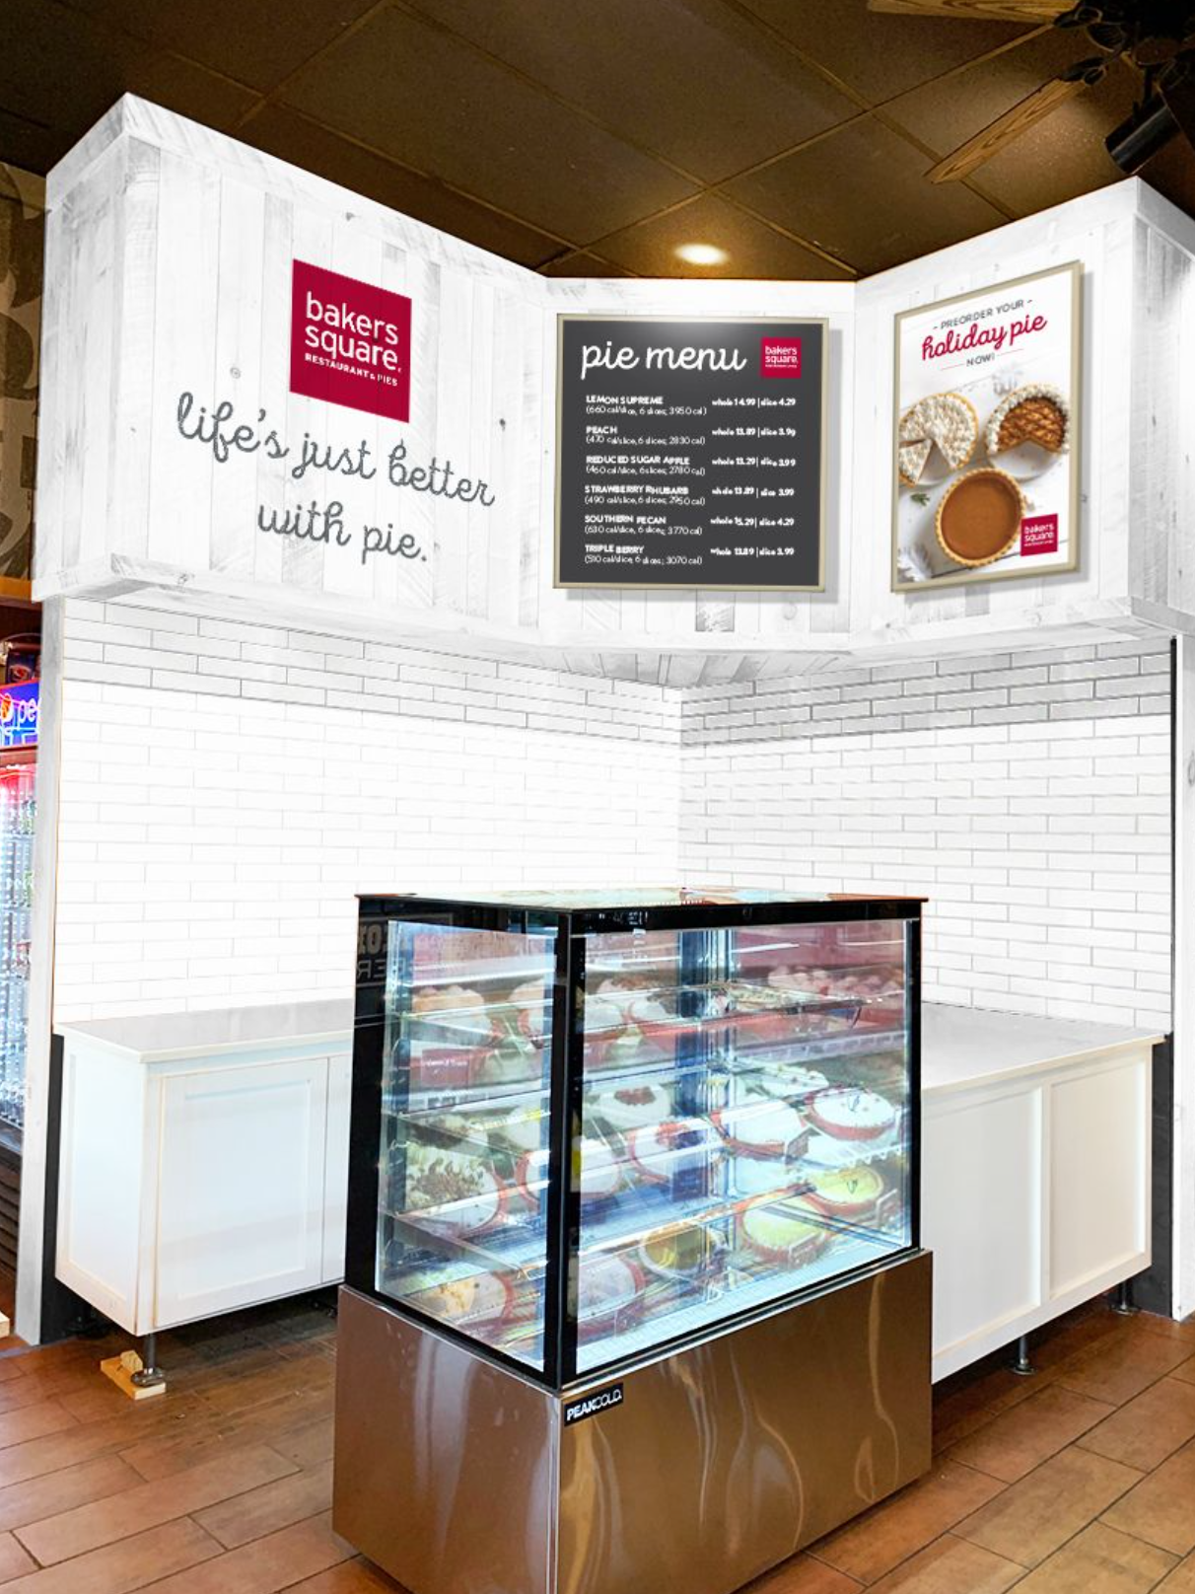
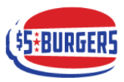
GROWTH: FILL LATENT CAPACITY
Famous Dave’s 6,500 sq. ft. boxes were designed to execute at a higher AUV level than its current AUV of $2.8 MM.
Dual Concepts
Ghost Kitchen / Virtual Brand
Baker Square pies in Famous Dave’s
Live in 3 corporate and 4 franchise locations
Planning rollout to other corporate & franchise locations over Q2 and Q3 of 2022
$5 Burger in Famous Dave’s
Virtual burger concept
25% flow through
  Tahoe Joe’s
  Famous Dave’s & Texas T-Bone – Colorado Springs, CO
  Famous Dave’s & Tahoe Joes - TBD
  The Company is using its learnings from dual branding with Texas T-Bone. Expectation is to add $800k in additional revenue with 25% flow through when a Famous Dave’s is teamed up with Tahoe Joe’s.
  Potential for $200k additional EBITDA per location.

Slide 16
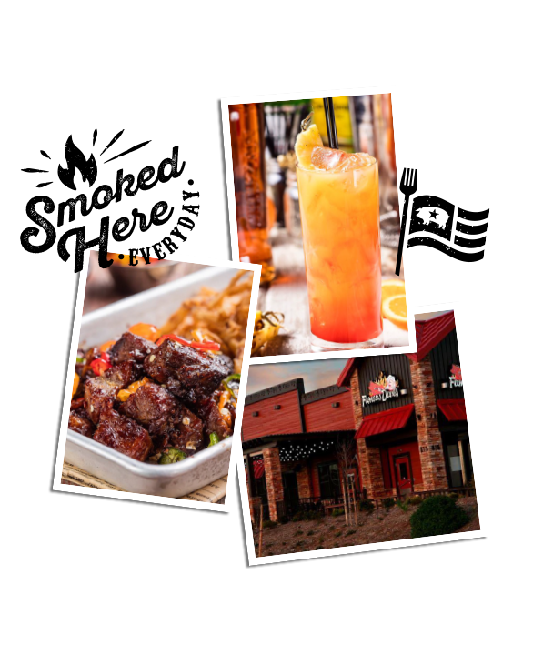
GROWTH: ORGANIC GROWTH
New Franchisees / Ghost Kitchens
Robust Franchisee Pipeline Activity
Increased activity due to take out success over the past 12 months
Multiple franchisees opened new line service concept
Franchisee opened a drive thru concept
Active Pipeline of Ghost Kitchen Units
20 currently open in franchisee restaurants
We continue to leverage in our corporate restaurants as well

Slide 17
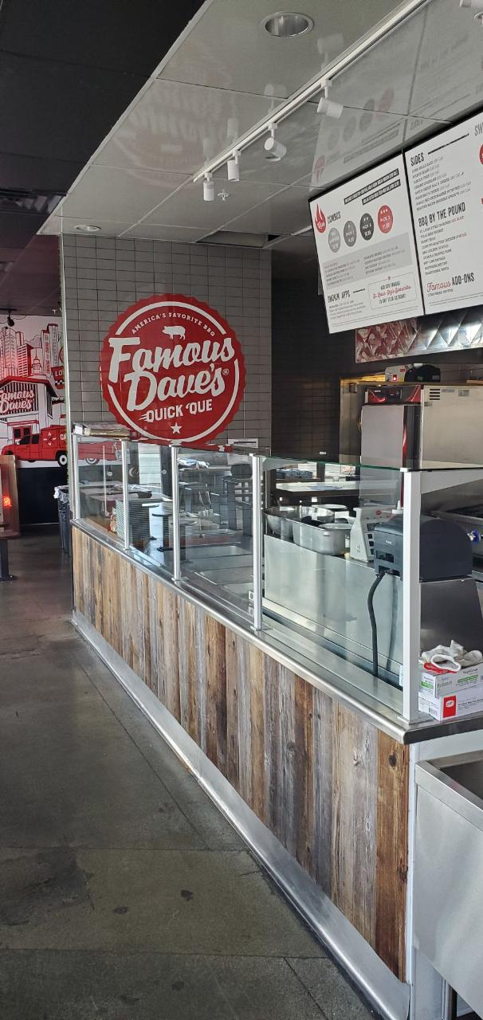
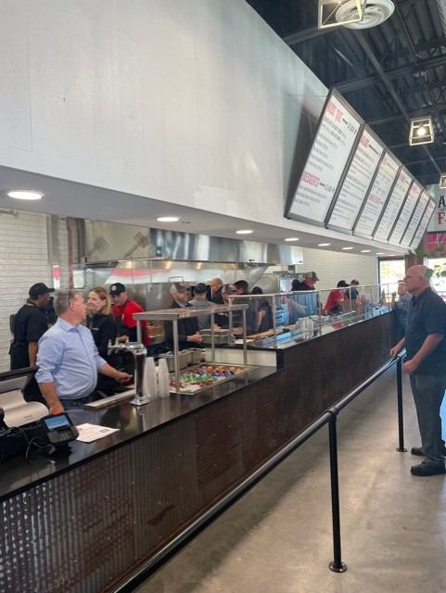
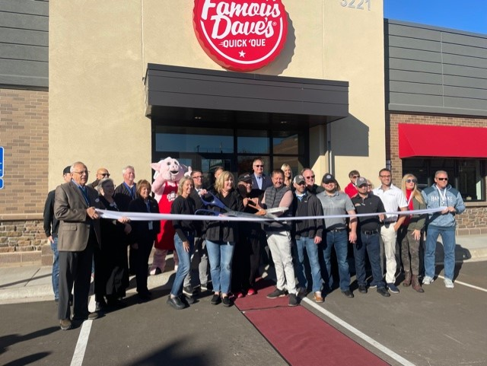
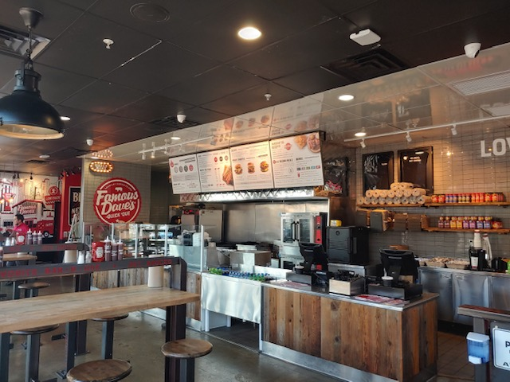
Quick ‘Que Line Serve
GROWTH: ORGANIC GROWTH
Opened Locations:
Las Vegas, NV (franchised) - August 5, 2021
Coon Rapids, MN (franchised) - October 25, 2021
South Salt Lake, UT (franchised) – March 7, 2022 – Quick ‘Que Drive Thru

Slide 18
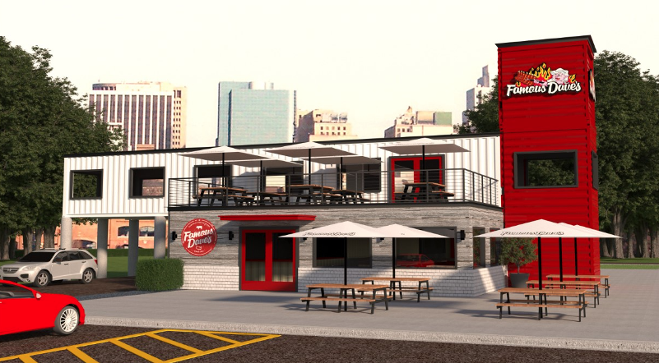
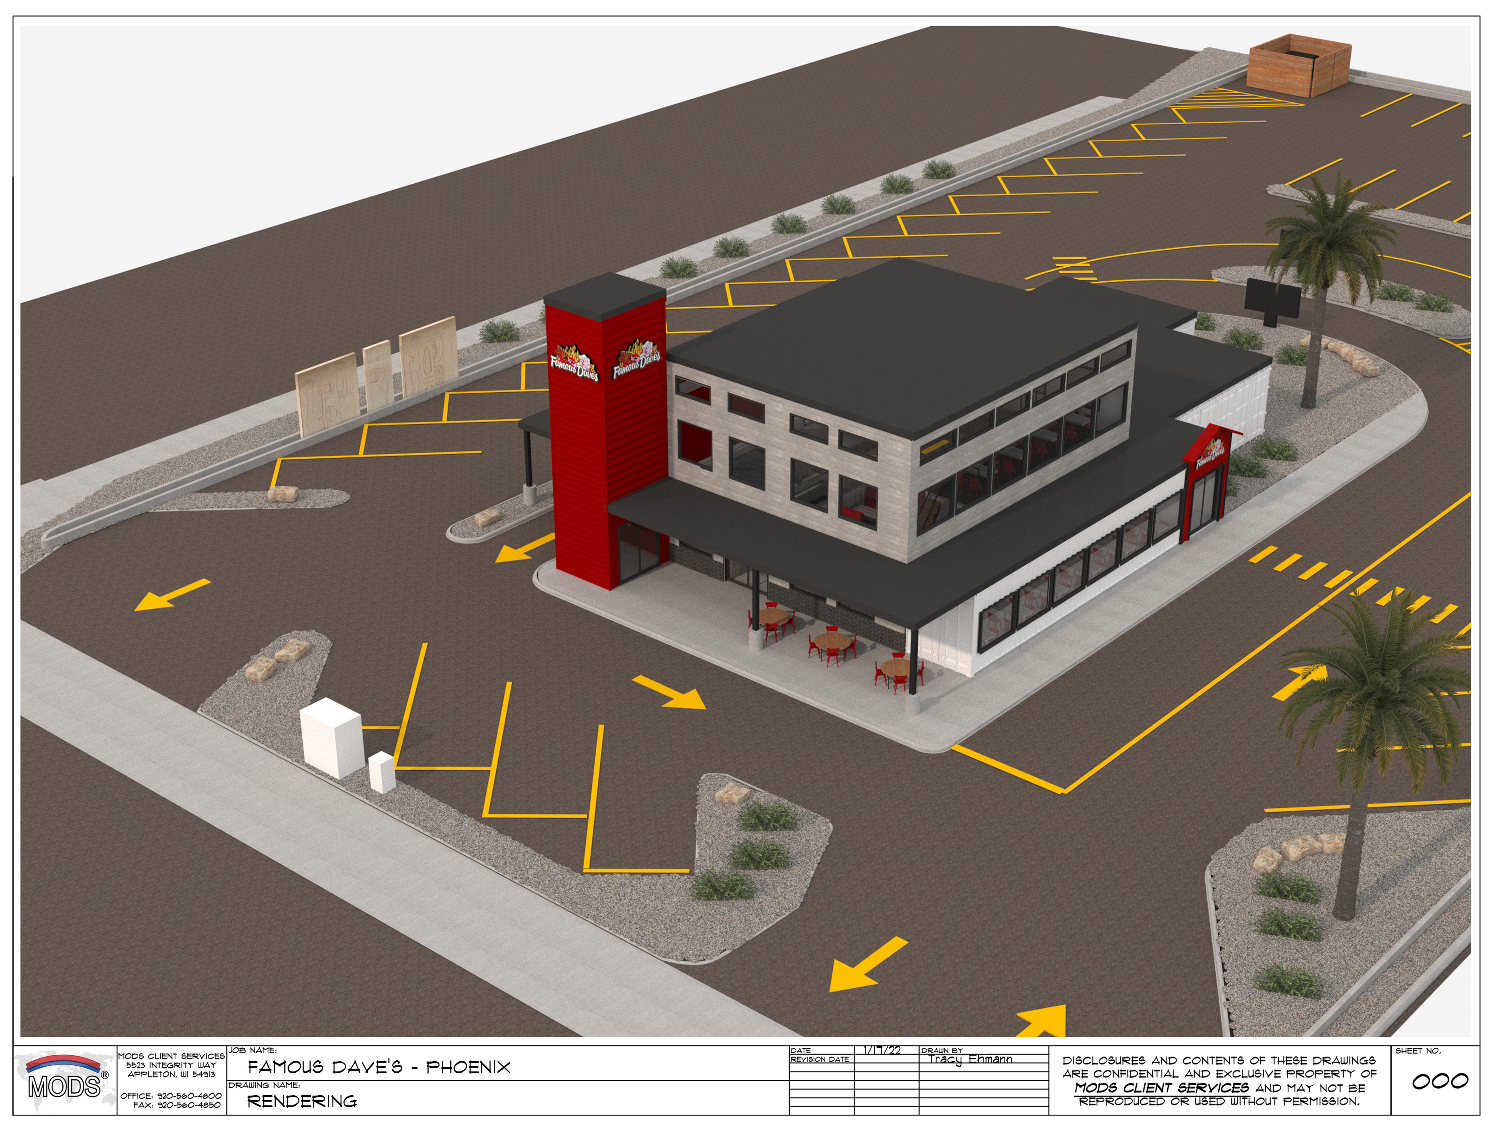
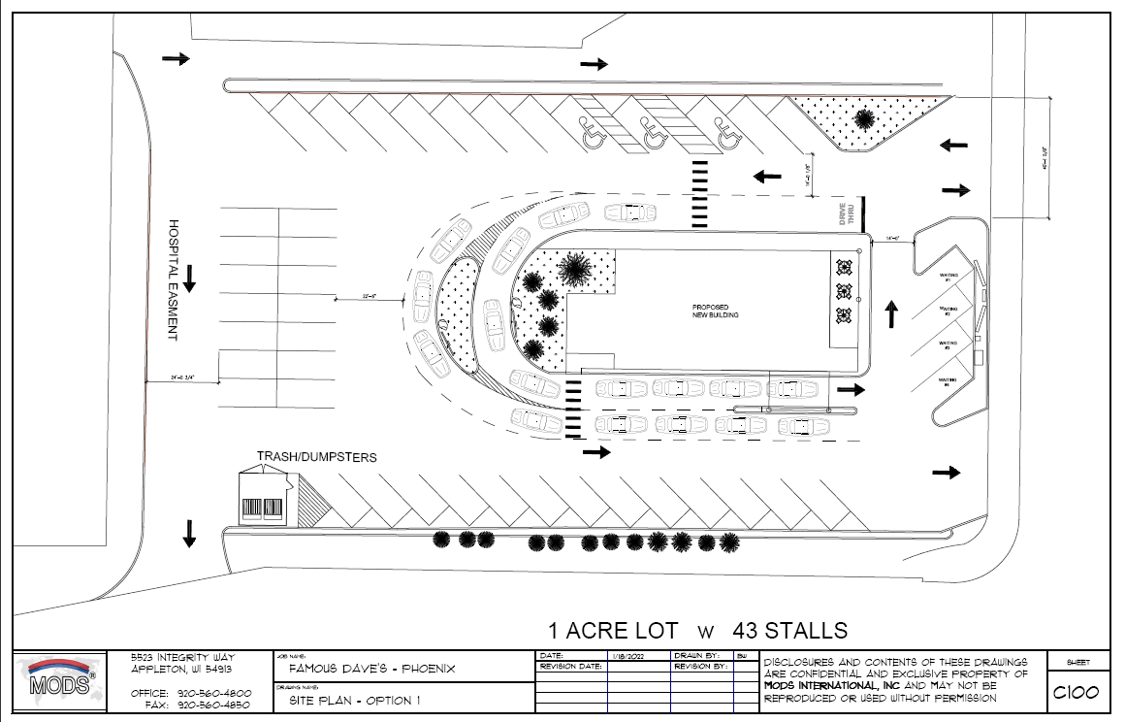
Quick ‘Que Drive Thru
GROWTH: ORGANIC GROWTH
Targeted opening by Q1 2023 (corporate location)
Modular Design
18

Slide 19


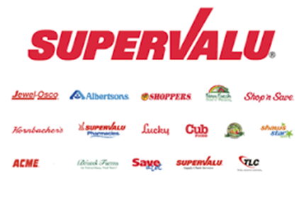
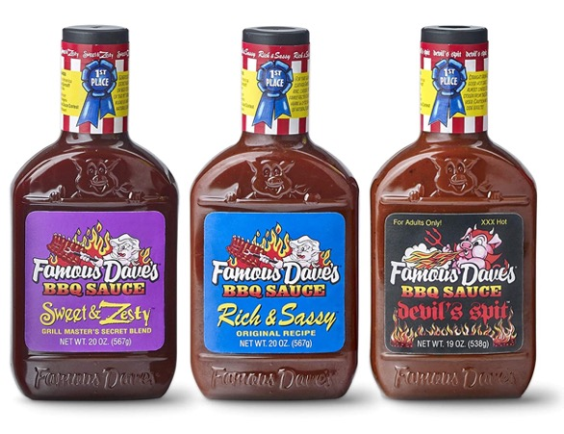
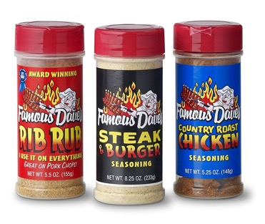
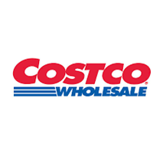

GROWTH: ORGANIC GROWTH
Expanding CPG Licensing
  CPG (Consumer Packaged Goods) – Passive Revenue
  BBQ receives a 3% licensing fee
  2021 licensing revenue ~$1.5 million
  Famous Dave’s has more SKU’s than any other restaurant in retail

Slide 20
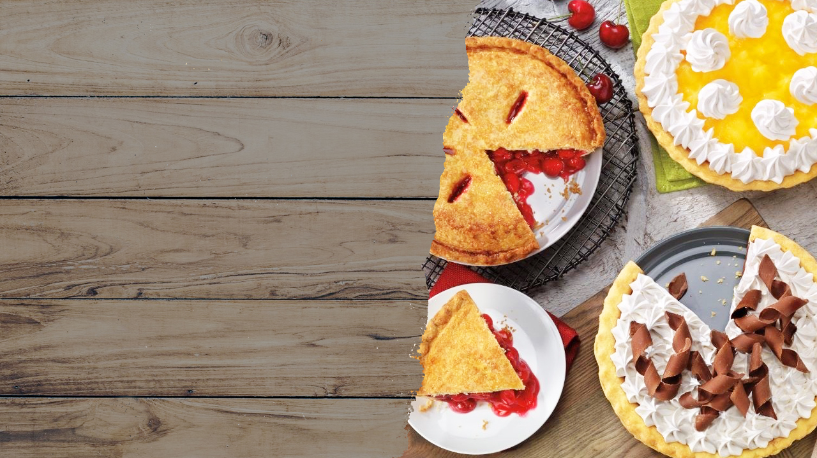
VILLAGE INN &
BAKERS SQUARE

Slide 21
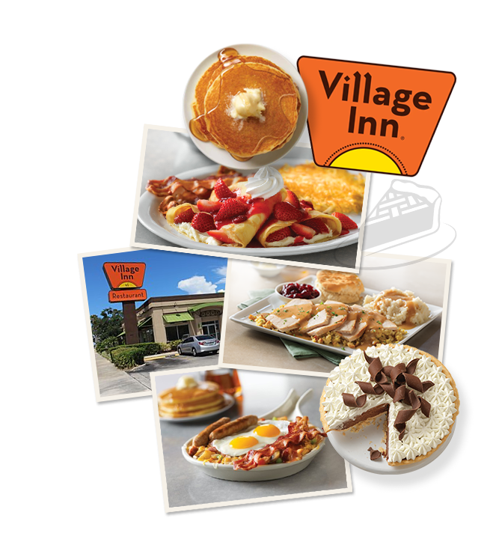
VILLAGE INN OVERVIEW
  21 corporate stores in U.S. generating $34 MM in revenue in 2021
  108 franchise stores in U.S generating ~$180 MM in revenue
    80% of franchisee’s have been with the brand for more than 15 years
  Average Corporate Unit Volume (AUV): $1.7 MM
  Strong & Consistent Metrics
    - Food & Beverage Costs 25%
    - Labor Costs: 35%
    - Occupancy: 8%

Slide 22
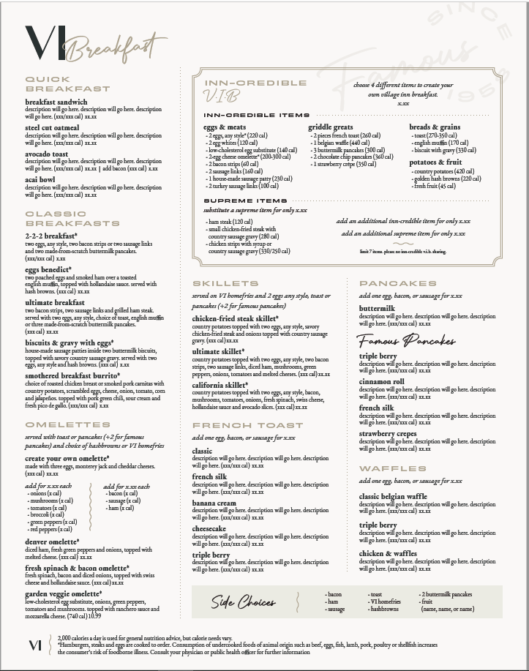
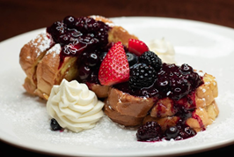
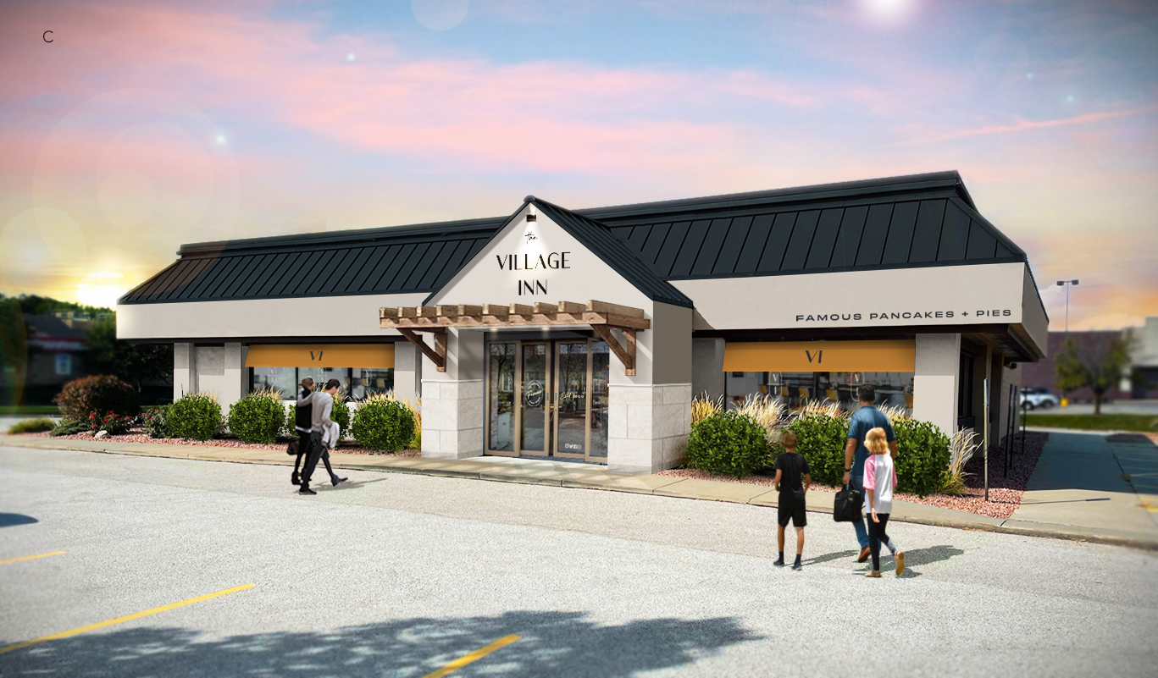
New Village Inn Prototype
GROWTH: ORGANIC GROWTH
Omaha, NE first corporate refresh expected to open in Q2 2022
Two Additional Corp sites identified for 2022 Refresh
6-10 Franchise locations expected to refresh in 2022
Menu innovation that will add a handful of higher end choices that play off our pie flavors
  Banana cream French toast, triple berry pancakes, cheesecake French toast
Healthy options, such as avocado toast and acai bowls
Keeping the value options available for our core guest

Slide 23

GRANITE CITY
FOOD & BREWERY

Slide 24

GRANITE CITY OVERVIEW
  Founded in 1999
  18 Corporate Stores in U.S. generating $63 MM in revenue in 2021
  Average Unit Volume (AUV): $3.5 MM
  2019 Corporate Store Sales of $75 MM
  20% Liquor Mix
  10% of Revenue in Sunday Brunch Pre-Pandemic
  Strong & Consistent Metrics:
    - Food & Beverage Costs 28%
    - Labor Costs: 34%
    - Occupancy: 11%

Slide 25
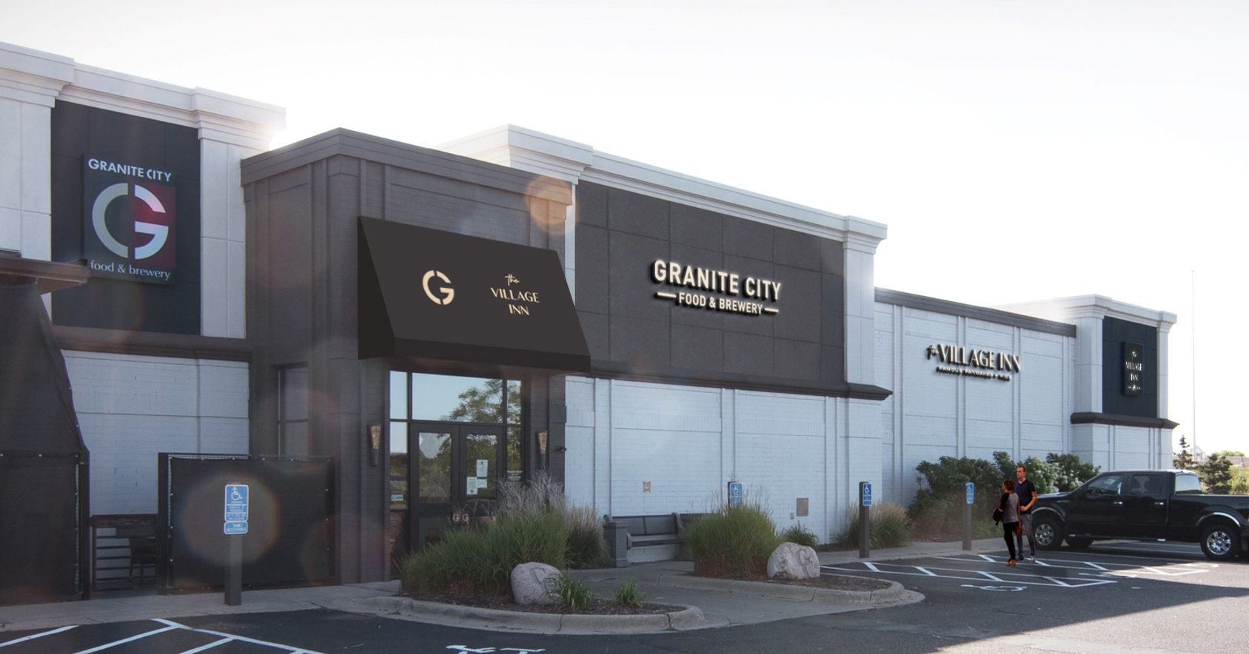
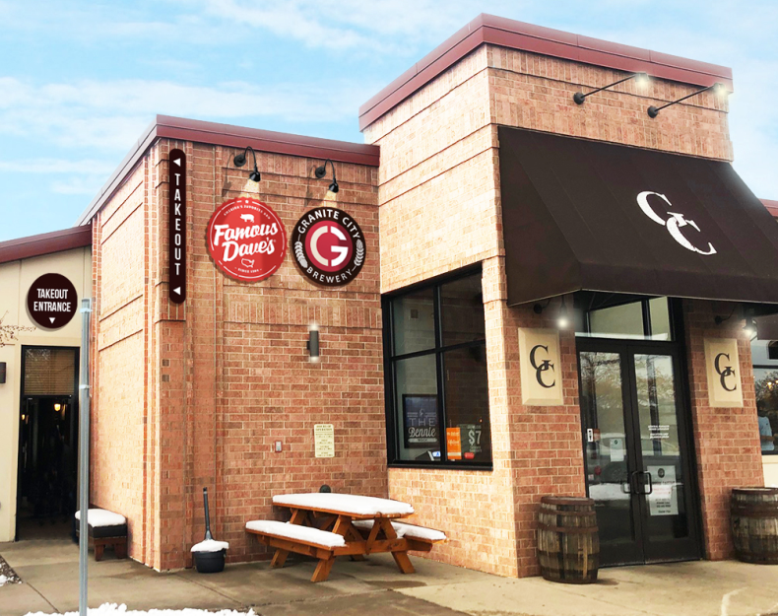
GROWTH: FILL LATENT CAPACITY
Village Inn & Granite City Dual Concept
Famous Dave’s Ghost Kitchens
Granite City kitchens were designed for ~$6 MM annual volume. Pre-covid AUV was $3.9 MM
Dual Concept that has an operating structure with low up front capital investment. $750K revenue with 30% flow through
Potential for $225K additional EBITDA per location
Opened first unit: March 1, 2022
8 locations generating ~$2.3 MM in revenue with 35% flow through
1 additional location to open in 2022

Slide 26
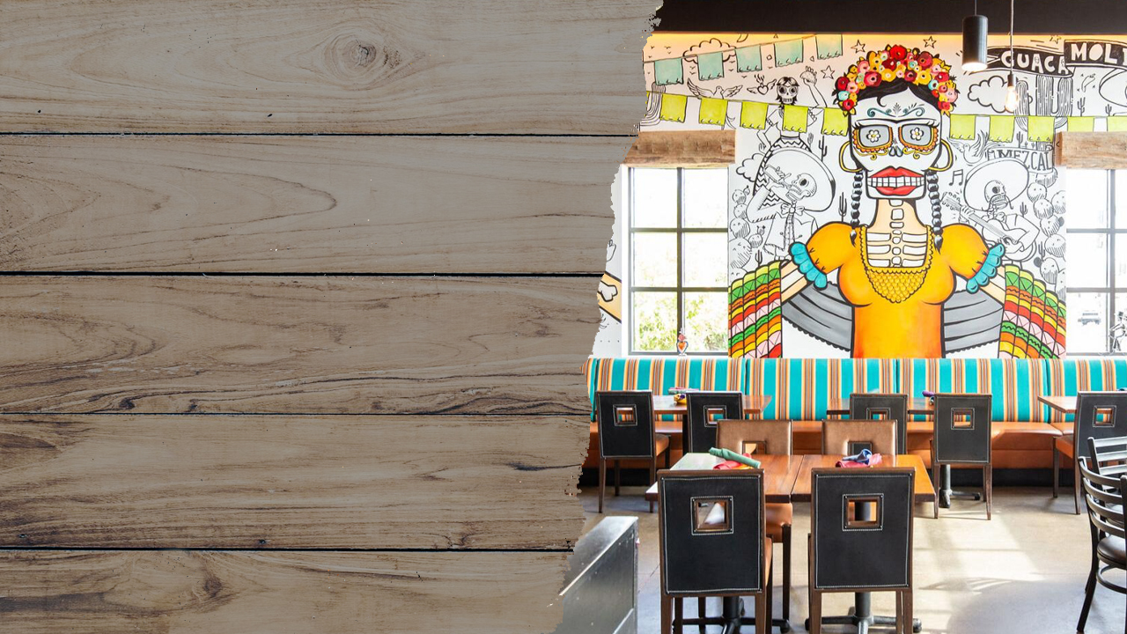
BARRIO QUEEN

Slide 27
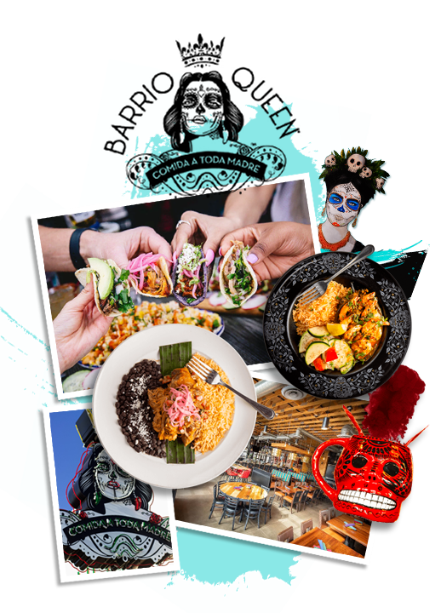
BARRIO QUEEN OVERVIEW
  7 Corporate Stores in U.S. generating $35.0 MM in revenue in 2021
  1 additional Corporate Stores to open Q4 2022
  Concept has franchising potential – 19% Restaurant-level margin
  Average Corporate Unit Volume (AUV): $5.0 MM
  Over 27% liquor mix
  Average cash-on-cash return of 63% based on first 7 units ($950K restaurant-level profit/$1.5 MM buildout)

Slide 28
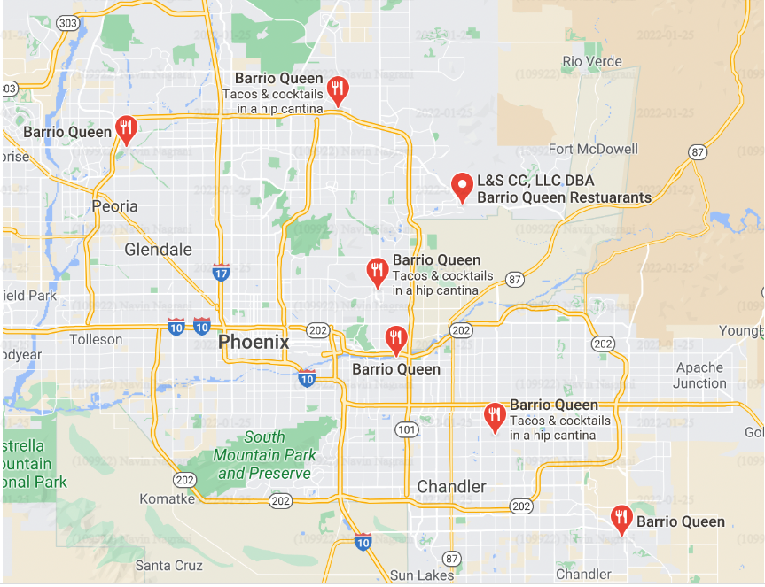
Phoenix Barrio Locations
Tempe
Desert Ridge
Scottsdale
Glendale
Gilbert
Queen Creek
Avondale
8th location in Surprise, opening in 2022
28

Slide 29

BAR CONCEPTS
FOX & HOUND and
CRAFT REPUBLIC

Slide 30
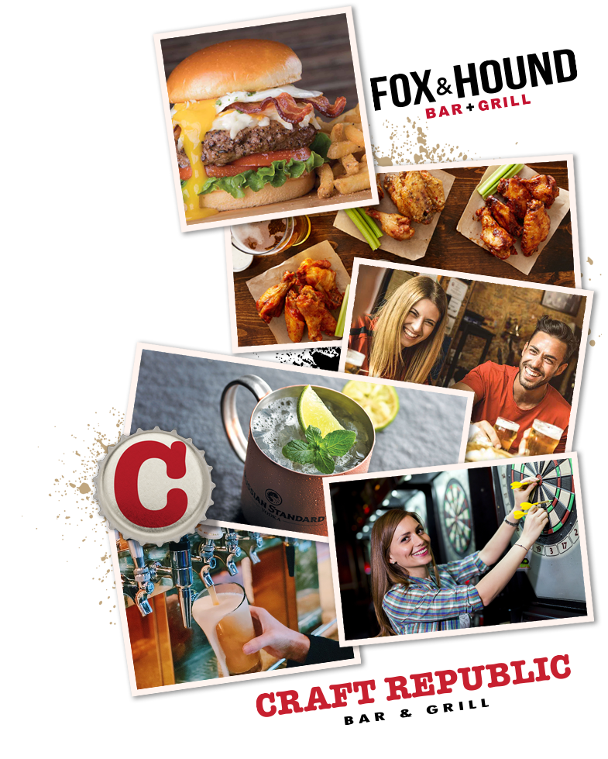
BAR CONCEPTS OVERVIEW
  3 Corporate Stores in U.S. generating $8.5 MM in revenue in 2021
  2 brands: Craft Republic, Fox & Hound
  Average Corporate Unit Volume (AUV): $2.8 MM
  Over 50% liquor mix

Slide 31

TARGET M&A

Slide 32
VISION TO BUILD A DIVERSE PORTFOLIO OF ESTABLISHED FOOD AND BEVERAGE CONCEPTS
Some aspects of what we look for:
Legacy brands that have stood the test of time
Franchise systems with growth potential
Potential for CPG sold in retail
Utilize expertise in digital marketing to attract new customers
Accretive acquisitions (~3-5x EBITDA) that fold into our current infrastructure
Recent M&A:
Granite City purchased March 2020
Real Urban purchased March 2020
Village Inn and Bakers Square purchased July 2021
Tahoe Joe’s purchased October 2021
Bar concepts purchased March 2022
We are currently analyzing additional opportunities.

Slide 33





INVESTMENT SUMMARY
Currently >68% franchised
Delivering profitable growth through operational improvement, opportunistic acquisitions, and plan to expand corporate owned and/or franchisee unit count
Huge growth potential with laser focus on growing high margin recurring royalty stream with newly developed Famous Dave’s small box with best-in-class unit-level economics.
Very high flow through dual concepts.
Robust M&A pipeline.
Fully aligned, seasoned management team dedicated to creating shareholder value.
Leverage structural synergies with existing infrastructure to add new concepts driving EBITDA.
Always searching for new and economical ways for our customers to experience our food on demand.
Intuitive and industry leading Digital Marketing Team.

Slide 34
CASH EBITDA AND FREE CASH FLOW RECONCILIATION
BBQ Holdings, Inc. and Subsidiaries
Non-GAAP Reconciliation
Cash EBITDA

Slide 35
ADJUSTED EARNINGS PER DILUTED SHARE
BBQ Holdings, Inc. and Subsidiaries
Non-GAAP Reconciliation
Earnings per share

Slide 36


12701 Whitewater Drive • Suite 100 • Minnetonka, MN 55343
Phone: 952-294-1300 • Website: bbq-holdings.com • E-mail: InvestorRelations@BBQ-Holdings.com

