Slide 1
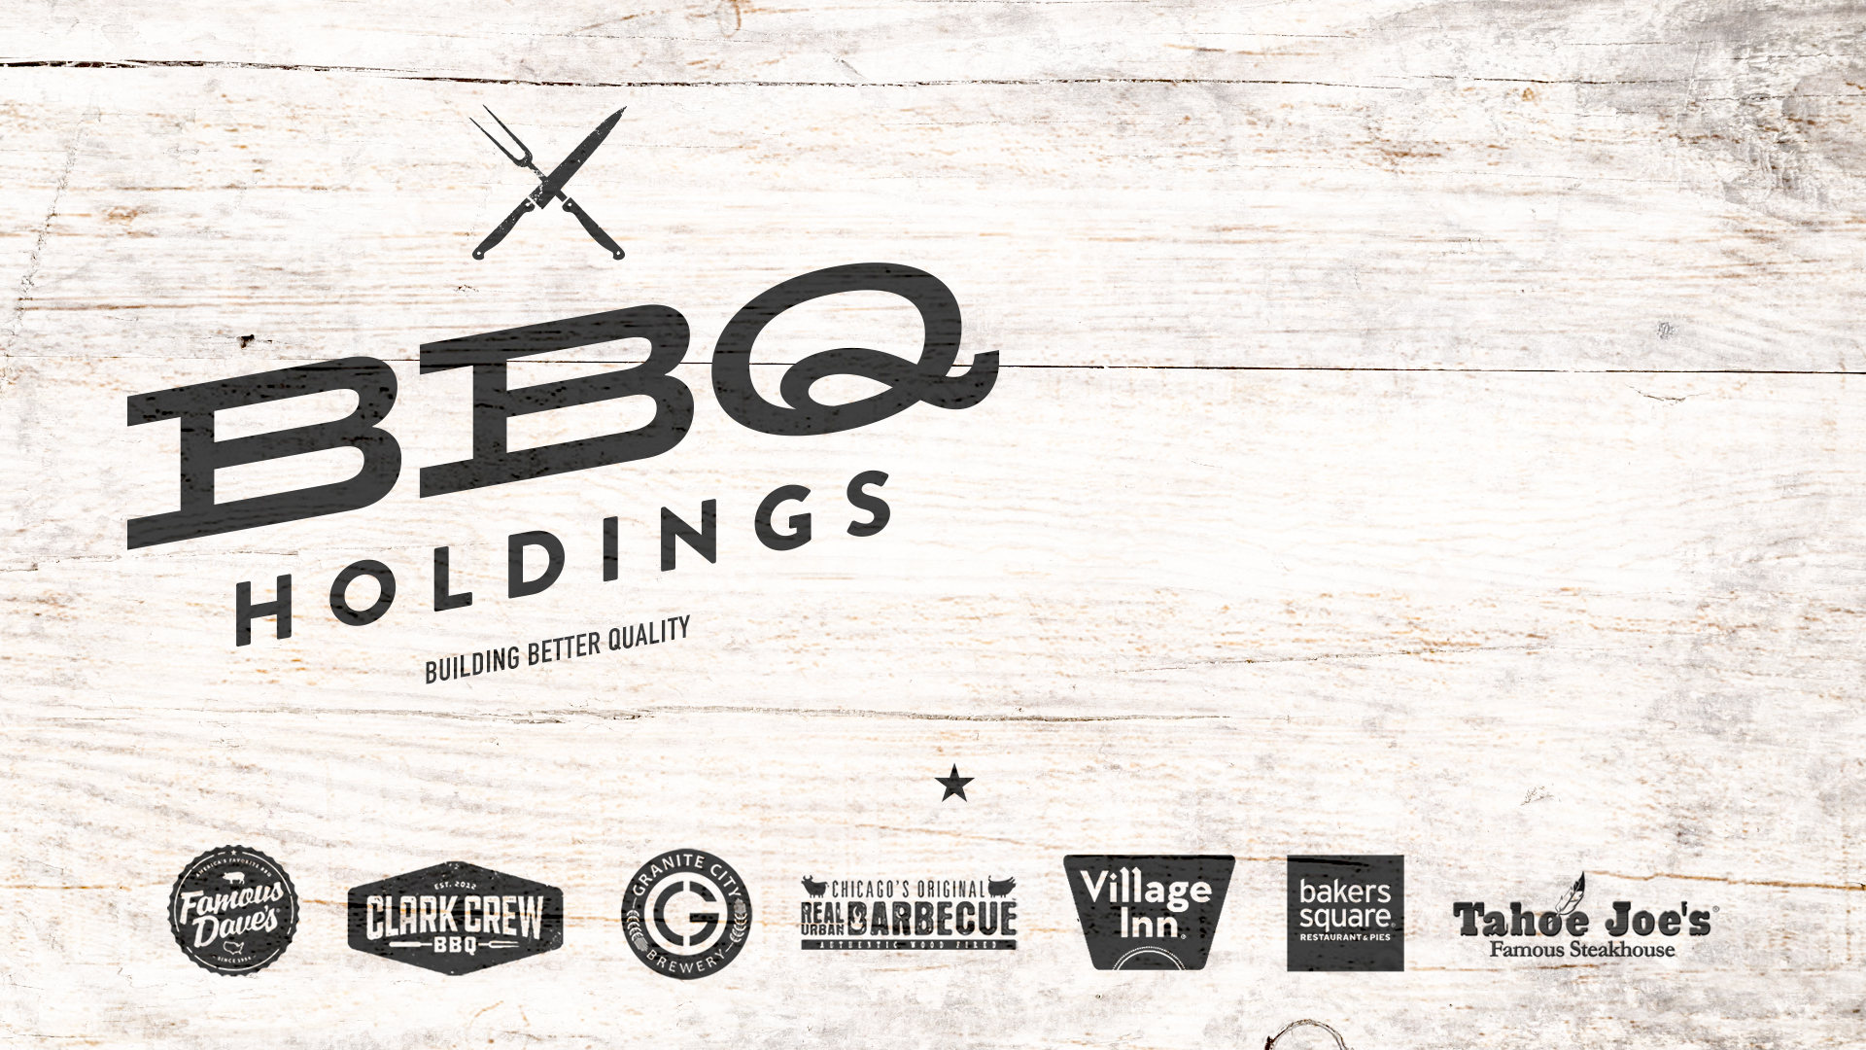
November 2021

Slide 2
SAFE HARBOR STATEMENT
Non-GAAP Financial Measures
To supplement its consolidated financial statements, which are prepared and presented in accordance with accounting principles generally accepted in the United States (“GAAP”), the Company uses non-GAAP measures including those indicated below. These non-GAAP measures exclude significant expenses and income that are required by GAAP to be recorded in the Company’s consolidated financial statements and are subject to inherent limitations. By providing non-GAAP measures, together with a reconciliation to the most comparable GAAP measure, the Company believes that it is enhancing investors’ understanding of the Company’s business and results of operations. These measures are not intended to be considered in isolation of, as substitutes for, or superior to, financial measures prepared and presented in accordance with GAAP. The non-GAAP measures presented may be different from the measures used by other companies. The Company urges investors to review the reconciliation of its non-GAAP measures to the most directly comparable GAAP measure, included in the accompanying financial tables.
Adjusted EBITDA is net income plus asset impairment, estimated lease termination charges and other closing costs, settlement agreements, depreciation and amortization, interest expense, net, net (gain) loss on disposal of equipment, stock-based compensation, acquisition costs, pre-opening costs, severance, gain on debt forgiveness, gain on bargain purchase, COVID-19-related expense and provision (benefit) for income taxes.
Forward-Looking Statements
Statements in this press release that are not strictly historical, including but not limited to statements regarding the timing of the Company’s restaurant openings and the timing or success of refranchising plans, are forward-looking statements within the meaning of the Private Securities Litigation Reform Act of 1995. These forward-looking statements involve known and unknown risks, which may cause the Company’s actual results to differ materially from expected results. Although the Company believes the expectations reflected in any forward-looking statements are based on reasonable assumptions, it can give no assurance that its expectation will be attained. Factors that could cause actual results to differ materially from Famous Dave’s expectation include financial performance, restaurant industry conditions, execution of restaurant development and construction programs, franchisee performance, changes in local or national economic conditions, availability of financing, governmental approvals and other risks detailed from time to time in the Company’s SEC reports.

Slide 3

neW 2021 Guidance
NASDAQ: BBQ
Net Restaurant Revenue
$183-188 MM
Royalty, License and Other Revenue
$14-15 MM
System-wide Sales
$480-485 MM
89
Company-owned locations
214
Franchised restaurants in
36 states
>70%
Franchised
Net Income
$22.5 – 23.0 MM
2021 Cash EBITDA
$16.5 – 17.0 MM
Corporate: Famous Dave’s 31, Village Inn 21, Granite City’s 18, Bakers Square 11, Tahoe Joe’s 5, Real Urban BBQ 2, Clark Crew 1
Cash¹ ²
$30.1 MM
Long Term Bank Debt ²
$8.8 MM
NASDAQ: BBQ
~10.4 MM Shares Outstanding
¹ Includes $1.15MM restricted cash
² as of 10/3/2021

Slide 4
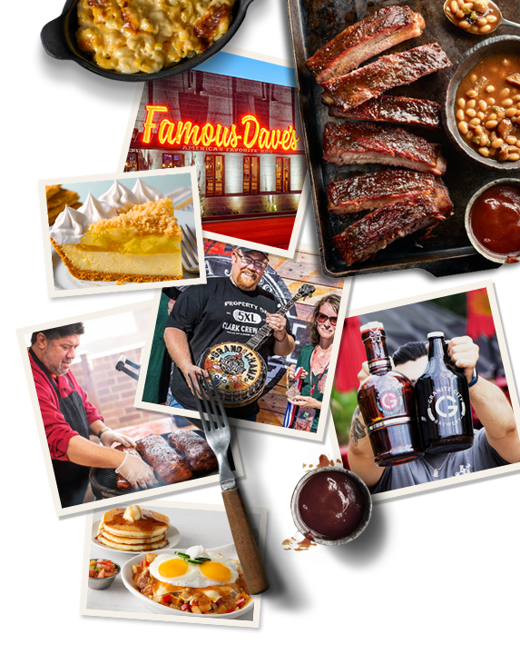
WHO WE ARE
Famous Dave understands what it’s like when the odds are against you. A Native American kid at the bottom half of his high school class, he didn’t have a whole lot of opportunities, but he had dreams and perseverance. His goal: create the best food America ever tasted. BBQ was a passion he caught from his dad, a Southerner working in construction. They always knew where to find the best ribs: the street-corner vendors with their 55 gallon smokers, cooking it up in the tradition of the deep South. After years of learning all he could about BBQ, he opened the first Famous Dave’s in Hayward, WI in 1994, quickly gaining great popularity.
In 2020 the company began acquiring other brands in the pursuit of a diversified portfolio to display its passion for hospitality. Our focus is on evolving and elevating the guest experience, maximizing the capacity of each restaurant, and growing both organically and acquisitively.
This 50 year obsession is with one purpose: To delight Guests with the most enjoyable and authentic experience possible. With an entrepreneurial management team and vision in place, yes in the answer, what’s the question?

Slide 5
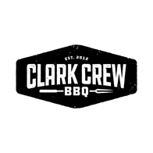
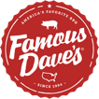

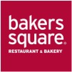


OUR PORTFOLIO
 | FAMOUS DAVE’S | VILLAGE INN | GRANITE CITY | BAKERS SQUARE | REAL URBAN BBQ | CLARK CREW BBQ | TAHOE JOE’S | Total
Corporate Locations | 31 | 21 | 18 | 11 | 2 | 1 | 5 | 89
Franchise Locations | 104 | 110 | 0 | 0 | 0 | 0 | 0 | 214
Total Locations | 135 | 131 | 18 | 11 | 2 | 1 | 5 | 303
Growth Plan | New line serve and drive thru locations | New trendy breakfast prototype | Dual concept with new breakfast brand | Sell pies in retail, kiosk and other restaurants | New line serve locations and CPG’s | New full serve locations and CPG’s | Dual Concept with FD’s

Slide 6
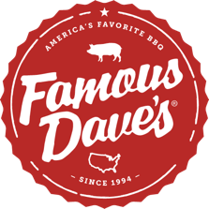

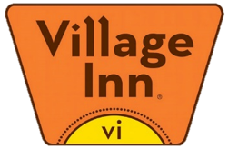
12 MONTH CORPORATE RESTAURANT REVENUE
8%
$17,800,000
8%
$18,800,000
16%
$37,600,000
35%
$81,200,000
3%
$7,500,000
2%
$4,000,000
29%
$68,000,000

Slide 7



Three Pillars of Growth
Fill Latent Capacity of Current Boxes
Organic Unit Growth
M&A
Dual concepts within the Famous Dave’s and Granite City boxes
Ghost kitchens
Virtual brands
Famous Dave’s Line Serve Prototype
Famous Dave’s Line Serve w/ Drive Thru
Village Inn a.m eatery prototype
Pipeline of new franchisees
Lease or purchase prime second gen restaurant real estate
Continue to acquire immediately accretive brands which have withstood the test of time
Buy-in franchise units at accretive valuations

Slide 8
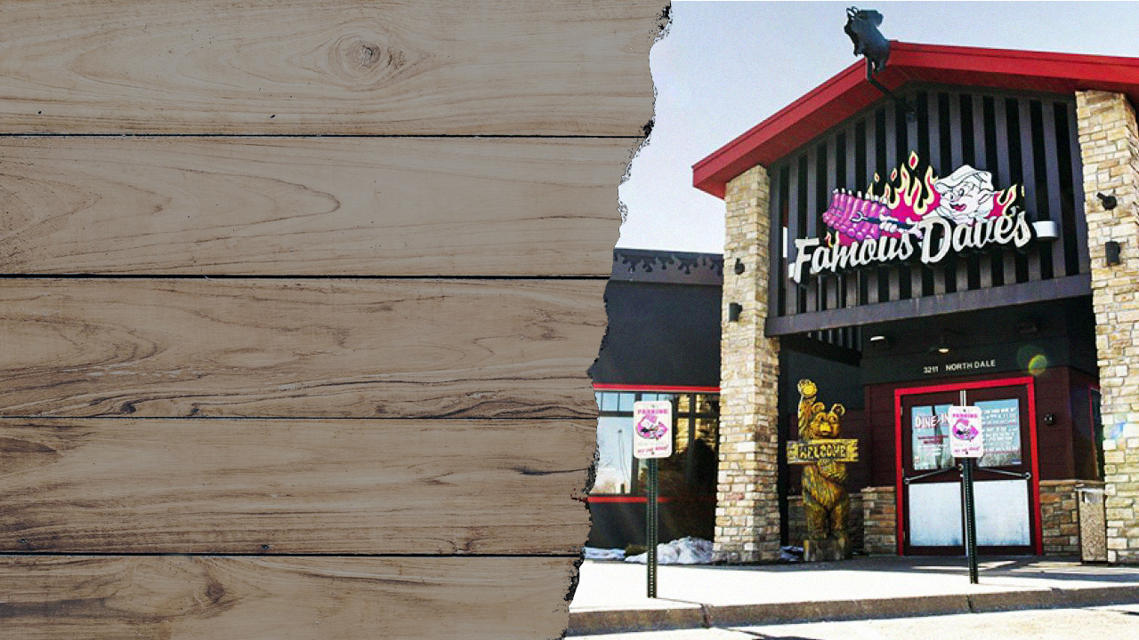
FAMOUS DAVE’S

Slide 9
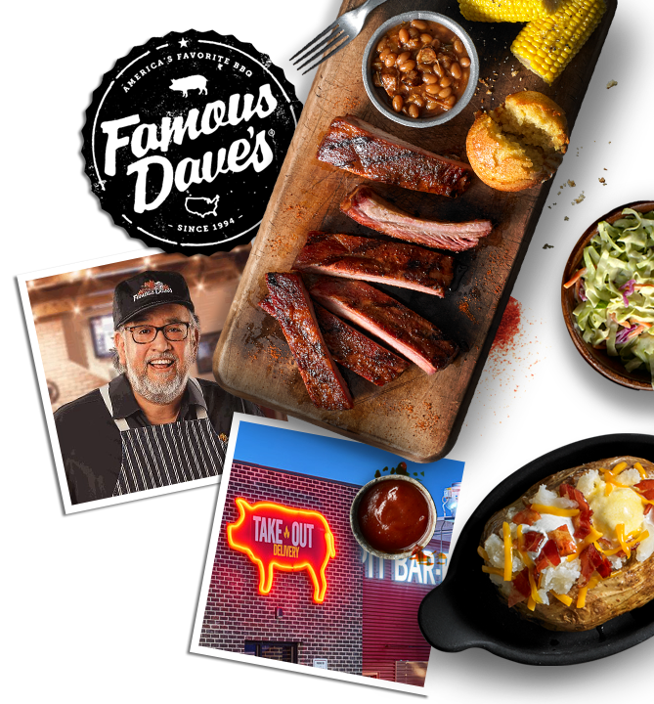
FAMOUS DAVE’S OVERVIEW
  31 Corporate Stores in U.S. generating $80.0-$81.0 MM in revenue in 2021
  104 franchise stores in U.S., Canada and UAE generating ~$225 MM in revenue
  Average Corporate Unit Volume (AUV): $2.8-$2.9 MM
  Strong & Consistent Metrics
    - Food Costs 30%
    - Labor Costs: 30%
    - Occupancy: 7%
  Famous Dave Ghost Kitchens
    - 8 in Granite City’s
    - 20 in 3rd Party
    - 10 Additional Units expected in 2021 (10 Franchise)
  Dual Concept
    Famous Dave’s & Texas T-Bone Colorado Springs, CO
    Famous Dave’s & Cowboy Jacks – Woodbury, MN
    Potential of Famous Dave’s and Tahoe Joe’s

Slide 10
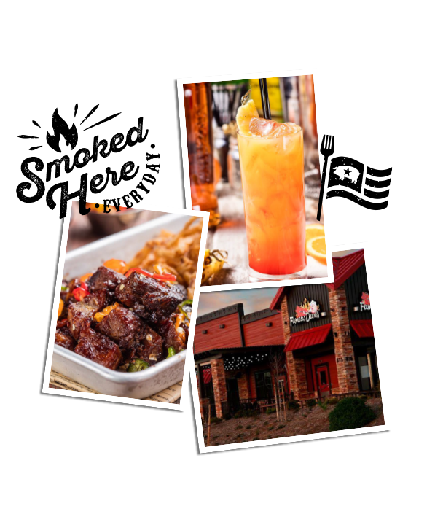
ORGANIC GROWTH
Ghost/Virtual/Dual Concepts/New Franchisees
Active Pipeline of Ghost Kitchen Units
Robust Franchisee Pipeline Activity
Increased activity due to take out success over the past 12 months
Franchisees opened new line service concept in Coon Rapids, MN and Las Vegas, NV
Franchisee working with BBQ to open a drive thru concept in Salt Lake City, UT

Slide 11
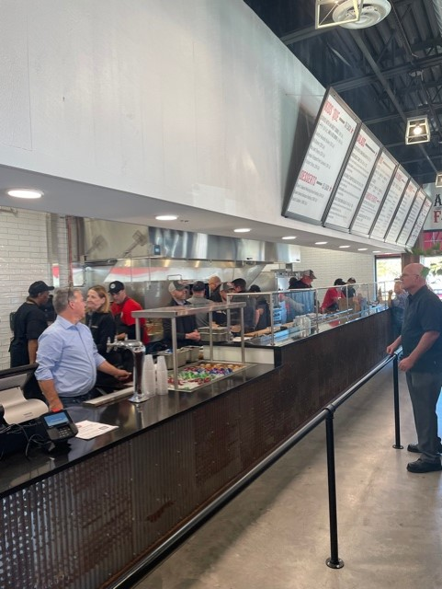
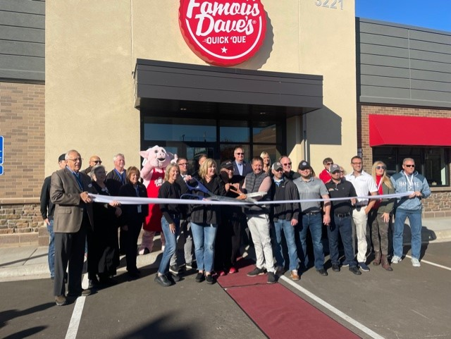
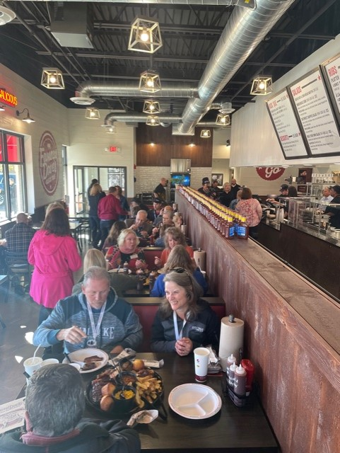
GROWTH: Quick Que Line Serve
First location opened in Las Vegas August 5th
Second location opened in Coon Rapids, MN. October 25th

Slide 12

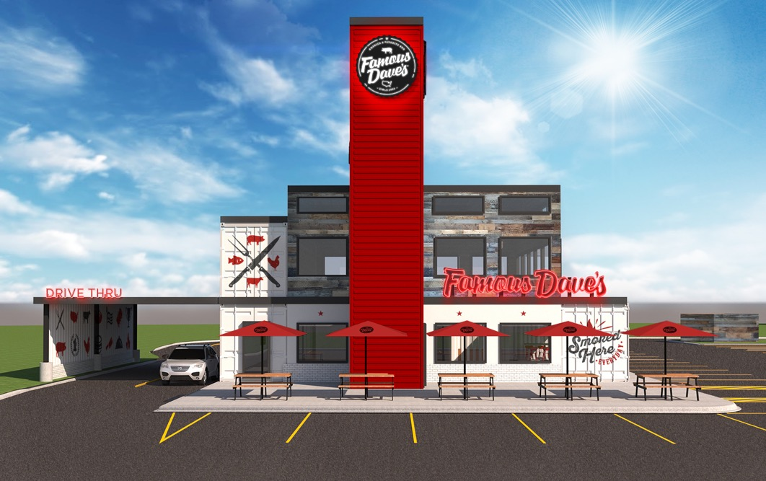
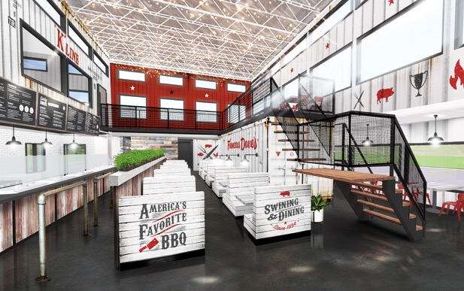
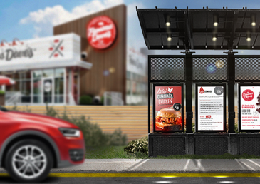
GROWTH: DRIVE THRU PROTOTYPE

Slide 13
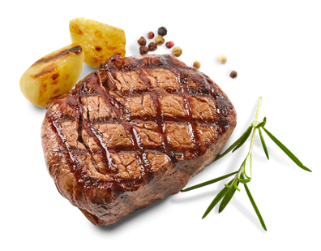
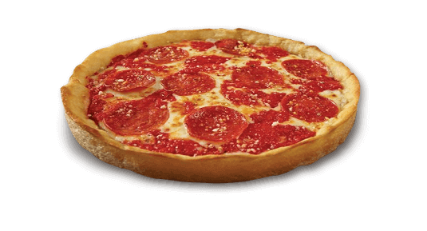
GROWTH: DUAL CONCEPTS
Famous Dave’s 6,500 sq. ft. boxes were designed to execute at a higher AUV level than its current AUV of $2.8 MM.
  Tahoe Joe’s
  The Company is using its learnings from dual branding with Texas T-Bone in Colorado Springs, CO. Expectation is to add $800k in additional revenue with 25% flow through when a Famous Dave’s is teamed up with Tahoe Joe’s.
  Potential for $200k additional EBITDA per location.
  Other (ie: Pizzeria or Saloon)
  Dual/Virtual Concept with a known pizza brand that has simplistic operations with low up front capital investment. $800k revenue with 25% Flow through. Potential for $200k additional EBITDA per location.

Slide 14


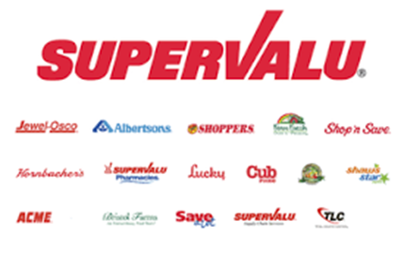
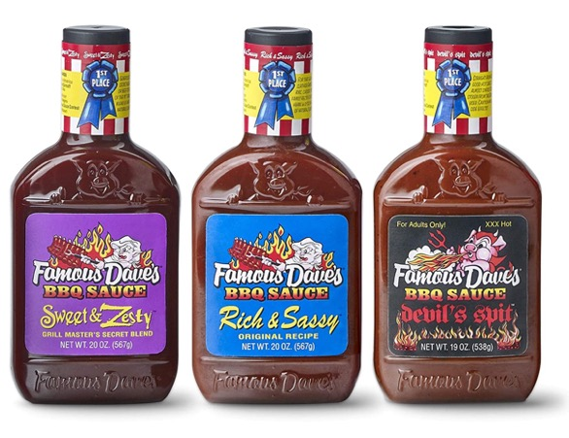
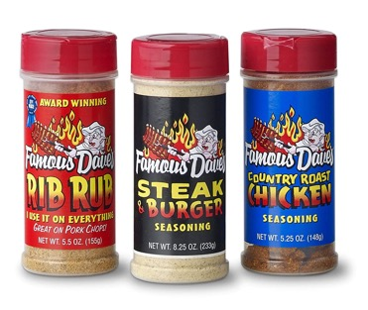
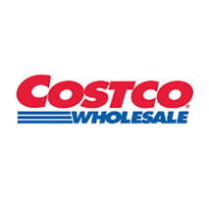

GROWTH: EXPANDING CPG LICENSING
  CPG (Consumer Packaged Goods) – Passive Revenue
  BBQ receives a 3% licensing fee
  2021 licensing revenue ~$1.5 million
  Famous Dave’s has more SKU’s than any other restaurant in retail

Slide 15
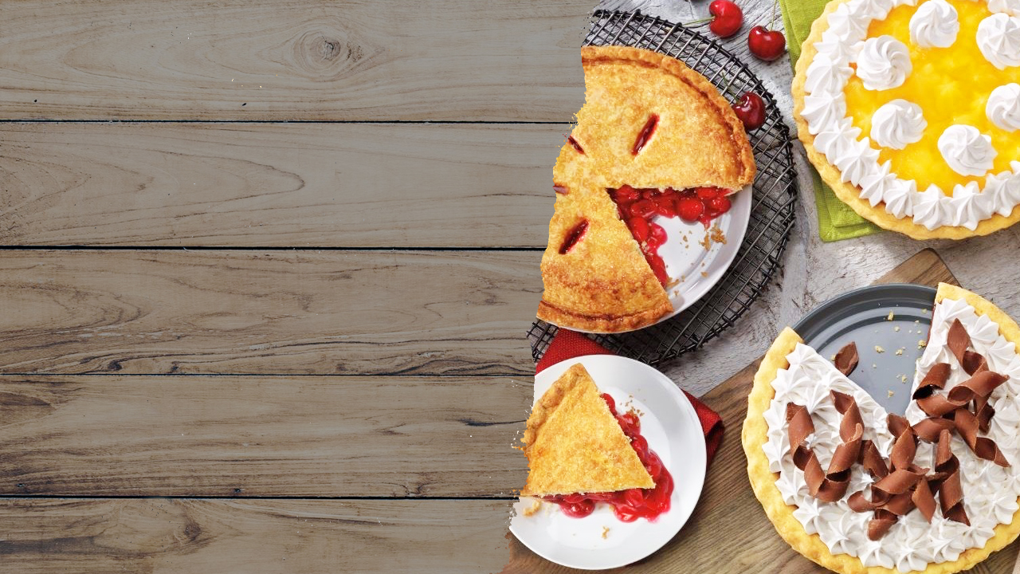
VILLAGE INN &
BAKERS SQUARE

Slide 16

AUTHENTIC FAMILY DINING BRANDS
WITH LONG HISTORIES
Village Inn:
Founded in Denver, Colorado in 1958
Known for breakfast all day, especially pancakes
Located primarily in the Rockies, the Mid West, Arizona, and Florida
Bakers Square:
Founded in Des Moines, Iowa in 1969
Celebrated for soups, sandwiches, and pies
Located in the Mid West

Slide 17
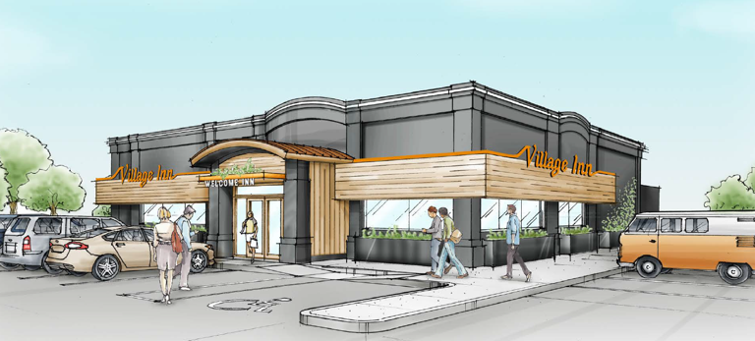
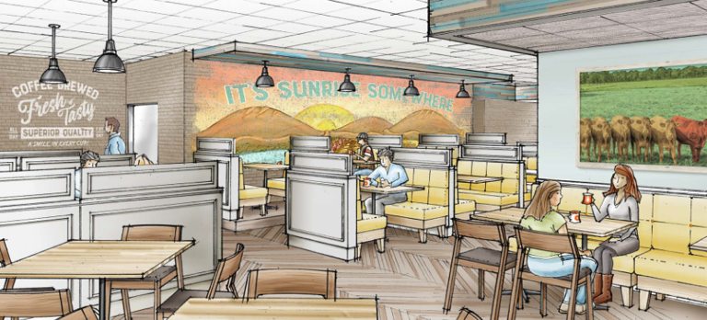
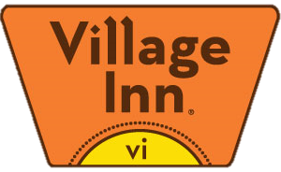
OUR VISION FOR VILLAGE INN
AND BAKERS SQUARE GROWTH
  Bakers Square – The best pie in America can be sold in many retail locations including grocery, kiosks, and our other restaurants (Famous Dave’s, Granite City, Real Urban BBQ).
  Village Inn - Rejuvenate the brand with a new VI Café prototype and launch a new growth initiative.

Slide 18
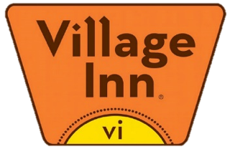
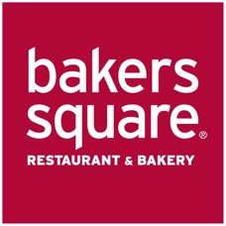



HOW VILLAGE INN & BAKERS SQUARE DELIVER
Homemade |  | Home-style breakfast is key |  | Primarily pie, but the whole menu generally conveys home-style food
Variety and Customization |  | Breakfast items are the strongest menu segment |  | Across all day parts
Quality |  | Great breakfast and highest quality pie |  | Unique pies are high quality offerings
Fresh |  | Breakfast is largely made from scratch |  | Large variety of fresh baked pies
Value |  | Village Inn Breakfast represents greatest value for number of options and price |  | Affordable items
Key Business Driver
Strong Secondary
Value Proposition

Slide 19




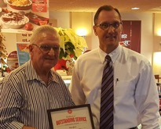






FRANCHISE SYSTEM & PERFORMANCE
Percentage of Units Owned by Franchisees
28
Average Franchisee Years with Brand
Others
Franchisee 1⁽¹⁾
Franchisees 6-10
46
Stores Operated by Largest Franchisee
Franchisee 5
Franchisee 4
Franchisee 3
Franchisee 2
84%
Village Inn Locations Franchised
Largest franchisee represents 29% of system sales, no other franchisee represents more than 10% of system sales
37
Locations Refranchised from Corporate Over the Last Two Years
22
Unique
Franchisees
Significant Franchisee Tenure with the Brand
> 80% with brand more than 15 years
Third generation franchisee

Slide 20

GRANITE CITY
FOOD & BREWERY

Slide 21

GRANITE CITY OVERVIEW
  Founded in 1999
  18 Corporate Stores in U.S. generating $65-$67 MM in revenue in 2021
  Average Unit Volume (AUV): $3.2-$3.3 MM
  2019 Corporate Store Sales of $75 MM
  21% Liquor Mix
  10% of Revenue in Sunday Brunch Pre-Pandemic
  Strong & Consistent Metrics:
    - Food Costs 28%
    - Labor Costs: 34%
    - Occupancy: 11%

Slide 22
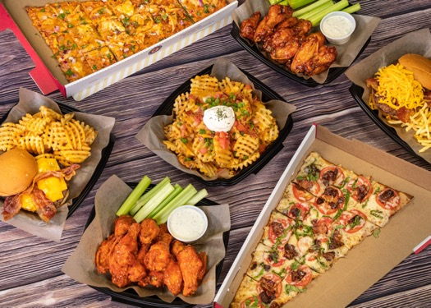
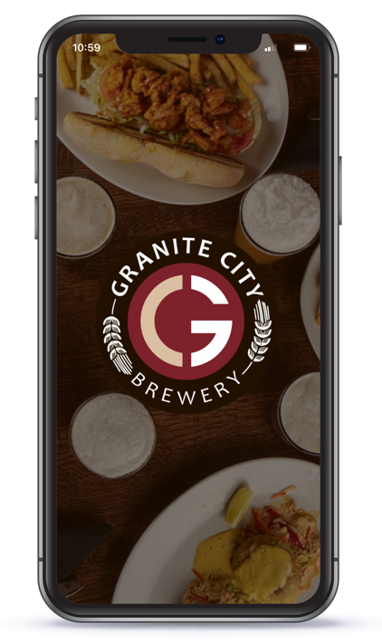
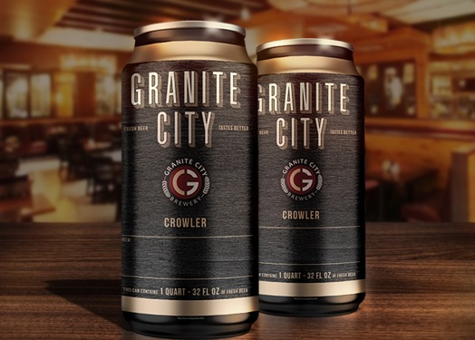
GRANITE CITY
GROWTH OPPORTUNITIES
  Re-establish same store sales growth
  New Loyalty / Mobile App Program
  Beer Subscription Program
  Ghost Kitchens
  Dual Concepts
  Off-Premise Revenue growth
  Brewery 3rd Party Revenue opportunities

Slide 23
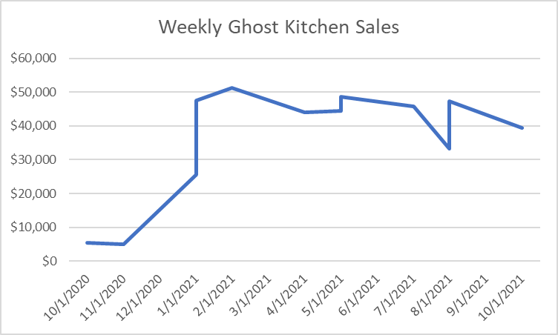
ADDING FAMOUS DAVE’S
GHOST KITCHENS
Ghost Kitchen Concept
Began adding Famous Dave’s in Granite City restaurant in 2020:
  Ghost kitchens are generating an average of $5,500/store per week at corporate locations through this initiative
  Currently have Ghost kitchens in 8 Granite City’s
  Menu is being offered through DSP providers and also a native in store Pick-Up experience
  Where volume warrants, investing in separate To-Go areas to streamline operations and improve guest experience
  Most productive locations will evolve into a dual concept

Slide 24
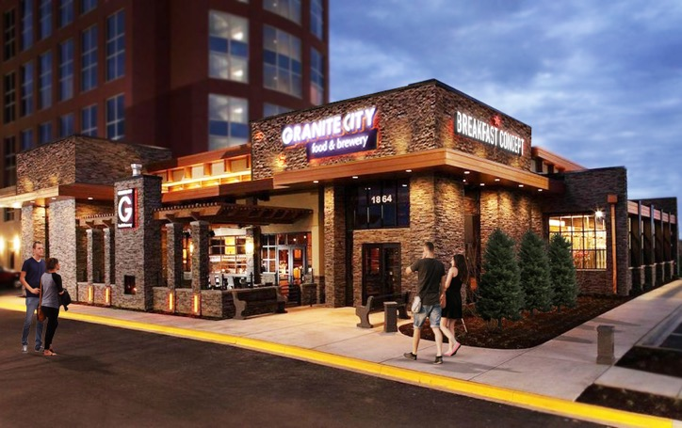
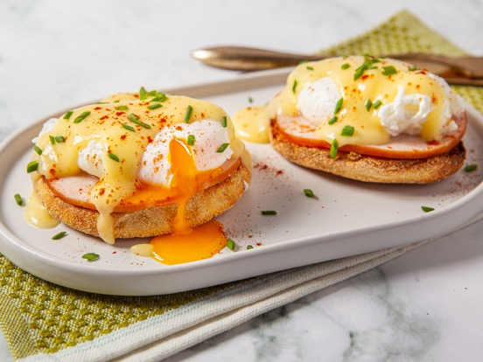
GRANITE CITY:
DUAL CONCEPTS – Village Inn
Similar to Famous Dave’s, the GC kitchens were designed for ~$6 MM annual volume. Pre-covid AUV was $3.9 MM
We believe a breakfast concept would work well within our restaurants by adding the breakfast daypart.
  Operating Hours:
  • Village Inn: 7 am – 3 pm
  • Granite City: 3 pm – 11 pm
  Dual Concept that has an operating structure with low up front capital investment. $1MM revenue with 25% Flow through.
  Potential for $250k additional EBITDA per location.

Slide 25
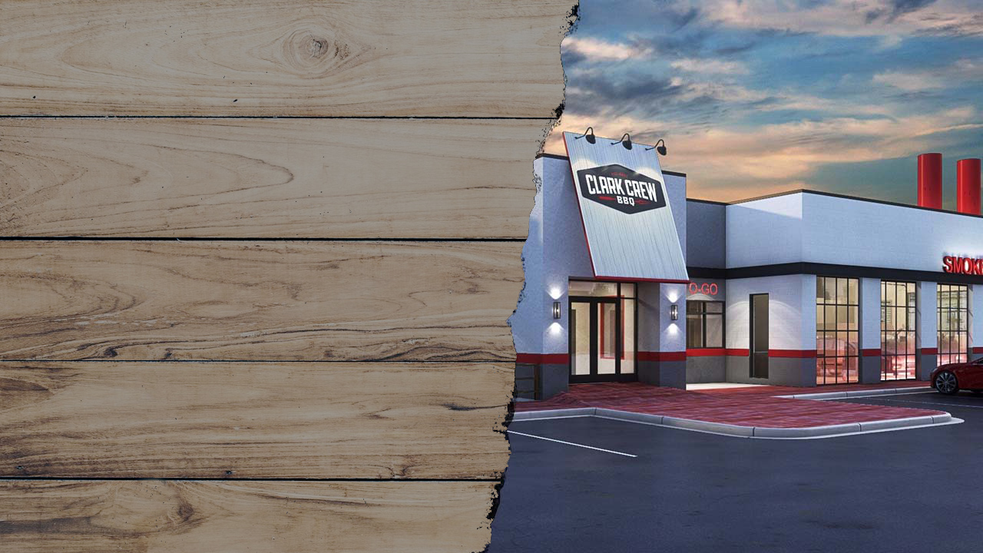
CLARK CREW
BBQ

Slide 26
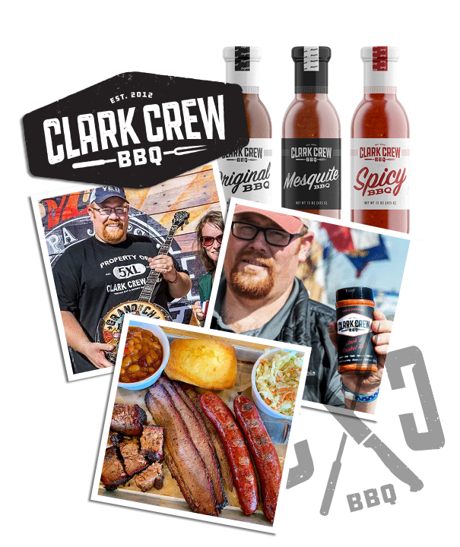
CLARK CREW BBQ
OVERVIEW
  Over 600 top 10 awards including Jack Daniels Grand Champion & National Team of the Year
  Partnered with BBQ Holdings to open first location in December 2019
  $8.0-$8.5 MM in revenue in 2021
  BBQ Holdings owns a controlling interest in restaurant, 49% of CPG’s and rights to franchise

Slide 27
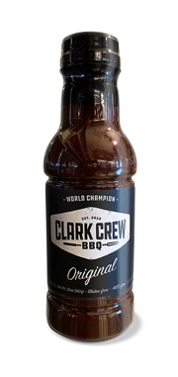
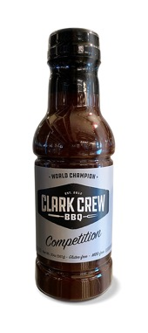
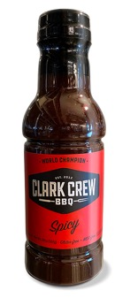
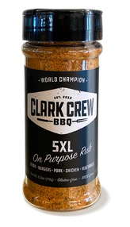
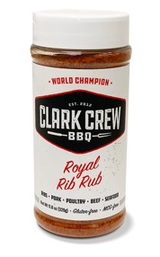
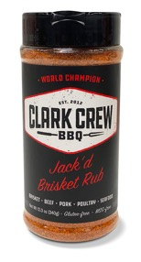
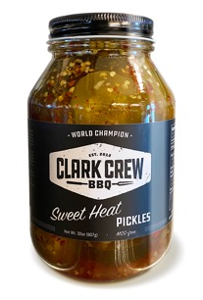
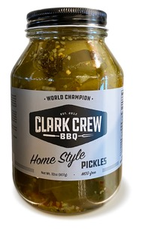
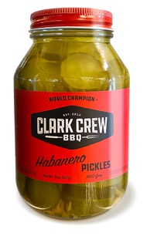
CLARK CREW BBQ
ORGANIC GROWTH
CPG Business
  Currently sauces and rubs are in ~60 stores.
New Locations
  Hub & Spoke Model
  4k sq. ft.
Catering
  High-end events
  Wide open opportunity in OKC

Slide 28
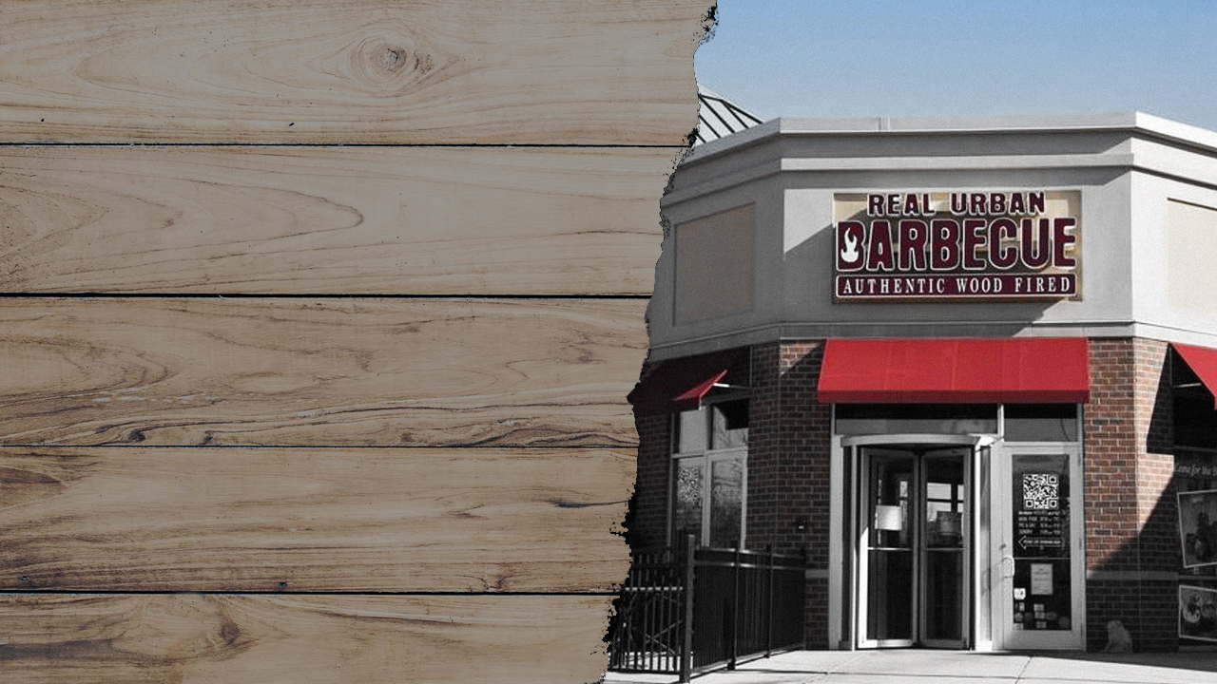
REAL URBAN BBQ

Slide 29
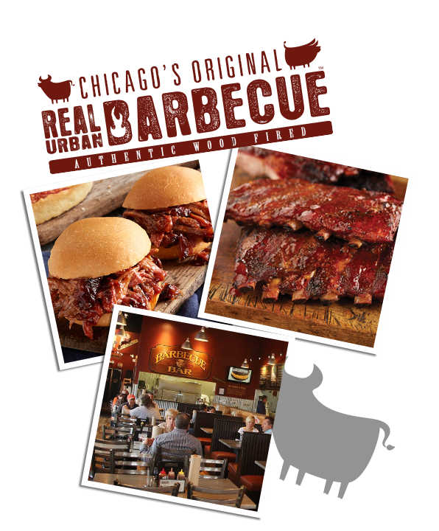
REAL URBAN BBQ
OVERVIEW
  Founded in 2009 by Jeff Shapiro who is current Director of Culinary & Development for BBQ
  Acquired concept for Line Service Prototype
  $2.5-$3.0 MM in revenue in 2021
  1.5 minute ticket times
  $350K CPG Revenue in 2020

Slide 30
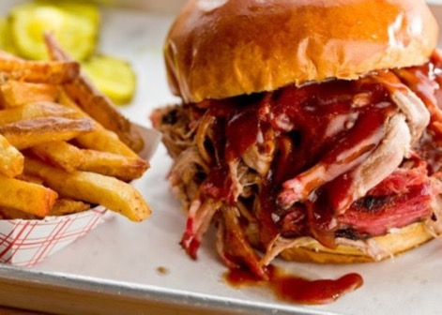
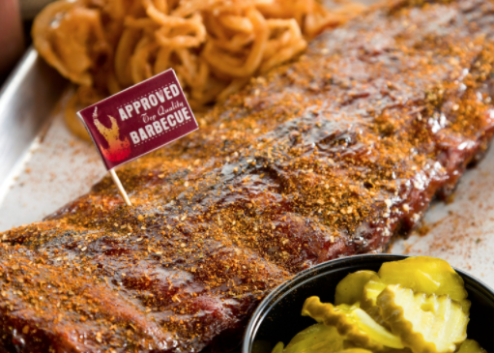

REAL URBAN BBQ
ORGANIC GROWTH
CPG Business
Opportunities to increase offerings
Additional Corporate or Franchise Line Service Units
Proven efficiencies
  - 1-2 min Ticket Times
  - Reduced Total Labor Costs
  - Efficient and effective guest experience
  - Simplified Menu and Offerings

Slide 31

TAHOE JOE’S

Slide 32

TAHOE JOE’S AT A GLANCE
Founded in 1993
Ski Lodge styled restaurants with pine log beams stretched throughout spacious ceilings and hand painted teepee lamps.
Acquired by BBQ Holdings on October 8, 2021
~$18 MM in annualized revenue for the 5 steakhouses acquired
Also acquired the IP related to Old Country Buffet, Hometown Buffet, Ryan’s Buffet and Furr’s Restaurants.
Provides a dual concept opportunity for Famous Dave’s

Slide 33

TARGET M&A

Slide 34
VISION TO BUILD A DIVERSE PORTFOLIO OF ESTABLISHED FOOD AND BEVERAGE CONCEPTS
What we look for:
Legacy brands that have stood the test of time
Franchise systems with growth potential
Potential for CPG sold in retail
Utilize expertise in digital marketing to attract new customers
Accretive acquisitions (~3-4x EBITDA) that fold into our current infrastructure
Recent M&A:
Granite City purchased in 2020 at 1.3x 2019 EBITDA ($7MM of synergies realized)
Real Urban purchased in 2020 at <1x realized 2020 EBITDA
Village Inn and Bakers Square in July 2021 at a proforma of ~3X EBITDA
Tahoe Joe’s at a proforma of ~3X EBITDA
We are currently analyzing additional opportunities.

Slide 35





INVESTMENT SUMMARY
Currently >70% franchised
Delivering profitable growth through operational improvement, opportunistic acquisitions, and plan to expand corporate owned and/or franchisee unit count
Huge growth potential with laser focus on growing high margin recurring royalty stream with newly developed Famous Dave’s small box with best-in-class unit-level economics.
Very high flow through dual concepts.
Robust M&A pipeline.
Fully aligned, seasoned management team dedicated to creating shareholder value.
Leverage structural synergies with existing infrastructure to add new concepts driving EBITDA.
Always searching for new and economical ways for our customers to experience our food on demand.
Intuitive and industry leading Digital Marketing Team.

Slide 36
ADJUSTED CASH EBITDA RECONCILIATION
BBQ Holdings, Inc. and Subsidiaries
Non-GAAP Reconciliation
Cash EBITDA

Slide 37


12701 Whitewater Drive • Suite 100 • Minnetonka, MN 55343
Phone: 952-294-1300 • Website: bbq-holdings.com • E-mail: InvestorRelations@BBQ-Holdings.com

