Slide 1

3Q20 Results Conference Call
Investor Presentation

Slide 2
SAFE-HARBOR STATEMENT
This release contains “forward looking statements”—that is, statements related to future, not past, events—as defined in Section 21E of the Securities Exchange Act of 1934, as amended, that reflect our current expectations regarding our future growth, results of operations, financial condition, cash flows, performance, business prospects and opportunities, as well as assumptions made by, and information currently available to, our management. Forward-looking statements include any statement that does not directly relate to a current or historical fact. We have tried to identify forward looking statements by using words such as “anticipate,” “believe,” “expect,” “intend,” “will,” “should,” “may,” “plan” and similar expressions, but these words are not the exclusive means of identifying forward looking statements.
Our forward-looking statements may include or relate to our beliefs, expectations, plans and/or assumptions with respect to the following, many of which are, and will be, amplified by the COVID-19 pandemic: (i) the impact of global health concerns, including the impact of the current COVID-19 pandemic on the economies and financial markets and the demand for our products; (ii) state, local and federal regulatory frameworks affecting the industries in which we compete, including the wind energy industry, and the related extension, continuation or renewal of federal tax incentives and grants and state renewable portfolio standards as well as new or continuing tariffs on steel or other products imported into the United States; (iii) our customer relationships and our substantial dependency on a few significant customers and our efforts to diversify our customer base and sector focus and leverage relationships across business units; (iv) the economic and operational stability of our significant customers and suppliers, including their respective supply chains, and the ability to source alternative suppliers as necessary, in light of the COVID-19 pandemic; (v) our ability to continue to grow our business organically and through acquisitions, and the impairment thereto by the impact of the COVID-19 pandemic; (vi) the production, sales, collections, customer deposits and revenues generated by new customer orders and our ability to realize the resulting cash flows; (vii) information technology failures, network disruptions, cybersecurity attacks or breaches in data security, including with respect to any remote work arrangements implemented in response to the COVID-19 pandemic; (viii) the sufficiency of our liquidity and alternate sources of funding, if necessary; (ix) our ability to realize revenue from customer orders and backlog; (x) our ability to operate our business efficiently, comply with our debt obligations, manage capital expenditures and costs effectively, and generate cash flow; (xi) the economy, including its stability in light of the COVID-19 pandemic, and the potential impact it may have on our business, including our customers; (xii) the state of the wind energy market and other energy and industrial markets generally and the impact of competition and economic volatility in those markets; (xiii) the effects of market disruptions and regular market volatility, including fluctuations in the price of oil, gas and other commodities; (xiv) competition from new or existing industry participants including, in particular, increased competition from foreign tower manufacturers; (xv) the effects of the change of administrations in the U.S. federal government; (xvi) our ability to successfully integrate and operate acquired companies and to identify, negotiate and execute future acquisitions; (xvii) the potential loss of tax benefits if we experience an “ownership change” under Section 382 of the Internal Revenue Code of 1986, as amended; (xviii) our ability to utilize various relief options enabled by the CARES Act, including our ability to receive forgiveness of the PPP Loans; (xix) the limited trading market for our securities and the volatility of market price for our securities; and (xx) the impact of future sales of our common stock or securities convertible into our common stock on our stock price. These statements are based on information currently available to us and are subject to various risks, uncertainties and other factors that could cause our actual growth, results of operations, financial condition, cash flows, performance, business prospects and opportunities to differ materially from those expressed in, or implied by, these statements including, but not limited to, those set forth under the caption “Risk Factors” in Part I, Item 1A of our Annual Report on Form 10-K for the year ended December 31, 2019, as supplemented by our Current Report on Form 8-K filed April 17, 2020 and our Quarterly Report on Form 10-Q for the quarterly period ended June 30, 2020. We are under no duty to update any of these statements. You should not consider any list of such factors to be an exhaustive statement of all of the risks, uncertainties or other factors that could cause our current beliefs, expectations, plans and/or assumptions to change. Accordingly, forward-looking statements should not be relied upon as a predictor of actual results.

Slide 3
PERFORMANCE
OVERVIEW

Slide 4
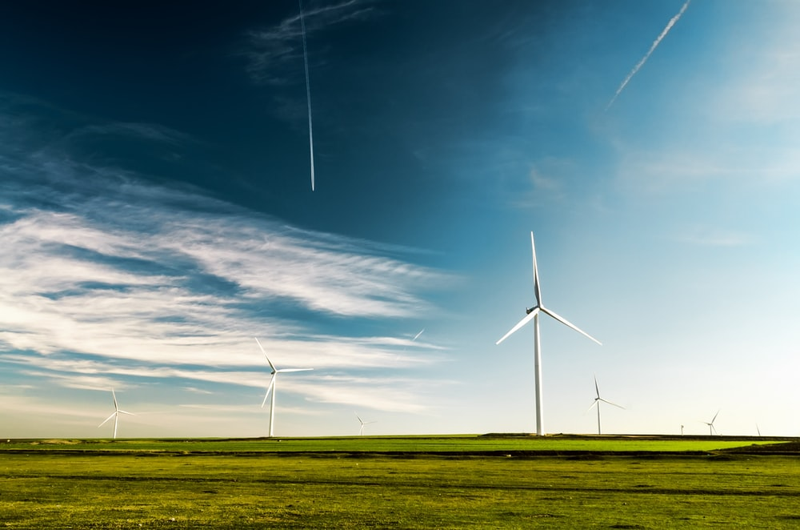



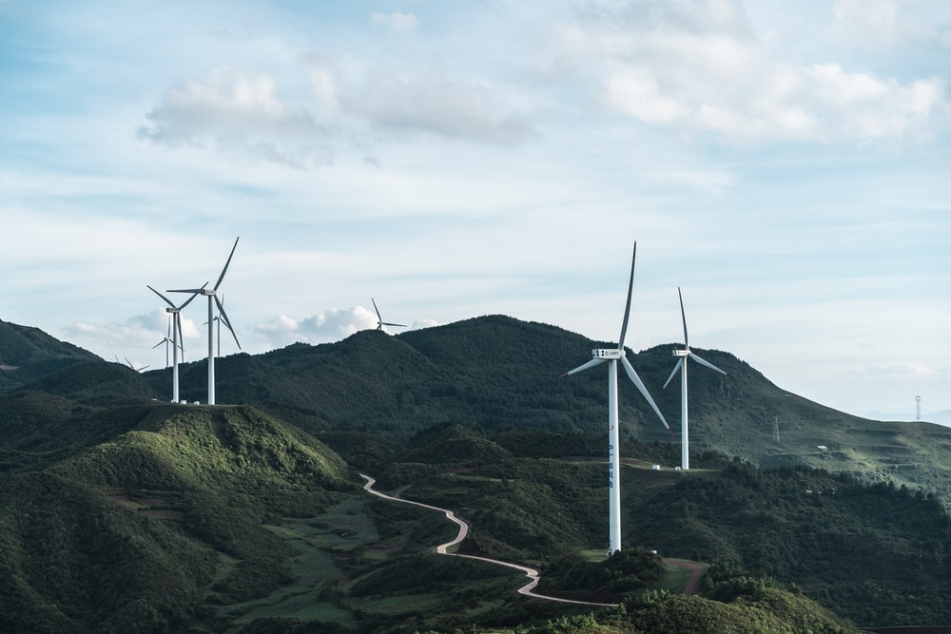

EXECUTIVE SUMMARY
Third Quarter 2020
Stable revenue growth driven by wind tower demand
Operated wind tower manufacturing facilities near optimal capacity
Pandemic-related supply chain disruptions impacted margin capture
Total revenue increased 18.4% y/y to $54.6 million in 3Q20; growth in Heavy Fabrications offset declines in Gearing and Industrials Solutions
Total tower sections sold increased 30% y/y in 3Q20; plant capacity nearly booked for 2020; 35% booked for 2021
Gross margin declined 190 bps y/y to 6.8%; Adjusted EBITDA margin declined 160 bps y/y to 2.4%
Working capital discipline drove improved free cash flow
Reduced outstanding borrowings, while improving liquidity position
Evaluating both organic and inorganic growth opportunities
Total free cash flow of $7.3 million in Q3, driven by working capital improvements
Outstanding LOC borrowings of $7.6 million as of 9/30/20 – the lowest level since 3Q17; exiting 3Q20 with $21.8 million in cash and availability on LOC
Organic focus remains on offshore wind partnerships and end-market diversification; inorganic focus on complementary, immediately accretive assets

Slide 5
CONSOLIDATED FINANCIAL DATA
Wind-driven revenue growth offset by near-term pandemic-related supply chain constraints
18% y/y revenue growth; increased demand within wind business partially offset by lower non-wind revenue
Total Revenue
($MM)
Gross Profit
($MM)(1)
Gross margin +230 bps y/y to 9.3%
Gross margin (190) bps y/y to 6.8%
3Q20 gross margin impacted by pandemic-related supply chain disruptions and design change-overs
TTM Adjusted EBITDA increased $5.8 million y/y to $9.5 million
Adjusted EBITDA
($MM)(1)
Earnings Per Share
($)
Adjusted EBITDA margin (160) bps y/y to 2.4%
Adjusted EBITDA margin +220 bps y/y
Non-wind business poised for improvement during the first half 2021, given current expectations for customer activity levels
(1) Margin implies the listed metric divided by total revenue in the period listed

Slide 6
HEAVY FABRICATIONS SEGMENT
Strong wind tower demand contributed to revenue growth, margin expansion
28% y/y segment revenue growth in 3Q20, driven by increased demand from the wind and industrials markets
Segment Revenue
($MM)
Segment Adjusted EBITDA
($MM)
2020 tower production is fully committed; currently 35% booked for 2021 tower production
Adjusted EBITDA increased 63% y/y; Adj EBITDA margin improved 150 bps y/y in 3Q20
Segment Orders
($MM)
Segment Backlog
($MM)
Continue to experience pandemic-related order delays, contributing to y/y decline in backlog; no major order cancellations
9/30/19
6/30/20
9/30/20

Slide 7
HEAVY FABRICATIONS SEGMENT
Continued y/y growth in demand for wind tower sections
Total Wind Tower Sections Sold
(Number of Sections)
+59% y/y
+372% y/y
+66% y/y
+28% y/y
Note: In December 2019, the United States production tax credit for renewable wind projects was extended for one-year, pursuant to a year-end 2019 appropriations bill, from January 1, 2020 to January 1, 2021. As a result of the new legislation, the PTC will subsidize wind projects commenced as late as 2020 and completed by 2024, or later, if continuous construction can be demonstrated.

Slide 8
GEARING SEGMENT
Challenged by short-term pandemic-related delays in customer orders; anticipate 1H21 recovery
11% segment revenue decline driven by short-term delays in customer orders due to the pandemic
Segment Revenue
($MM)
Segment Adjusted EBITDA
($MM)
Industrial gearing revenue increased 100% y/y, offset by declines in oil/gas, mining and steel
Less favorable sales mix and lower utilization impacted Adjusted EBITDA in 3Q20
Segment Orders
($MM)
Segment Backlog
($MM)
Y/Y increase in backlog supported by end-market diversification
9/30/19
6/30/20
9/30/20

Slide 9
INDUSTRIAL SOLUTIONS SEGMENT
Stable y/y performance; 38% y/y growth in segment backlog supported by consistent order activity
5% y/y decline in segment revenue; growth in aftermarket offset by decline in NGT
Segment Revenue
($MM)
Segment Adjusted EBITDA
($MM)
TTM Adjusted EBITDA margins expanding
Segment Orders
($MM)
Segment Backlog
($MM)
TTM segment order trend is +20% y/y, supported by broad based market growth
Segment backlog +38% y/y in 3Q20
9/30/19
6/30/20
9/30/20

Slide 10
BALANCE SHEET UPDATE
Sequential decline in working capital as % of sales; elevated cash and availability on LOC
Operating Working Capital as a % of Sales(1)
9/30/18
12/31/18
3/31/19
6/30/19
9/30/19
12/31/19
3/31/20
6/30/20
9/30/20
Total Cash and Availability on Credit Facility
($MM)
9/30/18
12/31/18
3/31/19
6/30/19
9/30/19
12/31/19
3/31/20
6/30/20
9/30/20
(1) Operating working capital divided by T3M annualized sales

Slide 11
MANAGEMENT OUTLOOK

Slide 12
COVID-19 BUSINESS RESPONSE
Ensuring business continuity, while protecting the health and safety of our employees
Employee Health & Safety
Liquidity Profile
Business Continuity
Significant employee scheduling challenges, as pandemic spreads
We are closely monitoring the potential impact of the novel coronavirus (COVID-19) on our operations, customers and supply chain
We have adopted all necessary and appropriate virus prevention protocols consistent with the recommendations provided by the U.S. Centers for Disease Control and Prevention
The Company remains in full compliance with all debt covenants, recently extended Line of Credit for 3 years, with lower borrowing costs
The Company received a Paycheck Protection Program loan in April; planning to submit forgiveness application in Q4
Our business is considered critical and essential infrastructure by the U.S. Department of Homeland Security
All facilities are considered essential businesses and are currently open/operating
Order rates have declined since the COVID-19 outbreak
Supply chain disruptions for global commodities intensifying

Slide 13
CUSTOMER DIVERSIFICATION INITIATIVE
Balanced revenue mix supports long-term growth and profitability
Non-Wind Revenue By Sector
(as % of total revenue)
Wind vs. Non-Wind Revenue Concentration
($MM)(1)
(1) Wind energy figures shown above exclude repair/replacement demand

Slide 14






DEMAND OUTLOOK BY END-MARKET
Customer guidance drives our outlook
Wind Sector
Industrial/Other Sector
Power Generation Sector
TTM Revenue
  8%
Sector Outlook
  Positive
Customer Feedback
  Primary customer regaining share in the near term
TTM Revenue
  70%
Sector Outlook
  Positive
Customer Feedback
  Continue to pursue offshore opportunity
  Levelized cost of wind energy continues to decline / demand from C&I buyers continue
TTM Revenue
  8%
Sector Outlook
  Positive/Neutral
Customer Feedback
  Manitowoc deep water port and manufacturing competencies strategic advantages
  Gearbox quoting opportunities rising
Mining Sector
Oil & Gas Sector
Construction Sector
TTM Revenue
  4%
Sector Outlook
  Negative
Customer Feedback
  Early signs of recovery, cannibalization of equipment exhausting inventory levels
  Supporting next generation gearbox designs
TTM Revenue
  9%
Sector Outlook
  Neutral
Customer Feedback
  Orders weakened following COVID-19 outbreak
TTM Revenue
  1%
Sector Outlook
  Neutral/Negative
Customer Feedback
  Infrastructure bill would be meaningful

Slide 15
U.S. WIND SECTOR FORECAST
Onshore ramp occurring; offshore ramp accelerating in the 2023-2025 timeframe
There are currently more than 60,000 wind turbines operating across 41 states and two U.S. territories
U.S. Wind Power Onshore and Offshore Capacity Installations
(Annual On-Shore GW Installed)(1)
16.6
Recent PTC extension provides additional time to bring new wind projects online without jeopardizing tax credits(2)
13.2
11.0
9.9
9.0
9.1
9.2
13 states with more than 1 GW under construction or advanced development
8.0
7.9
8.2
6.8
6.4
Offshore wind installations to represent more than half of all new capacity additions by 2025
Source: Wood MacKenzie 3Q20 Wind Sector Outlook; wind values include new build and repowering
On May 27, 2020, the Internal Revenue Service issued Notice 2020-41, providing taxpayers with relief for purposes of satisfying the beginning-of-construction requirement for qualifying production tax credit (PTC) and investment tax credit (ITC) projects, including wind and solar projects. Specifically, the IRS notice provides (1) a one-year extension to the Continuity Safe Harbor for projects that began construction in 2016 or 2017, and (2) a new safe harbor for satisfying the 3-1/2 Month Rule for property or services purchased after Sept. 15, 2019, and received by the taxpayer no later than Oct. 15, 2020.

Slide 16
WIND IS A MORE COMPETITIVE POWER GENERATION SOURCE
Since 2009, the levelized cost of wind energy has declined 70%
Levelized Cost of Wind Energy
($/MWh)(1)
Levelized Cost of Energy Across Energy Sources
($/MWh)(1)
$169
$148
$101
$99
$92
$95
$95
$81
$77
$62
$60
$56
$54
$50
$48
$45
$37
$32
$32
$30
$29
$28
Source: Lazard Levelized Cost of Energy Analysis (v13.0)

Slide 17
KEY INITIATIVES BY SEGMENT
Positioned for profitable growth across diverse customer and product end markets
Heavy Fabrications Segment
Capitalize on continued growth in both wind and non-wind markets
  Sell ’21 tower capacity and expand tower and repowering customer base
  Add production capabilities and complete key systems upgrades to maximize profitability
  Continue to evaluate offshore wind market partnerships
  Expand Industrial Fabrication product line customer base
  Leverage engineering and supply chain organization to support evolving tower market
  Take continuous improvement actions to ensure "zero defect" quality ratings
Gearing Segment
Focus on Gearbox market share growth, increase weighting in less cyclical end-markets
  Accelerate end-market diversification beyond oil/gas gearing market
  Strengthen engineering and sales resources
  Grow custom gearbox business; expand repair business geographically
  Leverage recently completed systems initiatives to maximize profitability
  Continue core focus on gas turbine market, while expanding customer base
  Pursue clean tech growth opportunities
  Leverage BWEN engineering and business development resources
Industrial Solutions Segment
Focus on revenue diversification within gas turbines and growth in clean tech

Slide 18
INVESTMENT THESIS
Diversified precision manufacturer serving clean tech and industrial applications
1. Leading precision manufacturer with a diversified industry focus
Heritage is in the renewable sector (e.g., Wind); future includes mining, oil/gas, power gen, material handling, construction and industrial
2. Multi-year revenue diversification initiative gaining momentum
Annual revenue outside the wind sector is $63 million, customer concentration improving
Plant utilization dramatically improving; non-wind revenue has increased by nearly 3x since 2016
3. Extension of PTC and recent trade case findings provide major catalyst for Heavy Fabrications
Demand for renewable energy driven by government incentives and corporate ESG initiatives
4. Clean tech play positioned for profitable growth
Base wind business remains strong; off-shore wind remains a key growth opportunity
5. Liquidity profile improving; total cash and availability of $21.8 million as of 9/30/20
Supportive of customer and end market diversification strategy; opportunistic acquisitions and organic growth investments

Slide 19
APPENDIX

Slide 20
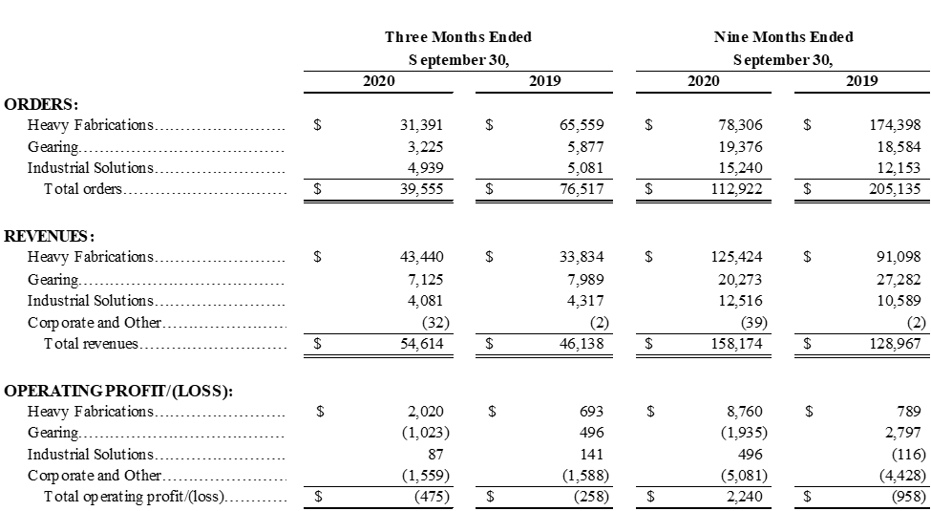
EXHIBIT A
Orders, Revenues and Operating Income (Loss) By Segment

Slide 21
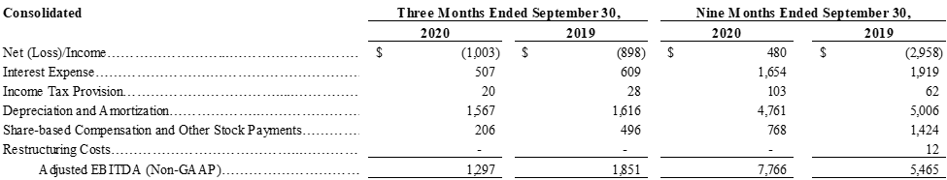
EXHIBIT B
GAAP to Non-GAAP Consolidated Adjusted EBITDA Reconciliation

Slide 22
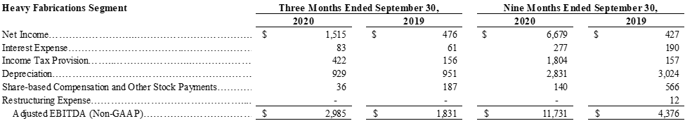
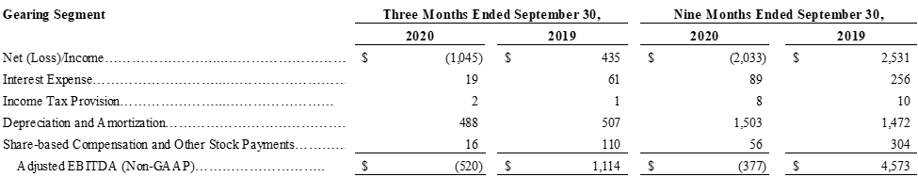
EXHIBIT C
GAAP to Non-GAAP Adjusted EBITDA Reconciliation By Segment

Slide 23
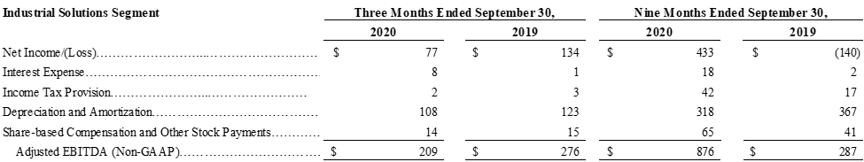
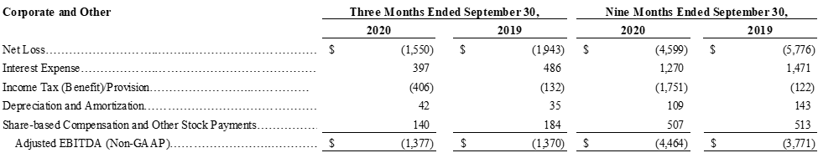
EXHIBIT C (Continued)
GAAP to Non-GAAP Adjusted EBITDA Reconciliation By Segment

Slide 24
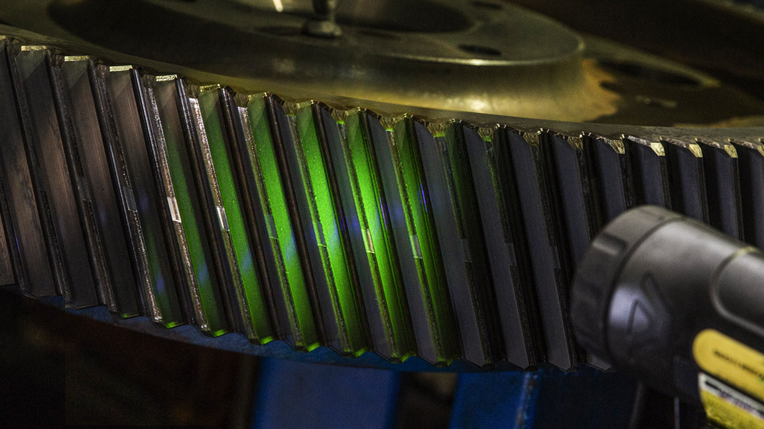
IR CONTACT
Please contact our investor relations team at Investor@BWEN.com

